Slide 1
Washington State University AIS Account BALANCES
September 20, 2016
Notes:
Explain Trivial Pursuit game

Slide 2
Presenters
Karen Breese (kbreese@wsu.edu)
Controllers Office
335-2056
Kathleen Hagen (khagen@wsu.edu)
Vet Med
335-2232

Slide 3
What Is Account BALANCES ?
Account Balances is a legacy mainframe application which allows the user to query WSU accounting and financial information.
Get access by filling out a form and sending it to the Controller’s Office, mail code 1025.
BPPM 30.07 covers BALANCES plus some financial rules.
Originally developed in the 1980s and continues to be updated and maintained.
USE BALANCES TO QUERY. You can’t break it!

Slide 4
WSU AIS Accounting System
Notes:
Computerized Accounting System
Centralized and Decentralized aspects

Slide 5
Terminal Emulator Software
Entire Connection (full functions but hefty cost).
WC3270 – old version…cannot copy-and-paste.
QWS3270 – free version; get what you pay for.
TN3270 Plus – www.sdisw.com also free, but better than QWS3270 (Controller’s Office uses this one.)
QWS3270 Secure – purchase from www.jollygiant.com (currently $69)
(Kathleen’s recommendation)

Slide 6
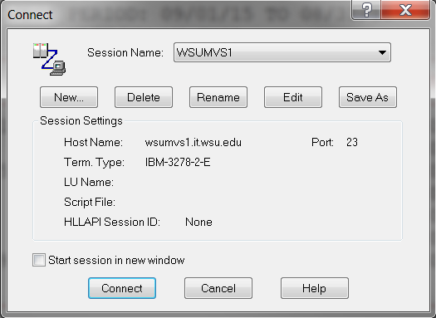
Connecting

Slide 7
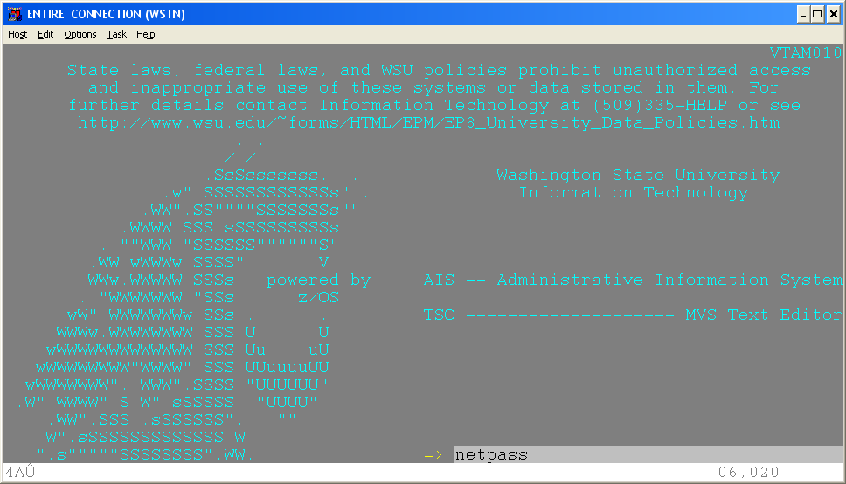
Netpass
The “Netpass” Command allows the user
to log into multiple AIS Sessions.
Type “Netpass” at the command line, then press <Enter>.

Slide 8
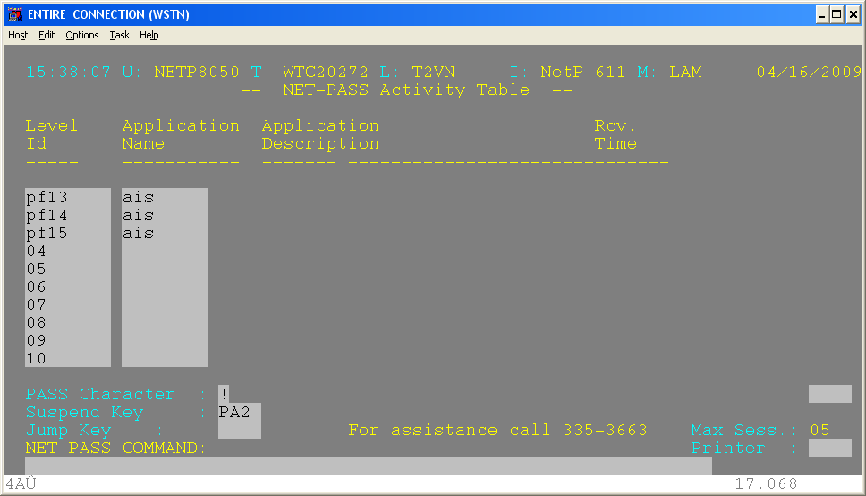
Log onto multiple sessions
Type in a PF (stands for Function Key) line for each AIS session desired. Type PF##, then tab to next field, and type AIS. When done, tab to a PF line and press <Enter> and log in normally. To log onto a 2nd or 3rd AIS application, hold down the SHIFT key and press F2 or F3, respectively.
Shift +F1 key
Shift +F2 key
Shift +F3 key
After logging on to all desired AIS applications, hold down the SHIFT key and the “PF”-Function key to toggle or move from one application to another.

Slide 9
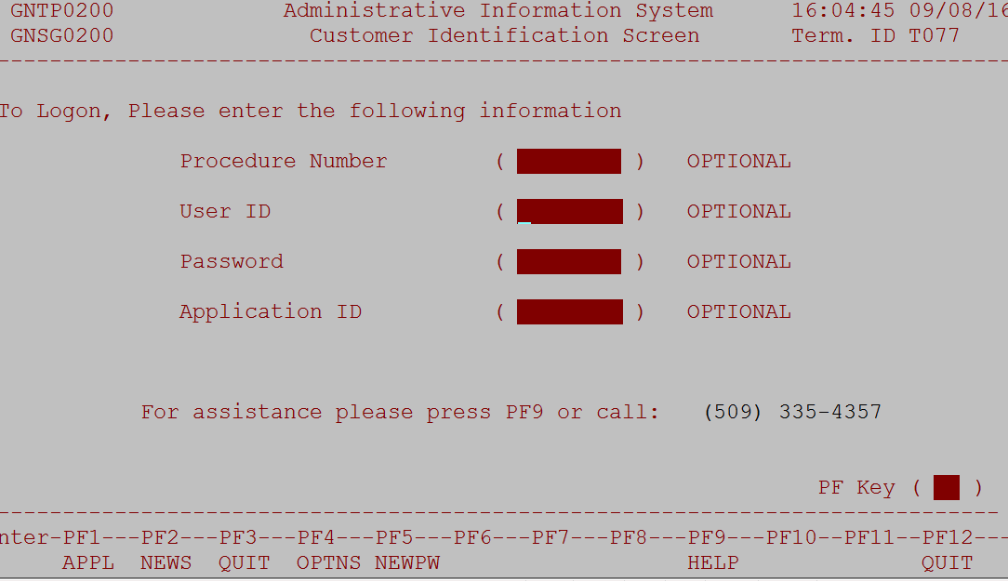
The sign on screen
Leave blank
From IT
8 characters
BALANCES, or PAPR, or DEPPS…

Slide 10
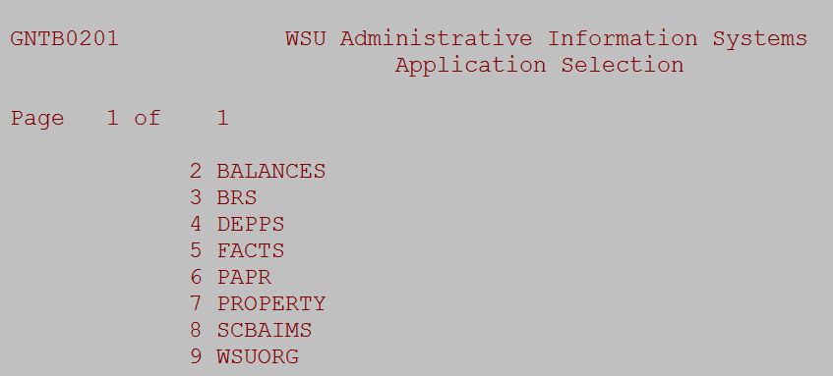
What applications do you have access to?
When logging in, use the PF1 key to see –
the applications to which you have access:

Slide 11
Menu Screens
1 (PF1) Menu – Account Balances Main Menu
2 (PF2) Detail Menu – Account Detail
3 (PF3) File Access Menu – Specific Transaction Detail
4 (PF4) Download Menu – Download Data
5 (PF5) Find Accounts – Find/Locate account queries
6 (PF6) Code Titles – Display Code Titles
7 (PF7) Cost Sharing – Grant-related Cost Share data and ability to download.
Where PF stands for the Function Key at the top of the keyboard.
Overall – Using, downloading and querying in Balances.
Notes:
To switch menus either:
.Press the F1 key(called PF1 is AIS)to toggle thru all the menus, or
.Press the specific PF key for each menu. (The keys are listed at the bottom of the screen).

Slide 12
Main Menu: pf1 Key
The ‘Home’ screen: Main Balances Menu
Report 01 and Report 15 are used the most.
Report 12 is handy for Departments.
Explanation on two other Report 15 screens:
15S
15X

Slide 13
Detail Menu: pf2 Menu
More detailed data compared to Main Menu
Adds date range to query
Holds only previous 18 months detail and 3 years plus current fiscal year for the “All” parameter.
Notes:
The Display Menu gives information on individual transactions for a given time period (must be within previous 18 months).

Slide 14
And – ‘Now for Something Completely Different” pf3 Full File Access Menu
Generally used by Central Offices to report to various agencies, i.e. Washington State, granting agencies.
Not very useful for departments

Slide 15
pf4 Download Menu Download to Your Personal Computer: View on-screen or Download as Data
The Financial Data Warehouse:
Access to all Financial Data.
Can export data to manipulate.
There is no charge to use - it’s FREE!
Notes:
Can download to screen or PC in pf4 Menu Balances.
Year-to-Date Reports correspond to Main Menu reports.
Account Detail Reports correspond to Detail Menu reports.
To download to PC enter “%+” into field.

Slide 16
The new ways to upload & download
The first way:
www.WSUMVS1.wsu.edu/webuplde/wbbb/dfh
Can access through SCBAIMS, FACTS, maybe more

Slide 17
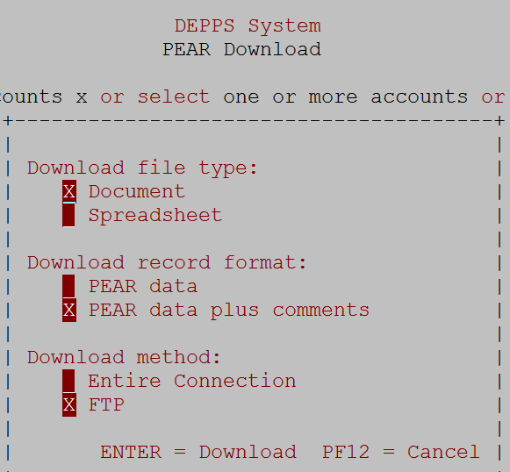
The new ways to download
The second way (for DEPPS/HEPPS)
Use FTP software such as FileZilla or WSTE95

Slide 18
pf5 - Find Accounts
Locate budgets by name, or by entering a budget to find all the projects associated with it.
To find accounts that have the word “Revenue” in it, choose report 10 and select the word Revenue as the search criteria.
Notes:
Informational menu
Reports 10-20 apply to all accounts
Reports 21-30 more applicable to grant accounts

Slide 19
pf6 Code Titles Menu
To find information about objects, sources, funds, programs, and other data.
This will bring you to a report screen to choose a display of various titles.
Notes:
Informational menu
Reports 10-21 apply to all accounts
Reports 30-36 more applicable to grant accounts

Slide 20
Cost Sharing: pf7 key Cost Share Inquiry Menu
From any main menu,
Click PF7 to get to the cost sharing query menus

Slide 21
Shadow Systems
They exist from simple (i.e. Excel) to complex (i.e. Access database)
Can be a “check register” to verify, confirm, or correction information in the WSU Accounting System.
If your written/published departmental procedures address maintaining a shadow system, it may be subject to audit.
In the end, AIS BALANCES is the official accounting record of WSU.

Slide 22
This concludes AIS BALANCES training.
Any questions or comments?
Feel free to contact us with any questions or concerns:
Karen Breese 335-2056
Kathleen Hagen 335-2232

Slide 23
This has been a WSU Training Videoconference
If you wish to have your attendance documented in your training history, please notify Human Resource Services within 24 hours of today's date: hrstraining@wsu.edu

