Slide 1
Expense Transfers

Slide 2
Purpose:
Review the payroll Expense Transfer form
Learn how to fill out the payroll form
Gather any thoughts, ideas or suggestions

Slide 3
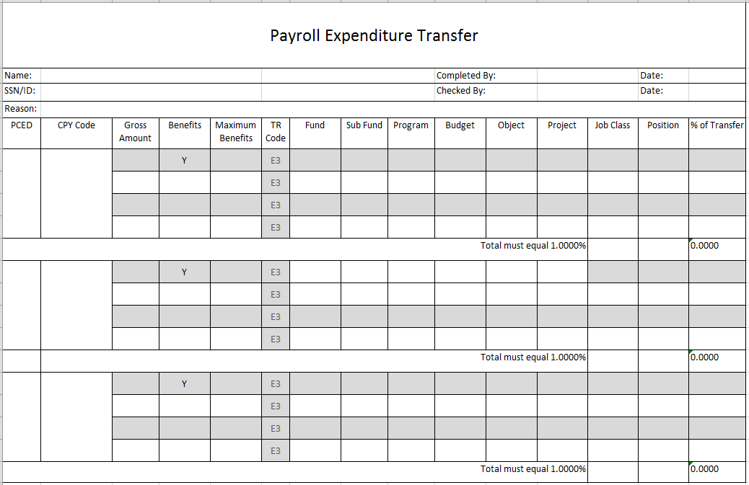
The payroll Expenditure Transfer form
Used only for RETROACTIVE adjustments

Slide 4
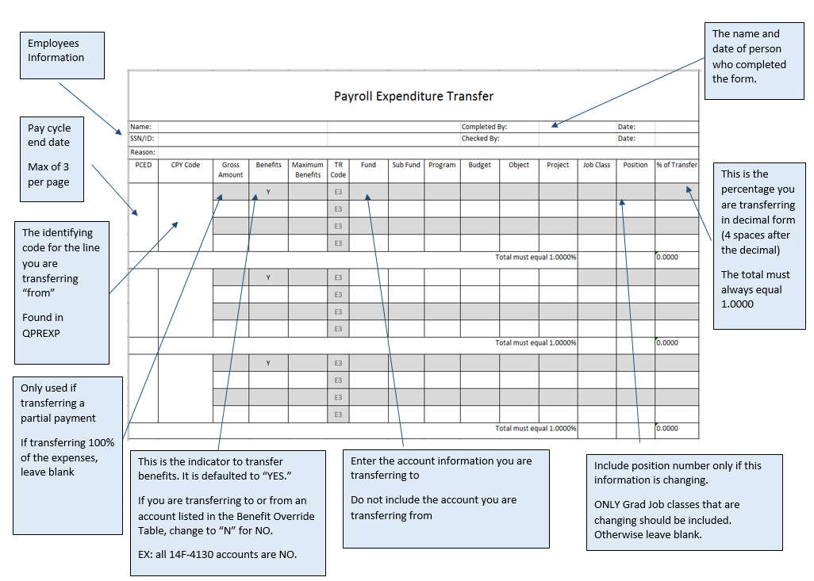

Slide 5
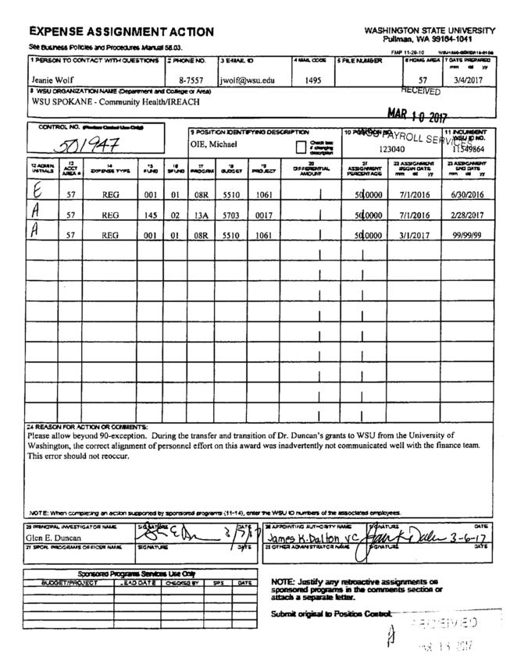
Lets Get Started!
Example 1
This EAA is requesting a transfer of 100% of the funds from account
5510-1061 to 5703-0017 effective 07/01/2016.

Slide 6
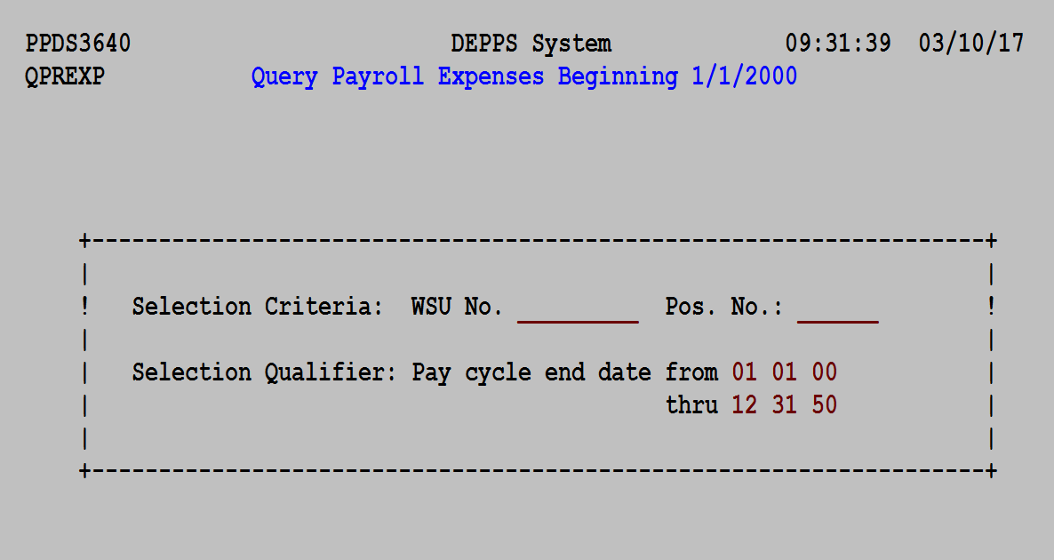
Steps Needed to Complete the Expenditure Transfer From: * Type in employee information into QPREXP
Type in employees ID#
Type in begin date of transfer request; leave “thru” as is

Slide 7
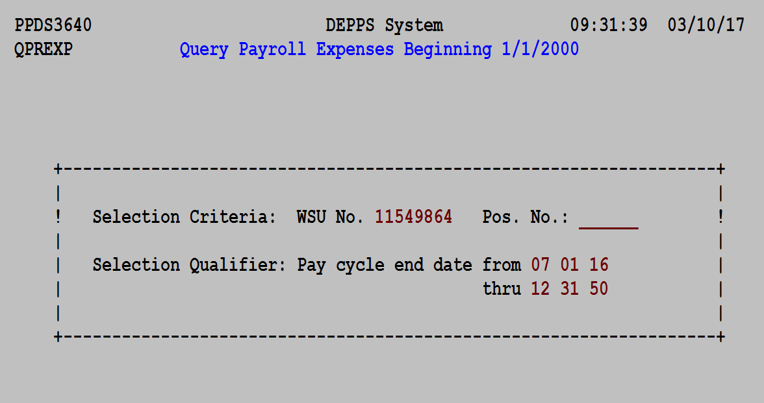
Steps Needed to Complete Expenditure Transfer From:

Slide 8
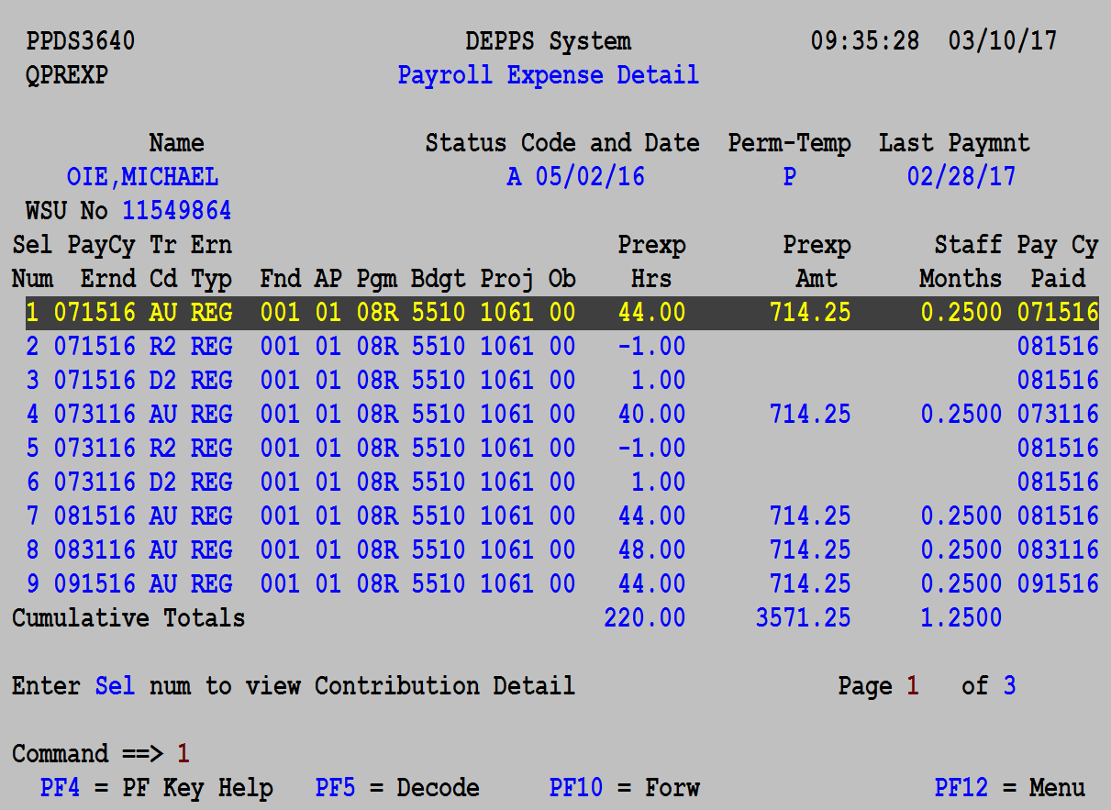
Steps Needed to Complete Expenditure Transfer From:
Notes:
Hit F3 to bring list in order!
AU: automatic pay
E1: transferred from
E2: transferred to
RA/TX: payroll manually paid employee for whatever reason
R2/D2: ignore

Slide 9
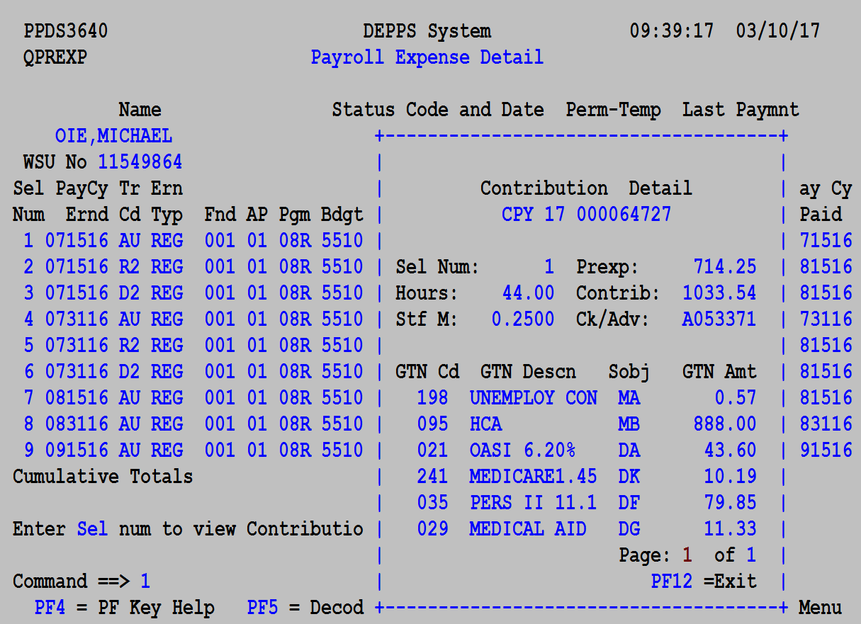
Steps Needed to Complete Expenditure Transfer From:
This is the CPY code we will need for the form!

Slide 10
Filling out the Form Step by Step
Filling out the top section of the form:
Employees name
WSU ID number
Reason for the transfer
The name of person who completed the form and the date.

Slide 11
Filling out the Form Step by Step
Next, fill out:
The pay cycle end date
The CPY code
Benefits default to “Y” unless we are transferring an account in the Benefits Override Table
Funding account information you are transferring to
The % of transfer
***The % of the transfer must equal 1.0000***

Slide 12
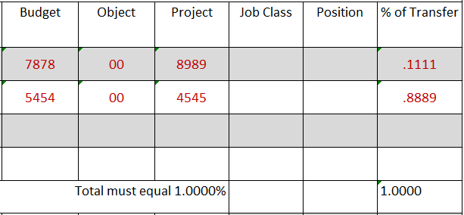
The Percent Column:
States the percentage of funds that are being transferred into the new account(s).
The percent should always be in decimal format (4 spaces after the decimal).
Column should always equal 1.0000
Total % column will atomically add up for you. This will help to make certain the total is always 1.0000

Slide 13
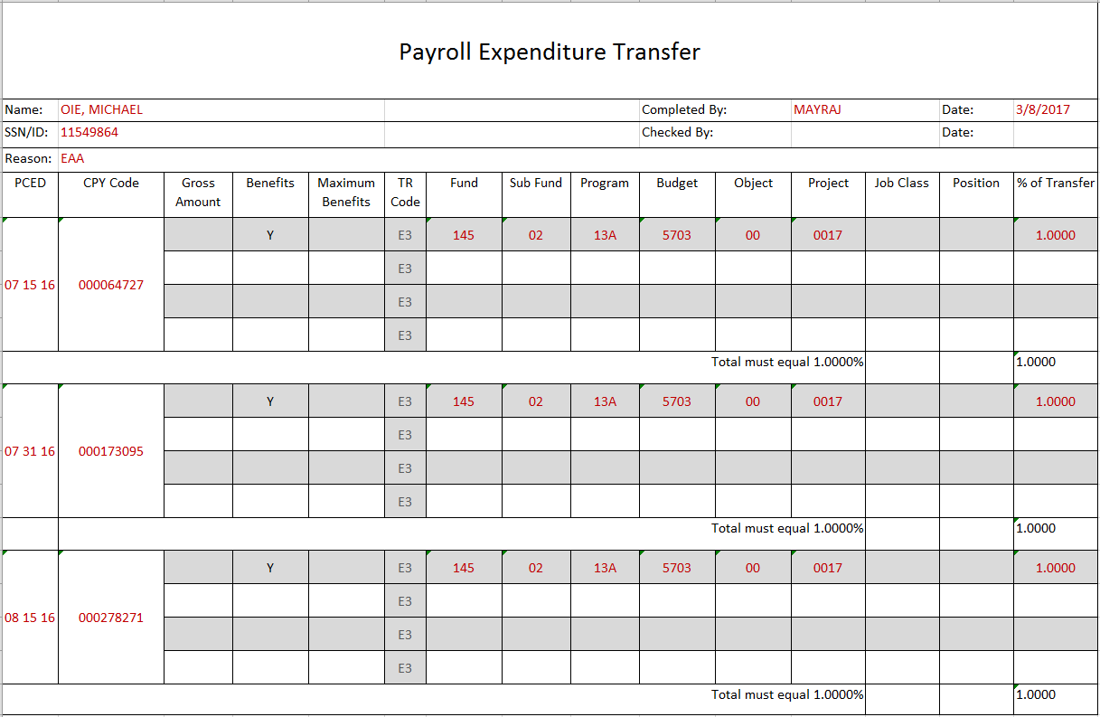
The Finished Product!...
***Per the EAA, we still need to complete transfers until the 02/28/17 pay cycle

Slide 14
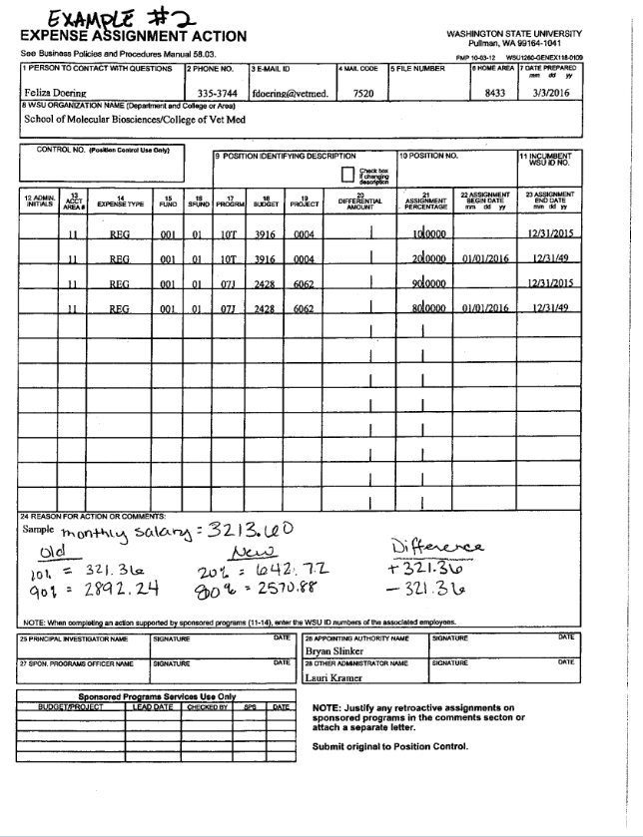
Spilt Funding Transfers!
Example 2
This is a split funding transfer.

Slide 15
Spilt Funding Transfers!
The EAA states effective 01/01/16,
accounts 3916-0004 & 2428-6062
are going from a 90/10 spilt to a 80/20 spilt.

Slide 16
The Percent Column:
The Equation: new % ÷ the % we are transferring from = decimal %
Because the allocation % of 3916-0004 is increasing and the allocation % of 2428-6062 is decreasing, we are going to transfer from 2428-6062 only.
Taking the equation above the math will look like this:
80÷90 = .8889 (this is the % that will stay in 6062)
(90-80)÷90 = .1111 (this is the % that will move to 0004)

Slide 17
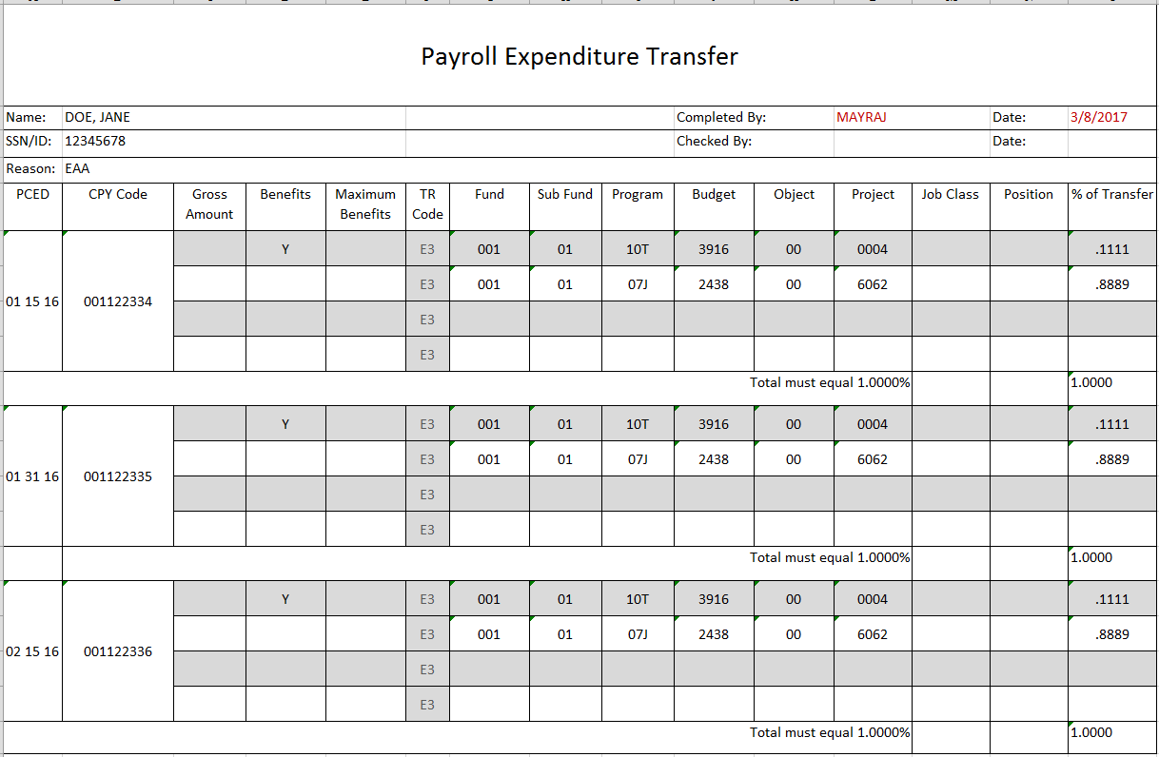
Final product!

Slide 18
Notes to Consider:
Doing a transfer for an employee less than 100% FTE
EX:
Currently funded 75% on project 0001
Effective 01/01/16 employee will be funded:
35% on project 0001 and 40% on project 0234

Slide 19
Doing a transfer for an employee less than 100% FTE EX: *Currently funded 75% on project 0001 *Effective 01/01/16 employee will be funded: *35% on project 0001 and 40% on project 0234
It’s the same equation! new % ÷ the % being transferred from
0001: 35 ÷ 75 = 0.4667
0234: 40 ÷ 75 = 0.5333

Slide 20
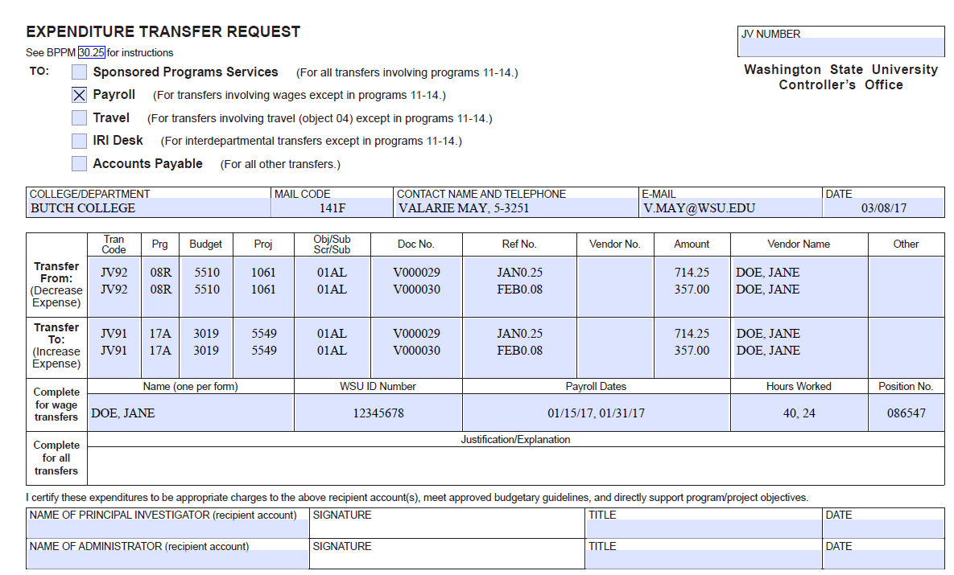
ETR transfers:

Slide 21
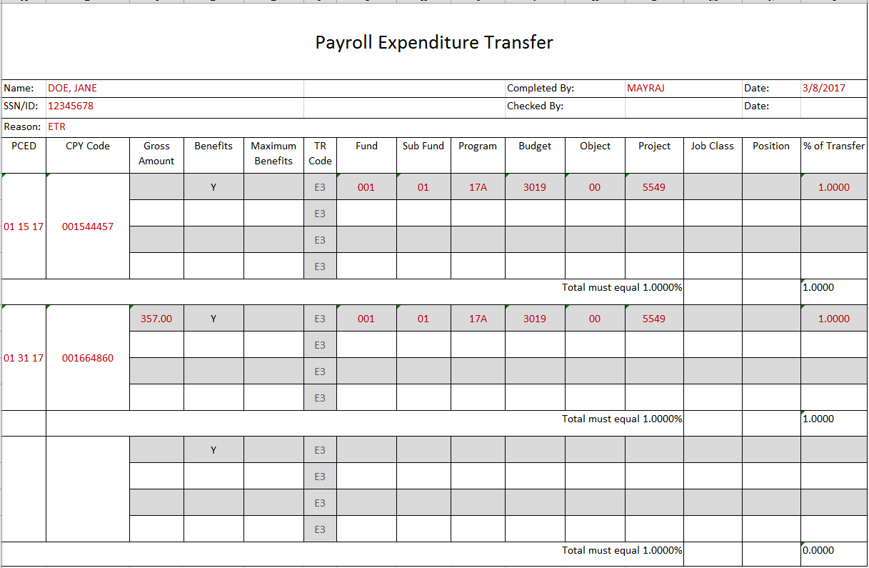

Slide 22
Need Help?!
Please Call us! 335-9575

