Slide 1
Financial Data Warehouse
“Some day, on the corporate balance sheet, there will be an entry which reads "Information"; for in most cases, the information is more valuable than the hardware which processes it.”
- Grace Murray Hopper
Updated 7-2015

Slide 2
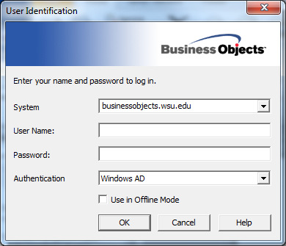
Log in to BusinessObjects
Notes:
Introductions
Show Data Warehouse web page and talk about access procedures.

Slide 3
Training Schedule
Lecture & Lab
Data Warehouse Background & Overview
Query Tool
Terms and Definitions
Financial Data Overview
Using Corporate Documents
Building a Query and Report in Business Objects
work through exercises in the lab
Notes:
Introductions
Show Data Warehouse web page and talk about access procedures.

Slide 4
Background
What is it?
Central warehouse for financial, personnel, etc.
Unlimited report building capabilities
Notes:
Went live in 2002 with Balances data.

Slide 5
Data Warehouse Overview
Data is organized for ad-hoc, reporting access not transaction processing
Snapshots at various points in time
Easy access with query tools
Retention of additional historical data
Accounting Activity from 1/2000 onward
Balances from 6/30/1998 onward
Notes:
Can access all data, not just your dept/area.

Slide 6
Flow of Data
P-Card/CTA
PAPR, SCBAIMS
END USER
(YOU)
DEPPS
FINANCIAL
DATA
WAREHOUSE
Employment Data
BPS (PBL data)
WSU ORG
Endowment
FACTS
ACCOUNT
BALANCES
Notes:
Data refreshed every night
Exceptions – Endowment data –quarterly, PBL data - monthly

Slide 7
Sources of Financial Data
FACTS - Financial Accounting System
Complete Account Information
Codes, picklists, descriptions, etc.
BALANCES System
Accounting Transaction Detail
WSUORG
Endowment System
BPS - PBL - Permanent Budget Level data

Slide 8
Sources of Employment Data
DEPPS - Personnel & Employee System
Employee
Position
Appointment
Funding

Slide 9
Sources of Purchasing Data
PAPR - Purchasing, Accounts Payable, Receiving System
Vendor Information
Purchase Order Line Item Detail
Cost Distribution
SCBAIMS
Service Center Billing
Requisitions
Purchasing Card/CTA Card
Purchase Description
Cost Distribution

Slide 10
Query Tool Options
BusinessObjects
Complete query and reporting tool
InfoBurst (Iburst)
Scheduler for pre-defined reports
May only be used with Business Objects
https://iburst.wsu.edu/InfoBurst/logon2.aspx?ReturnUrl=%2fInfoBurst%2fDefault.aspx
InfoView
Use for managing documents on repository
Use for scheduling (apart from iBurst)
https://businessobjects.wsu.edu/InfoViewApp/logon.jsp

Slide 11
Terms and Definitions
Universe
a collection of information (e.g. a warehouse); A semantic layer between you and the database that adds descriptive information, security and enables “smart” queries.
Class
a set of related objects. Classes can have sub-classes to further group objects together. (icon is a folder)

Slide 12
Terms and Definitions
Object - a data item or formula
dimension - a data object (icon is a blue cube)
measure - an object that is numeric and can be used in a calculation or is the result of a calculation (icon is a yellow battleship/histogram)
detail - a qualification of another object, provides more detail on another object (icon is a green diamond)
Pre-defined Condition - a special kind of object that helps to limit or filter the amount of data returned (icon is a yellow funnel)

Slide 13
Terms and Definitions
Document
a BusinessObjects file that acts as a container for reports (.rep extension)
Can either be housed on the BO repository or on your hard drive.
BusinessObjects documents are composed of 3 items:
Data Provider - the query that retrieves data for reports.
Data - the raw data that was returned from the data provider (database) and displayed on the report
Report - the formatted results of the query

Slide 14
Data Verification/Accuracy
Accountability in creating reports
Validate data in AIS – BALANCES, HEPPS, DEPPS etc.

Slide 15
Data Security/Privacy
Safeguard ID and password
Safeguard data and distribution of reports

Slide 16
Managing Documents
Save *.rep file on local or shared drive.
Be sure to check the box “Save for All Users”
Upload document to repository
Using InfoView
Using Deski
Share docs with others
Send to Users (puts in repository inbox)
Send to Email (leaves an email trail)
Save in public folders (requires setup)
Save on a shared file drive.

Slide 17
Repository storage
Advantages of storing documents in the repository
Safe and easily retrieved if your computer crashes
Repository can be passed on to successors in a position

Slide 18
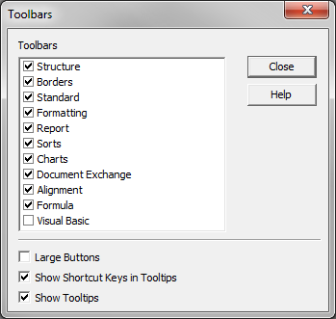
Corporate Documents
To begin – start the program, open view toolbars to select toolbars in heading. Select all but “Large Buttons” then drag around to arrange.

Slide 19
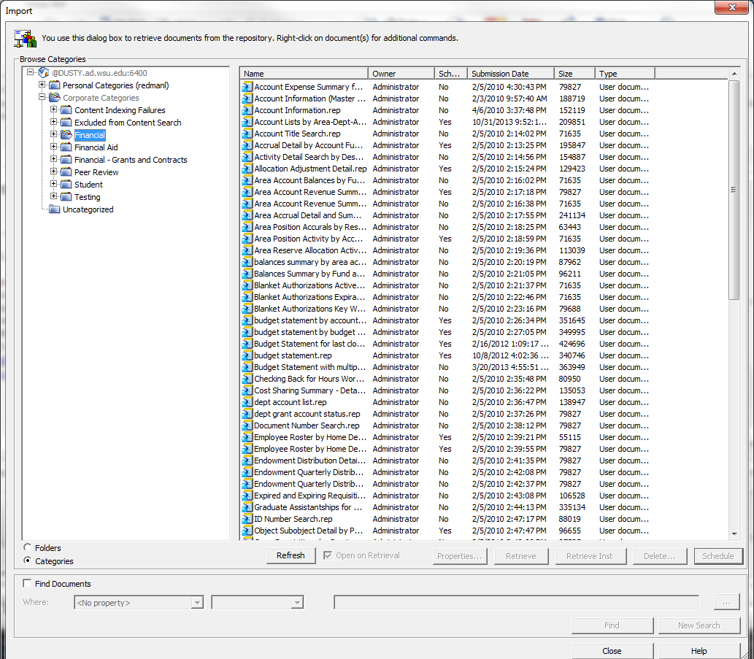
Import Corporate Documents
Go to File, Import From Repository, select “Categories” radio button then open “Corporate Categories” folder , “Financial” and then select the “budget statement.rep” and import.

Slide 20
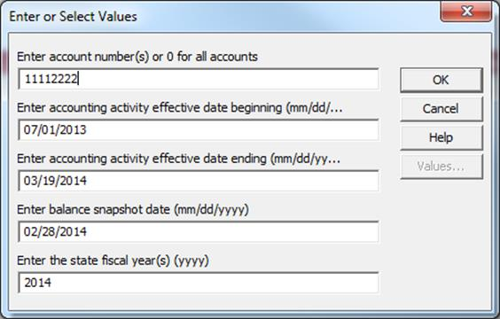
Run Corporate Documents
hit refresh icon
Enter criteria and hit OK
Balance Snapshot Date – can be last night or last month end

Slide 21
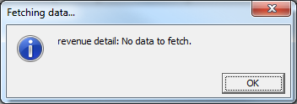
Run Corporate Documents
The message will appear on accounts that do not have revenue detail to report – just hit OK.

Slide 22
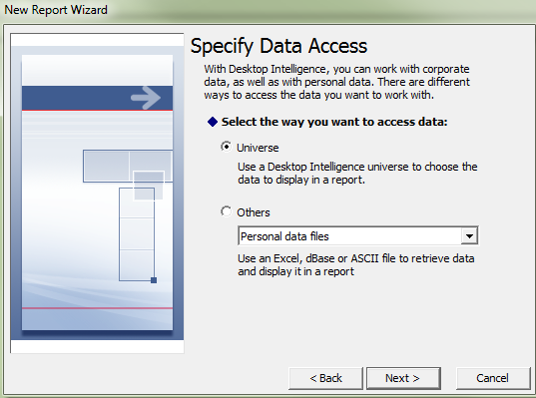
Begin Building Your Own Report
1
2

Slide 23
Select from Available Universes
3

Slide 24
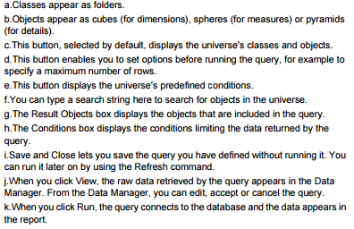
Query Panel Display
a
b
c
d
e
f
g
h
i
j
k

Slide 25
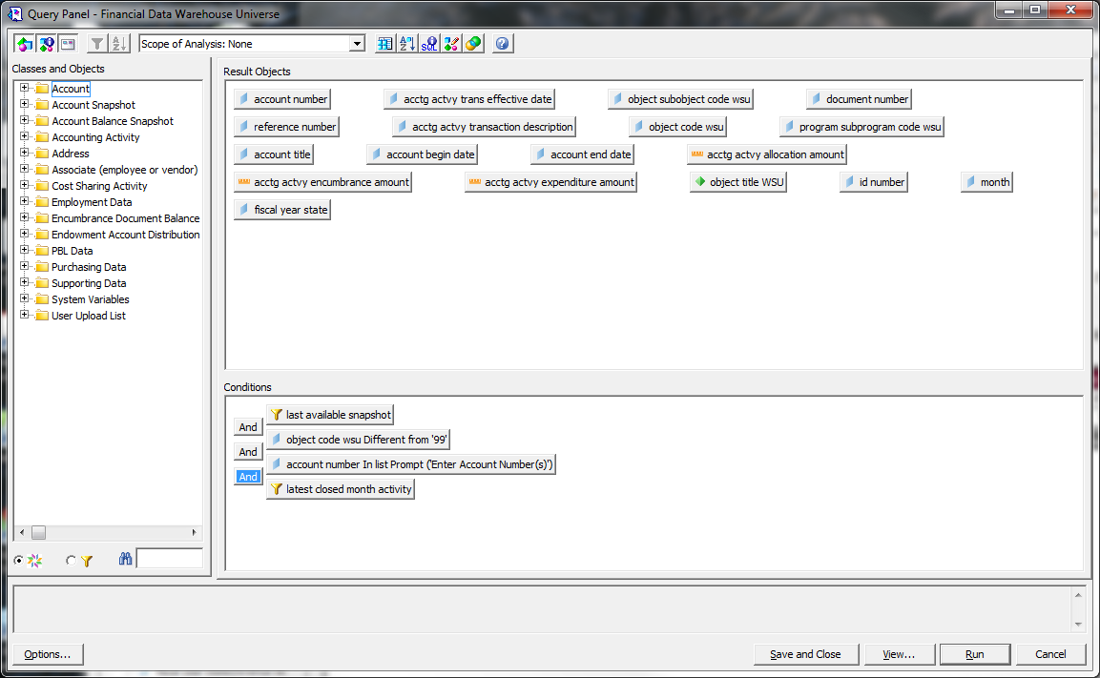
Query Panel
Top corner of Query Panel select all three boxes in the upper left corner. If you hover these will be “Show/Hide All Classes”, “Show/Hide Help on selected items”, “Wrap result objects.”

Slide 26
Building Your Own Report

Slide 27
Building Your Own Report
Select result objects - these are what columns of data will be returned from the database and displayed in your report.
Build conditions - these put limitations on the number of records that are returned from the database.
Use pre-defined or your own conditions as much as possible.
If you don’t specify otherwise, you will get ALL records.
Be careful when combining data from multiple classes
Notes:
Account balances for area.

Slide 28
Financial Data Overview
A brief walk- through of each class of data (folder) in BusinessObjects
Describe each class
Highlight key objects and pre-defined conditions (filters)
Things to watch for in each class
Notes:
Build example – employee roster with email address.
This might be a good time for a BREAK!
Show video during data overview.

Slide 29
Formatting the Report
Set as Master creates a master/detail report
Can also add breaks, totals, sorts, etc.
How to “Slice and Dice” the data

Slide 30
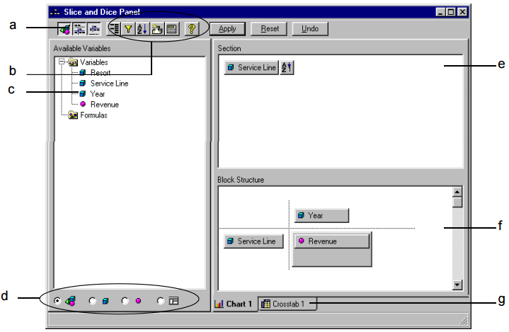
Slice and Dice Panel
Show/hide the Available Variables box
Apply breaks, filters, sorts, rankings and calculations
Report Variables
View all variables, dimensions only, measures only, or all variables by data provider.
Show masters in master/detail reports
Show the variables in the active table, chart or crosstab
Show the name and type (table, chart or crosstab) of each block

Slide 31
Tips and Techniques
If using more than one “snapshot” class, be sure to specify the snapshot generation on EVERY class
Use Account Snapshot and Account Balance Snapshot most of the time.
Only use Accounting Activity when detail is needed or when date range is not compatible with snapshot dates.
ONLY use Supporting Data when a list of codes is required.

Slide 32
Tips and Techniques
Build the query to get the data you want first, then format the report.
Start with a small set of data, then add to it.
Look at each object to make sure you have put appropriate conditions on each class used.
Conditions are what limit the amount of data returned; use them as much as possible.
Notice the UPPER CASE objects; they are the unique identifiers for each class.
Watch out for duplicate rows aggregation in BusinessObjects.

Slide 33
Save for all users

Slide 34
InfoBurst Access
Contact IT to request an InfoBurst account.
Log in to InfoBurst at https://iburst.wsu.edu

Slide 35
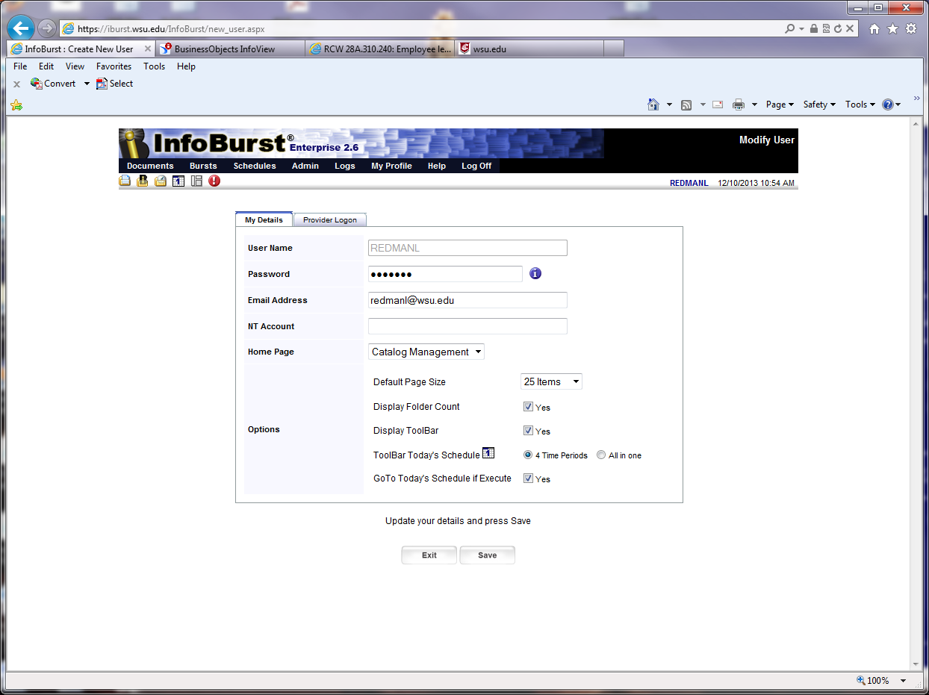
InfoBurst User profile set-up

Slide 36
How to learn more
WSU Data Warehouse web page: http://infotech.wsu.edu/datawarehouse/
Financial Data Warehouse listproc
financial_dw@listproc.wsu.edu

