Slide 1

WSU Training for Developing Leaders
Position Descriptions, Expectations, and Annual Reviews
January 2016

Slide 2
Today’s Learning Objectives
Three “Building Blocks” of performance management
Components of well-written job descriptions
Essential functions of a sample job description
Effective performance expectations
Phases of productive review meetings

Slide 3
Building Blocks of Performance Management
Position Descriptions
Performance Expectations
Performance Reviews

Slide 4
Building Block One – Position Descriptions
It is important for employees to clearly understand their roles.

Slide 5

Advantages of Position Descriptions
Employee
Supervisor
Communication

Slide 6
Position Description Defined
A summary of scope of authority and responsibility.
A statement of principal duties and functions.
Specific to the needs of the department
(Not to the employee)

Slide 7
Position Descriptions – Nuts and Bolts
Position Description
Details
Duties
Supervisor /Lead
Qualifications
Essential Competencies
Performance
Expectations

Slide 8
Position Descriptions - Classification
  Civil Service
  Must be consistent with the State Department of Enterprise Services Class Specifications for the classification.
  Administrative Professional
  Must comply with the State of Washington exemption definitions RCW 41.06.070 and WSU Benchmarks.

Slide 9


Slide 10
Building Blocks of Performance Management
Position Descriptions
Performance Expectations

Slide 11
Building Block Two –
Performance Expectations
Success in
my positions requires:

Slide 12
Performance Expectations
A statement of the result an individual employee will achieve when he/she is doing a job satisfactorily.
position description = “what”
performance expectations = “how well”

Slide 13
Expectation Criteria
Civil Service: | Quantity of Work Quality of Work Job Knowledge Working Relationships Other Criteria
Administrative Professional: | Productivity Quality of Work Interpersonal Skills Optional Factors

Slide 14
Performance Expectation Categories
Expectations for Civil Service employees must include:
  Unsatisfactory
      Needs improvement
  Satisfactory/meets expectations
  Outstanding performance
      Exceeds expectations
It is recommended that AP employees also have performance expectations.

Slide 15
Performance Expectations
Consistent
Realistically attainable
Legally defensible
    Valid
    Free of bias
    In compliance with applicable laws, regulations, WSU policy and procedures

Slide 16


Slide 17


Slide 18
Building Blocks of Performance Management
Position Descriptions
Performance Expectations
Performance Reviews

Slide 19
Building Block Three –
Performance Reviews
It’s important to receive constructive and corrective feedback throughout the year.

Slide 20
Preparing for the Performance Review
Prepare throughout the year
  Know your EE Categories and performance expectations
  Keep and review notes, goals, accomplishments
Know what official forms and processes to use
Understand / Identify criteria and ratings

Slide 21
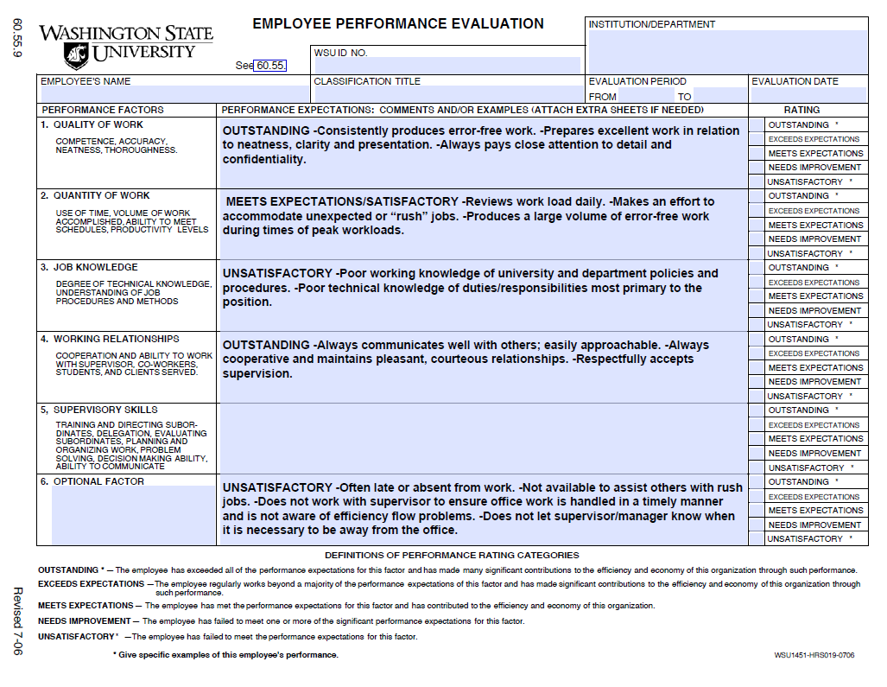

Slide 22
Evaluation Policies
Civil Services
WAC 357-37
BPPM 60.55
REQUIRED
Permanent EE’s - Annually (prior to PID)
Probation or Trial Service – 6 months
May be postponed for 6months
May request cyclic reviews
HRS
Bargaining Unit
Collective Bargaining Unit Agreement
Some state No Performance Evals – Check Contracts
Administrative Professional
AP Handbook
BPPM 60.55
Calendar Year
HRS
Faculty
Faculty Manual
BPPM 60.55
Calendar Year
May Use WORQS
Provosts Office

Slide 23

“Wow, I’m so excited for my performance review today!”
- Said by no one . . . ever

Slide 24


Slide 25
Performance Review Meetings
Purpose of Review Meeting
Discuss review period
Future planning
Planning for the Meeting
Coordinate in advance
Schedule appropriate
amount of time
During the Meeting
Greet employee /
put at ease
Start on a positive note
Closing the Meeting
Summarize discussion
Clarify ratings/expectations
Facilitate communication
Review evaluation
prior to meeting?
Discuss items and rating
Talking points
Encourage input and participation
Confirm employees understanding
Summarize improvement plan(s) and/or goals
End positively

Slide 26
Performance Review Reminders
No surprises
CS employees may appeal
    alleged irregularities in forms and/or procedures, not content
Written Rebuttal
Employee signature:
  indicates receipt of review – not agreement

Slide 27
Performance Review Pitfalls
PITFALLS
Biases
Déjà vu
Gossip
Inflated Rating

Slide 28
Preparing for Next Year
  Periodically review goals
  Monitor progress in removing deficiencies
  For growth and development
      Encourage employee
      Provide an environment that allows for success

Slide 29
Summary
Building Blocks of Performance Management
  Current and accurate position description
  and performance expectations
      Lead to useful and valid performance reviews.
Position Descriptions
Performance Expectations
Performance Reviews

Slide 30


Slide 31
Resources
BPPM 60.55
WAC 357.37
Collective Bargaining Unit Agreements
Administrative Professional Handbook
Faculty Manual
Visit HRS’s web site to access a sample of Performance Expectations.
  Go to www.hrs.wsu.edu, and click on
  Manager/ Classification-Compensation
Online Position Description System
  www.wsujobs.com/hr
HRS– www.hrs.wsu.edu
Questions can be directed to HRS at
335-4521, or hrs@wsu.edu

Slide 32

This has been a
WSU Training Videoconference
If you attended this live training session and wish to have your attendance documented in your training history,
please notify Human Resource Services
within 24 hours of today's date:
hrstraining@wsu.edu

