Slide 1

Time Report Training
Presented by:
    Human Resource Services
Revised December 2016

Slide 2
Today’s Objectives
Review Time/Leave Processes
Discuss Department Responsibility for Time/Leave Reporting

Slide 3
HRS has increased communication with areas that have repeated errors processing time/leave reports and notify Appointing Authorities, Deans and Vice Presidents of concerns.
HRS notifies WSU Internal Audit of serious and/or repeated concerns.

Slide 4
Policies and Regulations
Fair Labor Standards Act (FLSA) sets and regulates minimum wage, hours worked, overtime and record keeping
Washington Administrative Codes (WAC)
Business Policies & Procedures Manual (BPPM)
Revised Code of Washington (RCW)

Slide 5
Department Responsibility
Employees are required to complete a monthly time or leave report.
      Time Report – records attendance, leave, and overtime for overtime-eligible employees (civil service, bargaining unit, AP and Faculty)
      Leave Report – records leave activity for Faculty and AP employees who are ineligible to earn overtime.

Slide 6
Department Responsibility
Department maintains original leave/time report for each employee.
    If employee transfers to another department, the leave file is transferred to the new department
Department must provide employee with a copy of the completed time/leave report each month
Upon separation from WSU, department submits original time/leave reports to HRS for official audit

Slide 7
Annual Leave and Sick Leave Accruals
Civil Service Employees
New CS & BU employees hired 1-15th of month earn full accruals at FTE rate. If hired 16th to end of month, do NOT earn accruals
CS & BU Employee separating 1-15th, do NOT earn accruals; employee separating 16th-end of month, earn full accruals.
If FTE changes during a single month, accruals are figured on the FTE on the last working day of the month.

Slide 8
Leave Accruals
Civil Service Employees
Employees cannot use AL or SL until the first day of the month AFTER it is accrued.
Employees may NOT use AL until they have been employed for 6 months
Employees may use SL during probationary period
Employees may use Personal Holiday during probationary period (BU employees should check the appropriate contract)

Slide 9
Civil Service Annual Leave Accrual Rates for Full-Time Employees (BPPM 60.57)
Year | Accrual Per Year | Accrual Per Month
1 (of continuous state employment) | 12 days | 8.00 hrs.
2 (of continuous state employment) | 13 days | 8.67 hrs.
3-4 (of continuous state employment) | 14 days | 9.33 hrs.
5-7 (of total state employment) | 15 days | 10.00 hrs.
8-10 (of total state employment) | 16 days | 10.67 hrs.
11 (of total state employment) | 17 days | 11.33 hrs.
12 (of total state employment) | 18 days | 12.00 hrs.
13 (of total state employment) | 19 days | 12.67 hrs.
14 (of total state employment) | 20 days | 13.33 hrs.
15 (of total state employment) | 21 days | 14.00 hrs.
16 and longer (of total state employment) | 22 days | 14.67 hrs.

Slide 10
Accrual Chart
Continuous Employment Date: 10/14/06
Initial Hire Date: 10/14/06
DATE: | RATE: | MONTHS COMPLETED SERVICE:
10/06 | 8.00 | 0
10/07 | 8.67 | 12
10/08 | 9.33 | 24
10/09 | 9.33 | 36
10/10 | 10.00 | 48
10/11 | 10.00 | 60
10/12 | 10.00 | 72
10/13 | 10.67 | 84
10/14 | 10.67 | 96
10/15 | 10.67 | 108
10/16 | 11.33 | 120
10/17 | 12.00 | 132
10/18 | 12.67 | 144
10/19 | 13.33 | 156
10/20 | 14.00 | 168
10/21 | 14.67 | 180

Slide 11
Leave Accruals
Civil Service Employees - LWOP
When an employee has 11 or more FULL days of LWOP in a month:
    they do not earn AL or SL for that month, and
    their AL accrual rate increase will be deferred by one month.

Slide 12
Accrual Chart with LWOP
Continuous Employment Date: 10/14/06
Initial Hire Date: 10/14/06
Employee had LWOP 1/5/08-3/7/08 and 10/2/09-11/7/09
DATE: | RATE: | MONTHS COMPLETED SERVICE:
10/06 | 8.00 | 0
10/07 | 8.67 | 12
*LWOP 1/5/08-3/7/08 – defer 2 months
12/08 | 9.33 | 24
*LWOP 10/2/09-11/7/09 – defer 1 month
1/10 | 9.33 | 36
1/11 | 10.00 | 48
1/12 | 10.00 | 60
1/13 | 10.00 | 72
1/14 | 10.67 | 84
1/15 | 10.67 | 96
1/16 | 10.67 | 108
1/17 | 11.33 | 120
1/18 | 12.00 | 132
1/19 | 12.67 | 144
1/20 | 13.33 | 156
1/21 | 14.00 | 168
1/22 | 14.67 | 180

Slide 14
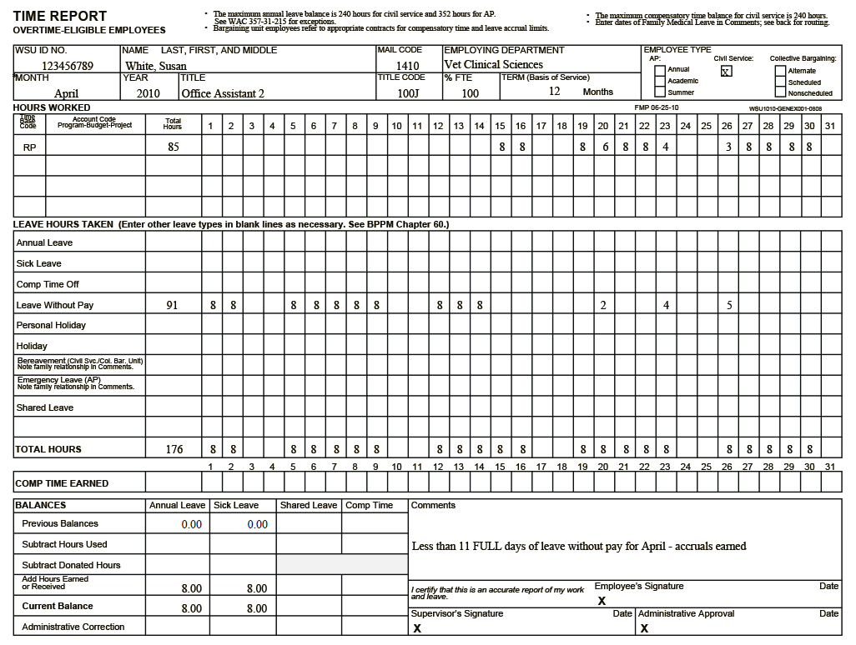

Slide 15
Leave Accruals
AP and Faculty Employees
      Employees cannot use AL or SL until the first day of the month AFTER it is accrued.
      Faculty on annual 12 month appointments earn AL & SL;
      Faculty on academic appointments (at least a semester) earn SL only.
Faculty & AP on full-time appointments earn 8 hours SL and 14.67 AL per month
Faculty & AP less than full-time accrue leave at their FTE rate (50% FTE = 4 hrs SL, 7.34 AL)

Slide 16
Leave Accruals
AP and Faculty Employees
Faculty & AP hired or separated within the month receive leave on a prorated basis; based on number of days in paid status
Faculty & AP on LWOP receive leave on a prorated basis; based on number of days in paid status

Slide 17
Prorating Leave Accruals
AP and Faculty Employees
Number of days in paid status ÷ number of paid working days in the month = Fraction; Fraction x 14.67 x FTE = AL accrual
  Example: 100% FTE employee works 10 days out of 22 possible in the month 10/22=.454x14.67x100%=6.67 AL
Number of days in paid status ÷ number of paid working days in the month = Fraction; Fraction x 8.00 x FTE = SL accrual

Slide 18
Leave Policies
AP & Faculty - Maximum AL balance is 352 hours; leave earned in excess of 352 is lost
Civil Service – Maximum AL balance is 240 hours on anniversary date
AP & Faculty - Emergency Leave is granted up to 5 days for qualifying event
Civil Service – Bereavement Leave is granted up to 3 days for qualifying event

Slide 19
Personal Holiday
Civil Service - Earn a Personal Holiday each calendar year (Jan 1 - Dec 31) based on FTE rate
AP & Faculty - Earn a Personal Holiday each fiscal year (July 1-June 30) based on FTE rate
    Faculty on appointment less than 12 months do not earn a personal holiday
Personal Holiday does not carry forward to the next year.

Slide 20
Recording Hours Worked
The official WSU work week is from Sunday, 12:01 a.m. to Saturday, 11:59 p.m.
Overtime eligible employees must account for hours worked each day
Overtime is calculated at hours worked in excess of 40 hours in the work week, not hours worked each workday

Slide 21
What Constitutes Overtime for
Overtime Eligible Employees?
Civil Service Employees (WAC 357-28-255)
  Work in excess of forty hours in one work week
  Work on a holiday
  For full-time employees, work on a scheduled day off when assigned by the employer
Notes:
Civil Service Reform – 40 hour work week NOT 8 hour day.
Examples

Slide 22
What Constitutes Overtime for
Overtime-Eligible AP and Faculty
Overtime-eligible AP and Faculty
  Overtime is work in excess of 40 hours in one work week
    Work on a holiday is NOT considered overtime but hours worked count towards total hours in the work week
    Work on a schedule day off is NOT considered overtime but hours worked count towards total hours in the work week
Notes:
Civil Service Reform – 40 hour work week NOT 8 hour day.
Examples

Slide 23
Overtime Compensation
Hours worked over 40 must be compensated at one and one-half times the employee’s regular rate of pay. WAC 357-28-260
Part-time employees do not earn overtime at time and one-half until they have worked more than 40 hours in the work week. Hours worked between their required hours and 40 hours must be PAID at straight time. No Straight Time Comp Time
Notes:
Civil Service Reform – 40 hour work week NOT 8 hour day.
Examples

Slide 24
Overtime Compensation
Premium Pay (PP): employee receives payment at time and one-half.
Compensatory time (PC): employee receives time off with pay at time and one-half.
    Comp time may substitute for paid overtime if employee and employer agree. WAC 357-28-275
    The accumulation of unused comp time may not exceed 240 hours. Departments may establish maximums of less than 240 hours.
    Unused compensatory time must be paid in cash at the end of each biennium
Straight Time (OP): employee receives payment at regular rate of pay.
Notes:
Department cannot tell employee how they will receive overtime payment. Employee’s decision

Slide 25
Calculating Overtime
  Paid Holidays: considered hours worked for calculating overtime.
  Personal Holiday: considered hours worked for calculating overtime.
  Work on Scheduled Day Off: CS/BU - Full-time employees assigned to work on a scheduled day off earn overtime (PP or PC);
  Work on a Holiday: CS/BU Earn overtime (PP/PC)
      If holiday falls on Friday and there is overtime for the week, OT hours should be reflected on Thursday
Notes:
In Lieu of Holiday – considered hours worked

Slide 26
Calculating Overtime
  Sick Leave
      is NOT considered hours worked for calculating overtime
  Annual Leave
      is NOT considered hours worked for calculating overtime
  Compensatory time off
      is NOT considered hours worked for calculating overtime
  Leave without Pay
      is NOT considered hours worked for calculating overtime
Notes:
Prior to 7/1/05 all paid leave (SL, AL, CT) was considered hours worked

Slide 27
Temporary Hourly Appointments
  WSU employees who hold a temp/hourly position in addition to their primary appointment must be compensated accordingly.
      Full-time, OT-eligible employees receive OT payment for all hours worked in temp/hourly position. The secondary department is required to ensure they receive appropriate rate of pay.
      OT-ineligible employees must coordinate with their primary department to account for hours worked in temp/hourly secondary position.
Notes:
Prior to 7/1/05 all paid leave (SL, AL, CT) was considered hours worked

Slide 28
Temporary Schedule Changes
  By mutual agreement, employee and supervisor may agree to a temporarily modified schedule during the work week. Such scheduling does not require advance notice. WAC 357-28-252(3)
  To request a temporary schedule change, employee submits the request to the department for approval (BPPM 60.33).
  The employing official may approve the request but is not required to do so.
Notes:
Example: 4x10 schedule – use 2 hours

Slide 29
  Employer must provide two calendar days notice for temporary changes lasting 30 calendar days or less. Employer may provide less than two calendar days notice in some circumstances.
  Permanent changes in schedule that exceed thirty calendar days, employer must provide seven calendar days notice. WAC 357-28-252(2)
Temporary Schedule Changes
Notes:
Example: 4x10 schedule – use 2 hours

Slide 30
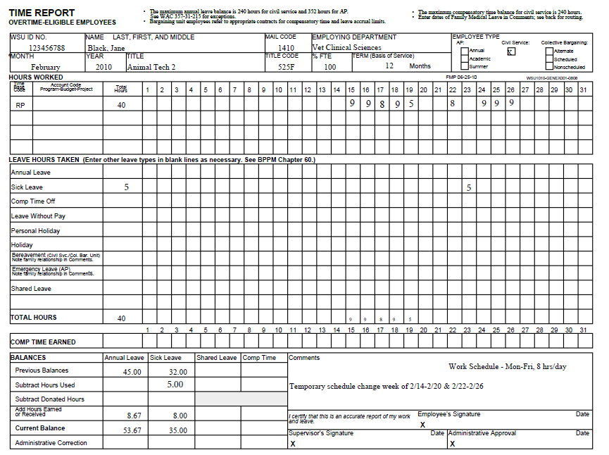

Slide 31
Alternate Work Schedules
  When a holiday falls on an employee's scheduled work day, record holiday hours and necessary amount of AL, CT or LWOP to account for work day schedule. BPPM 60.60
  When a holiday falls on an employee’s scheduled day off, the department may:
      Designate the prior or following work day as the holiday
      Provide the employee with equivalent paid time off (OP)
      Allow the employee to observe an in lieu of holiday at a later date.
Notes:
Example: 4x10 schedule – use 2 hours

Slide 32
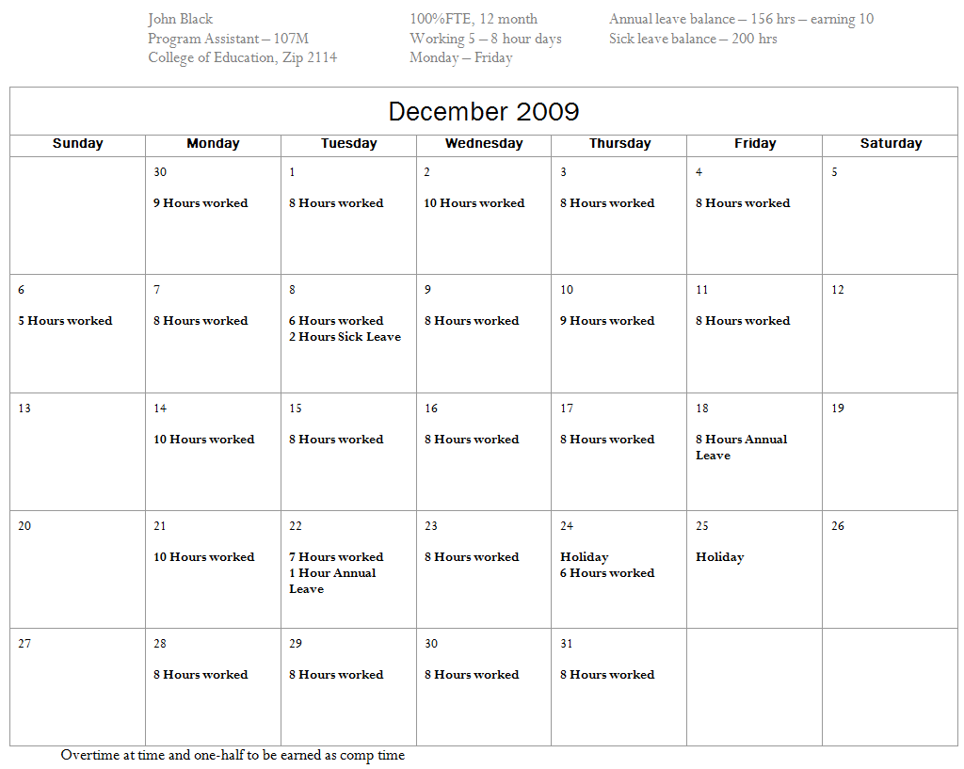
December 2009

Slide 33
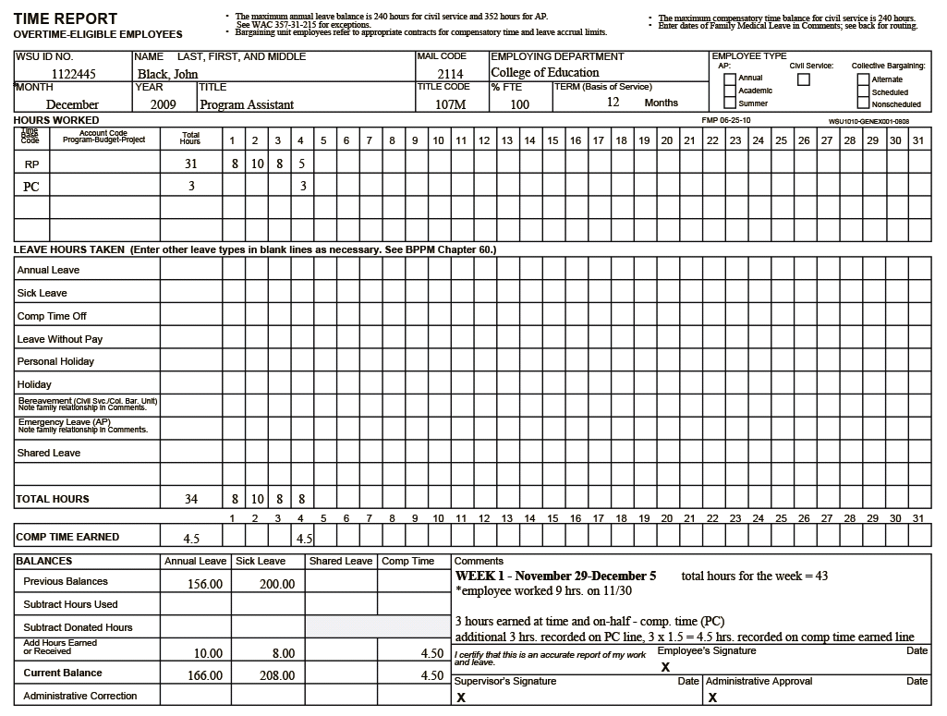

Slide 34
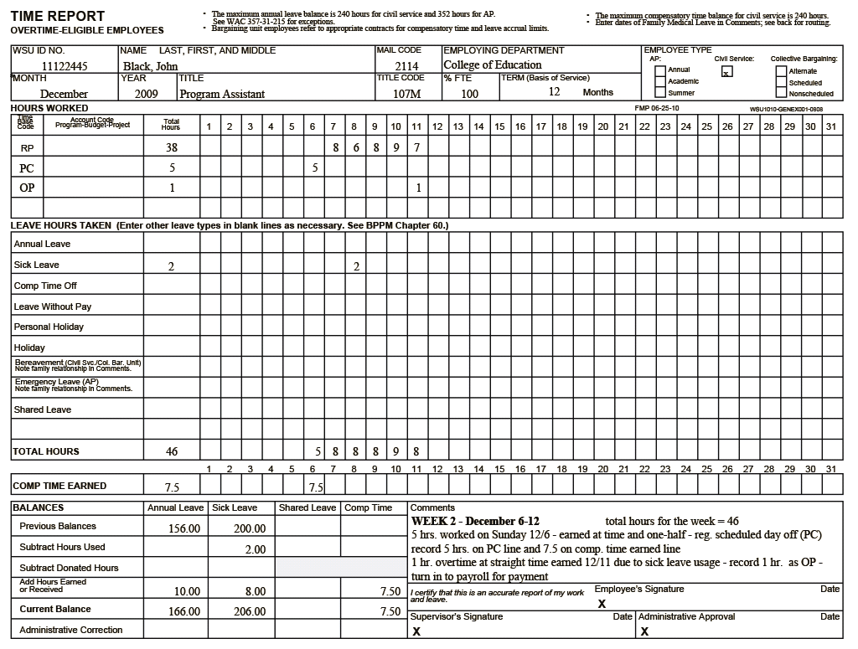

Slide 35
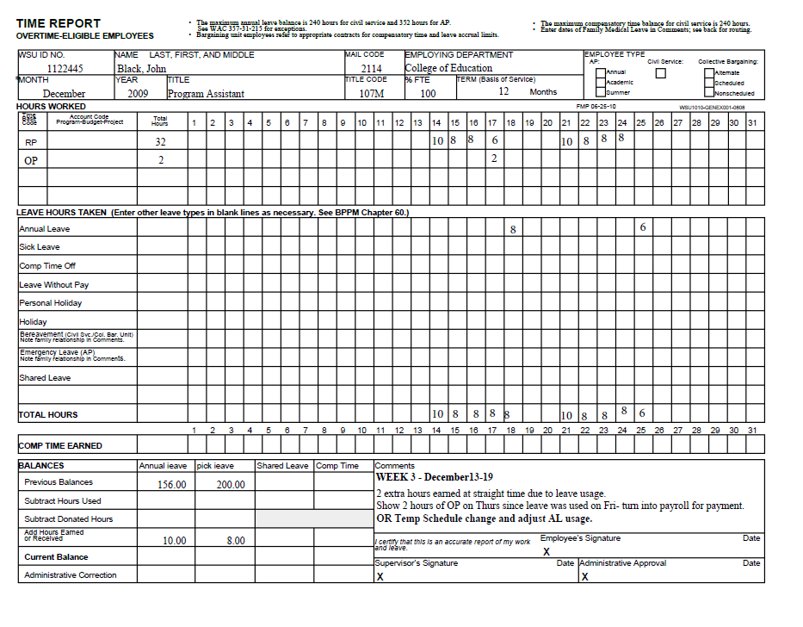

Slide 36
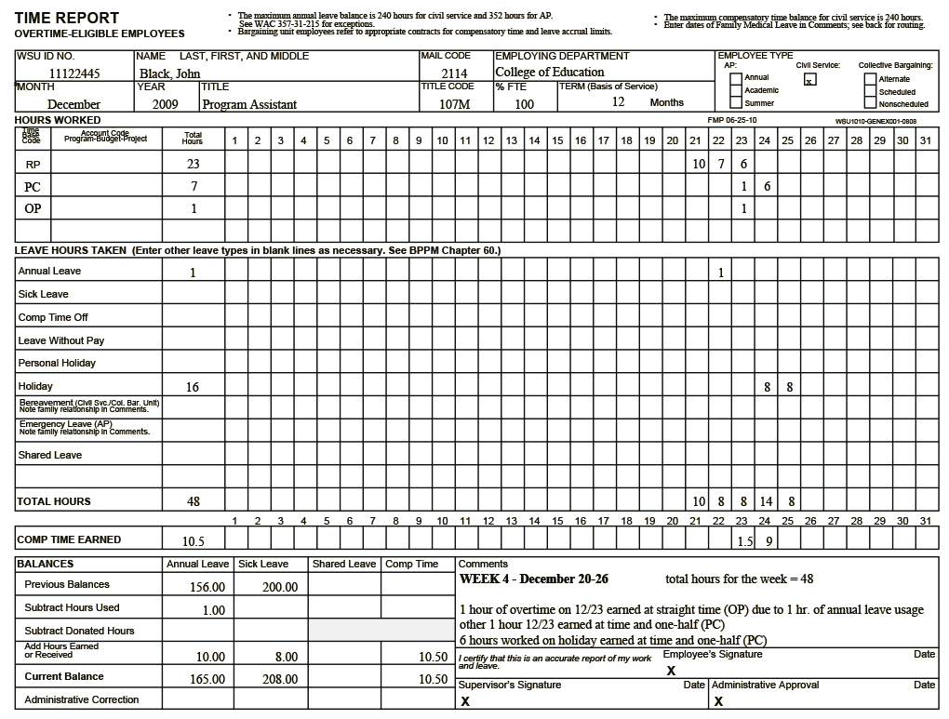

Slide 37
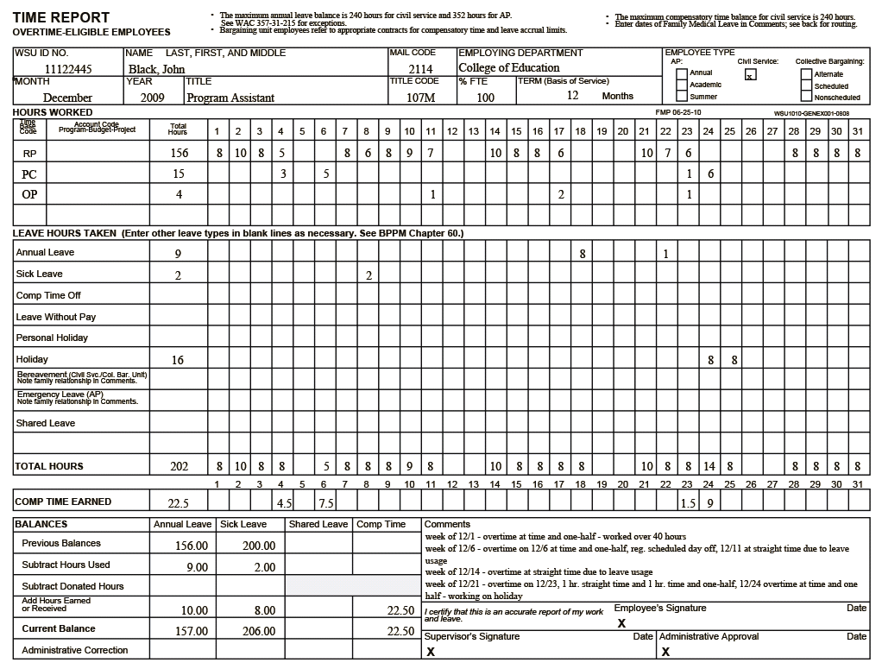

Slide 38
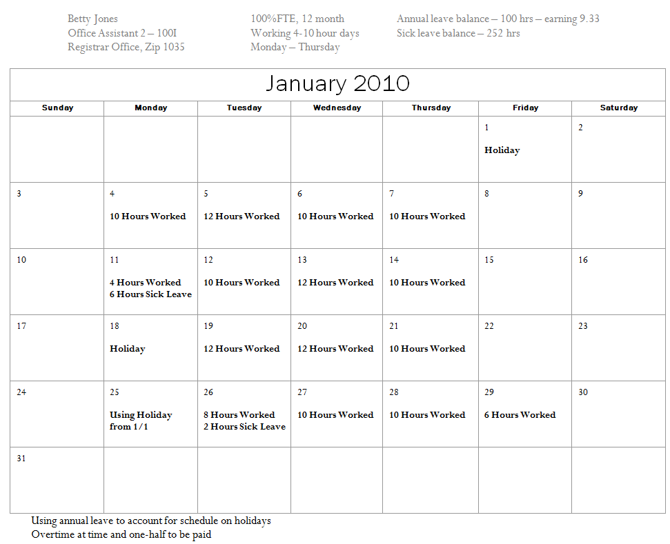
January 2010

Slide 39
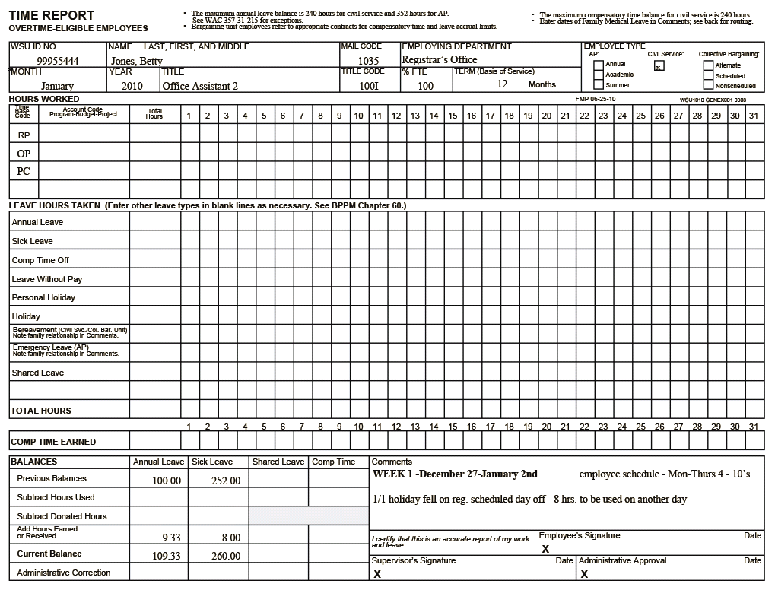

Slide 40
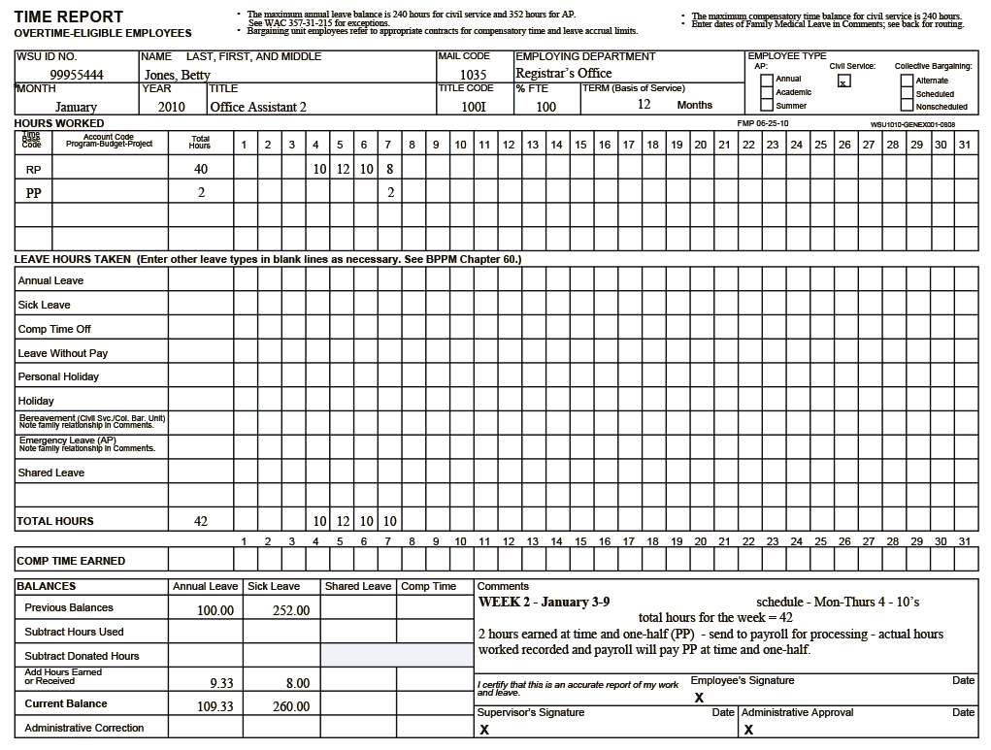

Slide 41
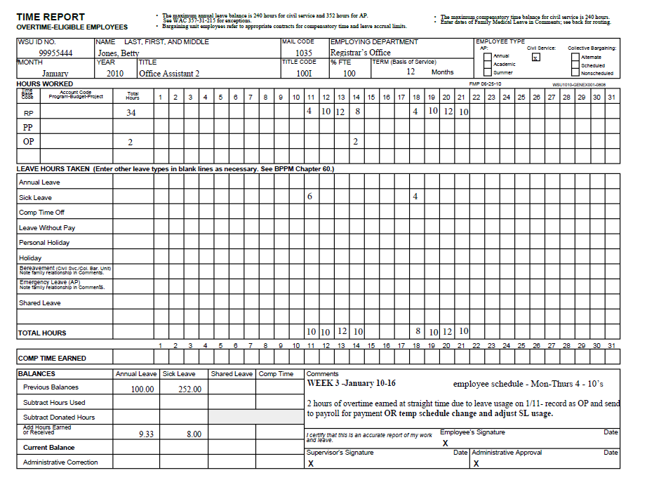

Slide 42
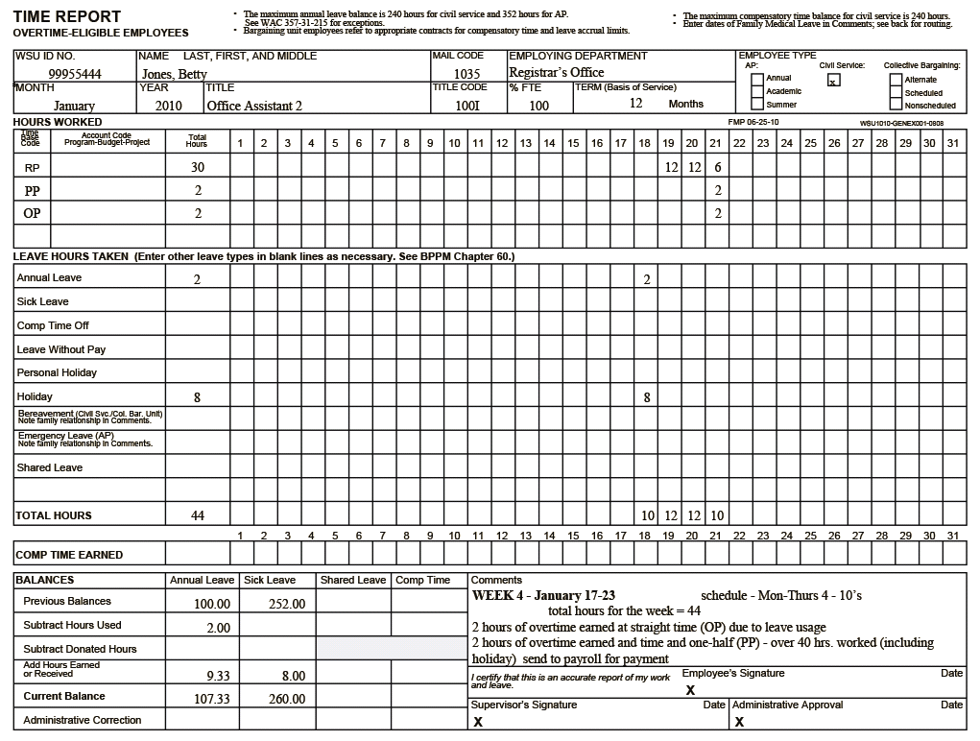

Slide 43
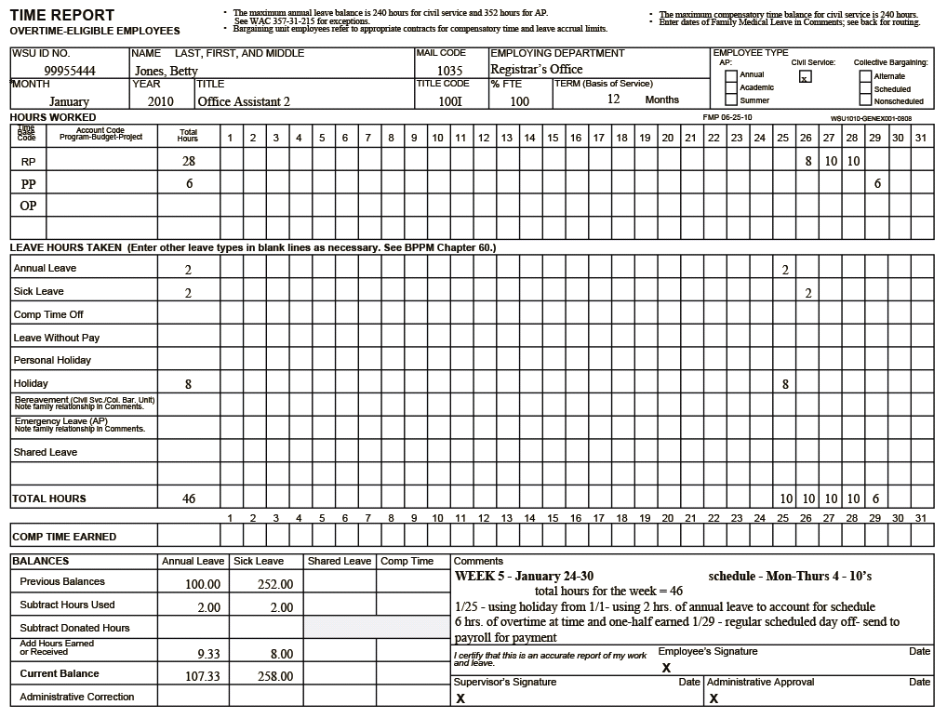

Slide 44
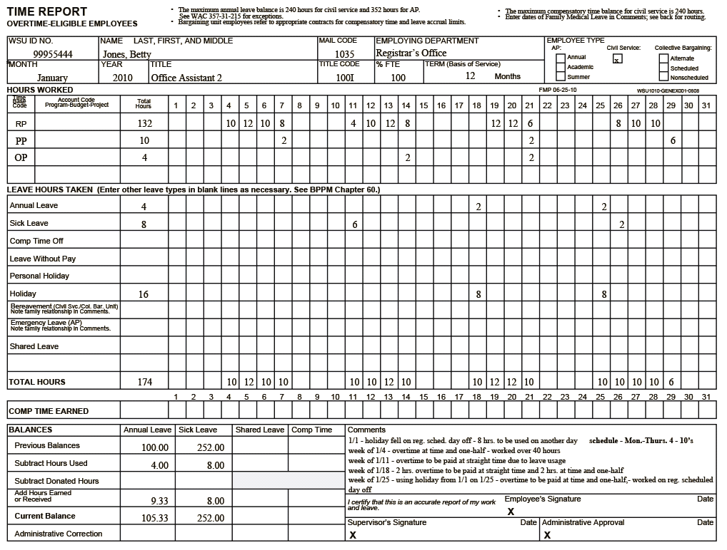

Slide 45
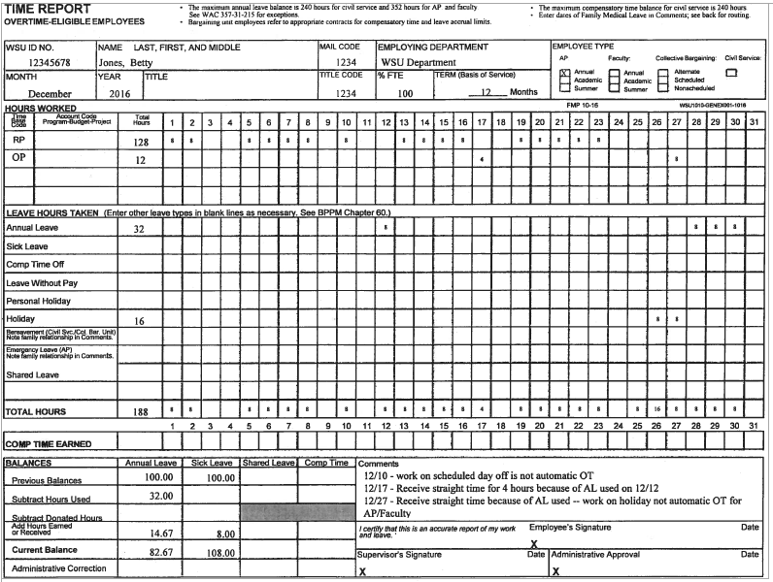

Slide 46
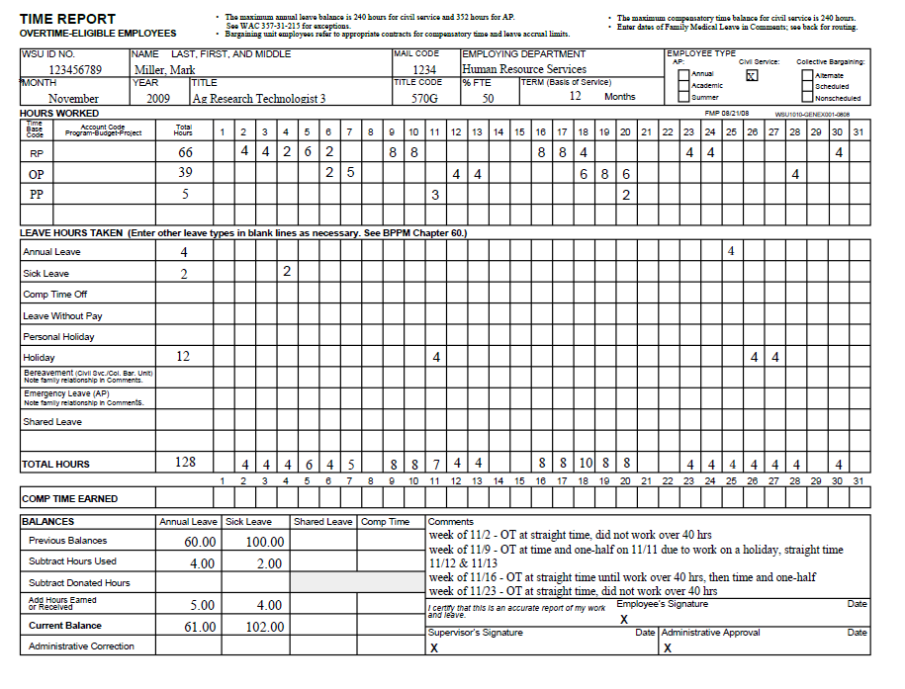

Slide 47
Common Time Reporting Errors
Employees must be in FULL pay status the work shift before a holiday to receive holiday pay.
Calculate appropriate accruals for civil service.
Carry forward correct leave balances.
Simple addition and subtraction errors.
Notes:
Standard hours of work – determine and communicate what the standard hours of work will be for exempt employees.
If hours have been worked, the department MUST pay for overtime

Slide 48
Common Time Reporting Errors
Time/Leave Report must be completed in ink.
Signatures and dates on all time/leave reports.
      All changes/corrections must be initialed.
LWOP must be submitted to HRS for processing.
Bereavement Leave: note relationship in comment box of time report
Notes:
Standard hours of work – determine and communicate what the standard hours of work will be for exempt employees.
If hours have been worked, the department MUST pay for overtime

Slide 49
Additional Information & Resources
Department of Labor
        www.dol.gov/fairpay
Department of Labor & Industries
        www.lni.wa.gov
Human Resource Services
        www.hrs.wsu.edu

Slide 50
Contact Information
Human Resource Services 335-4521
Lisa Neal, Assistant Director 335-3037
Classified Services
Candy Hachmann (A-K) 335-8533
Sally Wickizer (L-Z) 335-1293
Administrative Professional
Emily Vander Zanden 335-9417
Faculty
Lori Miller 335-3121

Slide 51

This has been a WSU Training Videoconference
If you wish to have your attendance documented in your training history,
please notify Human Resource Services
within 24 hours of today's date:
hrstraining@wsu.edu

