Slide 1
Understanding the University Budget Joan King Associate Vice President/Chief University Budget Officer
October 20, 2016

Slide 2
Understanding the University Budget Overview
Funding Sources Within the University Budget
WSU Budgeting Principles
How the University Receives State Funding
Uses of the 2015-17 Biennial Budget
Looking Ahead

Slide 3
Sources of Funds for Core University Functions
State Appropriations
Net Operating Tuition
Facilities & Administrative (F&A) Fees on Grants
All are used to fund the permanent budget of the University

Slide 4
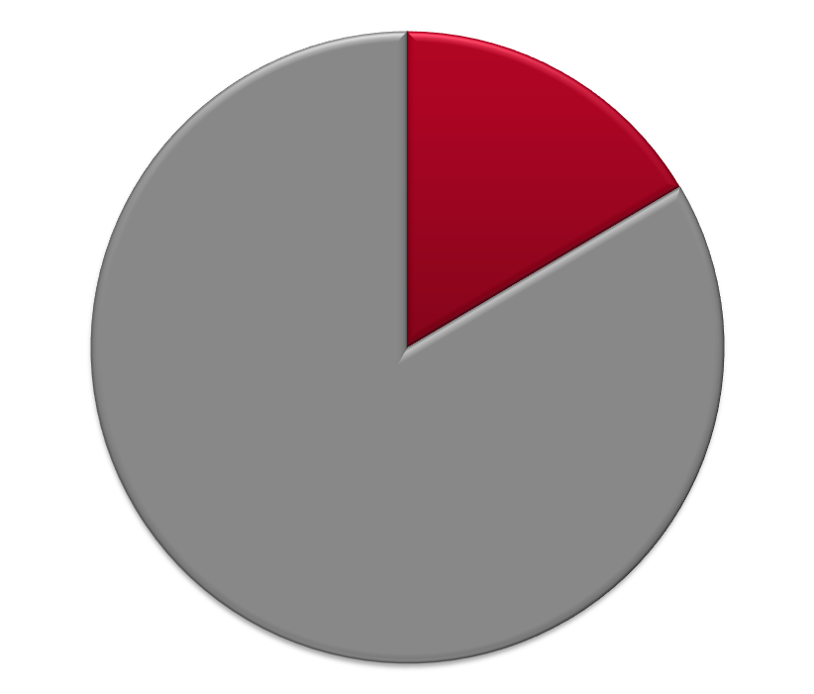
University Budget Funding Sources 2015-17 Biennium - $2.297 Billion Total
Capital 13%
$296.7M
$2.0B
Operating 87%

Slide 5
2015-17 Capital Budget Fund Expenditures Total Authority: $311.7 M Projected Expenditures: $296.7 M (includes Reappropriation Balances)
Parking 1%
WSU Building/Land Grant Endowment
16%
Local/Private 53%
State General Obligation Bonds
26%
S&A Fees & Athletics less than1% each
Housing & Dining 4%
Notes:
State General Bonds: Vancouver Applied Tech and Riverpoint Bio Medial Facility (breaks ground today), Minor Capital Renovations.
Building/Land Grant: MCR, pre-design for an Ag Animal Health Facility and design for a Clean Tech laboratory.
Housing/Dining: Major renovations (North Side, Duncan Dunn)
Athletics: Martins Stadium Remodel

Slide 6
2015-2017 Operating Budget Fund Sources – Estimated Total: $2.0 Billion
Net Investment Income - 6%
Other
1%
Gifts/Endowment – 4%
*Net Operating Tuition & Fees
24%
Federal Appropriations
1%
*State Appropriations
16%
Net Restricted Student Fees
4%
Auxiliary Enterprises
14%
Federal Grants & Contracts
16%
Ed Dept Sales & Services
2%
Local Grants & Contracts
3%
State Grants & Contracts
9%
* Available for allocation
Notes:
Provide examples of different activities associated with each part of the chart.

Slide 7
Understanding the University Budget Overview
Funding Sources Within the University Budget
WSU Budgeting Principles
How the University Receives State Funding
Uses of the 2015-17 Biennial Budget
Looking Ahead

Slide 8
WSU Budget Principles
General funding is tracked by campus
Funding is credited to the campus that generates it through enrollment or research
Budget allocations are provided by the Budget Office to areas/campuses
Areas/campuses determine distribution of funding to their departments

Slide 9
WSU Budget Principles Special Funding Categories
Funding routed to responsible areas
•
Donated Funds
•
Facilities & Administration recoveries (aka F&A)
Policies dealing with budget savings/shortfalls
•
Allocation Transfers
•
Salary Accruals
•
Carryforward Balances

Slide 10
WSU Budget Principles Donated Funds
100% of donated funds go
to area specified by donors
WSU is one of only a few institutions that do not “tax” donated funds
* 3% fee on bequests and liquidations of trusts

Slide 11
WSU Budget Principles Distribution of F&A Revenue
For more information: BPPM 40.25

Slide 12
WSU Budget Principles Distribution of Generating Units F&A
23% of F&A revenue is distributed to revenue-generating units
Distributions are made in one of three ways:
PULLMAN CONTRACTS
URBAN CAMPUS CONTRACTS
WITH Academic Unit Affiliation
URBAN CAMPUS CONTRACTS
WITHOUT Academic Unit Affiliation
Department: 15%
Dean: 8%
Academic Dean: 11.5%
Chancellor: 11.5%
Chancellor: 23%

Slide 13
WSU Budget Principles Allocation Transfers
Transfers between non-salary objects
OK with Dean’s approval unless restrictions/provisos
Transfers between projects or budgets
OK with Dean’s approval unless restrictions/provisos
Transfers between fund types
Not allowed
Transfers between programs
Reviewed on case-by-case basis

Slide 14
WSU Budget Principles Accruals (Salary Savings) Policy
Central pool provides for turnover costs (sick and annual leave payouts), and PIDs
Areas retain savings from vacant faculty and graduate student positions on WSU program 05 (libraries) and 06 (instruction)
Areas retain savings from the transfer of expenditures to grants (programs 11A-14Y) regardless of employee type
Central captures savings from vacant classified, administrative professional, and non-instructional faculty positions for the first four months. Subsequent accruals are returned to areas upon request
* WSU Vancouver, WSU Tri-Cities, Extension, and Ag Research manage their own accruals.

Slide 15
WSU Budget Principles Carry Forward Policy
What happens to funds at fiscal year end?
Most funds carry forward at the area level. Dean, vice president or chancellor decides if they carry forward at the department level.
Operating budgets
F&A accounts
Donated funds
Some funds do not carry forward
Equipment replacement allocations
Special allocations for specific purposes

Slide 16
Understanding the University Budget
Funding Sources Within the University Budget
WSU Budgeting Principles
How the University Receives State Funding
Uses of the 2015-17 Biennial Budget
Looking Ahead

Slide 17
State of Washington
Biennial Budget Process - Capital
Institutional Budget Requests
(Summer, Even Years)
OFM Scoring Process
Governor’s Budget Recommendation
(December, Even Years)
House Budget
(Spring, Odd Years)
Senate Budget
(Spring, Odd Years)
Conference Committee Budget
Passage by House
Passage by Senate
Signed by Governor
Allotments to Agencies

Slide 18
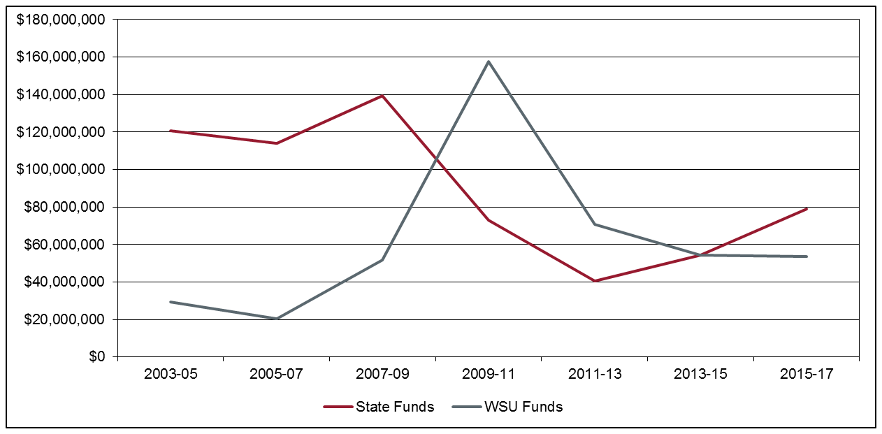
Overall Capital Costs Continue to Shift Mix of Funding between State Funds and WSU Local Funds Including New WSU Debt Authorization

Slide 19
State of Washington
Biennial Budget Process - Operating
Calculation of Agency Budgets
at Carryforward Levels
(Summer, Even Years)
Revenue Estimates
(Summer, Even Years, then updated throughout the process)
Calculation of 601
Expenditure Limits
(Summer, Even Years)
Agency Budget
Request
(Summer, Even Years)
Governor’s Budget Recommendation
(December, Even Years)
House Budget
(Spring, Odd Years)
Senate Budget
(Spring, Odd Years)
Conference Committee Budget
Passage by House
Passage by Senate
Signed by Governor
Allotments to Agencies

Slide 20
State and Tuition Funding per FTE (in 2013 Dollars)
Adjusted for inflation, the total cost of educating a student at WSU has remained steady during 20 years of declining state investments.
Student tuition now covers 59% of the cost of education.

Slide 21
Tuition History
2015-17 Biennium
Resident undergraduate tuition (operating fee portion) reduced by 5% for academic year 2015-16 and will be reduced by an additional 10% in academic year 2016-17, per legislative mandate and funding.
Although authorized to increase tuition by any amount for all other student categories, WSU opted for no tuition increase in academic year 2015-16, per President Floyd.
2013-15 Biennium
No tuition increases, per legislative mandate.
2011-13 Biennium
Governing boards were authorized to increase tuition (including operating and building fees)
For resident undergraduates: up to 16% per year*
(authority established by Legislature in appropriations act each biennium)
For all other categories of students: by any amount
(authority in RCW)
*Institutions had authority for higher increases but would trigger financial aid mitigation requirements.

Slide 22
Understanding the University Budget
Funding Sources Within the University Budget
WSU Budgeting Principles
How the University Receives State Funding
Uses of the 2015-17 Biennial Budget
Looking Ahead

Slide 23
Use of 2015-17 Biennial Budget – By Function State Appropriation and Operating Tuition
Plant Operations & Maintenance 9%
Institutional Support
10%
Instruction
50%
Student Services
5%
Library 2%
Primary Support
9%
Public Service
6%
Research
9%

Slide 24
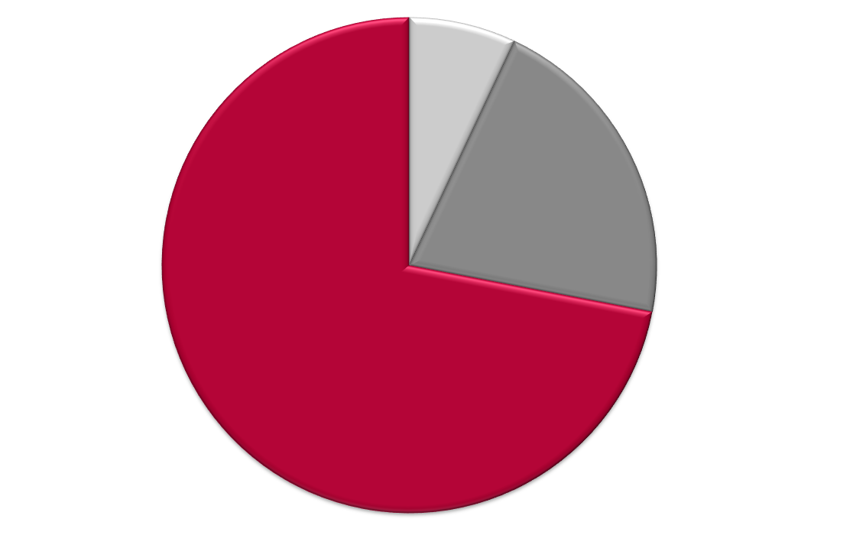
Use of 2015-17 Capital Budget – By Expense Type State Appropriation, Land Grant Income, and Student Building Fees
Preventative Maintenance
(Operating) – 7%
Minor Capital Projects – 20%
Major Capital Projects – 73%

Slide 25
Use of 2015-17 Operating Budget – By Expense Type State Appropriation and Operating Tuition
Operations
15%
Benefits
18%
Salaries and Wages
67%

Slide 26
Understanding the University Budget
Funding Sources Within the University Budget
WSU Budgeting Principles
How the University Receives State Funding
Uses of the 2013-15 Biennial Budget
Looking Ahead

Slide 27
2017-19 Operating Budget WSU Request
OPERATING Medical Education, Elson S. Floyd College of Medicine $10.8M
Salaries for Faculty, Staff, and Graduate Students $37.0M
(4% for each of the two years)
Center for Advanced Manufacturing and Aerospace $ 5.0M
(Vancouver and Everett)
Maintenance and Operations for New Buildings $ 1.6M
Research for Spokane – One Health Initiative $ 1.2M
Collective Bargaining Agreements Various

Slide 28
2017-19 Operating Budget WSU Request
CAPITAL
Pullman Plant Sciences (REC5) Construction $58.90M
Pullman Global Animal Phase 2 Construction $38.10M
Tri-Cities Academic Building Design $ 3.00M
Minor Capital Improvement (MCI/Equipment) Pool $21.75M
Minor Capital Preservation (MCR) Pool $42.50M
STEM Teaching Labs/Bld. Infrastructure Upgrades Renovation $ 4.90M
Upgrades
Pullman Life/Physical Sciences Building Predesign/Design $ 3.50M
Vancouver Life Sciences Building Predesign $ 0.50M
Pullman Security-Building Card Key Access Infrastructure $ 4.75M
Renovation for Consolidated University Data Center Renovation $ 4.95M
Pullman Life/Safety/BAS Building Systems Infrastructure $ 4.90M
Spokane Teaching Lab/Clinical Research Renovation $ 4.99M
TOTAL $192.7M
Side-by-side charts of the 2015-17 budget operating and capital proposals from the Governor and the Legislature can be found at: https://budget.wsu.edu/state-budget/index.html

