Slide 1
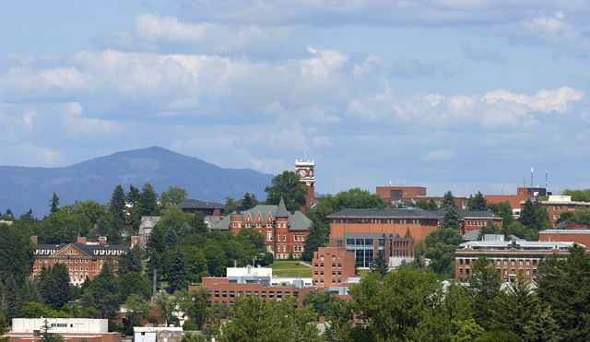
WSU Research Administration Series: Life Cycle of a Sponsored Project
Diane Rathbun, Office of Research Support & Operations
Brian Dentler, Sponsored Program Services
September 30, 2016
Notes:
This series is approximately 10 years
So many changes in research administration
Information is never current for very long

Slide 2
Recording date of this workshop is
September 30, 2016
Some of the rules and procedures discussed in this workshop are subject to change.
Please check university resources
before relying exclusively
on this recorded presentation.

Slide 3
Why are we here today?
This 12 part series is designed for those employees who have sponsored management responsibilities to gain a better understanding of what research administration is made up of - the pre-award and post-award processes, requirements and compliance from A to Z.

Slide 4
Session One Agenda
Research Life Cycle Resources Across Campus:
Research Advancement & Partnerships
Office of Research Support & Operations
Sponsored Programs Services
Office of Research Assurances
Office of Commercialization
Internal Audits

Slide 5
SPONSORED RESEARCH
DIRECT GUIDANCE
Research Advancement &
Partnerships
Pre-Proposal Development
Locates Funding Sources
Conducts Writing Classes
Proposal Development
Provides proposal writing assistance/classes
Budget assistance
ORSO
Office of Research Support & Operations
Proposal & Award Processing
Drafts/negotiates contracts
Prepares/Reviews Budgets
Review/submit proposals
Coordinate w/SPS for change requests & allocations
PI dashboard
Confidentiality/Material Transfers
Obtains non-disclosure agreements
Handles material transfer agreements
No money, licensing, equipment agreements
SPS
Office of Sponsored Programs Services
Award Set-up
Coding, budget allocation
Activates accounts
Invoicing/Reporting
Invoicing, Reports
Cost share
Reports Program Income
Payment Processing
Receipt payments
Subcontract Invoices
Account Closing
FFR, invention, property reports
Inactivation
Sub-Recipient Monitoring
Submits FFATA reporting
Assists with Sub-recipient compliance

Slide 6
SPONSORED RESEARCH
Support Guidance
ORA
Office of Research Assurance
Law & Regulation Compliance/Policy
Export controls (IBC)
hazardous waste & shipment, radiation (IRC)
Use of humans & animals for research (IACUC)
Reviews possible research misconduct
Post Award Approval Review (PAR)
Assists with compliance
OC
Office of Commercialization
Submits Applications
Invention Disclosures
Patent, Copyright, Trademarks
Assists with Protection
Scholarly & Educational Material
Intellectual Property
Technology Transfer
OIA
Office of Internal Audit
Audits
Conducts Internal financial audits
Ethic Audits
Operational Audits
Fraud Investigations
Completes Risk Evaluations
Unannounced Cash counts
Control Systems
Develops Control Systems
Creates Policies & Procedures
Audit Liaison
Assists departments with internal controls
Acts as Liaison between departments, external auditors
Attends auditors entrance & exit meetings

Slide 7
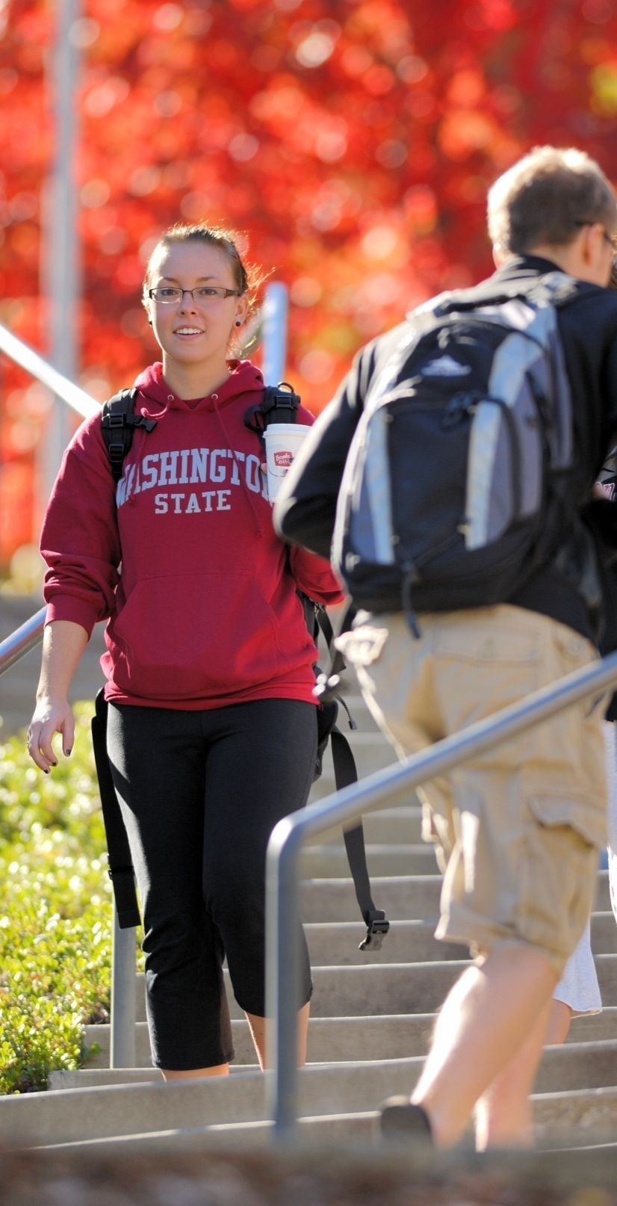
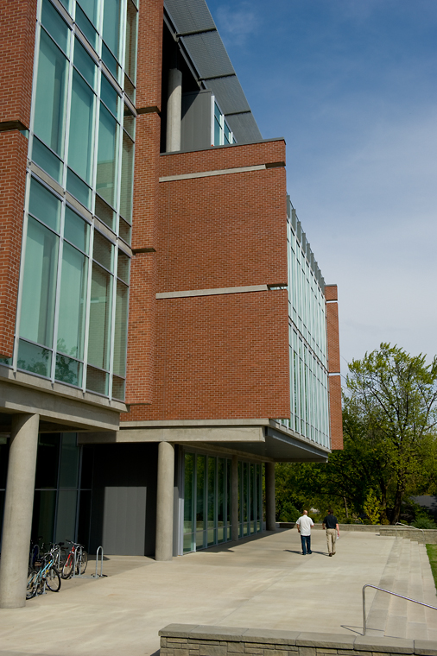
Office of Research Advancement & Partnerships Pre-Award
Notes:
Started in 1973

Slide 8
Research Development Resources
Identify & Disseminate Funding Opportunities
COS Pivot funding database & training
Informer
Limited submission Competitions
Large Multi-disciplinary Projects &
Single Investigator Support
RFP review, timeline assistance, meeting coordination
Templates/models development, editing & budget support
Serve as a point-of-contact for collaborating partners
Help with special needs and proposal submission
Notes:
Identification of Funding Sources – contact Sammy Rodriguez-Flecha (samuel_rodriguez@wsu.edu)
• COS Pivot Funding Database – Available to all WSU faculty, staff and students. To sign-up go to http://pivot.cos.com.
• COS Training Workshops, tutorials, help and individually tailored searches upon request.
• Informer - website & monthly email: http://informer.ogrd.wsu.edu/
• Limited Submission - Listserv and coordination.

Slide 9
Training and Outreach
Grantsmanship Training
Writing Winning Grants Seminar
Mentored Proposal Writing Program
Productive Proposal Writing Class
Grant Writing Resources
Library of resources
Outreach & Collaboration Building Activities
Coordinate meetings, workshops, seminars and state-wide outreach activities
Coordinate WSU internal grant competitions
Promote prestigious faculty awards & provide applicant support
Notes:
Grantsmanship Training
• Write Winning Grants Seminar - Dr. Peg AtKinson– contact nshrope@wsu.edu
• Mentored Proposal Writing – Faculty may competitively apply for this program. Dr. AtKinson provides individual mentorship, critiques, advice and review as PI’s create a proposal for submission to a federal agency. - contact samuel_rodriguez@wsu.edu
• Productive Proposal Writing Class – Chair nominated, eight-class course for newer faculty, walking them through the process of writing a proposal. Includes peer review, discussions with senior faculty and optional proposal review by OGRD staff.
Grantwriting Resources: – Sammy Rodriguez or Nancy Shrope
• Provide sample proposals, templates & tutorials
.

Slide 10
ORSO Office of Research Support & Operations Pre-Award
Notes:
Started in 1973

Slide 11
ORSO
Proposal and Award Processing
Review & Authorize Proposals
Provide guidance on RFP compliance/help with forms
Review of final proposal, budget
Submission of proposal to sponsor
Tracking & monitoring of proposal
Review, accept and negotiate Contracts and Awards
Review contractual language, negotiate as needed
Prepare & Execute Standard Agreements & Contracts
Draft various subawards, agreements & contracts
Material transfer, non-disclosure, no-money, data set & equipment loan agreements

Slide 12
ORSO
Proposal and Award Processing
Certify and assure university adherence to governmental policies
U.S. Code of Federal Regulations and other
federal regulations
Uniform Guidance; OMB Circulars
Revised Code of Washington (Title 28B)
WSU Business Policies & Procedures Manual
WSU’s Faculty Manual
Monitor and report sponsored project activity
Work with sponsor on change requests
Work with SPS and sponsor on award changes
Help with additional materials
Advise faculty, staff & graduate students on these functions & activities
Notes:
What applies? Most important for research are the circulars: in the process of being revised into just one circular
OMB Circulars:
A-21 Cost Principles for Educational Institutions
A-110 Uniform Administrative Requirements for Grants and other Agreements with Institutions of Higher Education
A-133 Audits of States, Local Governments, and Non-Profit Organizations

Slide 13
ORSO
ORSO Updates
Cool Stuff
Online eREX for routing and approvals
PI Dashboard
2,862 proposals totaling $912.5M (FY16)
1,783 awards totaling $219.2M (FY16)
40,213 log items inside the MyResearch grants database
Reporting is HUGE
Work with Institutional Research to give them all our numbers to determine WSU's national ranking
Data shack or canned reports are now available through MyResearch
(Training provided: contact Derek Brown for dates)

Slide 14
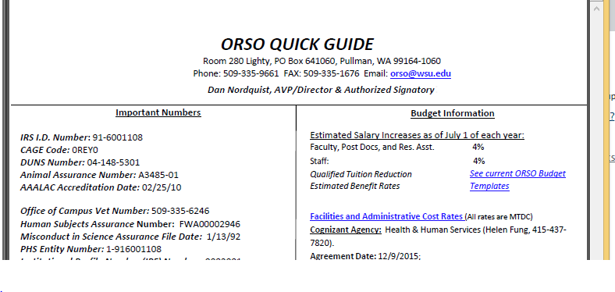
ORSO
Important Websites/Resources

Slide 15
ORSO
Important Websites/Resources
http://orso.or.wsu.edu/
RAC list, quick guide, policies, guidelines, templates, etc.
https://myresearch.wsu.edu
ORSO Database
www.grants.gov; https://www.fastlane.nsf.gov/fastlane.jsp
Federal generic proposal submission sites
informer.or.wsu.edu
funding opportunities
www.youtube.com/user/WSUOGRD
Grant & funding tips for the greater WSU community
http://www.facebook.com/pages/Office-Grant-Research-Development-OGRD-WSU/185924391445269?ref=hl
Find us on Facebook

Slide 16
SPS Office of Sponsored Programs Services Post-Award
Notes:
Started in 1973

Slide 17
SPS’s Role As WSU Post Award Office
Provide fiscal administration.
Educate and train.
Establish accounts and input budget allocations.
Maintain data systems and project files.
Prepare, submit & record financial reports & associated payments.
Subcontract payments.
Periodically notifying departments of overdrafts.
Draw funds from federal government, prepare receipts for checks and electronic funds transfers.

Slide 18
Award & Sub-Contract Set-up
Reviews Award for Key Terms and Conditions
Creates Billing Instructions; Records Award Information for Tracking & Reporting
Establishes Accounts in Databases; Activates Account Number
Notes:
Review award for POP, Equipment, Invoicing/Reporting, Unspent balances at term
AGENCY APPROVED BUDGET
IMPORTANT TO HAVE MOST UPDATED ACCOUNT SETUP INFORMATION –MOST RECENT APPROVED BUDGETS, ACCOUNT NUMBERS
Many of you have seen the new Billing instructions- evolving process, thank you for your patience
Upon data entry you will see the 15 screen, 15x screen right away – the allocation will be released and show in the 01 balances screen in the next day few days.
PI dashboard – update to ACCT – SPS has finalized their process Sometimes TO ACCT will show before the acct is setup due to our review process. –internal control and review

Slide 19
Guarantees
Executed Award or Amendment Not Received
Request on a Sponsored Project Activity Request Form
(BPPM 40.23.10)
SPS will remove GUAR after receiving Executed Award
Notes:
GUAR against a dept account in the event the executed award is denied. GUAR for time, money or both. Allows the PI to spend on the account prior to receiving the award. Once SPS receives award, GUAR code removed, allocation released, account information updated. GUAR and SPAR are not the same thing, but uses the same form. Serves two different purposes – 1st half of form used for GUAR, 2nd half for SPARs (ie. Internal rebudgets)

Slide 20
Invoicing & Reporting
Works with department to create monthly, quarterly, final invoices, financial status reports
Monitors Sub-Recipient payments and process payment
Track Cost Share & Reporting

Slide 21
Review Process
Review of expenditures for allowable, reasonable, allocable and consistent treatment
Approves and Processes SPAR’s, EEA’s, ETR’s, Grad Student Support Memos
Notes:
Please ensure explanations meet the necessary requirements and make sense for the SOW and POP and all required signatures. audit findings.

Slide 22
Closing
Coordinate for final invoicing/reports
Review of the requirements within Federal, Sponsor, and University Policy/Regulations
Final Financial & Invention Reports, etc
Closing of Accounts
Time Extensions: Only if scope of work is unfinished, NOT because there is money left over to spend
Clear overdrafts
Zero Objects/De-obligations
Close Account w/in 90 days

Slide 23
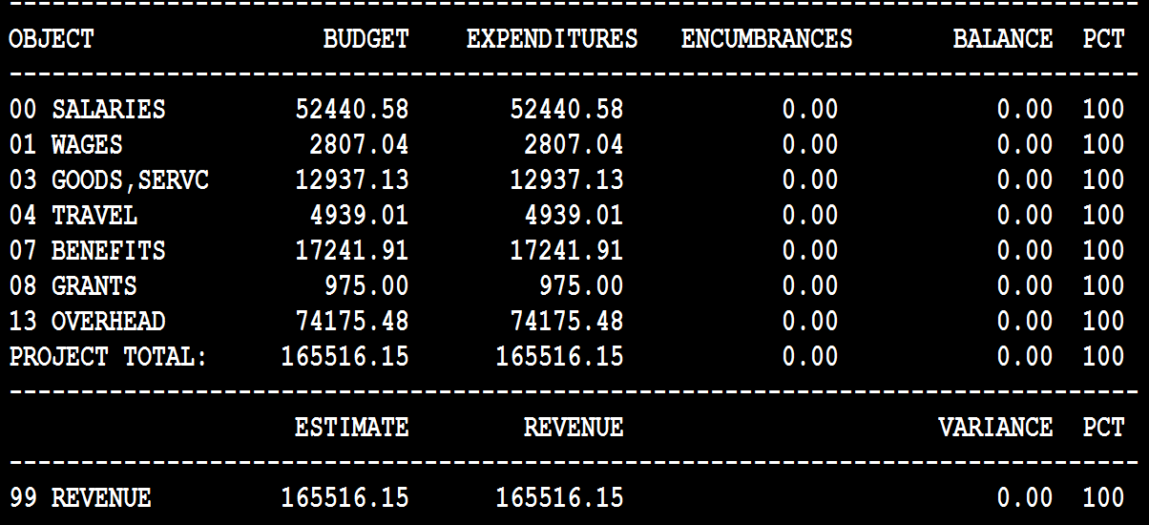
Ready to Close

Slide 24
SPS Updates
F&A Rates
Stipends / Fellowship Payments
Subrecipient Monitoring
Cost Transfers
Effort Reporting
Notes:
Current Rate is at 51% - new rate being negotiated
Stipends/fellowship payments must be under object 08-no longer going through as payroll (wages)
UG: Monitoring piece of subrecipient monitoring : dept keep really good records of all contact with recipient, if holding subcontract invoices need quick and thorough documentation (30D to pay)
Cost Transfers : auditors completing desk reviews and cost transfers are questioned-name unacceptable reasons for cost tranfers
Effort Reporting: investigating opportunities to change current practice

Slide 25
SPS Website
http://sps.wsu.edu/
Contact information
Expenditure Information in various formats
Notes:
Website in planning stage to update and revise

Slide 26
ORA Office of Research Assurances
Notes:
Started in 1973

Slide 27
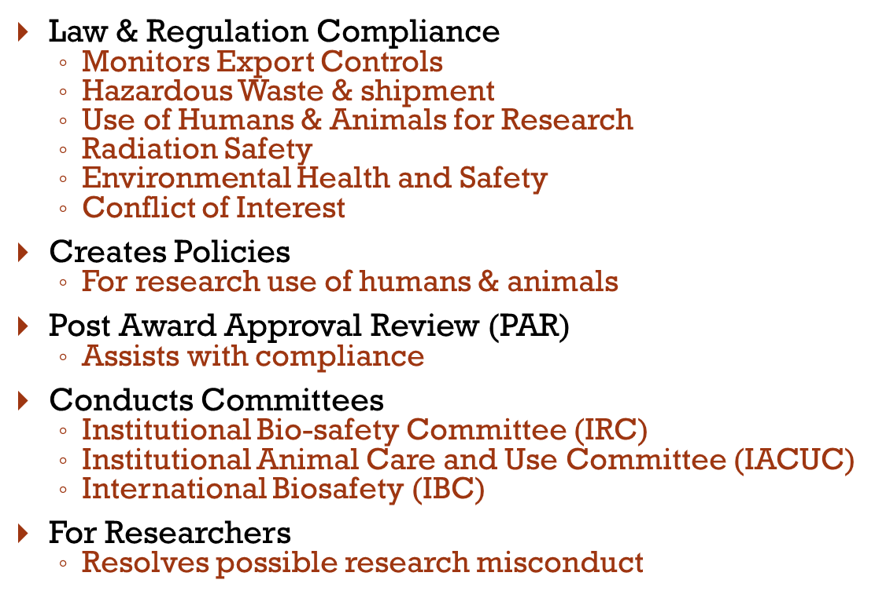
Compliance Issues

Slide 28
When might SFI/COI apply to a faculty member?
Engaging in intellectual property activities
Office of Commercialization
Engaging in Sponsored Agreements, Subcontracts, or Facility Use Agreements, where you are an owner of a company working with WSU
Grants from Public Health Services and Adopting Sponsor Grants (HHS/PHS)
Significant Financial Interest
Outside salary and payments for service (overlap with institutional responsibilities)
Consulting, working at start up company, Membership on advisory board, etc.
Equity interest (overlap)
Third Party Sponsored travel
Gifts
A gift of greater than $50 from an outside entity is a significant financial interest;
Family connected to activities above

Slide 29
OC Office of Commercialization
Notes:
Started in 1973

Slide 30
OC Purpose
-Supports, nurtures, guides, sustains commercialization efforts for the University
Process disclosures of Inventions
Assists with Patents, Copyrights, Plant variety protection, Trademarks
Assists with protection of trade secrets and knowhow
Licensing and start-up company development
Signs Confidentiality disclosure agreement with agency/company

Slide 31
Audits

Slide 32
Purpose of Audits
Required
By accepting federal money, grantee agrees to comply with rules
Grantor has an expectation for
Accountability
Proper stewardship
Terms carried out – results, product, service, etc.

Slide 33
Role of WSU Internal Audit
Act as liaison between WSU and external auditor
With SPS and unit, ensure information requested is provided complete and accurate to support conclusions
Work with auditor on reporting
Internal advisory for management on controls, policy, training
Audits and investigations

Slide 34
Types of Audits
Compliance
Circular A-133, ‘Single Audit’
Program reviews
Financial Statement
Operational
Reviews
assessments
Investigations

Slide 35
Effects of a Negative Audit Report
Loss of future awards
Bad publicity
Potential undermining of public trust and confidence in agency and government
Personal losses

Slide 36
Audit reminders
When approached by external auditor:
Always verify auditor’s credentials before giving information
Notify supervisor and SPS
Notify Internal Audit
Be prepared
Be organized
Do it right the first time
Notes:
SPS wants to be represented at all reviews-site and financial in order to provide support

Slide 37
Resources
WSU Sponsored Programs Services
WSU Office of Research Support & Operations
Internal Audit – 5-5336, hlopez@wsu.edu
OMB Circulars - http://www.whitehouse.gov/omb/circulars/
SAO – http://www.sao.wa.gov
Uniform Guidance –
https://www.whitehouse.gov/omb/grants_docs
Office of Research Assurances www.ora.wsu.edu
Office of Commercialization http://commercialization.wsu.edu/Contacts/
Notes:
Reminder: Part of ongoing in-depth series. All topics have classes of their own.

Slide 38
Proposal Development
Generate Idea
Begin Creating Proposal*
Find Collaborators*
Create a one page proposal pitch*
Seek Funding for Idea*
Proposal Prepared* w/ help from Dept. RA, advisors and team
Proposal uploaded to eREX & submitted for electronic approval (at least 2 days prior to due date.)
Proposal Reviewed & budget approved
by Dept. RA
Proposal Denied: Improve Idea and/ or look for other funding*
eREX Approved & Routed to ORSO
ORSO reviews Proposal and submits it to agency
AWARDED!
Now the fun begins.
*ORAP available for assistance, orap.or.wsu.edu.

Slide 39
AWARDED!
Now the fun begins
Research Compliance Protocols Needed? Work with ORA
Subawards? Work with RA and ORSO
ORSO Receives award
ORSO has Dan Nordquist sign award & returns it to the agency for execution (if needed)
ORSO Reviews award for acceptance, negotiates changes as needed
ORSO routes to Dept/RA & PI for review (if needed)
Dept/ RA returns award to ORSO with approval &/or changes to be made
ORSO sends Executed copy of award to SPS
If changes to project after awarded work with RA and ORSO
SPS sets up WSU Account, manages invoices & financial reports

Slide 40
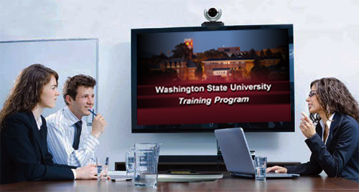
This has been a WSU Training Videoconference
If you wish to have your attendance documented in your training history, please notify Human Resource Services within three days of today's date: hrstraining@wsu.edu

