Slide 1

Understanding the University Budget
Kelley Westhoff
Operating Budget Director
March 21, 2017

Slide 2
Recording date of this workshop is
March 21, 2017
Some of the rules and procedures discussed in this workshop are subject to change.
Please check university resources
before relying exclusively
on this recorded presentation.

Slide 3
Understanding the University Budget
Overview
Funding Sources Within the University Budget
WSU Budgeting Principles
How the University Receives State Funding
Uses of the 2015-17 Biennial Budget
Looking Ahead

Slide 4
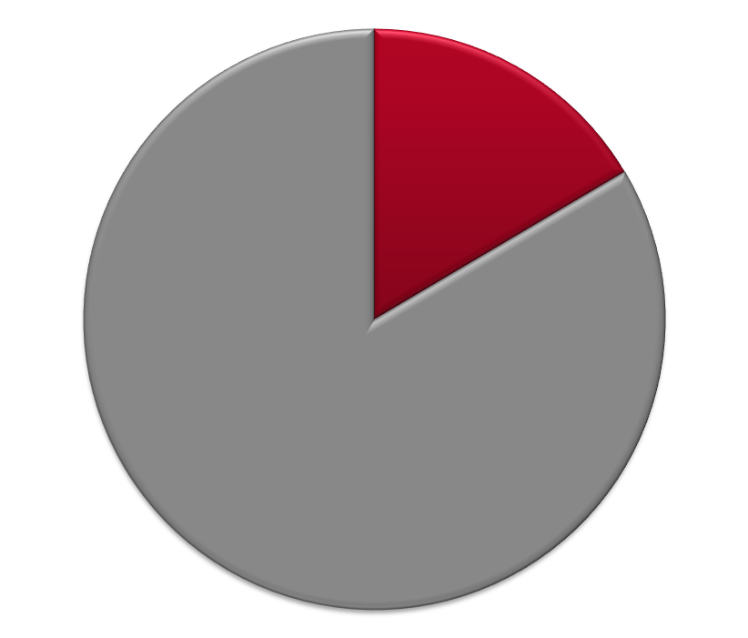
University Operating & Capital Budgets
2015-17 Biennium - $2.297 Billion Total
Capital
13%
$296.7M
$2.0B
Operating
87%

Slide 5
2015-17 Capital Budget
Total Authority: $311.7 M Projected Expenditures: $296.7 M
(includes Re-appropriation Balances)
Parking
1%
WSU Building/Land Grant Endowment
16%
Local/Private
53%
State General Obligation Bonds
26%
S&A Fees & Athletics
less than1% each
Housing & Dining
4%
Notes:
State General Bonds: Vancouver Applied Tech and Riverpoint Bio Medial Facility (breaks ground today), Minor Capital Renovations.
Building/Land Grant: MCR, pre-design for an Ag Animal Health Facility and design for a Clean Tech laboratory.
Housing/Dining: Major renovations (North Side, Duncan Dunn)
Athletics: Martins Stadium Remodel

Slide 6
2015-2017 Operating Budget
Fund Sources – Estimated Total: $2.0 Billion
Net Investment Income - 6%
Other
1%
Gifts/Endowment – 4%
*Net Operating Tuition & Fees
24%
Federal Appropriations
1%
*State Appropriations
16%
Net Restricted Student Fees
4%
Auxiliary Enterprises
14%
Federal Grants & Contracts
16%
Ed Dept Sales & Services
2%
Local Grants & Contracts
3%
State Grants & Contracts
9%
* Available for allocation
Notes:
Provide examples of different activities associated with each part of the chart.

Slide 7
Sources of Funds for Core University Functions
State Appropriations
Net Operating Tuition
Facilities & Administrative (F&A) Fees on Grants and Contracts
All are used to fund the permanent operating budget of the University

Slide 8
Understanding the University Budget
Overview
Funding Sources Within the University Budget
WSU Budgeting Principles
How the University Receives State Funding
Uses of the 2015-17 Biennial Budget
Looking Ahead

Slide 9
WSU Budget Principles
General funding is tracked by campus
Funding is credited to the campus that generates it through enrollment or research
Budget allocations are provided by the Budget Office to areas/campuses
Areas/campuses determine distribution of funding to their departments

Slide 10
WSU Budget Principles
Special Funding Categories
Funding routed to responsible areas
•
Donated Funds
•
Facilities & Administration recoveries (aka F&A)
Policies dealing with budget savings/shortfalls
•
Allocation Transfers
•
Salary Accruals
•
Carryforward Balances

Slide 11
WSU Budget Principles
Donated Funds
Currently, 100% of donated funds go
to area specified by donors
WSU is one of only a few institutions that
do not “tax” donated funds*
* 3% fee on bequests and liquidations of trusts

Slide 12
WSU Budget Principles
Distribution of F&A Revenue
For more information: BPPM 40.25

Slide 13
WSU Budget Principles
Distribution of Generating Units F&A
23% of F&A revenue is distributed to revenue-generating units
Distributions are made in one of three ways:
PULLMAN CONTRACTS
URBAN CAMPUS CONTRACTS
WITH Academic Unit Affiliation
URBAN CAMPUS CONTRACTS
WITHOUT Academic Unit Affiliation
Department: 15%
Dean: 8%
Academic Dean: 11.5%
Chancellor: 11.5%
Chancellor: 23%

Slide 14
WSU Budget Principles
Allocation Transfers
Transfers between non-salary objects
OK with Dean’s approval unless restrictions/provisos
Transfers between projects or budgets
OK with Dean’s approval unless restrictions/provisos
Transfers between fund types
Not allowed
Transfers between programs
Reviewed on case-by-case basis

Slide 15
WSU Budget Principles
Accruals (Salary Savings) Policy
Central pool provides for turnover costs (sick and annual leave payouts), and PIDs
Areas retain savings from vacant faculty and graduate student positions on WSU program 05 (libraries) and 06 (instruction)
Areas retain savings from the transfer of expenditures to grants (programs 11A-14Y) regardless of employee type
Central captures savings from vacant classified, administrative professional, and non-instructional faculty positions for the first four months. Subsequent accruals are returned to areas upon request
* WSU Vancouver, WSU Tri-Cities, Extension, and Ag Research manage their own accruals.

Slide 16
WSU Budget Principles
Carry Forward Policy
What happens to funds at fiscal year end?
Most funds carry forward at the area level. Dean, vice president or chancellor decides if they carry forward at the department level.
Operating budgets
F&A accounts
Donated funds
Some funds do not carry forward
Equipment replacement allocations
Special allocations for specific purposes, such as proviso funds

Slide 17
Understanding the University Budget
Funding Sources Within the University Budget
WSU Budgeting Principles
How the University Receives State Funding
Uses of the 2015-17 Biennial Budget
Looking Ahead

Slide 18
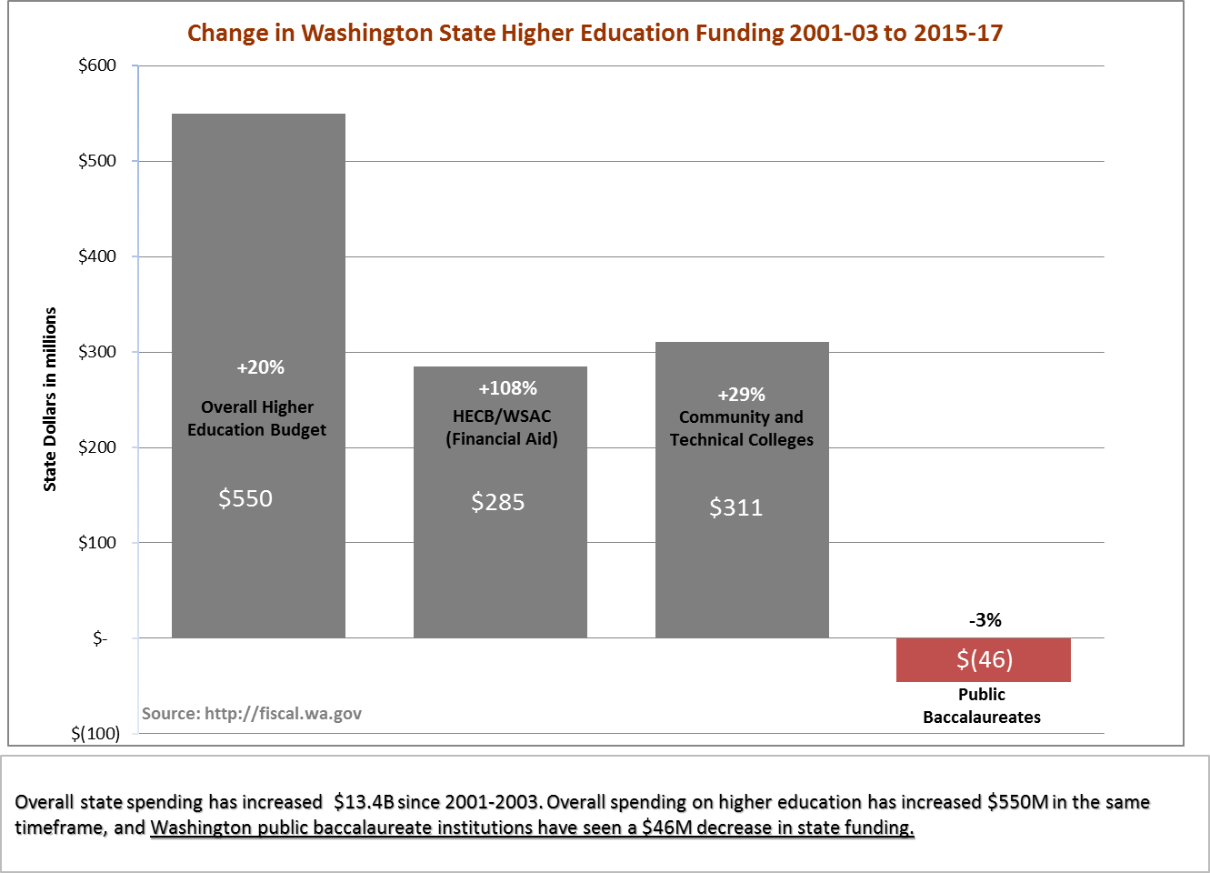
State Funding for the Higher Ed Sector
The Higher Education Sector is about 9%
of the total State budget

Slide 19
State of Washington
Biennial Budget Process - Operating
Calculation of Agency Budgets
at Carryforward Levels
(Summer, Even Years)
Revenue Estimates
(Summer, Even Years, then updated throughout the process)
Calculation of 601
Expenditure Limits
(Summer, Even Years)
Agency Budget
Request
(Summer, Even Years)
Governor’s Budget Recommendation
(December, Even Years)
House Budget
(Spring, Odd Years)
Senate Budget
(Spring, Odd Years)
Conference Committee Budget
Passage by House
Passage by Senate
Signed by Governor
Allotments to Agencies

Slide 20
Tuition Rate History
2015-17 Biennium
Resident undergraduate tuition (operating fee portion) reduced by 5% for academic year 2015-16 and by an additional 10% in academic year 2016-17, per legislative mandate. Backfill state funding was provided.
Although authorized to increase tuition by any amount for all other student categories, WSU opted for no tuition increase in academic year 2015-16, or 2016-17.
2013-15 Biennium
No tuition increases, per legislative mandate.
2011-13 Biennium
Governing boards were authorized to increase tuition
For resident undergraduates: up to 16% per year*
  (authority established by Legislature in appropriations act each biennium)
  For all other categories of students: by any amount
  (authority in RCW)
*Institutions had authority for higher increases but would trigger financial aid mitigation requirements.

Slide 21
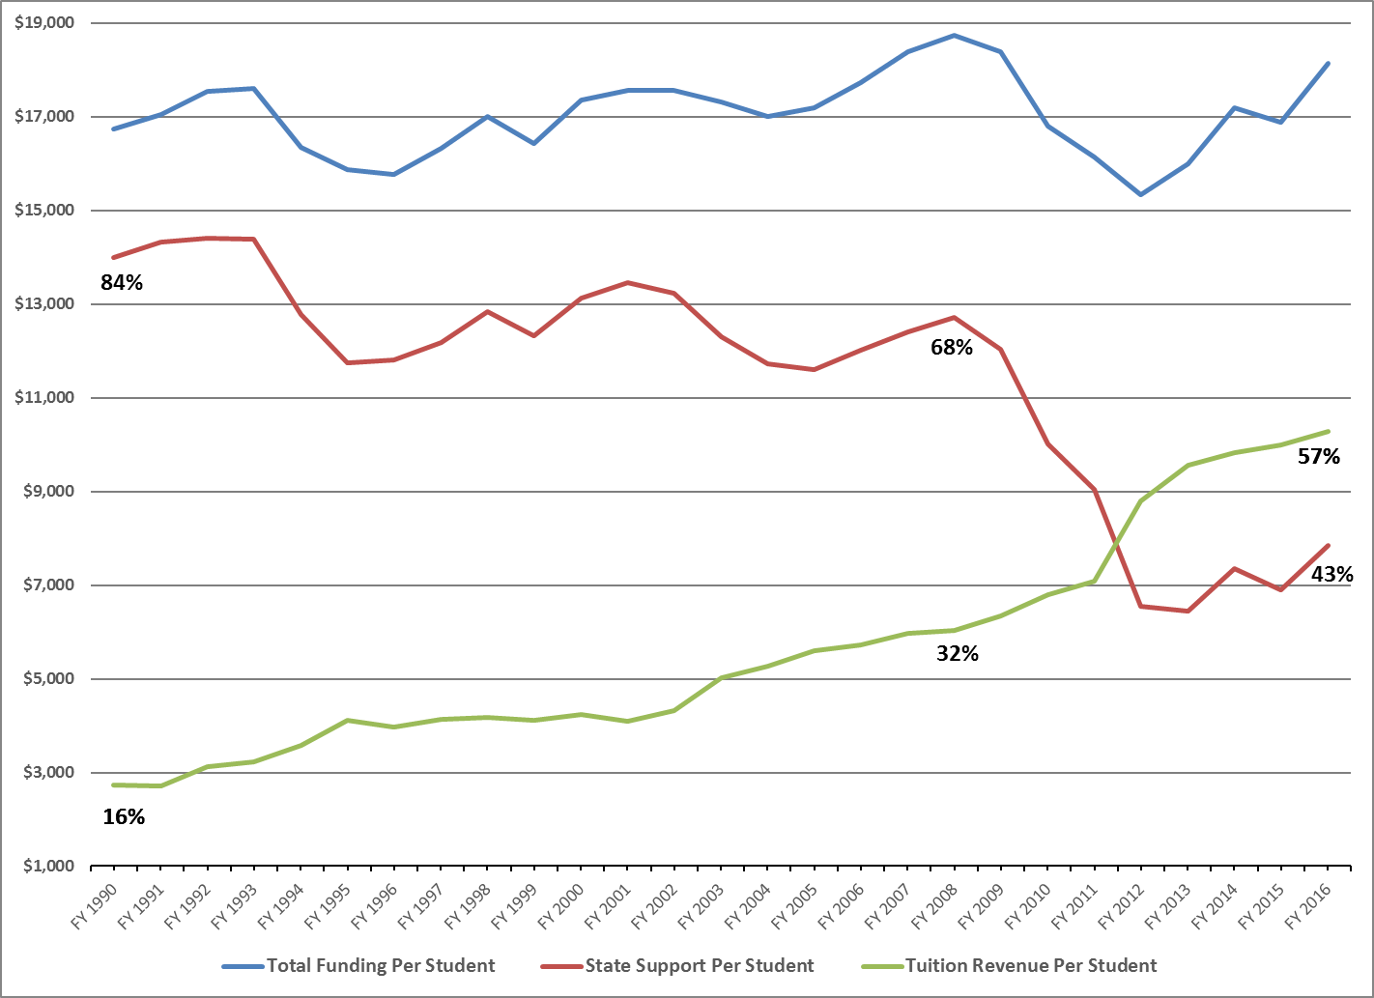
State and Tuition Funding per FTE
(in 2017 Dollars)
Adjusted for inflation, the total cost of educating a student at WSU has remained steady during 20 years of declining state investments.
Student tuition now covers 57% of the cost of education.

Slide 22
State of Washington
Biennial Budget Process - Capital
Institutional Budget Requests
(Summer, Even Years)
OFM Scoring Process
Governor’s Budget Recommendation
(December, Even Years)
House Budget
(Spring, Odd Years)
Senate Budget
(Spring, Odd Years)
Conference Committee Budget
Passage by House
Passage by Senate
Signed by Governor
Allotments to Agencies

Slide 23
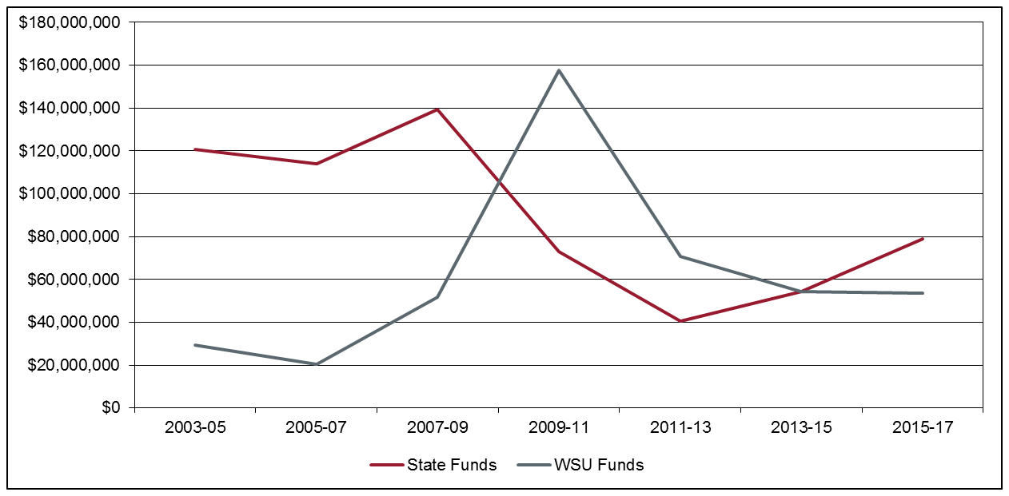
Overall Capital Costs Continue to Shift
Mix of Funding between State Funds and WSU Local Funds Including New WSU Debt Authorization

Slide 24
Understanding the University Budget
Funding Sources Within the University Budget
WSU Budgeting Principles
How the University Receives State Funding
Uses of the 2015-17 Biennial Budget
Looking Ahead

Slide 25
Use of 2015-17 Biennial Budget – By Function
State Appropriation and Operating Tuition
Plant Operations & Maintenance
9%
Institutional Support
10%
Instruction
50%
Student Services
5%
Library
2%
Primary Support
9%
Public Service
6%
Research
9%

Slide 26
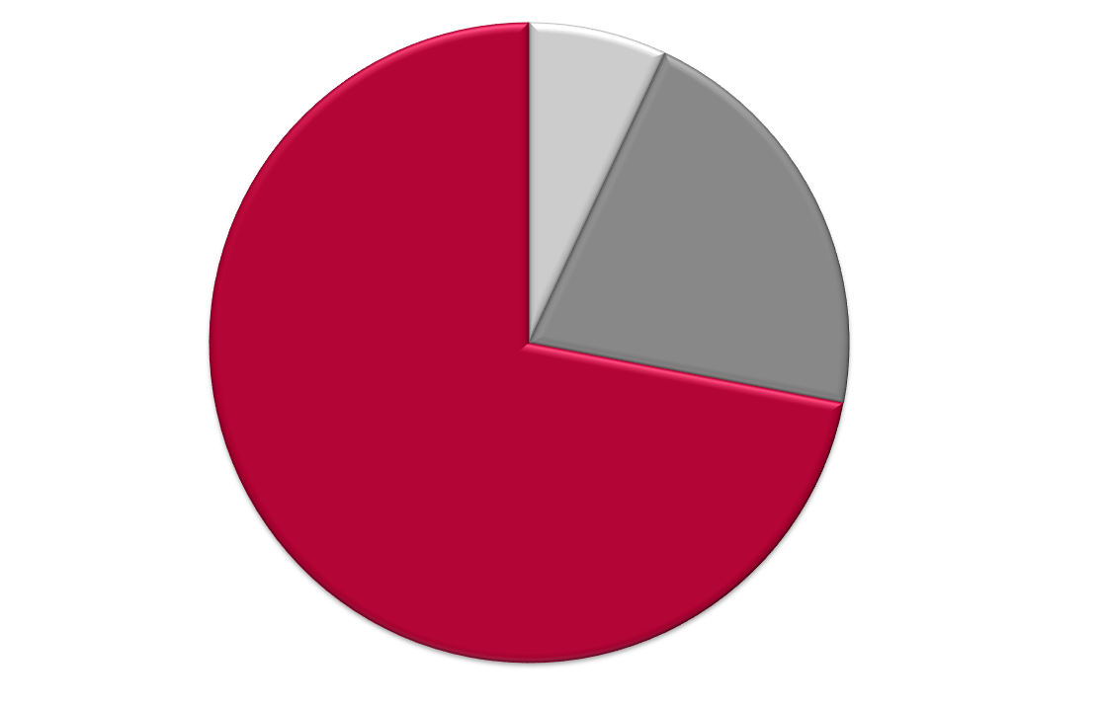
Use of 2015-17 Capital Budget – By Expense Type
State Appropriation, Land Grant Income, and Student Building Fees
Preventative Maintenance
(Operating) – 7%
Minor Capital
Projects – 20%
Major Capital Projects – 73%

Slide 27
Use of 2015-17 Operating Budget – By Expense Type
State Appropriation and Operating Tuition
Operations
15%
Benefits
18%
Salaries and Wages
67%

Slide 28
Understanding the University Budget
Funding Sources Within the University Budget
WSU Budgeting Principles
How the University Receives State Funding
Uses of the 2013-15 Biennial Budget
Looking Ahead

Slide 29
2017-19 Operating Budget
WSU Request
Medical Education, Elson S. Floyd College of Medicine $10.8M
Salaries for Faculty, Staff, and Graduate Students $37.0M
(4% for each of the two years)
Center for Advanced Manufacturing and Aerospace $ 5.0M
(Vancouver and Everett)
Maintenance and Operations for New Buildings $ 1.6M
Research for Spokane – One Health Initiative $ 1.2M
Collective Bargaining Agreements Various

Slide 30
2017-19 Capital Budget
WSU Request
CAPITAL
Pullman Plant Sciences (REC5) Construction $58.90M
Pullman Global Animal Phase 2 Construction $38.10M
Tri-Cities Academic Building Design $ 3.00M
Minor Capital Improvement (MCI/Equipment) Pool $21.75M
Minor Capital Preservation (MCR) Pool $42.50M
STEM Teaching Labs/Bld. Infrastructure Upgrades Renovation $ 4.90M
Upgrades
Pullman Life/Physical Sciences Building Predesign/Design $ 3.50M
Vancouver Life Sciences Building Predesign $ 0.50M
Pullman Security-Building Card Key Access Infrastructure $ 4.75M
Renovation for Consolidated University Data Center Renovation $ 4.95M
Pullman Life/Safety/BAS Building Systems Infrastructure $ 4.90M
Spokane Teaching Lab/Clinical Research Renovation $ 4.99M
TOTAL $192.7M
Side-by-side charts of the 2015-17 budget operating and capital proposals from the Governor and the Legislature can be found at: https://budget.wsu.edu/state-budget/index.html

Slide 31
2017-19 Governor’s Operating Budget
Governor’s biennial budget proposes $4.4 billion in new revenue
  Increases state B&O tax on services from 1.5% to 2.5%
  7.9% capital gains tax on sale of stocks, bonds, other assets
  Carbon pollution tax on emissions from production, consumption of fossil fuels
  Repeal of various tax preferences

Slide 32
2017-19 Governor’s Operating Budget
Proposed for WSU in the Governor’s Budget:
Freezes resident undergraduate tuition at 2016-17 rates for both years of the biennium.
Funds $10.0M of WSU’s $10.8M request for funding to support the first class of 60 students at the Elson S. Floyd College of Medicine beginning fall of 2017.
Provides for salary increases for state employees for both years of the biennium.
Provides $1.086M in new funds for the study of long- and short-term effects of marijuana use.
Provides $1.58M in maintenance and operations funding (on a marginal basis) for new buildings.
Provides funding for implementation of Initiative 1433 which will increase the minimum wage incrementally beginning January 2017 through 2020.

Slide 33
2017-19 Governor’s Capital Budget
Governor Inslee's proposed capital budget actions include:
Funds $58.9 million construction of the Plant Sciences Building
Funds $3 million design of the Tri-Cities Academic Building
Funds $4.9 million renovation of STEM Teaching Labs/Building Infrastructure Upgrades
Funds $500,000 predesign for the Vancouver Life Sciences Building
Funds $33.202 million for Minor Capital Preservation

Slide 34

This has been a WSU Training Videoconference
If you attended this live training session and wish to have your attendance documented in your training history,
please notify Human Resource Services
within 24 hours of today's date:
hrstraining@wsu.edu

Slide 35


