Slide 1
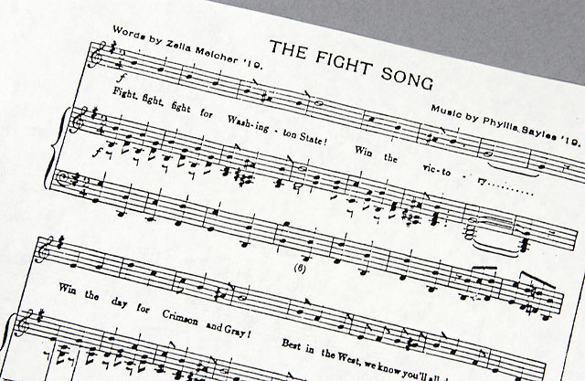
Washington State University Strategic Plan 2014-19
Overview and Implementation Process
On web site at
www.strategicplan.wsu.edu
Updated Jan. 2016

Slide 2
Recording date of this workshop is
January 11, 2016
Some of the rules and procedures discussed in this workshop are subject to change.
Please check university resources
before relying exclusively
on this recorded presentation.

Slide 3
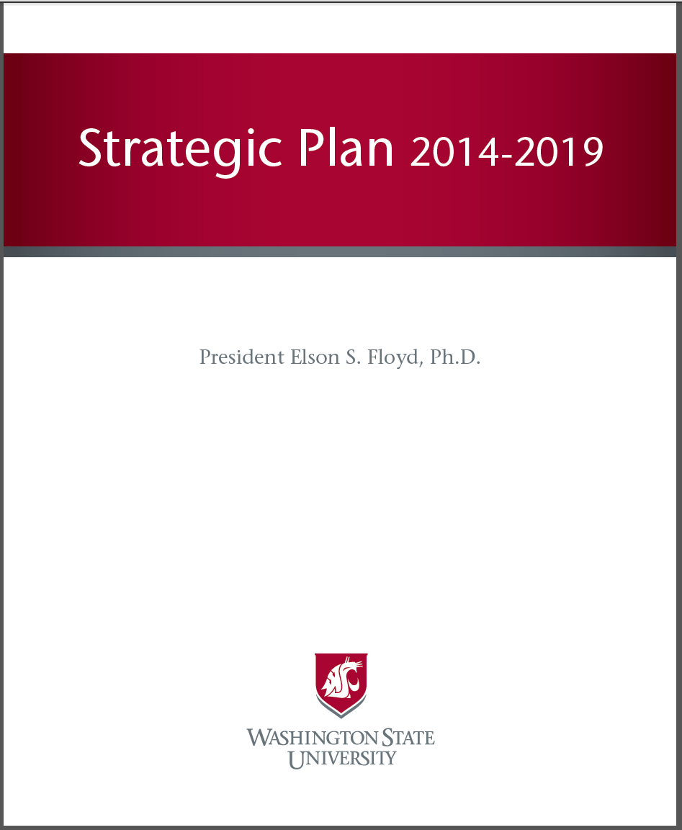
On web site at www.strategicplan.wsu.edu

Slide 4
Strategic Plan web site
www.strategicplan.wsu.edu

Slide 5
It’s important to have a strategic plan
http://upload.wikimedia.org/wikipedia/commons/a/a7/Longleat-maze.jpg

Slide 6
Developing and using a strategic plan creates and fulfills opportunities
Provides direction and focus
Enables accountability
Facilitates celebration of accomplishments

Slide 7
It also is required for accreditation, which:
Enables students to receive federal aid
Enables institution to receive federal funds
Helps students move across institutions
Certifies graduates’ credentials to employers
Communicates verification of quality to the public

Slide 8
Some of what we accomplished under previous strategic plan
Undergrad enrollment up 20%
Increase from 15%-27% ethnically diverse
Largest grant ever: $40M USDA biofuels project
Faculty size grew 8% (mostly clinical)
Sponsored research expenditures up 20%
Publications per faculty FTE up 48%
Enrollment in grad prof. programs > doubled
New UCore curriculum, Common Reading
Vast majority of programs doing assessment
Service learning hours more than doubled
http://strategicplan.wsu.edu/archives/2008-2013/report/

Slide 9
How we created the 2014-19 plan
Iterative committees
Feedback loops
Web site updates for transparency
Approval by Board of Regents
Development of implementation plan

Slide 10
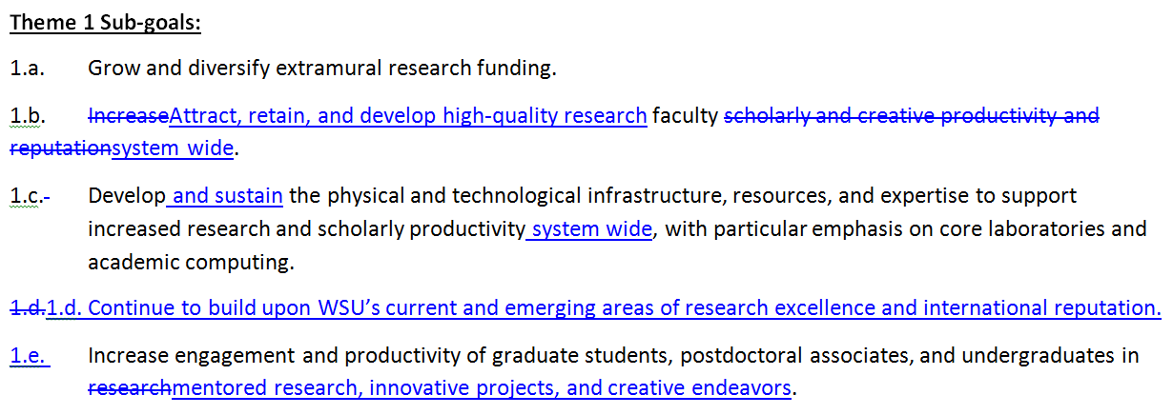
An example of edits based on feedback from groups and individuals

Slide 11
What is new: Our operating environment has changed significantly
Dramatic changes in public funding (52% reduction in state allocations*)
Increased accountability to the state and its citizens
Dramatic and fundamental changes within higher education nationwide
Changing demographics of Washington state
* http://budget.wsu.edu/state-budget/final-biennial-budget.html

Slide 12
Overarching features
“Refresh” – mission, vision, values largely unchanged.
Emphasizes unique mission as a land-grant research university.
More attention to infrastructure needs and resource alignment.
Infuses commitment to diversity and inclusiveness throughout plan.
Emphasizes implementation and measurement of progress.

Slide 13
Vision = How we contribute
Washington State University will be one of the nation’s leading land-grant universities, preeminent in research and discovery, teaching, and engagement.
Our ultimate destination

Slide 14
Mission = Why we exist (Directs how we intend to achieve our vision)
Washington State University is a public research university committed to its land-grant heritage and tradition of service to society. Our mission is threefold:
To advance knowledge…
To extend knowledge through innovative educational programs in which students and emerging scholars are mentored to realize their highest potential and assume roles of leadership, responsibility, and service to society.
To apply knowledge through local and global engagement that will improve quality of life and enhance the economy of the state, nation, and world.

Slide 15
Values = Operating principles
Quality and Excellence
Integrity, Trust, and Respect
Research, Innovation, and Creativity
Diversity and Global Citizenship
Freedom of Expression
Stewardship and Accountability

Slide 16
Two central foci
Offering a truly transformative educational experience to undergraduate and graduate students
Accelerating the development of a preeminent research portfolio

Slide 17
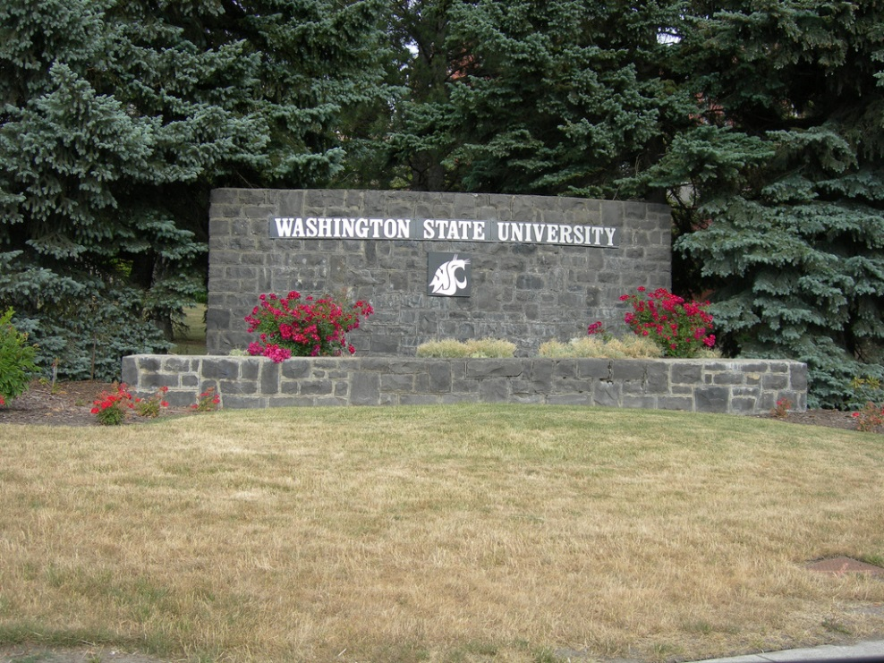
Themes = Summarize intentions
Theme 1: Exceptional Research, Innovation, and Creativity
Theme 2: Transformative Student Experience
Theme 3: Outreach and Engagement
Theme 4: Institutional Effectiveness: Diversity, Integrity, and Openness
https://www.flickr.com/photos/auvet/3750918356/

Slide 18
Mapping of Themes, Goals Sub-goals, Initiatives & Metrics
Themes:
1.____
2.____
3.____
4.____
Goals:
1.____
2.____
3.____
Sub-goals:
1.____
2.____
3.____
4.____
Initiatives:
1.____
2.____
3.____
4.____
Metrics:
1.____
2.____
3.____
4.____

Slide 19
Mapping example Theme 2: Transformative Student Experience
Goal 2: Provide a university experience centered on student engagement, development, and success, which prepares graduates to lead and excel in a diverse United States and global society.
Subgoal 2.d.: Align student recruitment, admissions, and retention system-wide to enhance access, inclusiveness, and student success.

Slide 20
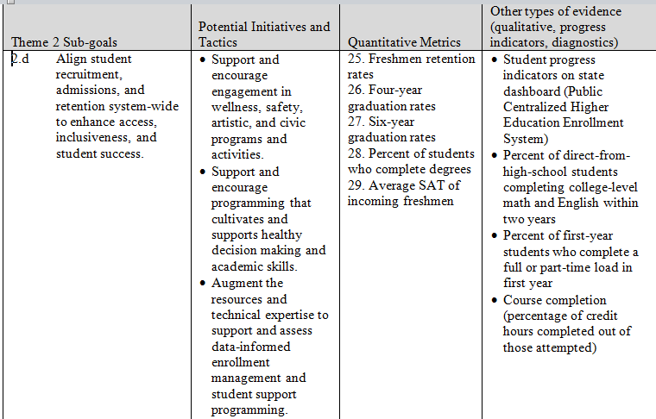
Implementation map

Slide 21
Implementation plan
Strategic planning implementation committee: Institutional Effectiveness Council
Council will define quantitative benchmarks for each of the 55 metrics
Grand Challenges identify current and emerging areas of research excellence
Annual report of progress to be issued by Provost’s Office

Slide 22
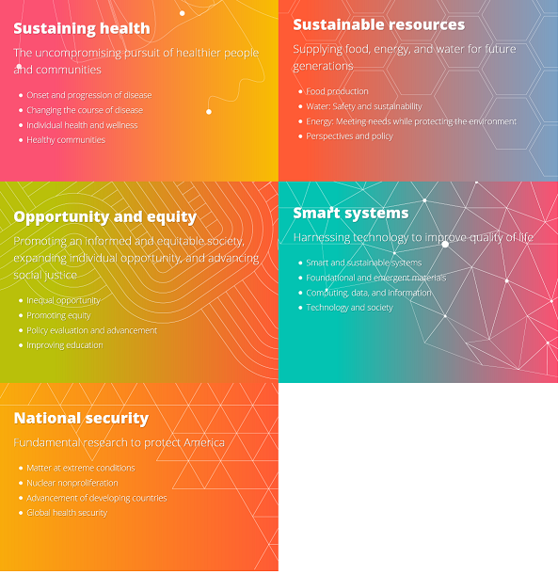
The Grand Challenges
https://research.wsu.edu/research-initiatives/grand-challenges/

Slide 23
The Institutional Effectiveness Council: “A coordinated, sustainable system to pursue university institutional effectiveness”
To coordinate strategic planning implementation, required accountability reporting, and decision support;
To reduce redundancy and increase efficiency, transparency, and accountability among strategic planning, institutional management, university accreditation, and other state and federal reporting requirements; and
To optimize usefulness of data and reports system-wide at all levels.

Slide 24
The IEC Steering Committee
Provost and Executive Vice President (Erica Austin for Dan Bernardo) — Chair
Vice President for Research (Chris Keane)—Theme 1 Chair
Vice Provost for Academic Affairs (Craig Parks for Erica Austin)—Theme 2 Chair
Vice President for External Affairs and Government Relations (Colleen Kerr)—Theme 3 Chair
Academic Dean (Michael Trevisan) —Theme 4 Co-Chair
Vice President for Finance and Administration (Vicky Murray)—Theme 4 Co-Chair
Executive Director of Institutional Research (Fran Hermanson)—Supervisor of Institution-Level Metrics Collection
Urban Campus Chancellor (Keith Moo Young)

Slide 25
IEC Steering Committee purpose
Oversees implementation and fulfillment of strategic plan.
Directs and resources the Council and the Accreditation, Assessment and Academic Program Review Committee.
Reviews and approves recommendations from the Council for strategic planning implementation and institution-level accountability metrics
Ensures alignment of data collection and reporting for institutional effectiveness, NWCCU accreditation standards, other external report mandates, and other internal needs for data and evaluation.

Slide 26
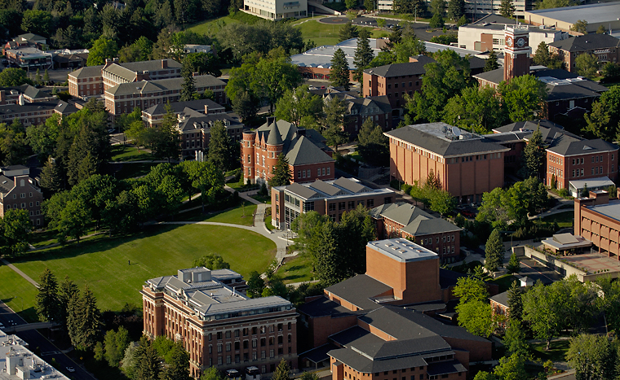
IEC Subcommittees (1 per theme)
Broad range of representatives from
Academic affairs
Student affairs
Business services and operations
Faculty
Staff
Students
All campuses and areas
Membership and contributions based on how programs and services connect to each theme.

Slide 27
What IEC subcommittees do
Facilitate unit- and program-level fulfillment of strategic plan goals, including collection and analysis of data to track progress toward the theme’s objectives.
Monitor and report to steering committee on infrastructure and training needs from units and programs.
Contribute to a university-wide annual inventory of assessment activities for each theme.
Promote awareness and communication about these topics among WSU units and employees.
Provide summary reports on strategic plan fulfillment annually to the IEC Steering Committee.

Slide 28
How the strategic plan relates to accreditation
NWCCU’s Five Standards:
The institution's Mission and Core Themes;
How the Core Themes translate into assessable objectives supported by programs and services;
Appraisal of the institution's potential to fulfill the Mission;
Planning and implementation involved to achieve and assess desired outcomes of programs and services;
An evaluation of mission-fulfillment efforts and sustainability.
http://accreditation.wsu.edu
http://nwccu.org

Slide 29
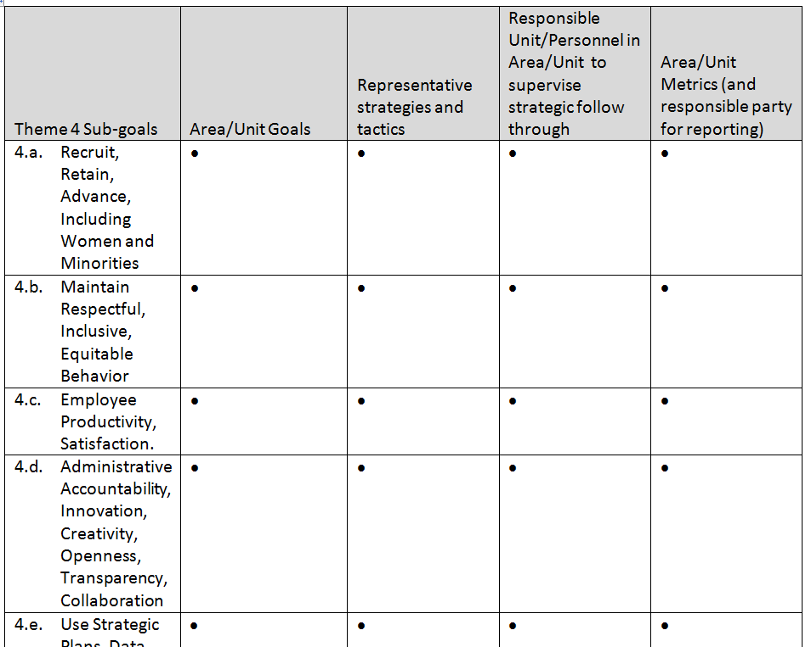
Mapping on to the plan

Slide 30
IEC timeline (sample)
October 2014 IEC plan released
November-February Steering committee launched, subcommittees forming
May 2015 IEC subcommittees present initial inventory of their strategies and metrics for benchmarks
Aug 2015 IEC Themes present first summary reports
Sept 2015 Writing of 2017 accreditation report commences

Slide 31
IEC timeline (continued)
August 2016 IEC Subcommittees present 2nd-year reports
Nov. 2016 Accreditation report introduced to Regents
2017 Public release of accreditation report; NWCCU on-site review
2017+ IEC Subcommittees continue annual reports
2018 Planning for updated strategic plan (2020-24) begins

Slide 32
Strategic Plan web site
www.strategicplan.wsu.edu

Slide 33
More information
Erica Austin (eaustin@wsu.edu), 335-5581
www.strategicplan.wsu.edu

Slide 34
This has been a WSU Training Videoconference
If you attended this live training session and wish to have your attendance documented in your training history, please notify Human Resource Services within 24 hours of today's date: hrstraining@wsu.edu

