Slide 1
Recording date of this workshop is
September 2, 2015
Some of the rules and procedures discussed in this workshop are subject to change.
Please check university resources
before relying exclusively
on this recorded presentation.

Slide 2
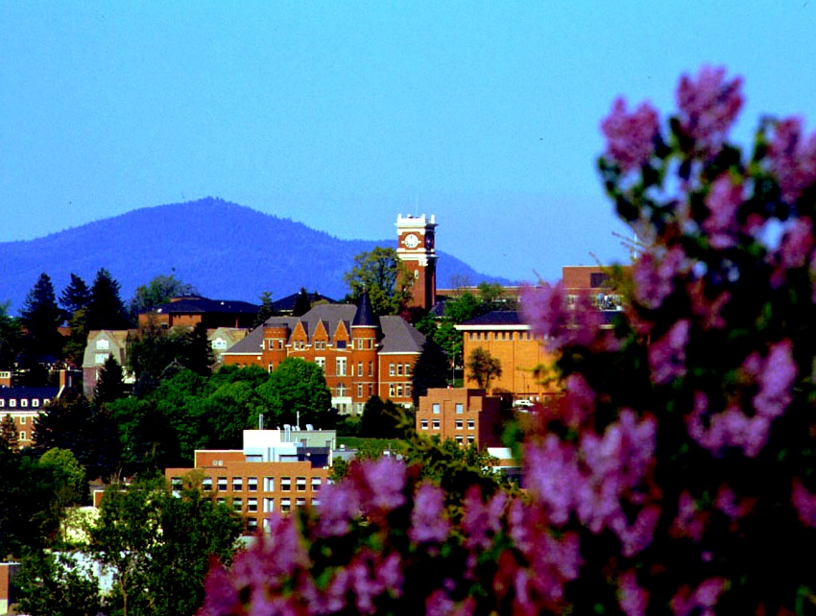
Chairs and Directors Series
University Overview,
Recruitment and Retention,
Tips on Your Job

Slide 3
Today’s Objectives
Brief University Overview
Faculty Recruitment and Retention
Tips on your job
Networking

Slide 4


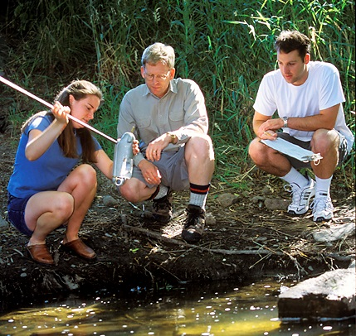
Washington’s Land Grant University
Education
Scholarship
Service

Slide 5
The Morrill Acts (1862 and 1890)
Universities that teach “agriculture, military tactics, and the mechanic arts” as well as classical studies so “members of the working classes could obtain a liberal, practical education…that has direct relevance to their daily lives.”

Slide 6
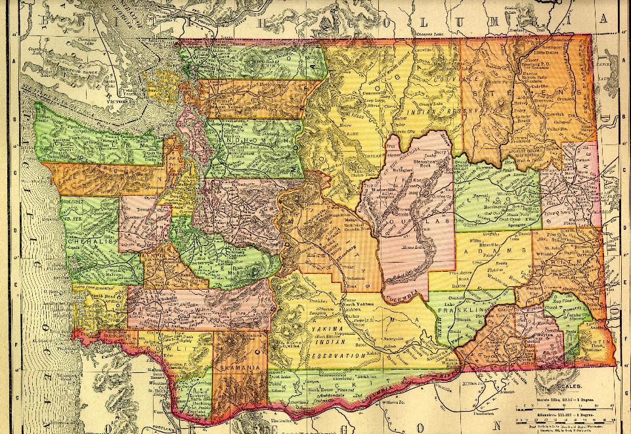

Slide 7

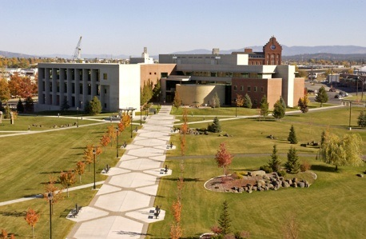
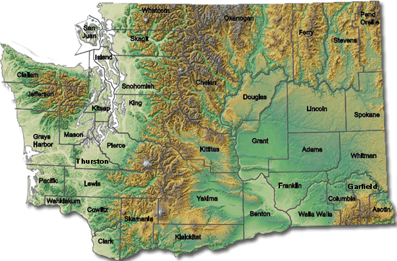

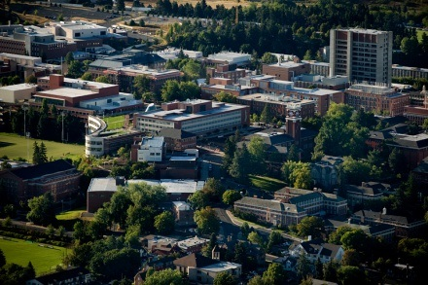
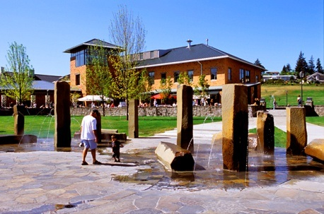
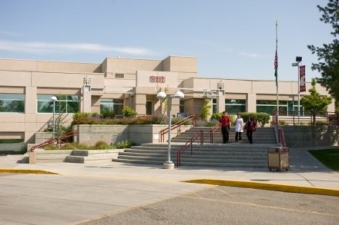
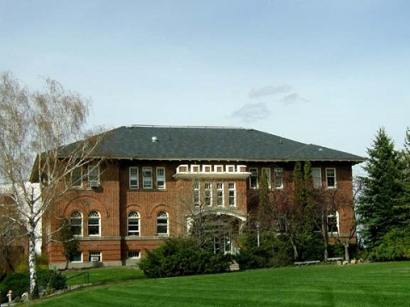
One University Geographically Dispersed
North Puget Sound
Spokane
Pullman
Vancouver
Tri-Cities
Global Campus

Slide 8
^{Board of Regents}
^{Interim President}
^{Chancellor}
^{WSU Spokane}
^{Interim Co-Provosts}
Vice President for Finance and Administration
^{Vice President for}
^{Information Services and CIO}
^{Chancellor}
^{WSU Tri-Cities}
Vice President for Student Affairs
^{Vice President for}
^{Research}
^{Chancellor}
^{WSU Vancouver}
Vice Provost for Academic Affairs
Vice Provost for Undergraduate Education
Vice President for Agriculture and Extension
Vice President for Global Campus
^{Chancellor}
^{WSU North Puget Sound}
Vice Provost for Faculty Affairs
Vice Provost for Enrollment Management
^{AVP and}
^{Chief Budget Officer}
^{Director for Legal Affairs and}
^{Special Counsel}
Vice President for Legislative Affairs
Director for Intercollegiate Athletics
^{Deans of 11 Colleges}
^{AVP for Economic Development}
^{Director for Internal Audit}
^{CEO for WSU Foundation}
Vice President for International Programs
Associate Vice President for Public Affairs

Slide 9
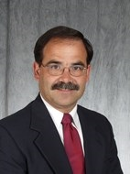
Interim President
Daniel J. Bernardo

Slide 10
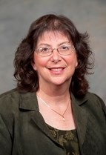
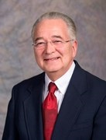
Interim Co-Provosts
Ron
Mittelhammer
Erica Austin

Slide 11
Our Colleges
Agricultural, Human, & Natural
Resource Sciences (CAHNRS)
Arts & Sciences (CAS)
Carson College of Business (CCOB)
Communication (Murrow)
Education (COE)
Honors (HC)*
Medical Sciences
Nursing (CON)
Pharmacy (COP)
Veterinary Medicine (CVM)
Voiland College of Engineering & Architecture (VCEA)

Slide 12
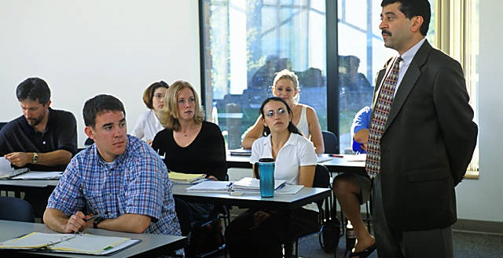
Our Programs
95 Undergraduate Majors
100 Certificate Programs
120 Graduate and Professional
47 Doctoral degrees

Slide 13
2014 Enrollment
Location | Number
Spokane | 1,458
Tri-Cities | 1,426
Vancouver | 3,264
Everett | 78
Global Campus Online | 2,794
Pullman | 19,756
Total | 28 686
27% Minority and 7% International

Slide 14

New Students
Expect 4600 new freshmen*
Expect 2600 new transfers*
30% More from out of state
38% Underserved population
3.30 Average high school GPA
*includes all campuses

Slide 15
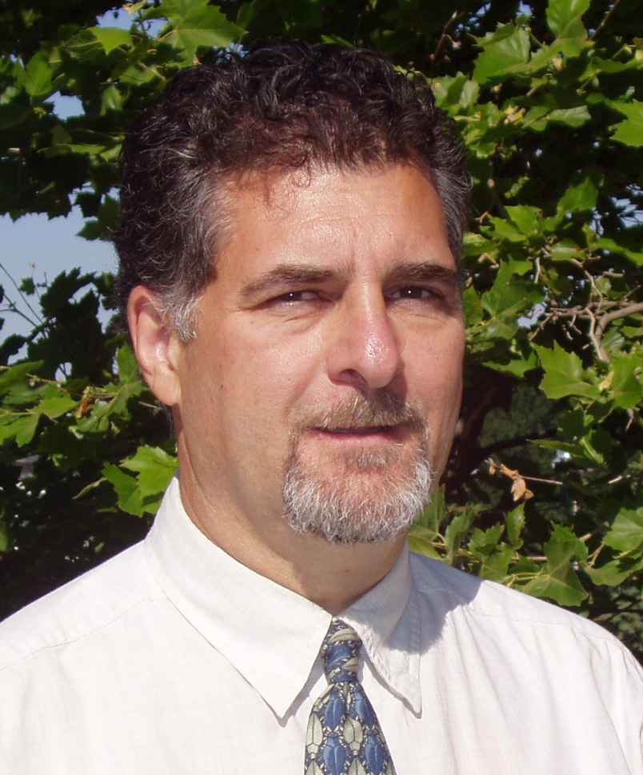
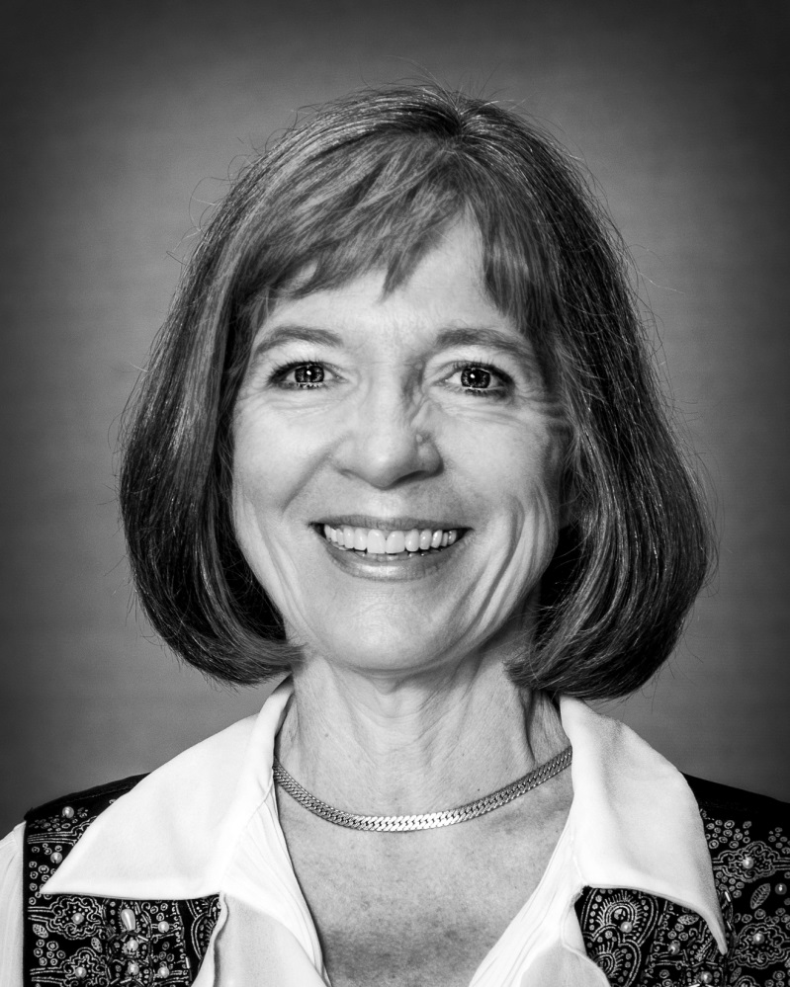
Faculty Senate
Representing our 2300 Faculty
Richard Zack,
Chair
(Entomology)
Sheila Converse
Executive Secretary
(Music)

Slide 16
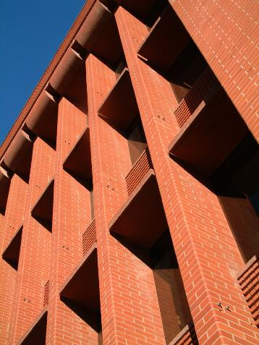
Senate Committees
Academic Affairs
Budget
Catalogue
Committee on Committees
Faculty Affairs
Graduate Studies
Libraries
Research and Arts

Slide 17
Faculty Manual
The letter of offer and the Faculty Manual are the faculty member’s contract with the university.
  Consult the Manual when you have a question.
  In the A – Z index on the webpage
  Faculty Manual 2014-2015

Slide 18
Faculty Manual (continued)
Policies for tenure-track faculty appear early in the manual (sections II – IV)
Policies for fixed-term faculty appear in section V
  It’s unclear which of the earlier policies apply to fixed-term faculty.

Slide 19
Important Policies
Policy prohibiting discrimination and sexual harassment
Policy on faculty-student and supervisor-subordinate relationships
Disciplinary process/procedures
  Serious and repeated neglect of duties
  Discrimination and Sexual Harassment

Slide 20
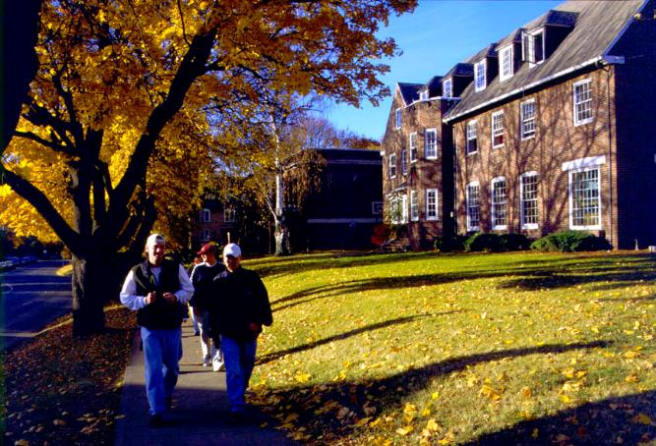
Recruitment and Retention

Slide 21

Faculty Friendly Policies
Approximately 45% of our faculty leave WSU before they stand for tenure.
That’s wasteful of:
  Recruiting time
  Recruiting expenses
  Mentoring time
  Start up costs

Slide 22
Key Policies
Spousal and Partner Accommodation
Mentoring
Modifying the tenure clock
Modified Duties
Professional Leave
Phased Retirement
Select Plus (formerly Sitter City)

Slide 23
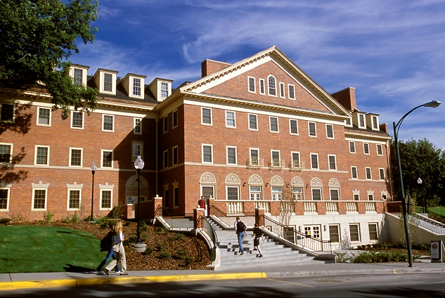
Partner & Spousal Accommodation Policy
BPPM 60.15 Partner and Spouse Accommodation

Slide 24
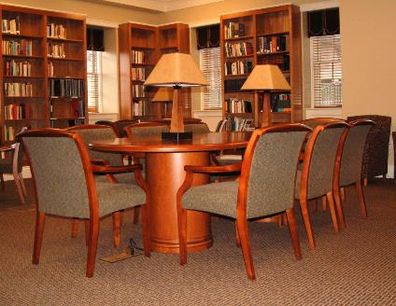
How Does It Work?
The partner must look for existing jobs.
If no job is found, the Provost will provide (pending available funding) either:
  0.5 funding for 2 years, or
  0.33 funding for 3 years.

Slide 25
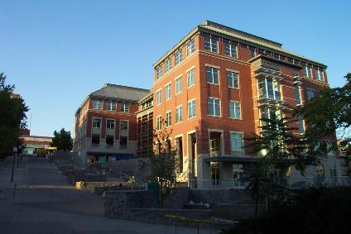
Requesting Funds
Locate a position.
Send a memo to the Provost through your dean.
  The policy indicates what you need to address.

Slide 26
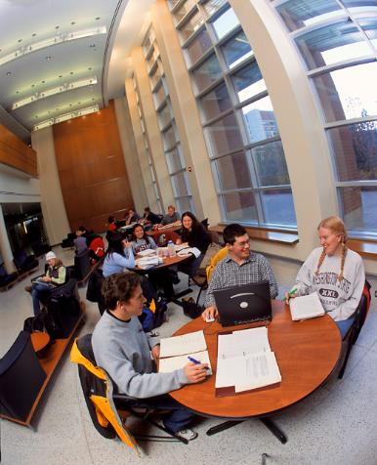
Your Commitment
All funds are matching funds.
The department helps to find someone with matching funds.
The department that receives the funds must make a good faith effort for a permanent accommodation.

Slide 27
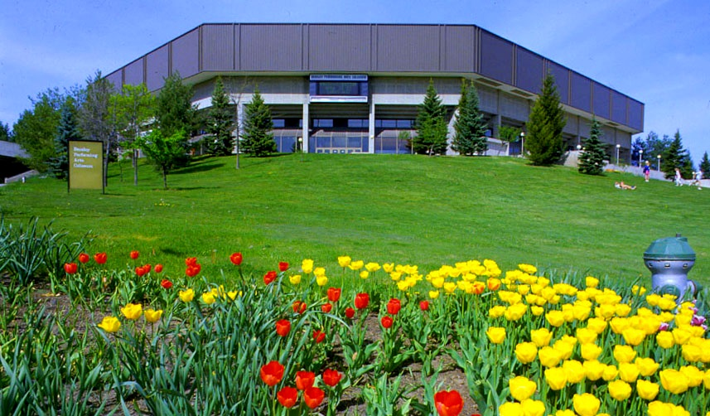
Mentoring
https://faculty.wsu.edu/mentoring/

Slide 28
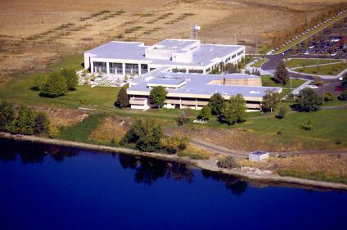
Who is it for?
All non-tenured tenure track faculty
Associate Professors
Others

Slide 29
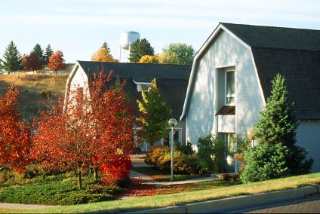
Department Decisions
One mentor or more?
Mentors from other departments?
Mentors from other campuses?
Who selects the mentors?
What do the mentors do?

Slide 30
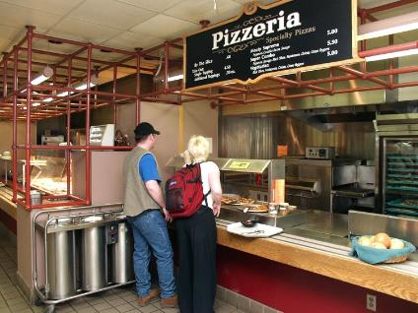
A Good Mentor is
Someone who:
  Is more senior than the mentored.
  Knows the rules.
  Is willing to commit the time.
  Is willing to give honest feedback.
  Is not thedepartment chair.

Slide 31
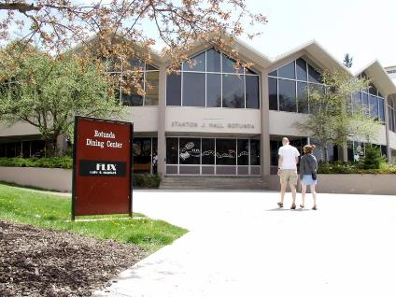
Mentors Provide:
  Understanding of “the system, especially the informal rules.
  Help with socialization.
  Encouragement.
  Honest feedback.
  Advice.

Slide 32
Mentors Provide
(continued):
Help with specific problems (e.g., teaching, publishing, or grant tips; introductions at conferences).
Help with setting priorities and professional goals.
Long-range career planning.
Support and advocacy.
Collaboration.

Slide 33

The Tenure Clock

Slide 34
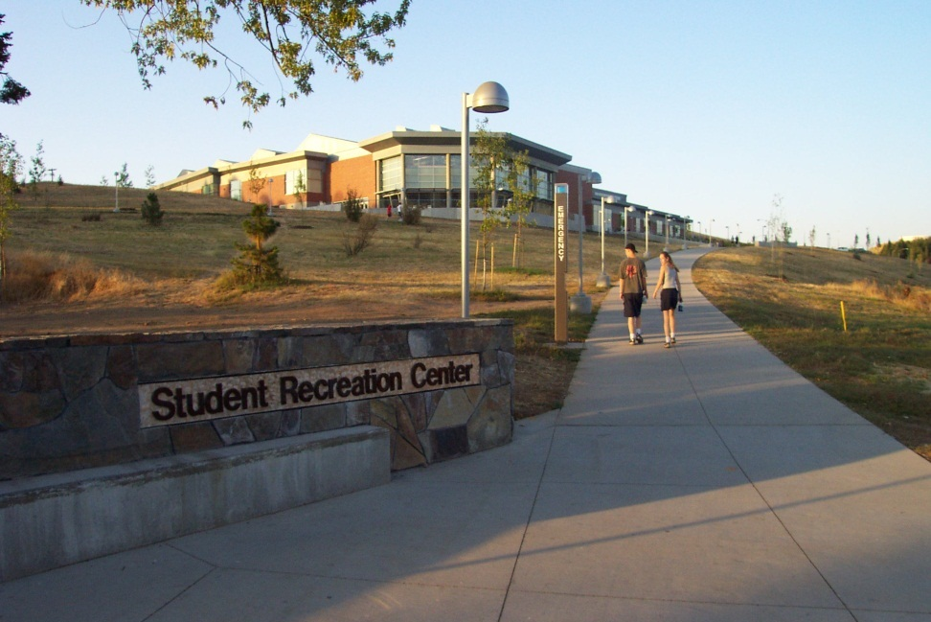
Tenure Consideration
Date in initial offer letter
Can be altered only through the agreement of the candidate, chair, dean and provost

Slide 35
Early Consideration
Early consideration permissible
  Usually only one year
  Extraordinary merit (?)
AAUP guidelines state that a candidate can be considered for tenure only once

Slide 36
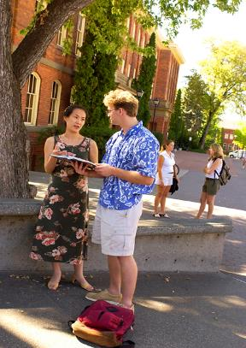
Stopping the Clock
Primary caretaker for a new child
  Maximum of two times
Extraordinary circumstances
  Catastrophic illness
  Family emergency
  Unexpected professional problems
  Usually only one year

Slide 37

Modified Duties Policy
Check HRS website for Faculty Friendly Policies

Slide 38
Modified Duties
A faculty member may request modification of their duties when:
  They have a new born or adopted child
  A family member has a serious health condition Serious health condition in a family member
Duties may be modified for up to a semester or equivalent.
Negotiated on an individual basis.
No additional duties in subsequent semesters.

Slide 39
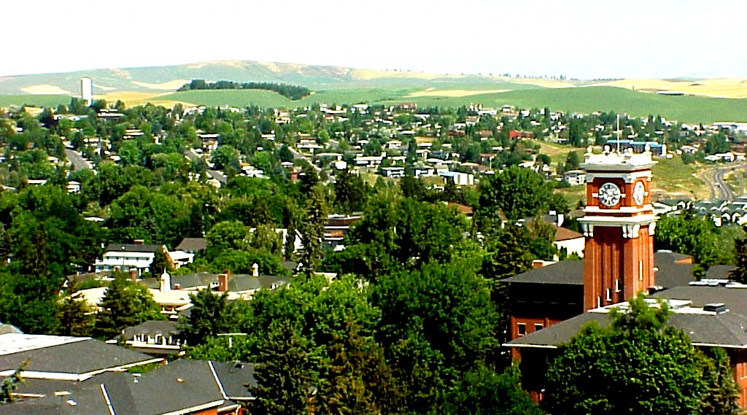
Requests granted no more than twice in 10 years.
Requests must be approved by the chair, the dean and the provost.
  Written reasons must be provided If the request is not supported.

Slide 40
Faculty Member with Modified Duties
No employment with outside agencies
Must remain in community to be available to students and colleagues.
Should request stopping of the tenure clock if needed.

Slide 41
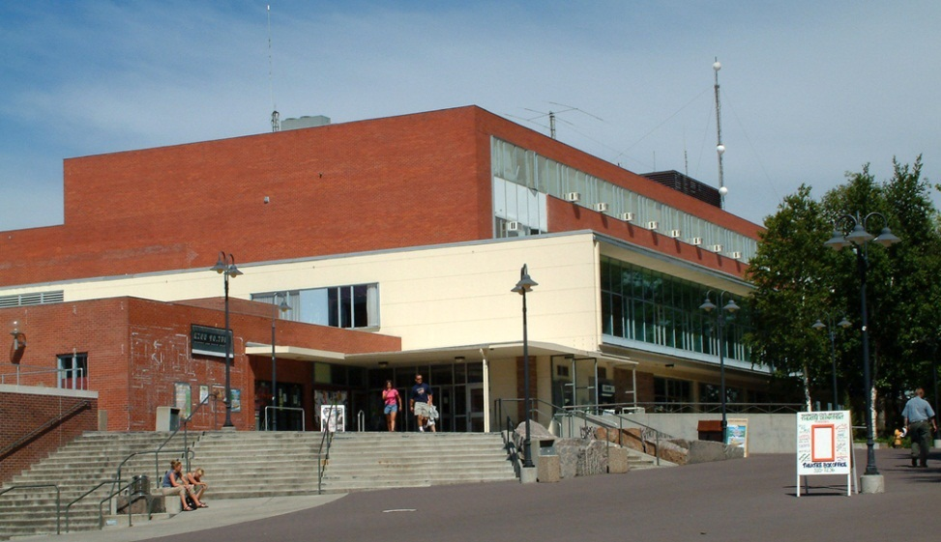
Professional Leave
Faculty, administrative professional employees who are:
  On permanent appointment, and
  Have completed 5 years of active service at the time of the leave (unless they’re pre-tenure).

Slide 42

Who is Not Eligible?
Those working on degrees
Those who will not remain at WSU
  Employee must agree to return for a period equal to the leave.
Deadline: January

Slide 43

Leave Basics
Leave may be taken for:
  2 semesters or 12 months at 75% pay, or
  1 semester or 6 months at 100% pay.
  Pay is capped at the average salary of the highest paid quartile of teaching faculty (currently $13,973/month).

Slide 44
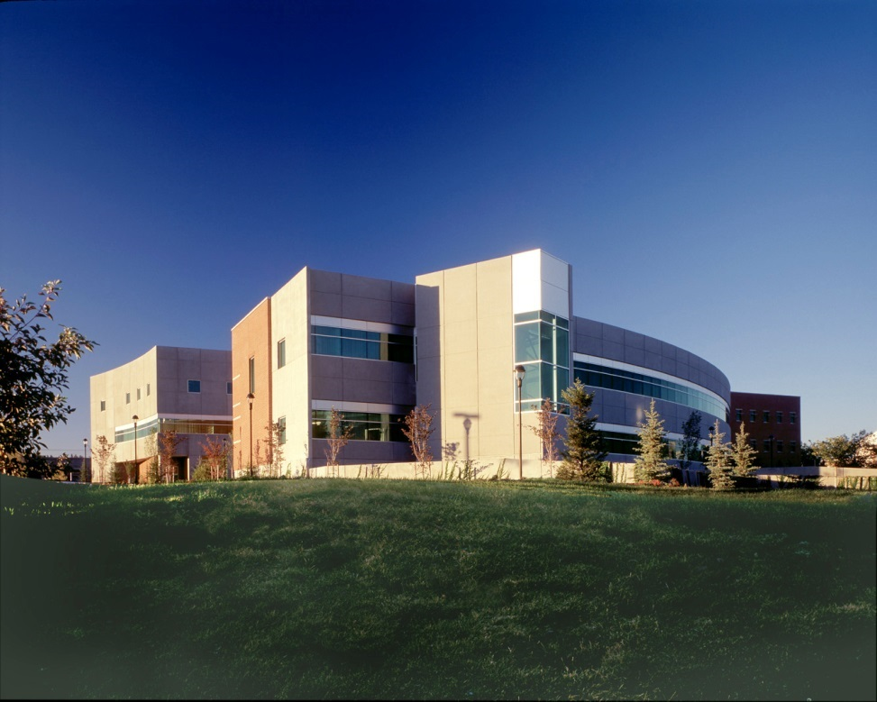
What Happens on Leave?
The recipient is relieved of all WSU activities except for the sabbatical project.
Employee is bound by:
  Faculty Manual
  Intellectual Property Guidelines.

Slide 45
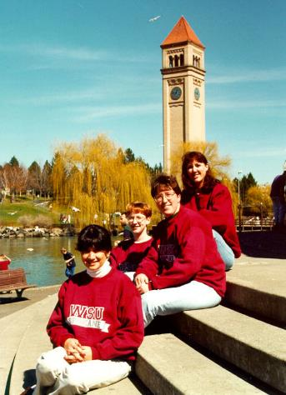
Don’ts
Use state funds to travel to site.
  Can be reimbursed for travel at site.
Engage in external employment.
Grant funding is OK if:
  compatible with sabbatical project
  Pay plus grant funding do not exceed 100% salary.

Slide 46
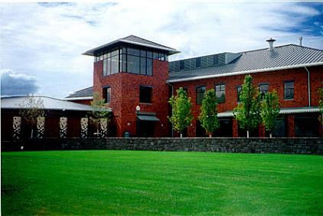
Leave Recipient
Must submit a proposal.
  2 recommendation letters
  Letters of support from people to be visited
Must certify in writing that (s)he will return to the University.
Must submit a report after the leave.

Slide 47

More
Leaves should line up with University calendar.
Leaves cannot be postponed without a new application.
The chair, dean, and provost must approve later changes in a leave plan.

Slide 48
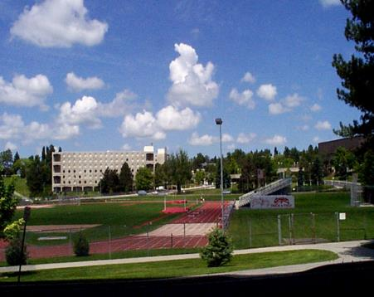
Phased Retirement
A process for reducing workload prior to retirement.
  Can reduce in any steps down to 50%.
  Reductions occur over a maximum of 7 years (but can be renewed on a yearly basis).

Slide 49
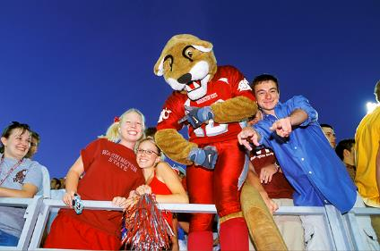
Who’s Eligible?
Faculty and administrative professionals who:
  participate in the WSU Retirement Plan
  are 55 years old with at least 10 years service to WSU
  would not create a detrimental impact to WSU.

Slide 50
Why Do It?
Can draw retirement benefits if eligible
Still accumulate benefits
Retain tenure and its privileges
Remain eligible for promotion

Slide 51

How To Apply?
Details are worked out among the applicant, chair and dean.
A memo with the appropriate signatures comes to Provost.
The Attorney General’s Office generates the paperwork.

Slide 52
What makes a good Department Chair?

Slide 53
Have a Vision
Don’t just manage, lead towards a vision
    Build on your departmental strengths.
    Be consistent with the vision of the College and the University.

Slide 54

Prepare
Know the likely outcome before bringing up an issue in public.
  Solicit opinions in their offices.

Slide 55
Know the Rules
Ask for Help
Consult the:
  Faculty Manual,
  Business Policies and Procedures Manual, and
  Executive Policy Manual.
Call someone.
  You’ll meet them later in the Workshops.

Slide 56

Communication
Communicate relentlessly in both directions
  Communicate clearly.
  Never surprise your dean.
  Never surprise your faculty.
  Repeat important messages.
    No one heard it the first time.

Slide 57

Be Transparent
Make sure everyone knows the rules and what’s expected.
Transparency increases trust and reduces an us-vs.-them climate.

Slide 58
Always Listen
Get both sides before making a decision.
Don’t assume malicious intent.
  Problems are usually created by stupidity and disinterest, rather than by evil intentions.
Don’t assume that a complainant expects you to fix the problem.
  People often just want you to listen.

Slide 59
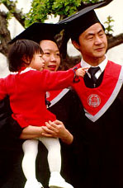
Consultation
Consult department members on proposed changes.
  They usually won’t comment.
  They will be angry if they don’t have the opportunity to do so.

Slide 60
Build Consensus
Try to reach agreement on important decisions.
  Those who go away angry will create problems in the future.
Diffuse tension with humor.
  Do not make a joke at someone else’s expense.

Slide 61
Build Good Will
Go beyond the annual review
Build a relationship.
Smile and say hello.
  If you fail to say hello, a faculty member may believe that (s)he is out of favor.
Praise in public. Criticize in private.
Think of good will as a bank.

Slide 62
Departmental Culture
You will anger people if you violate your departmental culture.
Be careful when adopting policies and procedures that work in other departments.
  What works in one department may cause problems in another.

Slide 63
Be Positive
You set the tone
Treat problems as challenges
Don’t sweat the small stuff
  You’ll have plenty of large stuff to sweat.

Slide 64

Delegate
Use an advisory group
  Advisors will think of things that you will not
  You will have allies.
  Don’t create an in group.

Slide 65

Lose Gracefully
Apologize if needed.
Let things go when the battle’s over.
Don’t hold a grudge.
Learn from your mistakes.

Slide 66

Use resources wisely
Reward good behavior.
  Small amounts of money can make a big difference

Slide 67
Chain of Command
Discuss all issues with your Dean before going to the Provost.
Always tell your Dean if you are going to go over his (her) head.
Consider resigning if you don’t share your Dean’s or the University’s vision.

Slide 68
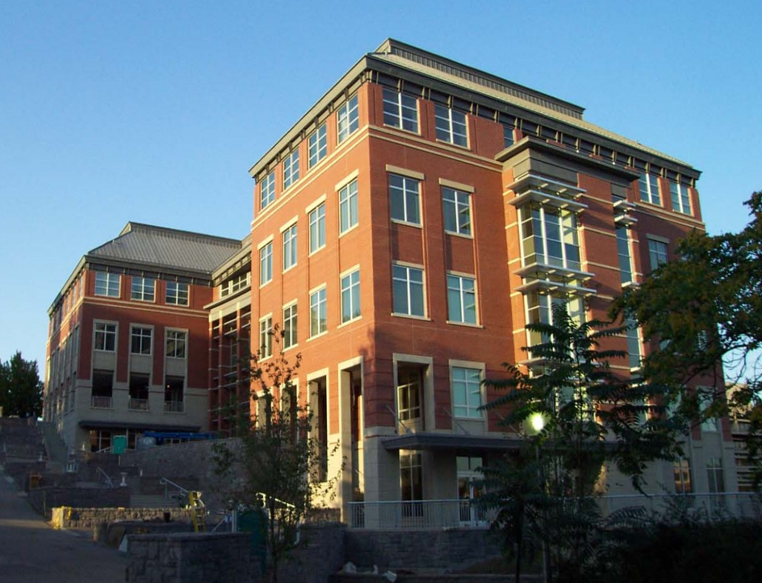
When involving the Dean
Offer solutions.
If you ask for something
  Show connection to strategic plan.
  Split costs if possible.

Slide 69
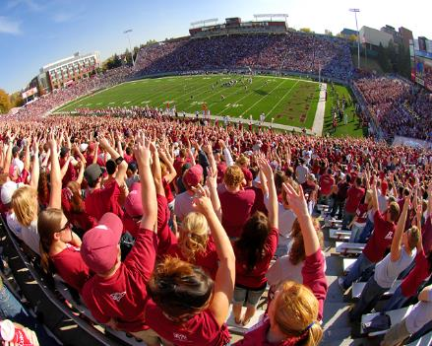
Nurture Your Staff
You depend on them.
Select them carefully
Improve their lives whenever possible.

Slide 70
Manage Your Time
Block out time for important, but not immediately demanding, work (e.g., research).
Do your most difficult work at the time when you are at your best.
Come to the office when others are not around.

Slide 71
Manage Emails
Be careful what you write in emails.
  All email is public
Avoid having critical conversations over email.
  Talk to the person.
Remember everything sounds harsher in email.

Slide 72

Be a Cheerleader
  Take charge of the fun, not just the problems.

Slide 73

Lead by Example and the Golden Rule
Don’t ask people to do things that you wouldn’t do.
Treat others as you would like to be treated.

Slide 74
Guard Your Reputation
Establish a reputation for integrity.
  Be fair, honest, and consistent.
Build and maintain trust by dealing honestly with your faculty and dean.
Treat faculty members similarly.
  They talk to each other. They will soon uncover inconsistencies in your words or actions.

Slide 75
Take Care of Yourself
Try not to stress over things that you cannot control.
Get plenty of sleep and exercise.
Have a life outside the office

Slide 76
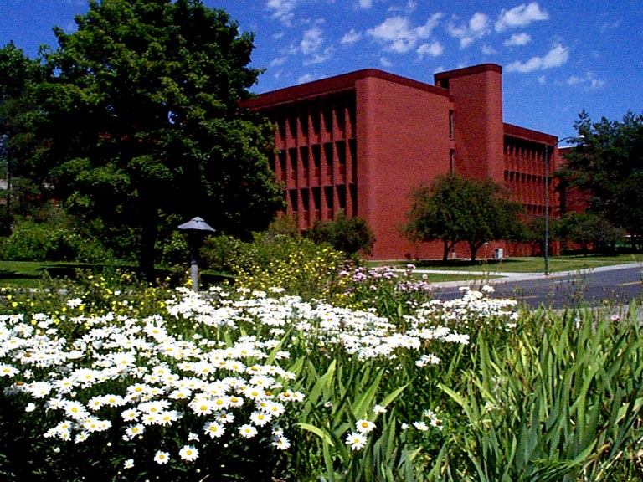
The End

Slide 77
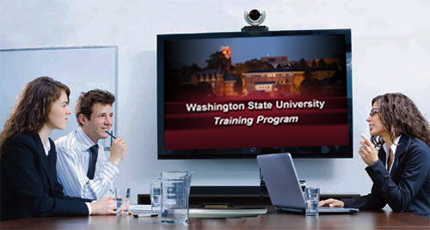
This has been a WSU Training Videoconference
If you wish to have your attendance documented in your training history,
please notify Human Resource Services
within three days of today's date:
hrstraining@wsu.edu

