Slide 1
WSU Assistantship & Fellowship Training
Rita Whitcomb: Area Finance Officer, rwhitcomb@wsu.edu, 5-5165
Kristina Elkins: Fiscal Specialist, Kristina.Elkins@wsu.edu, 5-4799
Updated July 2017

Slide 2
Objectives
Assistantships:
Eligibility Requirements
Waivers
Tuition and Fees
PERMS
Payroll Deduction
Sponsored Students/Fellowships:
Eligibility Requirements
Graduate Sponsored Student Support Memo
China Scholars
myWSU
Deadlines

Slide 3
Assistantship Eligibility Requirements
Academic Year Processing Memo
GS website→ Faculty & Staff→ Finances
Graduate Student Status
Admitted to Pullman or branch campus
RCR training / ITA exam
Full Time Enrollment (10-18cr) for the entire semester
3.0 Cumulative GPA
Must Reside in the state of WA- verified by looking at the mailing address in myWSU
Assistantship dates: 8/16-12/31 or 8/16-5/15 or 1/1-5/15

Slide 4
Waivers
Waivers are based on position funding
EAA or PA submitted after PERMS is approved may affect waiver. Please contact the GS before submitted your forms
If DEPPS does not contain updated funding information please include the account information in PERMS conditions
Appointment must be for the entire semester
FTE at least 25% to 50%
Student must be enrolled fulltime for the entire semester
Check student enrollment before submitting PERMS action or support memo

Slide 5
Waiver Types
Operating Fee Waiver (OFW) $5,445.00
Position must be funded on: State or F&A funded (001-01, 148-02,148-05)
All But Dissertation Waiver (ABD) $5,445.00
Student must meet all assistantship eligibility requirements –must enroll full time for the entire semester
Must be funded on competitive extramural grants
ABD application needs to be submitted prior to 8/16 or 1/1 – GS review begins 8/1 for fall semester and 12/1 for spring semester

Slide 6
Waiver Types continued
Non-Resident Waiver (NR) $6,716.00
Guarantee for 1 year for domestic students
International students get the NR waiver as long as they have an assistantship
Domestic student must submit a WA residency application
Takes 1 year
Please inform your students of residency requirements
Qualified Tuition Reduction (QTR) $5,445.00
Position funded by anything other than state or F&A funds
QTR is a fringe benefit of employment
TNA & BNA grants: use job class 9904 or enter QTR Ovr Acct in waiver section of PERMS

Slide 7
Tuition
Tuition due first day of classes (8/21)
9/5/2014 - 1st late fee
Insurance Rates FY18 PENDING

Slide 8
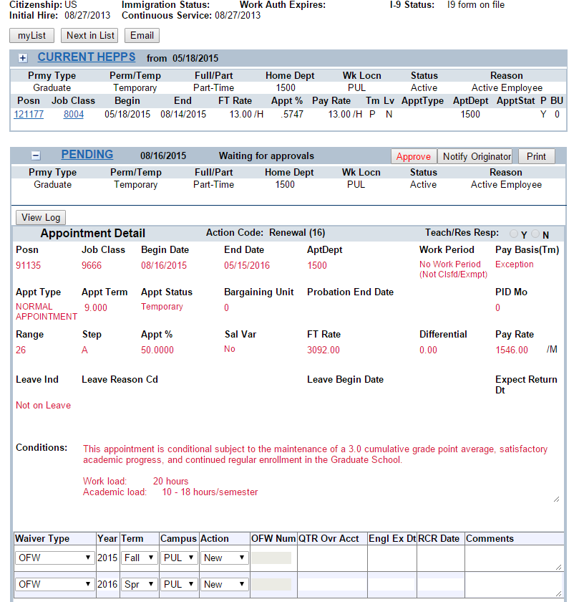
PERMS
Citizenship/Immigration status & I9
Current HEPPS
PENDING
Job class
Dates
Appt type
Appt term
Waiver info.

Slide 9
Payroll Deduction
50% graduate assistantship – academic semester only
Enrolled in at least 10 credits
Deduct tuition and fees only – 8 pay periods, fee of $8/semester –9/4/2017
Payroll Deduction request in myWSU
Students with academic year appointment may authorize deduction for fall/spring with one request
Direct Deposit
Encourage your students to sign up
Fast, easy, secure
Process: Complete Authorization card and submit to Payroll Services with a VOIDED check – French Admin 236

Slide 10
Sponsored/Fellowship
Students who receive support from department, grants/fellowships, home country – typically not on assistantship
If the student does hold an assistantship – mandatory fees and partial tuition can be guaranteed
May have some GS commitment associated with their funding – please reference the commitment number in the comments of the sponsored student support memo
Ph.D Fellowship Tuition Support Program
Supplement the fellowship COE allowance
Submit Graduate Support Memos via myWSU

Slide 11
Sponsored Students
Know your students AND your GS agreements
Waivers – Departments MUST submit support memo
Fully funded positions
China Sponsored Students – CSC
Receive in and out of state waivers- Departments MUST submit support memo
Department must provide $5000/yr of support
Assistantship
Time-Slip appointment
Scholarship (requires no work from student)
Pay mandatory tuition and insurance (requires no work from student)
Fulbright – In/out of state waivers: waivers requested by IP
CONACYT- sponsored by home country, COE may differ from student to student
JCATI agreement – in state waivers Departments MUST submit support memo

Slide 12
Departmental Requirements
Offer Letters – Please use our templates
ABD applications – due prior to 8/16 and 1/1
Verify waivers & position funding are correct
PERMS – look at the official PERMS form emailed to the originator
Payroll reconciling
Budget Reconciling- look at obj07QT
Student Evaluation & Certification of Effort
Exception to Policy:
Begin date not 8/16 or 1/1
Additional work beyond the assistantship
GPA less than 3.0
Waiver changes after 1/31/17

Slide 13
myWSU.edu
Request access:
View Customer Accounts or
Campus Community or
CS Reporting → Query Viewer (ASSISTANTSHIP reports)
GS_PERMS_WVRS_W_RESEDENCY: All graduate students that are enrolled for a specific term
GS_PERMS_WVRS_W_RESIDENCY_ID: Brings back a single graduate student
GS_PERMS_WVRS_W_RESIDENCY_ID_M: Brings back multiple graduate students

Slide 14
Deadlines
7/24/17: GS will begin review and approval of PERMS and Sponsored Graduate Student Support memos
STUDENTS MUST BE ENROLLED 10-18 CREDITS- do not look at PERMS action if not enrolled in atleast 10
7/31/2017: myWSU will calculate tuition (estimate)
8/14/2017: FinAid will begin disbursement (estimate)
8/16/2017: GS will work with SA to begin waiver posting
GS will not review PERMS between 8/16 and 8/20
Have your PERMS ready for approval and student enrolled by 8/15/17
8/18/2017: PERMS rolls into DEPPS (night)
8/21/2017: 1st day of classes
9/5/2017: 1st Late Fee

Slide 15
Departments Should contact?
The Graduate School
If waivers have not posted after the 3rd week of class and ONLY after you have checked
PERMS
Students’ enrollment
Students’ account in myWSU
If the incorrect waiver has posted – contact Rita Whitcomb, ASAP
If the position funding has changed after the PERMS action has been approved, contact
Rita Whitcomb – GS
Rick Grunewald – Payroll Services
Questions regarding the status of your Sponsored Graduate Student Support Memo
You can view the location of our memo on mywsu.edu

Slide 16
QUESTIONS
?

Slide 17
This has been a WSU Training Videoconference
If you attended this live training session and wish to have your attendance documented in your training history, please notify Human Resource Services within 24 hours of today's date: hrstraining@wsu.edu

