Slide 1
Effort Certification and Cost Sharing
Presented by:
Josh Graisy
Gerik Kimble
Sponsored Programs Services
Revised November 2017

Slide 2
Recording date of this workshop is
November 27th, 2017
Some of the rules and procedures discussed in this workshop are subject to change.
Please check university resources (BPPM)
before relying exclusively
on this recorded presentation.

Slide 3
Course Objectives and Goals
Establish what Effort Certification is and why it is necessary
Instructions for filling out an Effort Certification Report (ECR)
Helpful and Useful Information about Effort Certification
Examples/Details/Q&A – Effort Certification

Slide 4
Course Objectives and Goals
(Continued)
What is cost sharing and how is it reported?
Helpful and useful information about cost sharing
Examples/Details/Q&A – Cost Sharing

Slide 5
What Is Effort Certification?
Effort Certification is “after the fact” reporting of how certain employees time was spent and paid during a certain period

Slide 6
The Effort Process
Effort Certs are printed (4) times a year. Once for each semester as well as (2) summer sessions.
Spring: 01/01/17 - 05/15/17
Summer: 05/16/17 - 06/30/17
Summer: 07/01/17 - 08/15/17
Fall: 08/16/17 - 12/31/17
Each of the above batches are printed after the first payroll has ran after the period has ended.
Example: The fall period batch will print after payroll has processed on January 10th, 2018.
If a department needs a re-print for any reason, we print them each month around the 10th.
Remember your re-print order needs to be received by SPS by the 7th of each month.
To request a re-print, please e-mail sps@wsu.edu
Effort Certs are sent to the department listed on the report unless the department instructs us otherwise.
For re-prints, we prefer to send them to a specific person to reduce the chance of it being lost.

Slide 7
Who Receives An ECR?
Those whose salaries are charged directly to sponsored agreements. (Programs 11-14)
Those who contribute effort for cost sharing purposes (See BPPM 40.36)
Those whose earnings include federal appropriation monies (fund 143).
28 year system purge…hopefully this will stop the unnecessary reports

Slide 8
Why Do We Certify Effort?
Required by the Uniform Guidance, 2 CFR Part 200
As a condition to receive federal funding, institutions must maintain records that are supported by a system of internal control which provides reasonable assurance that the charges are accurate, allowable, and properly allocated.
In compliance with this requirement, the university has established a system for reporting the percentage of time (i.e., effort) that employees devote to federally sponsored projects.
The university has chosen to apply this standard to all sponsors.

Slide 9
Why Do We Certify Effort? (Continued)
The university's effort reporting system assures external sponsors that funds are properly expended for the salaries of those individuals working on the projects they sponsor.
It provides the principal means for certifying that the salaries charged to sponsored projects are consistent with the effort contributed.
All employees involved in certifying effort must understand that severe penalties and funding disallowances could result from inaccurate, incomplete, or untimely effort reporting.

Slide 10
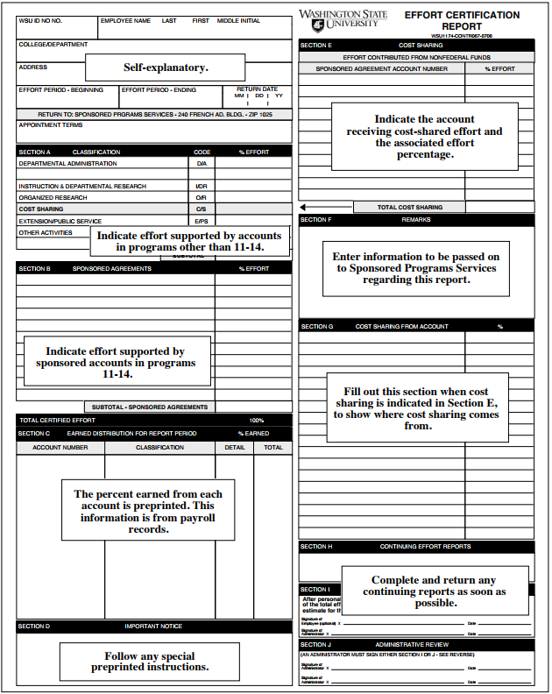
Completing an Effort Certification Report
If department is incorrect, please cross off and write in correct department so we can change in EFFORT system
Be sure to mark whether cost sharing was ON or OFF campus
Subtotal of A plus subtotal of B must equal 100%

Slide 11
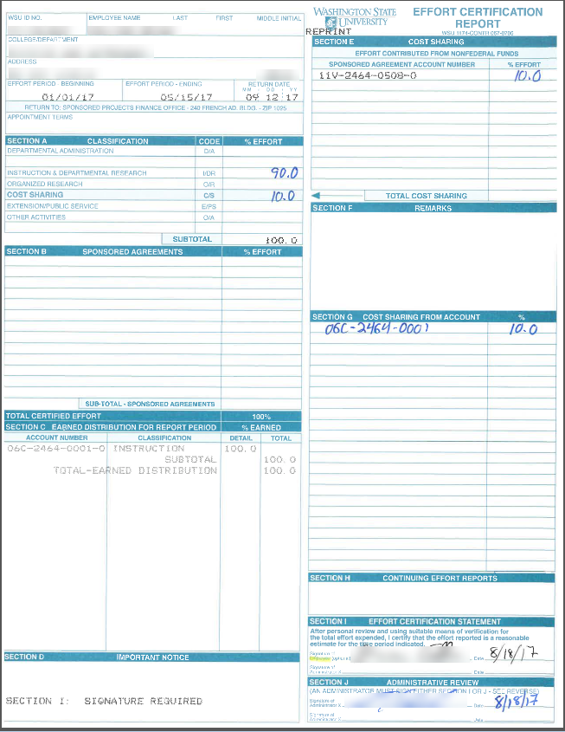

Slide 12
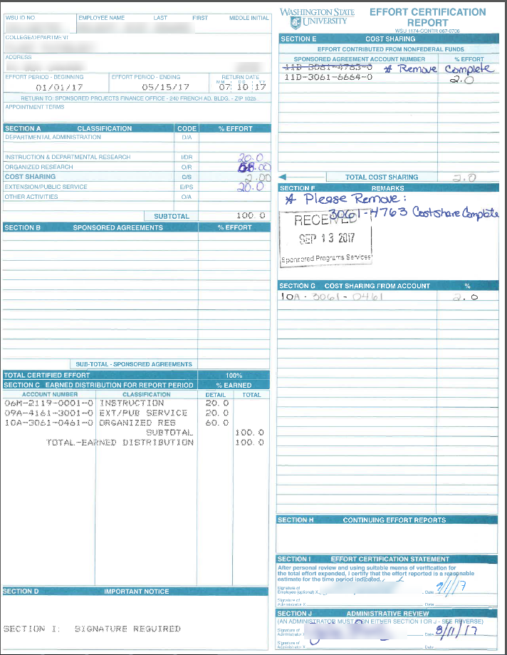

Slide 13
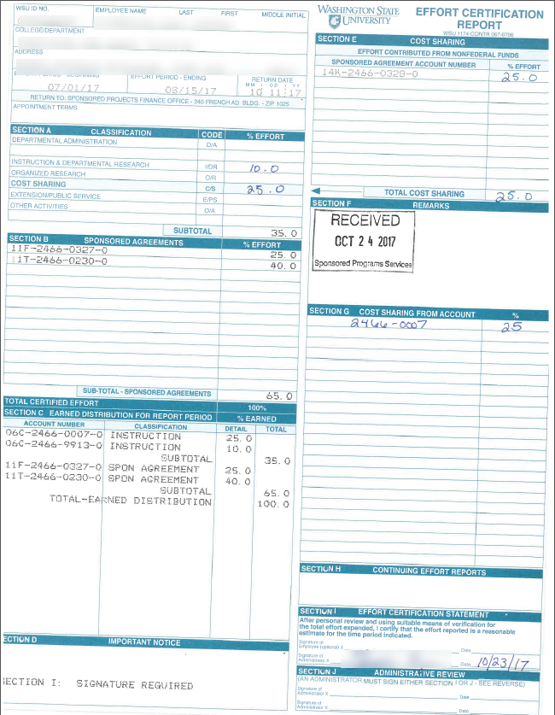

Slide 14
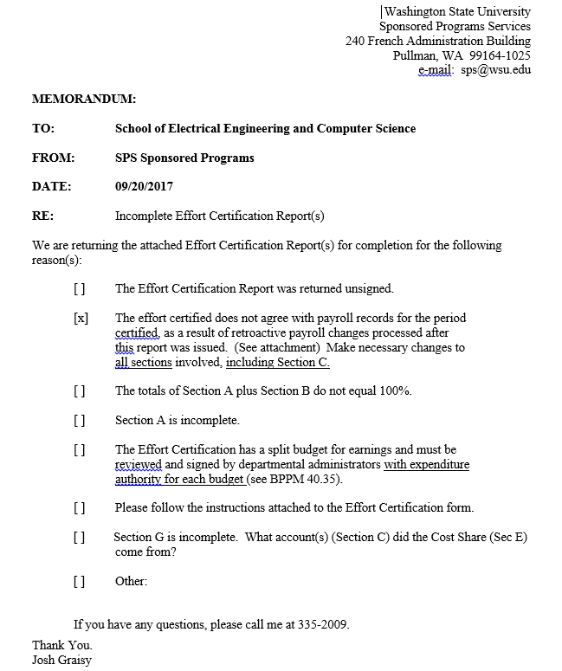

Slide 15
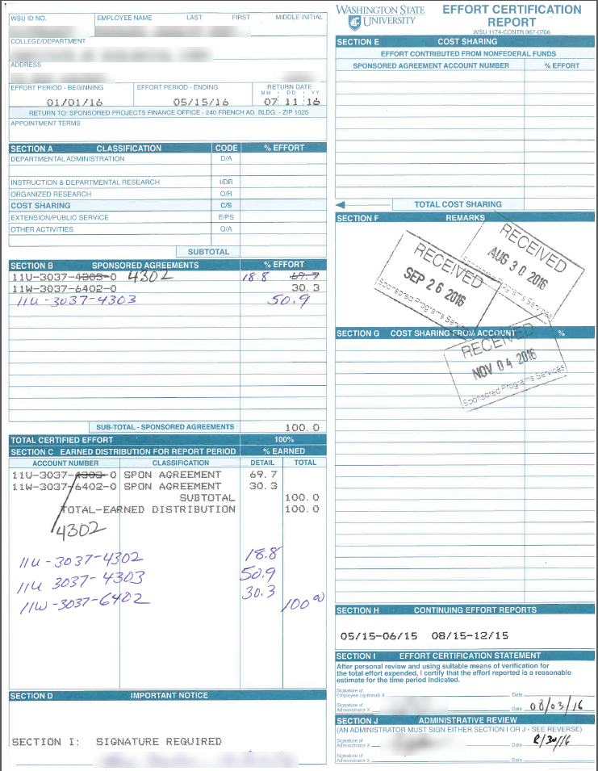
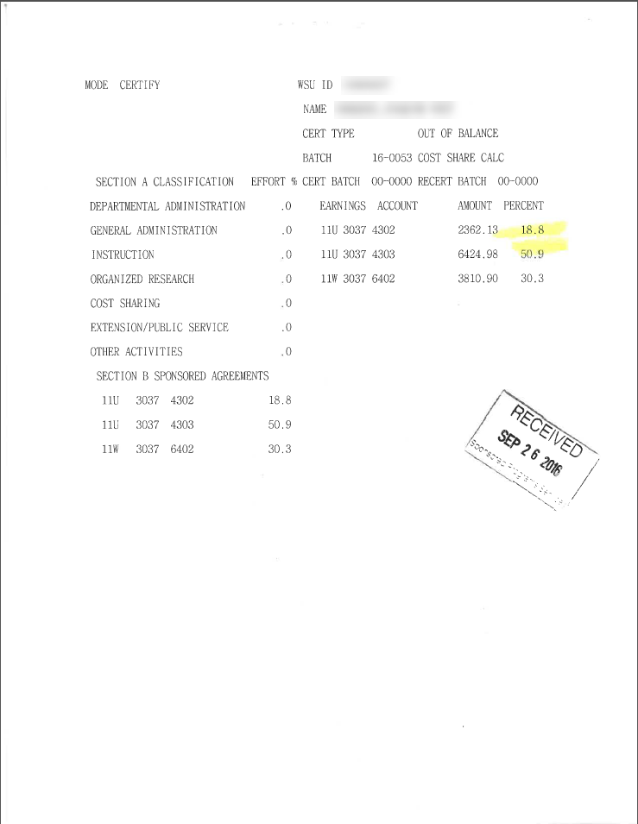

Slide 16
What Is Cost Sharing?
Cost Sharing represents the sponsored project or program costs (direct and indirect) that would normally be borne by a sponsor but instead are covered by the university or a third party, such as a subcontractor or an unfunded collaborator.

Slide 17
Why Cost Share?
Mandatory Cost Sharing:
Cost sharing required by the sponsor as a condition of eligibility for an award. Must be properly documented and tracked for compliance purposes.
Voluntary Committed Cost Sharing:
Cost sharing not required by sponsor but provided at the discretion of the institution. Must be properly documented and tracked for compliance purposes.
Voluntary Uncommitted Cost Sharing:
Cost sharing not required by the relevant program solicitation, not referenced in proposal or award, and not formally tracked or auditable.

Slide 18
Pitfalls of Cost Sharing/Matching
Cost sharing is a cost to the university
Cost sharing has negative effects on the F&A rate
Administrative burden of tracking and recording the match

Slide 19
What Funds Can Be Used To Cost Share?
Toward Federal Awards:
Cost sharing may come from state sources or private sources.
May NOT use another federal award unless approved by federal statute.
Can NOT use federal appropriations (fund 143).
Toward Other Awards:
See specific agency regulations.
May NOT use a federal award or appropriation.

Slide 20
Cost Sharing Effort Inquiry Request Form (CSEIR)
This form is sent to the department contact after the account is set up by SPS
It is necessary to submit a CSEIR for an employee to be added to the Cost Sharing Participation System
Also allows cost share account to be pre-printed on effort certification reports

Slide 21
How Do I Report Cost Sharing?
WSU Employee Salaries and Benefits:
Included on effort certification reports in sections E and A
Section G: Enter earned distribution account from Section C being used toward cost sharing. Section G total percentage must equal the total of Section E.
Other:
Reported via memo including pertinent documentation and detail to Sponsored Programs Services.

Slide 22
Manual Cost Share Entries
Refer to “Manual Cost Share Requirements” attachment from presentation notes

Slide 23
Tracking
Cost sharing obligations and amounts reported to date can be found in the BALANCES system
Go to main menu
Press F7 key for cost share screen
You can then search by account or by ID#
The effort and cost share systems are updated each night
Use the ORSO database to view cost share budget in the eREX form

Slide 24
Additional Cost Sharing Information
Employee salaries and benefits MUST be entered on effort certification report unless older than (2) years
If ECR already certified, you can request a re-print so that we can re-certify with cost share.
If more than two years out, a manual cost share entry will need to be processed.

Slide 25
Questions?

Slide 26
This has been a WSU Training Videoconference
If you attended this live training session and wish to have your attendance documented in your training history, please notify Human Resource Services within 24 hours of today's date: hrstraining@wsu.edu

