Slide 1
Award Administration
Part Two: Management of
Grants
Presented by:
Emilie Cousins and Kim Small
Updated March 2018

Slide 2
Recording date of this workshop is
March 23, 2018
Some of the rules and procedures discussed in this workshop are subject to change.
Please check university resources
before relying exclusively
on this recorded presentation.

Slide 3
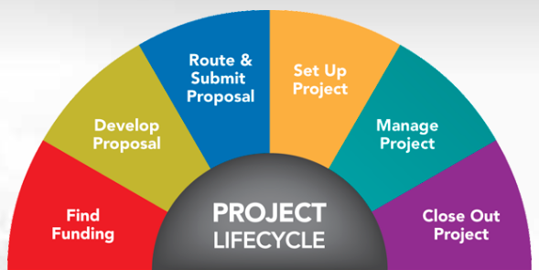
WHERE ARE WE?
Graphic source: University of Michigan Website

Slide 4
Post-Award Review
Department Review
Sponsored Programs Services (SPS) Review

Slide 5
Award Management Responsibilities
Department and SPS:
Expenses are Allowable
F&A Expense Review
Coordinate Invoicing
Reporting Cost Share Obligation is Met
Approving Subcontract Invoices
PI Technical Reports
Office of Commercialization handles Patent Filings
Monitor Property/Equipment per University Guidelines

Slide 6
The Storyline:
Emilie is working with Principal Investigator, Dr. Pat Researcher, who received notification that WSU will be awarded a new NIH agreement for the performance period 01/01/18-12/31/18.
The PI is anxious to start the project prior to the 1/1/18 start date, and Emilie will start the process.
What form needs to be completed to setup an account so that the project can start before the agreement arrives?

Slide 7
The Forms
Sponsored Projects Activity Request (SPAR)
Research or Conference Account Request (RCAR)
Subaward/Subcontract Initiation Form
Subaward/Subcontract Change
Expenditure Transfer Request (ETR)
Expense Assignment Action (EAA)
Cash Advance

Slide 8
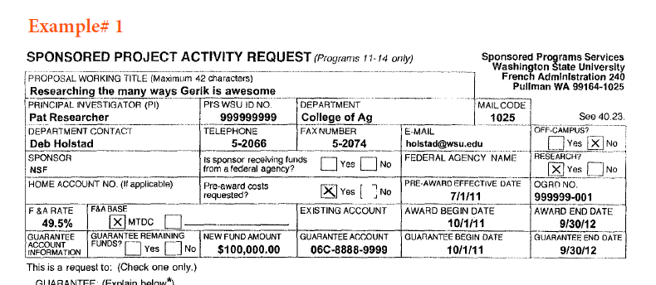
Sponsored Program Activity Request (SPAR) BPPM 40.23
Guarantee for New Account with 90 day Pre-award
See Example #1

Slide 9
SPAR – Guarantee Tips
It is important to answer these questions:
Is the account federal flow through?
Is the account research or non research?
Where will the work be conducted--on campus or off campus?
Is pre-award allowed by the sponsor without prior approval?
The guarantee holds the department responsible for the expenditures in the event that WSU does not receive an executed agreement.

Slide 10
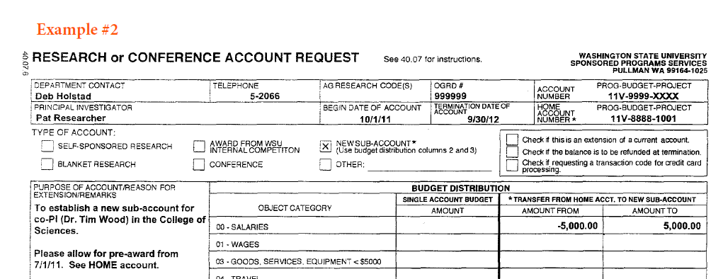
Research or Conference Account Request (RCAR)
BPPM 40.07
New Subaccount
See Example #2

Slide 11
RCAR
Used to set up a new:
Self Sponsored Research Account
Conference Account
Program Income Account
Subaccount under an Existing Award
Blanket Research Account
Graduate Education Account
Fixed Price Consolidation Account

Slide 12
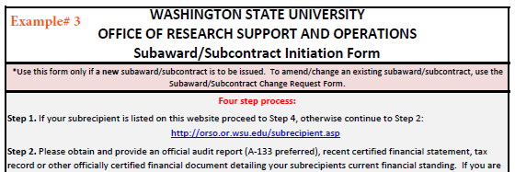
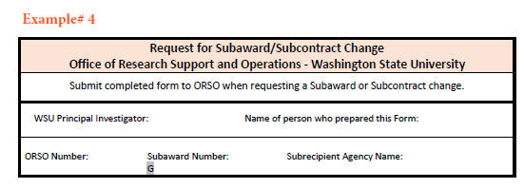
Subcontract Forms (ORSO Website)
See example #3
Initiation
See example #4
Change

Slide 13
Subcontract Initiation Form
Important factors:
Include budget breakdown
Include any cost share
Where is the subcontract allocation set aside?
If the allocation isn’t in object 14, SPS will need a SPAR completed to rebudget.

Slide 14
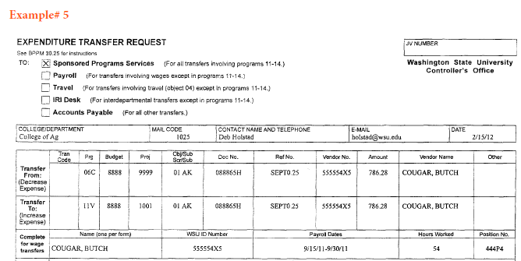
Expenditure Transfer Request (ETR) BPPM 30.25
See example #5 (Materials, Supplies, Travel, etc)

Slide 15
Common Errors on ETRs
90 Day Deadline & Exception
Missing signatures (i.e. effort certification)
Including wage transfers on same form with non-payroll transfers
Including wage transfers for more than one employee on the same form
Failing to include 90 day exception justification
SPS must receive the ETR within 90 days of the transaction date of the original charge, or the department will need to request a 90 day exception (BPPM 30.25)
90 day exceptions must explain the following:
Why the transfer was not initiated within 90 days.
What internal control procedures have been implemented to reduce the risk of reoccurrence.
Notes:
Emphasize bullet points 2 and 3

Slide 16
Award Management & Maintenance | ORSO | ORAP | SPS | PI | DEPT | DEAN | RCO
Fiscal Admin for grants &/or contracts, coop agreements, sub-contracts, and financial assist. Agreements negotiated with federal, state, & private sponsors at the central level |  |  | X
Approves all expenditure requests to be charged against the grant/contract |  |  |  | X
Review & approve expenditures for allowability & allocablility (See NOTE 13) |  |  |  | X
Oversee expenditures for allowability & allocablility (See NOTE 13) |  |  |  |  | X
Retain documentation to support allocation of expenditure |  |  |  |  | X
Audit the allowability & allocablility of expenditures |  |  | X |  | X
Reviews, on a regular basis the grant/contract acct expenditures with appropriate dept. college, or newer campus administrator(s) |  |  |  | X
Reconcile accounts on a monthly basis |  |  |  |  | X

Slide 17
Note 13
This responsibility includes the following:
a. That funds are used only for purposes directly related to the activity supported and that these funds are reasonable, allowable, and allocable as defined in 2 CFR 200.
b. That expenditures are consistent with all special terms, conditions, or limitations applicable under the particular grant/contract.
c. That expenditures do not exceed the total funds authorized for a given period under the grant or contract. In many cases, the grant or contract may also specify expenditure limits by budget category or line item.

Slide 18
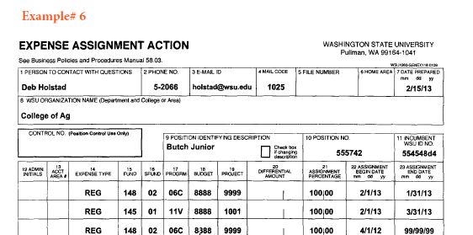
Expense Assignment Action (EAA) BPPM 58.03
See example #6 (Salaries)

Slide 19
Retroactive EAAs
EAAs –Common Errors
Retroactive EAAs involving sponsored accounts require SPS approval and a retroactive justification in the comments section.
90 day exception is also required if transferring salaries that meet the criteria.
The end date of the assignment exceeds the end date of the sponsored project.
Lack of reason for action or comments.

Slide 20
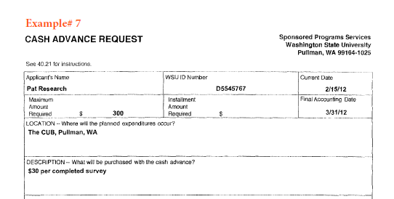
Cash Advance Request
BPPM 40.21
See example #7

Slide 21
Cash Advances
Cash Advances are only used on Sponsored Programs.
These are different from Petty Cash Funds and Travel Advances.
Kim Small handles Cash Advances. 335-2047 kksmall@wsu.edu
Used mostly for field work in remote areas and for subject payments
Funds are to be used only for the purpose requested and detailed records/receipts are required to clear the advance.
By signing for the advance, the applicant agrees to properly account for expenditures and also that funds may be withheld from applicant’s pay to cover any unaccounted balance.

Slide 22
Questions?
Contact information can be found at www.sps.wsu.edu

Slide 23
This has been a WSU Training Videoconference
If you attended this live training session and wish to have your attendance documented in your training history, please notify Human Resource Services within 24 hours of today's date: hrstraining@wsu.edu

