Slide 1

Time Report Training
Presented by:
    Human Resource Services
Revised April 2018

Slide 2
Today’s Objectives
Review Time/Leave Processes
Discuss Department Responsibility for Time/Leave Reporting

Slide 3
HRS has increased communication with areas that have repeated errors processing time/leave reports and notify Appointing Authorities, Deans and Vice Presidents of concerns.
HRS notifies WSU Internal Audit of serious and/or repeated concerns.

Slide 4
Policies and Regulations
Fair Labor Standards Act (FLSA) sets and regulates minimum wage, hours worked, overtime and record keeping
Washington Administrative Codes (WAC)
Business Policies & Procedures Manual (BPPM)
Revised Code of Washington (RCW)

Slide 5
Department Responsibility
Employees are required to complete a monthly time or leave report.
      Time Report – records attendance, leave, and overtime for overtime-eligible employees (civil service, bargaining unit, AP and Faculty)
      Leave Report – records leave activity for Faculty and AP employees who are ineligible to earn overtime.

Slide 6
Department Responsibility
Department maintains original leave/time report for each employee.
    If employee transfers to another department, the leave file is transferred to the new department
Department must provide employee with a copy of the completed time/leave report each month
Upon separation from WSU, department submits original time/leave reports to HRS for official audit

Slide 7
Annual Leave and Sick Leave Accruals
Civil Service Employees
New CS & BU employees hired 1-15th of month earn full accruals at FTE rate. If hired 16th to end of month, do NOT earn AL accruals but earn SL accruals prorated to hours worked
CS & BU Employee separating 1-15th, do NOT earn AL accruals but earn SL accruals prorated to hours worked; employee separating 16th-end of month, earn full accruals.
If FTE changes during a single month, accruals are figured on the FTE on the last working day of the month.

Slide 8
Leave Accruals
Civil Service Employees
Employees cannot use AL or SL until the first day of the month AFTER it is accrued.
Employees may use AL & SL during probationary period
Employees may use Personal Holiday during probationary period (BU employees should check the appropriate contract)

Slide 9
Current
Civil Service Annual Leave Accrual Rates for Full-Time Employees (BPPM 60.57)
Year Effective July 1, 2017 | Accrual Per Year | Accrual Per Month
1-2 years (of continuous state employment) | 14 days | 9.33 hrs
3 years (of continuous state employment) | 15 days | 10.00 hrs
4 years (of continuous state employment) | 16 days | 10.67 hrs
5-6 years (of total state employment) | 17 days | 11.33 hrs
7-9 years (of total state employment) | 18 days | 12.00 hrs
10-14 years (of total state employment) | 20 days | 13.33 hrs
15-19 years (of total state employment) | 22 days | 14.67 hrs
20-24 (of total state employment) | 24 days | 16.00 hrs
25 and longer (of total state employment) | 25 days | 16.67 hrs
See Page 4

Slide 10
Historical 7/1/05 – 6/30/17
Civil Service Annual Leave Accrual Rates for Full-Time Employees
Year July 1, 2005 – June 30, 2017 | Accrual Per Year | Accrual Per Month
1 (of continuous state employment) | 12 days | 8.00 hrs.
2 (of continuous state employment) | 13 days | 8.67 hrs.
3-4 (of continuous state employment) | 14 days | 9.33 hrs.
5-7 (of total state employment) | 15 days | 10.00 hrs.
8-10 (of total state employment) | 16 days | 10.67 hrs.
11 (of total state employment) | 17 days | 11.33 hrs.
12 (of total state employment) | 18 days | 12.00 hrs.
13 (of total state employment) | 19 days | 12.67 hrs.
14 (of total state employment) | 20 days | 13.33 hrs.
15 (of total state employment) | 21 days | 14.00 hrs.
16 and longer (of total state employment) | 22 days | 14.67 hrs.
See Page 5

Slide 11
Accrual Chart
Continuous Employment Date: 10/14/06
Initial Hire Date: 10/14/06
DATE: | RATE: | MONTHS COMPLETED SERVICE:
10/06 | 8.00 | 0
10/07 | 8.67 | 12
10/08 | 9.33 | 24
10/09 | 9.33 | 36
10/10 | 10.00 | 48
10/11 | 10.00 | 60
10/12 | 10.00 | 72
10/13 | 10.67 | 84
10/14 | 10.67 | 96
10/15 | 10.67 | 108
10/16 | 11.33 | 120
*7/17 | 13.33 | New rates
10/17 | 13.33 | 132
10/18 | 13.33 | 144
10/19 | 13.33 | 156
10/20 | 14.67 | 168
See Page 6

Slide 12
Annual Leave Accruals
Civil Service Employees - LWOP
When an employee has 11 or more FULL days of LWOP in a month:
    they do not earn AL for that month, and
    their AL accrual rate increase will be deferred by one month.

Slide 13
Sick Leave Accruals
Civil Service Employees - LWOP
When an overtime eligible employee has LWOP exceeding 80 hours in the month (prorated for part-time), sick leave must be prorated based on the number of hours in pay status for the month. WAC 357-31-121
When an overtime exempt employee has LWOP exceeding 80 hours in the month (prorated for part-time), they do not earn sick leave. WAC 357-31-121

Slide 14
Accrual Chart with LWOP
Continuous Employment Date: 10/14/06
Initial Hire Date: 10/14/06
Employee had LWOP 1/5/08-3/7/08 and 10/2/09-11/7/09
DATE: | RATE: | MONTHS COMPLETED SERVICE:
10/06 | 8.00 | 0
10/07 | 8.67 | 12
*LWOP 1/5/08-3/7/08 – defer 2 months
12/08 | 9.33 | 24
*LWOP 10/2/09-11/7/09 – defer 1 month
1/10 | 9.33 | 36
1/11 | 10.00 | 48
1/12 | 10.00 | 60
1/13 | 10.00 | 72
1/14 | 10.67 | 84
1/15 | 10.67 | 96
1/16 | 10.67 | 108
1/17 | 11.33 | 120
*7/17 | 13.33 | New rates
1/18 | 13.33 | 132
1/19 | 13.33 | 144
1/20 | 13.33 | 156
1/21 | 14.67 | 168
See Page 8

Slide 15
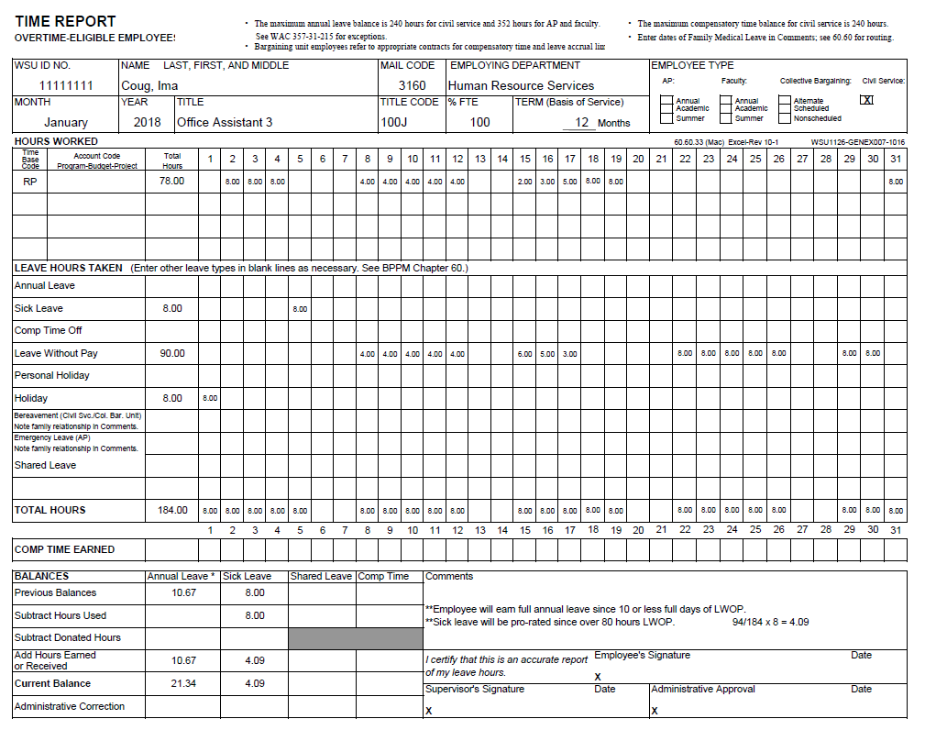
LEAVE WITHOUT PAY
See Page 9

Slide 16
Leave Accruals
AP and Faculty Employees
AP on full-time appointments earn 8 hours SL and 16.67 AL per month
Faculty on full-time appointments earn 8 hours SL and 16.67 AL per month
Faculty & AP less than full-time accrue leave at their FTE rate (50% FTE = 4 hrs SL, 8.34 AL)
Annual Leave accrual rate increased to 16.67 hours (from previous rate of 14.67) effective September 1, 2017

Slide 17
Leave Accruals
AP and Faculty Employees
      Employees cannot use AL or SL until the first day of the month AFTER it is accrued.
      Faculty on annual 12 month appointments earn AL and SL
      Faculty on academic appointments (at least a semester) earn SL only.

Slide 18
Leave Accruals
AP and Faculty Employees
Faculty & AP hired or separated within the month receive leave on a prorated basis; based on number of days in paid status
Faculty & AP on LWOP receive leave on a prorated basis; based on number of days in paid status

Slide 19
Prorating Leave Accruals
AP and Faculty Employees
Number of days in paid status ÷ number of paid working days in the month = Fraction; Fraction x 16.67 x FTE = AL accrual
  Example: 100% FTE employee works 10 days out of 22 possible in the month 10/22=.454x16.67x100%=7.58 AL
Number of days in paid status ÷ number of paid working days in the month = Fraction; Fraction x 8.00 x FTE = SL accrual

Slide 20
Leave Policies
AP & Faculty - Maximum AL balance is 352 hours; leave earned in excess of 352 is lost
Civil Service – Maximum AL balance is 240 hours on anniversary date
AP & Faculty - Emergency Leave is granted up to 5 days for qualifying event
Civil Service – Bereavement Leave is granted up to 3 days for qualifying event

Slide 21
Personal Holiday
Civil Service - Earn a Personal Holiday each calendar year (Jan 1 - Dec 31) based on FTE rate
AP & Faculty - Earn a Personal Holiday each fiscal year (July 1-June 30) based on FTE rate
    Faculty on appointment less than 12 months do not earn a personal holiday
Personal Holiday does not carry forward to the next year.

Slide 22
Recording Hours Worked
The official WSU work week is from Sunday, 12:01 a.m. to Saturday, 11:59 p.m.
Overtime eligible employees must account for hours worked each day
Overtime is calculated at hours worked in excess of 40 hours in the work week, not hours worked each workday

Slide 23
What Constitutes Overtime for
Overtime Eligible Employees?
Civil Service Employees (WAC 357-28-255)
  Work in excess of forty hours in one work week
  Work on a holiday
  For full-time employees, work on a scheduled day off when assigned by the employer
Notes:
Civil Service Reform – 40 hour work week NOT 8 hour day.
Examples

Slide 24
What Constitutes Overtime for
Overtime-Eligible AP and Faculty
Overtime-eligible AP and Faculty
  Overtime is work in excess of 40 hours in one work week
    Work on a holiday is NOT considered overtime but hours worked count towards total hours in the work week
    Work on a schedule day off is NOT considered overtime but hours worked count towards total hours in the work week
Notes:
Civil Service Reform – 40 hour work week NOT 8 hour day.
Examples

Slide 25
Overtime Compensation
Hours worked over 40 must be compensated at one and one-half times the employee’s regular rate of pay. WAC 357-28-260
Part-time employees do not earn overtime at time and one-half until they have worked more than 40 hours in the work week. Hours worked between their required hours and 40 hours must be PAID at straight time. No Straight Time Comp Time
Notes:
Civil Service Reform – 40 hour work week NOT 8 hour day.
Examples

Slide 26
Overtime Compensation
Premium Pay (PP): employee receives payment at time and one-half.
Compensatory time (PC): employee receives time off with pay at time and one-half.
    Comp time may substitute for paid overtime if employee and employer agree. WAC 357-28-275
    The accumulation of unused comp time may not exceed 240 hours. Departments may establish maximums of less than 240 hours.
    Unused compensatory time must be paid in cash at the end of each biennium
Straight Time (OP): employee receives payment at regular rate of pay.
Notes:
Department cannot tell employee how they will receive overtime payment. Employee’s decision

Slide 27
Calculating Overtime
  Paid Holidays: considered hours worked for calculating overtime.
  Personal Holiday: considered hours worked for calculating overtime.
  Work on Scheduled Day Off: CS/BU - Full-time employees assigned to work on a scheduled day off earn overtime (PP or PC);
  Work on a Holiday: CS/BU Earn overtime (PP/PC)
      If holiday falls on Friday and there is overtime for the week, OT hours should be reflected on Thursday
Notes:
In Lieu of Holiday – considered hours worked

Slide 28
Calculating Overtime
  Sick Leave
      is NOT considered hours worked for calculating overtime
  Annual Leave
      is NOT considered hours worked for calculating overtime
  Compensatory time off
      is NOT considered hours worked for calculating overtime
  Leave without Pay
      is NOT considered hours worked for calculating overtime
Notes:
Prior to 7/1/05 all paid leave (SL, AL, CT) was considered hours worked

Slide 29
Temporary Schedule Changes
  By mutual agreement, employee and supervisor may agree to a temporarily modified schedule during the work week. Such scheduling does not require advance notice. WAC 357-28-252(3)
  To request a temporary schedule change, employee submits the request to the department for approval (BPPM 60.33).
  The employing official may approve the request but is not required to do so.
Notes:
Example: 4x10 schedule – use 2 hours

Slide 30
  Employer must provide two calendar days notice for temporary changes lasting 30 calendar days or less. Employer may provide less than two calendar days notice in some circumstances.
  Permanent changes in schedule that exceed thirty calendar days, employer must provide seven calendar days notice. WAC 357-28-252(2)
Temporary Schedule Changes
Notes:
Example: 4x10 schedule – use 2 hours

Slide 31
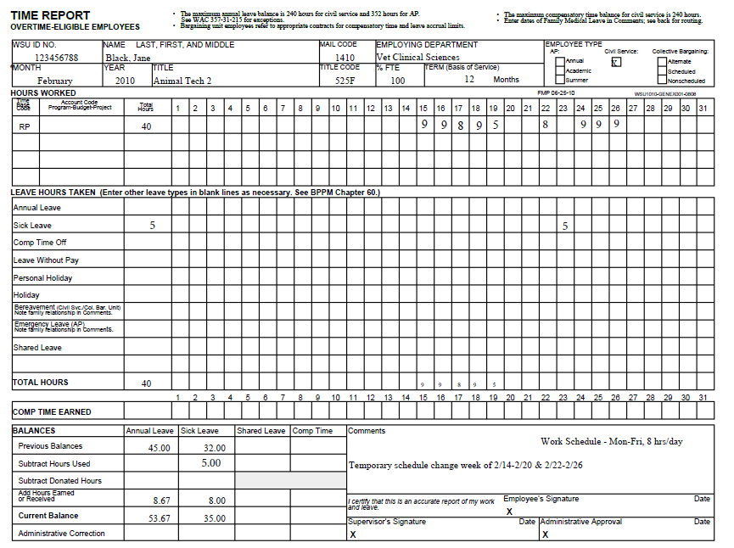
See Page 15

Slide 32
Alternate Work Schedules
  When a holiday falls on an employee's scheduled work day, record holiday hours and necessary amount of AL, CT or LWOP to account for work day schedule. BPPM 60.60
  When a holiday falls on an employee’s scheduled day off, the department may:
      Designate the prior or following work day as the holiday
      Provide the employee with equivalent paid time off (OP)
      Allow the employee to observe an in lieu of holiday at a later date.
Notes:
Example: 4x10 schedule – use 2 hours

Slide 33
Temporary Hourly Appointments
  WSU employees who hold a temp/hourly position in addition to their primary appointment must be compensated accordingly.
      Full-time, OT-eligible employees receive OT payment for all hours worked in temp/hourly position. The secondary department is required to ensure they receive appropriate rate of pay.
      OT-ineligible employees must coordinate with their primary department to account for hours worked in temp/hourly secondary position.
Notes:
Prior to 7/1/05 all paid leave (SL, AL, CT) was considered hours worked

Slide 34
Paid Sick Leave for Hourly Employees
  RCW 49.46.020(4), BPPM 60.43
  Beginning January 1, 2018, every employer in the state of Washington must provide to each of its employees paid sick leave (PSL) as provided in RCW 49.29.400 and 49.46.210.
  Paid sick leave shall accrue at 1 hour for every 40 hours worked (across WSU, not department/unit)
  PSL is calculated and paid through Positive Pay sysem
  Employee receives PSL at their normal hourly rate; department budget funds the PSL
  Unused PSL of 40 hours or less must be carried over to the following year
  Work-study students are eligible to earn PSL; work-study funds can’t be used for payment of PSL
  Employees rehired within 12 months of separation must have their accrued, unused PSL restored

Slide 35
Inclement Weather
(BPPM 50.40 & 60.40)
During inclement weather, employees may use the following types of leave:
  Accrued annual leave
  Accrued compensatory time
  Personal holiday (full day only)
  Sick leave (after all other leaves are exhausted, up to 3 days maximum in a calendar year)
  Leave without pay
  http://hrs.wsu.edu/resources/inclement-weather/
Notes:
Prior to 7/1/05 all paid leave (SL, AL, CT) was considered hours worked

Slide 36
Suspended Operations
(BPPM 50.40 & 60.40)
(
Emergencies forcing a declaration of suspended operations may occur and affect all or part of an instructional day.
  Employees required to work during suspended operations receive their regular rate of pay.
  Employees not required to work must account for the hours by:
        Accrued annual leave
        Accrued compensatory time (if overtime-eligible)
        Personal holiday (full-day only)
        Sick leave (after all other leaves are exhausted, up to 3 days maximum in a calendar year)
        Leave Without Pay
        Be given opportunity reschedule work time lost. Must be rescheduled and worked within the workweek
http://hrs.wsu.edu/resources/inclement-weather/
Notes:
Prior to 7/1/05 all paid leave (SL, AL, CT) was considered hours worked

Slide 37
December Holiday Reduced Operations
Most university operations and services will be unavailable during this time.
Departments are encouraged to be flexible determining schedules. If employees request to work and work is available, managers may approve. Final determinations are made by manager.
Employees not working must account for time by:
    Accrued annual leave
    Accrued compensatory time
    Personal holiday (full day only)
    Leave without pay
  http://hrs.wsu.edu/resources/december-holiday-reduced-operations/
Notes:
Prior to 7/1/05 all paid leave (SL, AL, CT) was considered hours worked

Slide 38
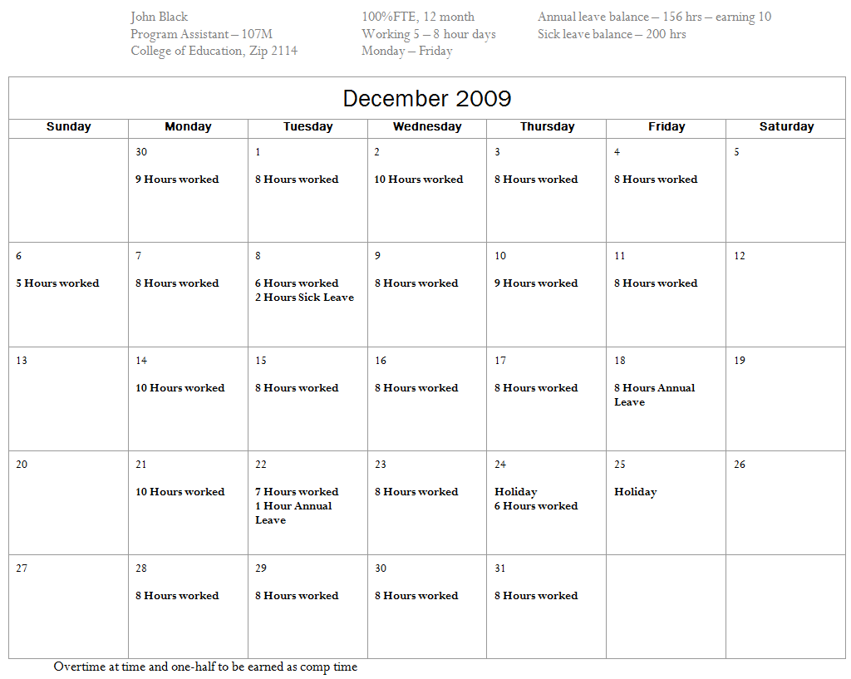
December 2009
See Page 18

Slide 39
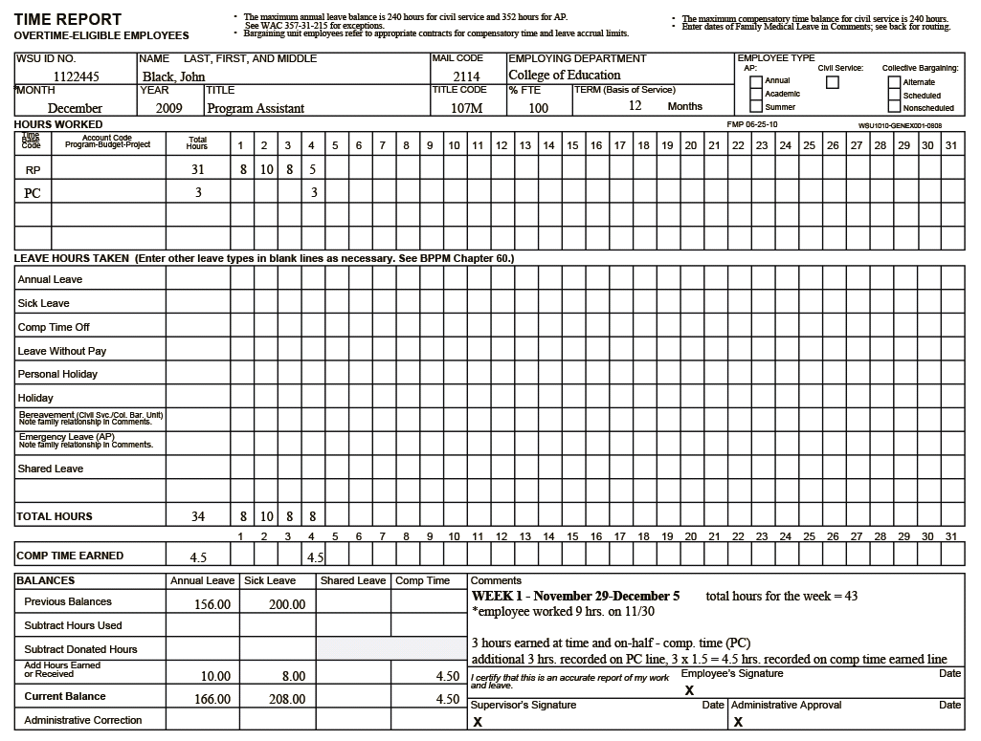
See Page 19

Slide 40
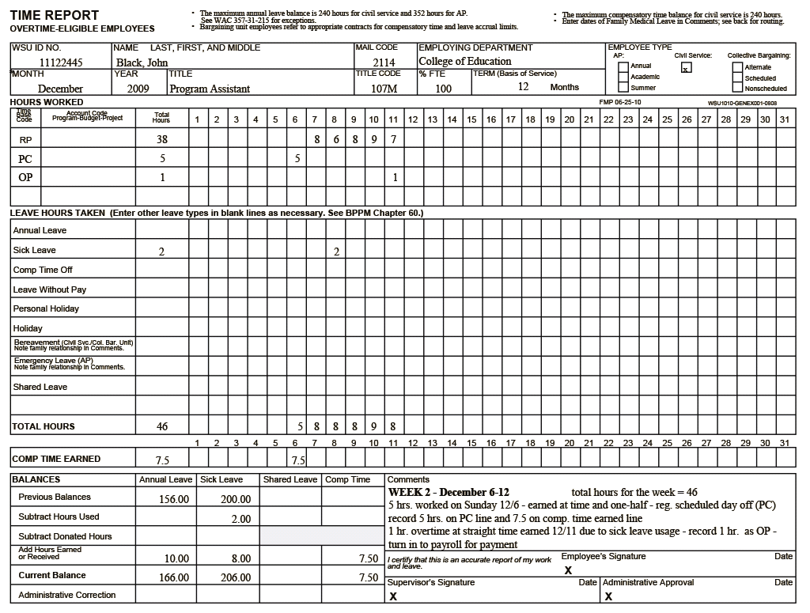
See Page 20

Slide 41
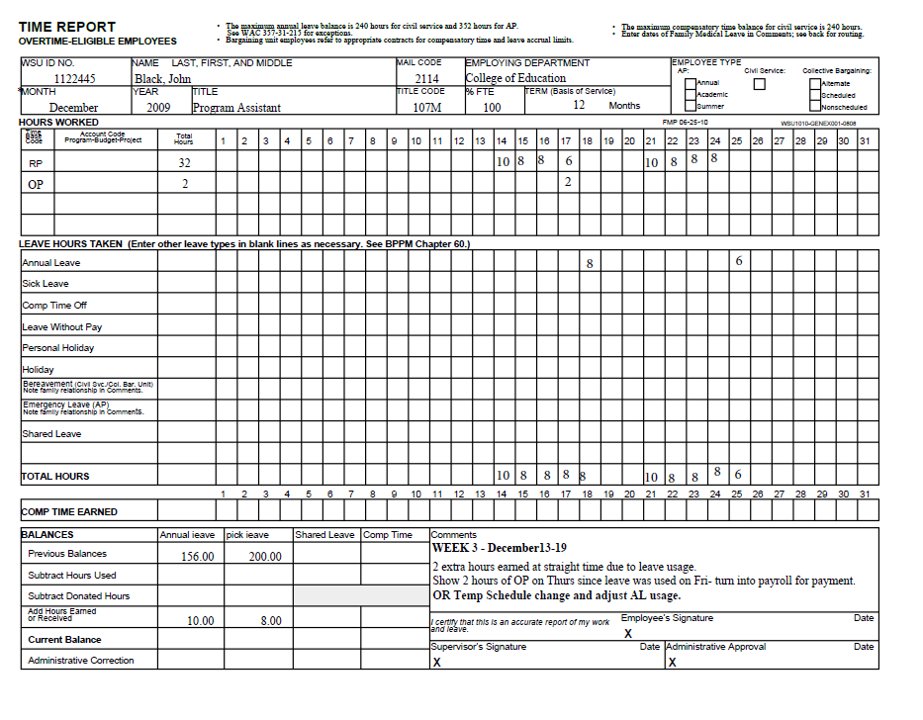
See Page 21

Slide 42
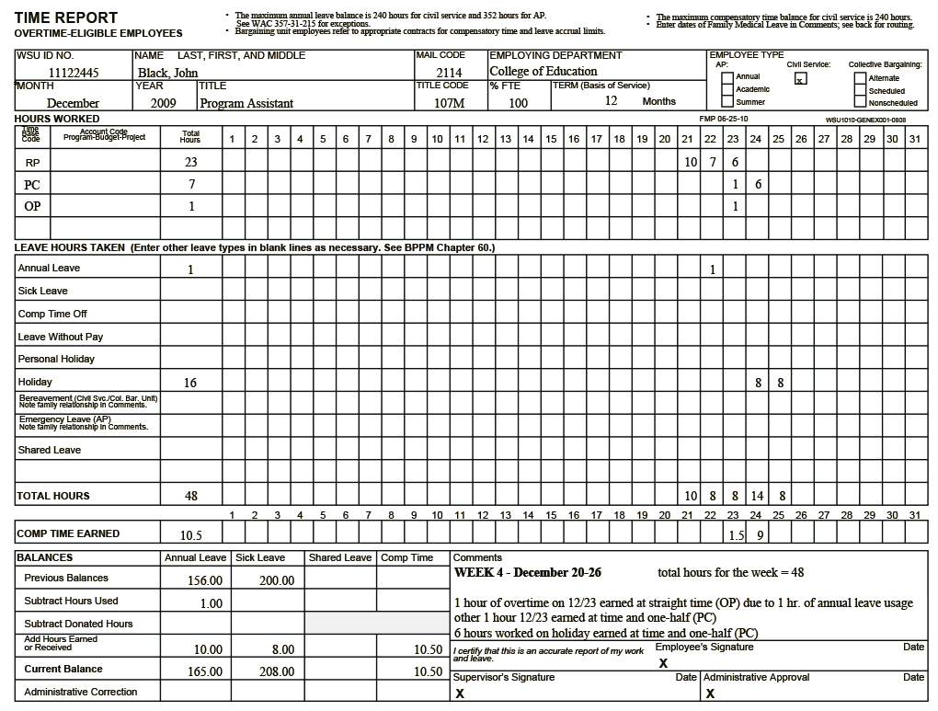
See Page 22

Slide 43
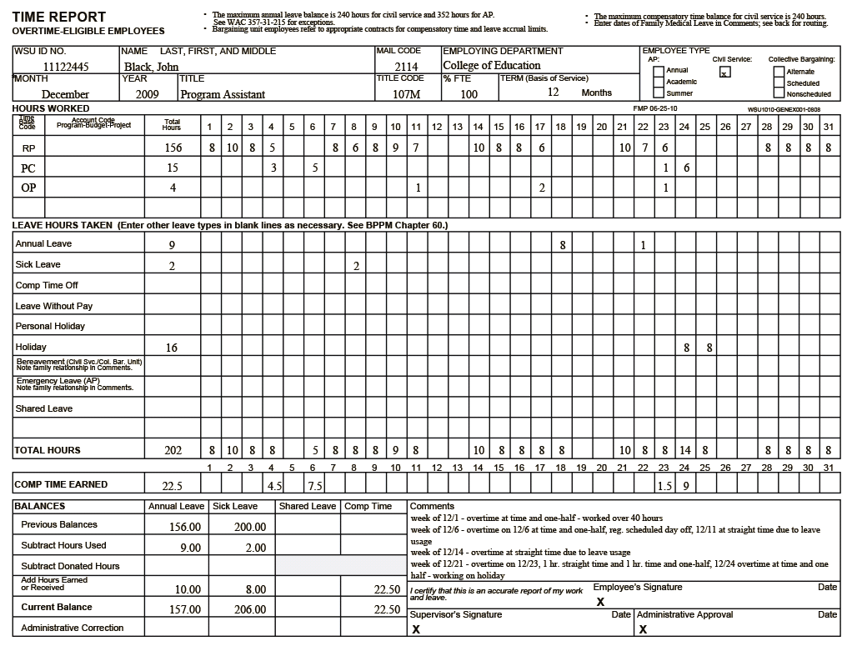
See Page 23

Slide 44
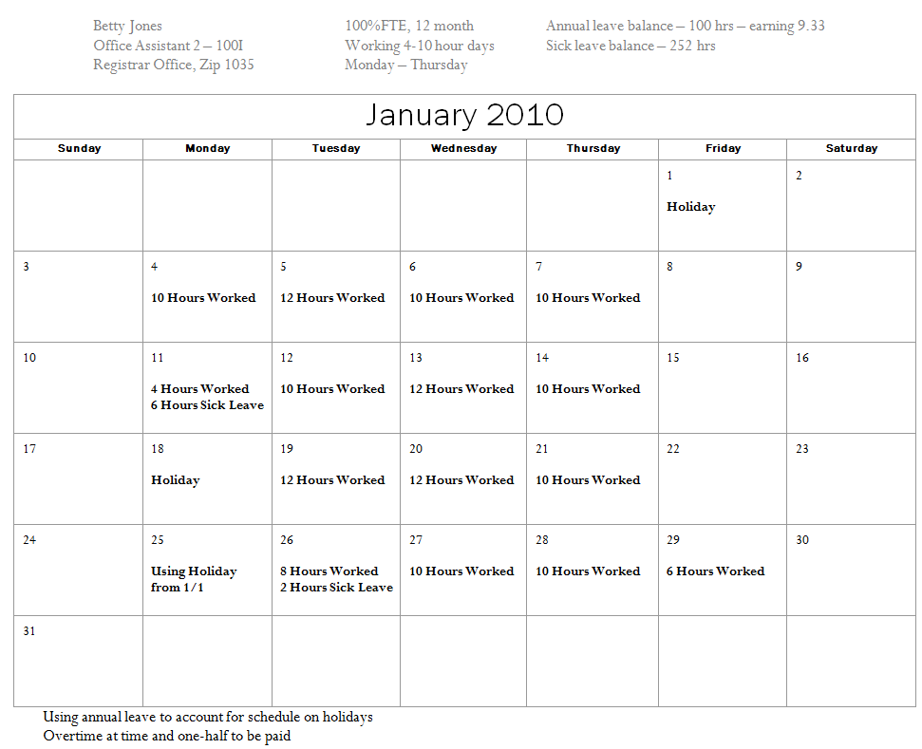
January 2010
See Page 24

Slide 45
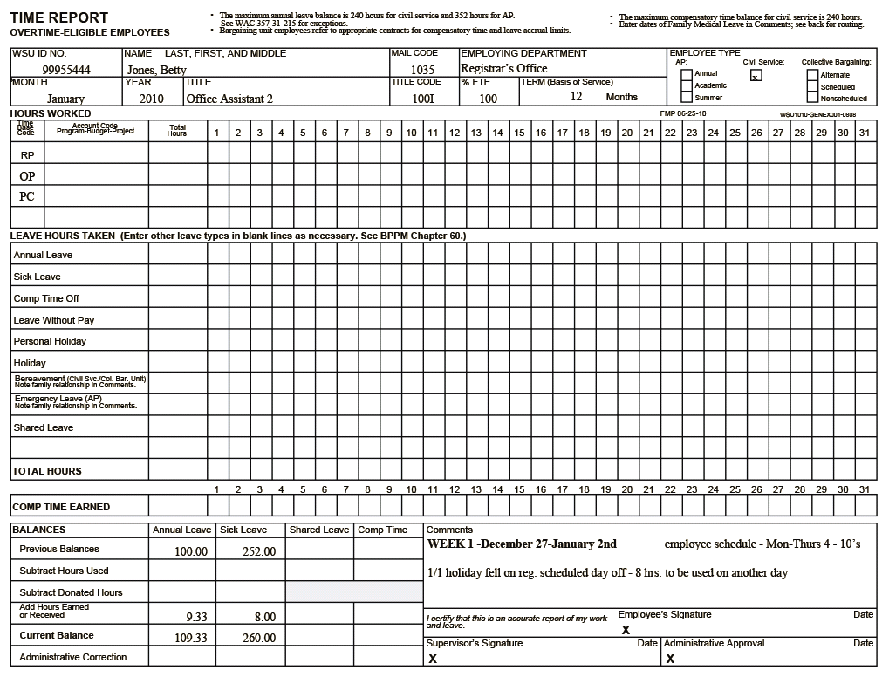
See Page 25

Slide 46
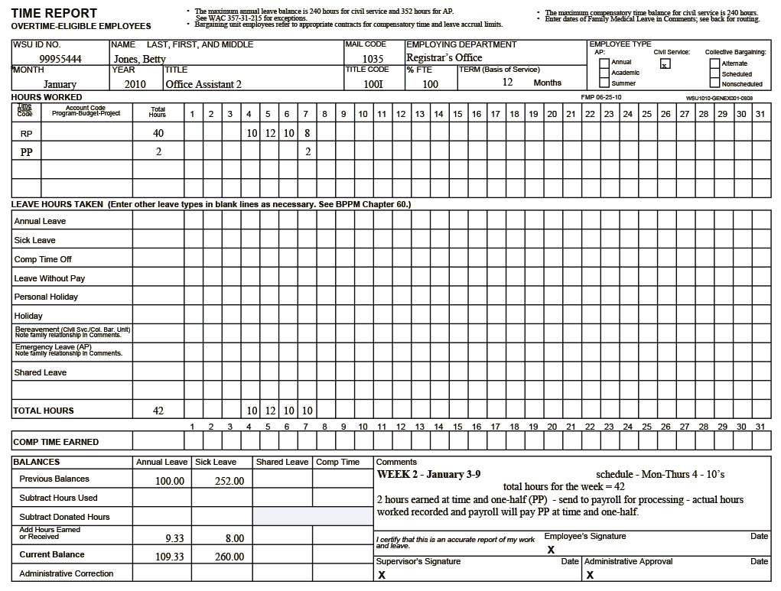
See Page 26

Slide 47
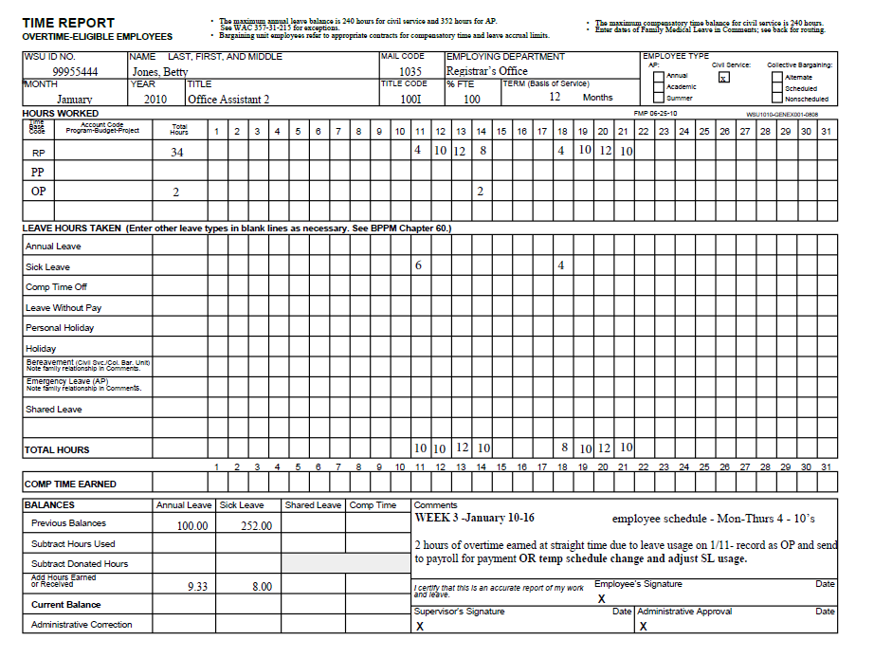
See Page 27

Slide 48
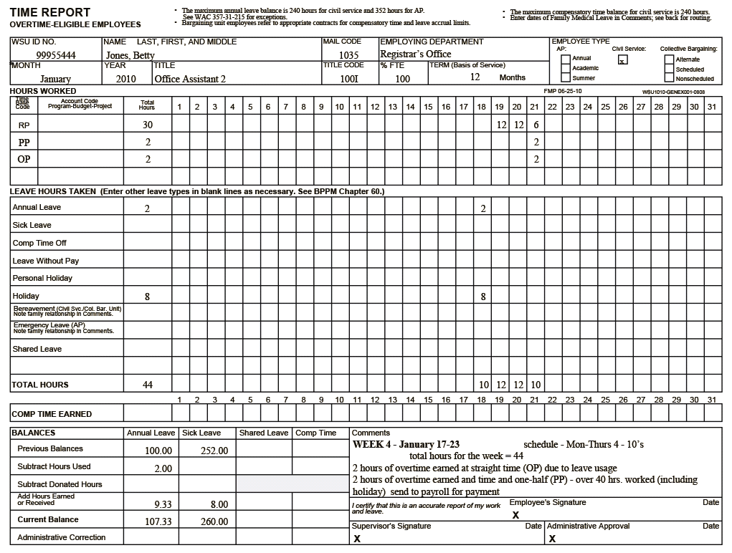
See Page 28

Slide 49
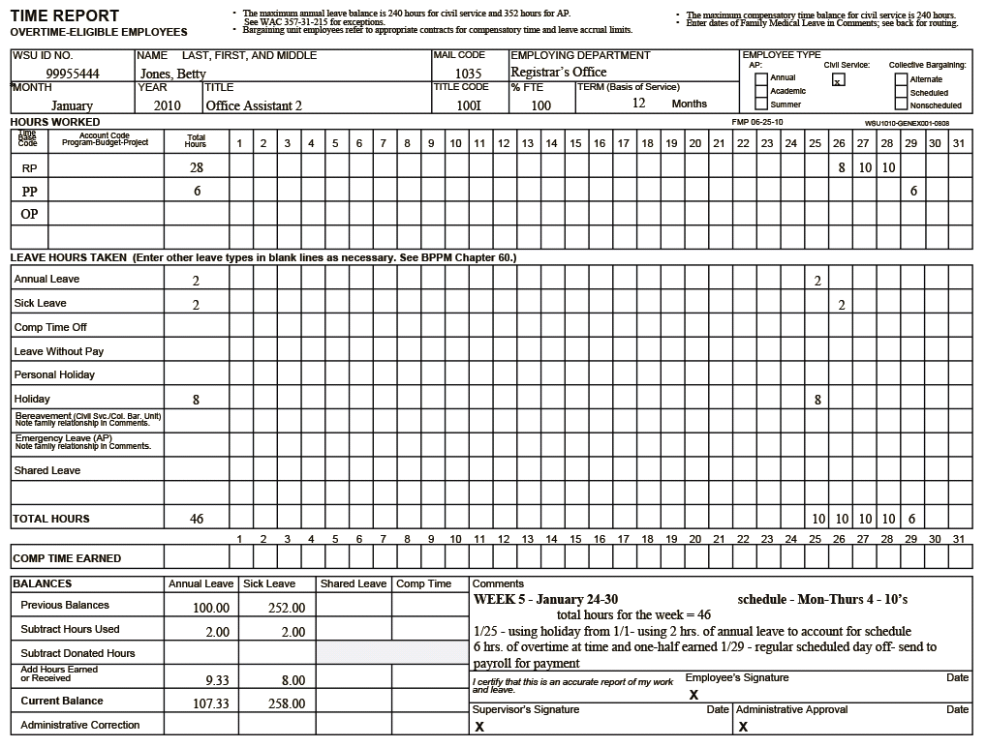
See Page 29

Slide 50
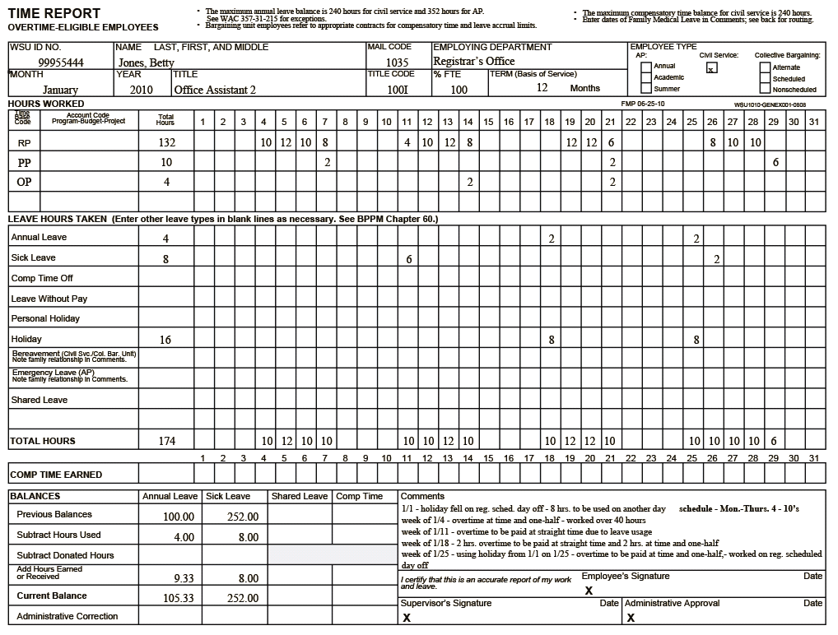
See Page 30

Slide 51
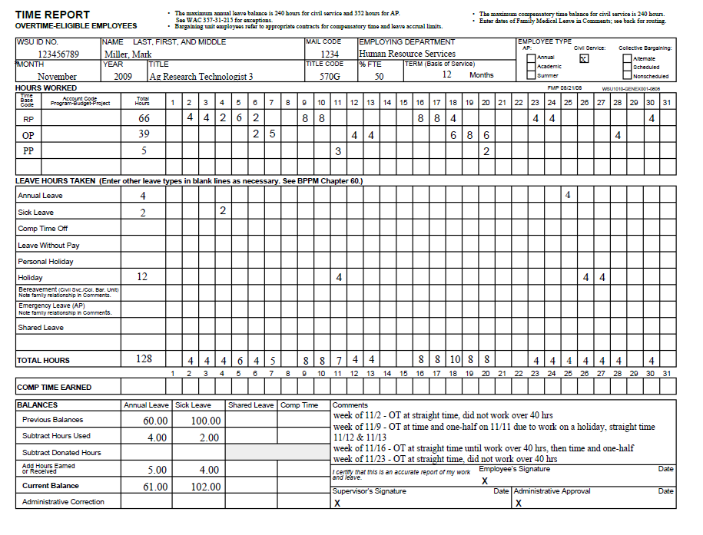
See Page 31

Slide 52
Common Time Reporting Errors
Employees must be in FULL pay status the work shift before a holiday to receive holiday pay.
Calculate appropriate accruals for civil service.
Carry forward correct leave balances.
Simple addition and subtraction errors.
Notes:
Standard hours of work – determine and communicate what the standard hours of work will be for exempt employees.
If hours have been worked, the department MUST pay for overtime

Slide 53
Common Time Reporting Errors
Time/Leave Report must be completed in ink.
Signatures and dates on all time/leave reports.
      All changes/corrections must be initialed.
LWOP must be submitted to HRS for processing.
Bereavement Leave: note relationship in comment box of time report
Notes:
Standard hours of work – determine and communicate what the standard hours of work will be for exempt employees.
If hours have been worked, the department MUST pay for overtime

Slide 54
Additional Information & Resources
Department of Labor
        www.dol.gov/fairpay
Department of Labor & Industries
        www.lni.wa.gov
Human Resource Services
        www.hrs.wsu.edu

Slide 55
Contact Information
Human Resource Services 335-4521
Lisa Neal, Assistant Director 335-3037
Classified Services
Candy Hachmann (A-K) 335-8533
Sally Wickizer (L-Z) 335-1293
Administrative Professional
J.R. Salo 335-3163
Faculty
Emily Vander Zanden 335-9417

Slide 56

This has been a WSU Training Videoconference
If you wish to have your attendance documented in your training history,
please notify Human Resource Services
within 24 hours of today's date:
hrstraining@wsu.edu

