Slide 1


Washington State University
Cash Handling Training
Developed by:
WSU Controller’s Office
Revised May 2012

Slide 2
The following two slides identify important cash handling resources discussed in this training:
The first slide lists various cash handling forms and where to obtain them.
The second slide lists the sections in the Business Policies and Procedures Manual (BPPM) that pertain to the topics of this presentation.

Slide 3
FORM | LOCATION
WSU D-RecEIPT | -- CONTROLLER’S
WSU D-RecEIPT AUTHORIZATION | --
WSU RECEIPT REQUEST | --
RECEIPT LOG SHEET | -- CONTROLLER’S
CASH DEPOSIT REPORT | -- CONTROLLER’S
INVOICE VOUCHER | -- CENTRAL STORES
BPPM 30.52.7
BPPM 30.52.8

Slide 4
BPPM FINANCIAL
FINANCE | --
ACCOUNTING FOR WSU MONIES | --
PETTY CASH | --
TILL CASH | --
WSU RECEIPTS | --
CASH HANDLING | --
REFUNDS | --
CASH REGISTERS | --
BPPM SECTION 30
BPPM 30.02
BPPM 30.50
BPPM 30.51
BPPM 30.52
BPPM 30.53
BPPM 30.55
BPPM 30.59

Slide 5
OBJECTIVES OF COURSE
Safeguarding Monies
Receipt and Deposit Money
WSU Receipt Authorization
Use of Revenue Codes
Dealing with Foreign Currency
Handling Returned Checks
Reimbursing Petty Cash
Process Refund of Revenue
Review Internal Control Policies
See BPPM SECTION 30

Slide 6
SAFEGUARDING MONIES
Deposit weekly or when receive $100
Cash never left unattended
Cash counted out of view of customers
Limit access to cash and vaults
Cash locked up (no common locks)
Endorse checks upon receipt

Slide 7
BASIC DEPOSITS
Whether a deposit consists of revenue or recoveries of expenditures, the basic receipting and depositing is the same. The following steps are taken when depositing funds to the WSU cashier’s section.

Slide 8

BASIC DEPOSITS
(include)
WSU D-Receipts & log sheets
Cash deposit report
Two calculator tapes on checks
Wrap coins in wrappers
Three copies of deposit slips

Slide 9
D-RECEIPT
It is state and university policy to issue a receipt for each instance that money is received. WSU has adopted the use of the WSU D-Receipt and WSU Logsheet to account for issuing receipts, or, accounting for money received on behalf of WSU.

Slide 10
D-RECEIPT
The following slides give an example of a
D-Receipt and how to complete the form.
A D-Receipt should always be prepared for all cash sales.
Checks can be listed on the WSU Logsheet.

Slide 12
D-RECEIPT
- Payment Type -
Indicate whether the payment received was by cash, check, or bankcard.

Slide 13
Payment Type

Slide 14
D-RECEIPT
- Prepared By -
Whomever prepares the D-Receipt initials in this space on the form.
The person preparing the D-Receipt should be the same person who accepted the payment.

Slide 15
Preparer’s
Initials

Slide 16
D-RECEIPT
- Date Recieved -
Indicate the date that the payment was received.
The D-Receipt should be prepared at the time the money is received.

Slide 17
Date Prepared

Slide 18
D-RECEIPT
- Name and Address -
        Fill in the name and address of the person making payment to WSU.
        This is important information to have on file in the event a refund will need to be done at a later date

Slide 19
Name & Address

Slide 20
D-RECEIPT
- Description -
        Fill in a description of the product or service that was performed. Be sure to fill in the amount received for the product or service

Slide 21
Amount
Description

Slide 22
D-RECEIPT
- Budget Coding -
        Indicate the budget coding where the funds are to be deposited. This is also valuable if and when a refund of revenue needs to be prepared.

Slide 23
Budget Coding

Slide 24
D-RECEIPT
- Amounts -
Indicate the amount for each line of budget coding and sum the total at the bottom of the D-Receipt

Slide 25
Line Amount
Total Amount

Slide 26
Properly
Completed
D-Receipt

Slide 27
WSU LOGSHEET
WSU LOGSHEET
The WSU Logsheet is used to record the receipt of checks and bankcards in lieu of issuing a D-Receipt. The following slides give examples of the log sheet and how to complete one.

Slide 29
WSU LOGSHEET
WSU LOGSHEET
- Department -
Indicate the department by name and number that received the payments or deposits.

Slide 30
Department

Slide 31
WSU LOGSHEET
WSU LOGSHEET
- Prepared By -
        Indicate the name or initials of the person who prepared this logsheet.

Slide 32
Prepared By

Slide 33
WSU LOGSHEET
WSU LOGSHEET
- Date Prepared -
Indicate the date the logsheet is being prepared to record the deposit to the cashier’s office.

Slide 34
Prepared Date

Slide 35
WSU LOGSHEET
WSU LOGSHEET
- Logsheet Number -
This number is preassigned on the logsheet.
Departments that have been granted an exception to use their own logsheets will assign their own series of numbers.

Slide 36
Pre-assigned Log sheet Number

Slide 37
WSU LOGSHEET
WSU LOGSHEET
- Payment By -
  Indicate the person or company from whom the money was received. If the same person has more than one check or bankcard, list each one separately.

Slide 38
Payment Received From

Slide 39
WSU LOGSHEET
WSU LOGSHEET
- Amount -
Indicate the amount for each check or bankcard received.

Slide 40
Amount

Slide 41
WSU LOGSHEET
WSU LOGSHEET
- Date Received -
Indicate the date the payment or deposit is received. This date may be different than the logsheet prepared date.
Normally, a logsheet is prepared for each day’s activity, depending on volume of receipts.

Slide 42
Date Received

Slide 43
WSU LOGSHEET
WSU LOGSHEET
- Payment Type -
Indicate the type of payment received:
“C” indicates payment was received by check.
“B” indicates the payment was received by a bankcard.

Slide 44
Payment Type

Slide 45
WSU LOGSHEET
WSU LOGSHEET
- Account Information -
Also indicate relevant account information.

Slide 46
Account Information

Slide 47
WSU LOGSHEET
WSU LOGSHEET
- Comments (optional) -
Consider including a brief description of the product or service provided.

Slide 48
Comments (not required)

Slide 49
WSU LOGSHEET
WSU LOGSHEET
- Total -
Total each page of the logsheet.
More than one logsheet may be used per deposit to the cashiers office.

Slide 50
Total

Slide 51
Properly Completed Log Sheet

Slide 52
WSU RECEIPTS
- Conclusion -
        Always issue a D-Receipt for cash sales. The logsheet may be substituted for check and bankcard sales.
        The total of all D-Receipts and logsheets should agree with the money in the till, unless there is an overage or shortage (to be discussed later).

Slide 53
WSU RECEIPTS
- Conclusion -
The overall purpose of the receipt forms is to account by transaction for all money received.
A beginning and ending transaction number is needed to account for all transactions, including voids.

Slide 54
WSU RECEIPTS
- Conclusion -
All checks should have been endorsed at the time of their receipt with the department or club name. Include the phrase “ for deposit only.”
Next, prepare the cash deposit report which is discussed on the next series of slides

Slide 55
DEPOSITING
After summing the D-Receipts and logsheets and reconciling to the amount of cash in the till, it is time to prepare the deposit.
Two adding machine tapes need to be made on each bundle of checks.
Coins should be wrapped when appropriate with the department name on each wrap.

Slide 56
CASH DEPOSIT REPORT
The cash deposit report is a summary indicating where to post the revenue to the subsidiary budget accounts.
The following slides show examples and how to complete a cash deposit report.

Slide 58
CASH DEPOSIT REPORT
- Department -
Indicate the name and mail code of the department making the deposit of revenue.

Slide 59
Name and Mail Code of Depositing Department

Slide 60
CASH DEPOSIT REPORT
- Deposit Date -
Indicate the date the deposit is being made at the cashier’s office.

Slide 61
Date Prepared

Slide 62
CASH DEPOSIT REPORT
- D-Receipt Series -
Indicate the “To” and “From” series of D-Receipts and/or logsheets. The D-Receipts and logsheets must total the amount that is being deposited unless there is an overage or shortage (to be discussed later).

Slide 63
D-Receipt or Log sheet Series

Slide 64
CASH DEPOSIT REPORT
- Missing D-Receipts -
Any missing D-Receipts in a series are listed in this space.
A memo should be attached explaining if they are lost or destroyed

Slide 65
Missing D-Receipt

Slide 66
CASH DEPOSIT REPORT
- Budget Coding -
Indicate the budget coding to be used for this deposit.
Multiple lines of coding are acceptable.

Slide 67
Budget Coding

Slide 68
CASH DEPOSIT REPORT
- Source -
The Source/Subsource is a five digit number indicating the source of the revenue.
The sources can be found in “BALANCES” from the main menu page by using “PF6” and choosing “Revenue Codes.”

Slide 69
Source & Sub source

Slide 70
CASH DEPOSIT REPORT
- Transaction Type -
This indicates whether the transaction is positive or negative:
Positive revenue is entered with a TT of “01”
Negative revenue is entered with a TT of “02”
(to be discussed later)

Slide 71
Transaction Type

Slide 72
CASH DEPOSIT REPORT
- Composition -
Indicate the composition of money being deposited:
Coin
Currency
Checks
Bankcards

Slide 73
Composition

Slide 74
CASH DEPOSIT REPORT
- Signatures -
Two signatures are required.
The person preparing the cash deposit report signs as preparer and a reviewer signs as the second signature

Slide 75
Preparer’s Signature
Approval Signature

Slide 76
Properly Completed Cash Deposit Report

Slide 77
DEPOSIT TO CASHIER’S
After the cash deposit report is prepared and signed, take the cash deposit report with the yellow copies of any D-Receipts and log sheets and the money to the cashier’s window of the Controller’s Office.
The cashiers will verify the funds, process the cash deposit report, assign a receipt number, and furnish the department a receipt.

Slide 78
D-RECEIPT AUTHORIZATION
D-Receipts are issued through the Controller’s Office cashier’s section. Each department has a primary person responsible for these receipts.
Secondary people may be assigned to pick up D-Receipts on behalf of the primary person

Slide 79
D-RECEIPT PROCECURES
Receipt authorization
  Authorized by Dean or V.P.
  Primary and secondary
Primary responsibilities
  Inventory of D-Receipts
  Review cash deposit reports
  Two signatures on cash deposit
Secondary responsibilities
  Pick-up D-Receipt supplies
  Sign cash deposit report

Slide 80
RECEIPT AUTHORIZATION FORM
The following slides provide instructions for correctly completing the receipt authorization form.

Slide 81
BPPM 30.52

Slide 82
Date, College, Department, Unit Number

Slide 83
Add or Delete

Slide 84
Primary or Secondary

Slide 85
Name

Slide 86
Signature

Slide 87
ID Number

Slide 88
Telephone Number if Known

Slide 89
Dean or V.P. Approval

Slide 90
RECEIPT REQUEST FORM
When requesting either D-Receipts or Logsheets from the Controller’s Office, a Receipt Request Form must be filled out.
The following slides give instructions for filling out this form.

Slide 92
Department, Org Number, Mail Code, Telephone Number

Slide 93
Number and Type of Invoices or Log Sheets Requested

Slide 94
Approval Name and Signature

Slide 95
WSU ID Number and Approval Date

Slide 96
RECEIPT REQUEST FORM
- Controller’s Responsibility -
The cashier’s will indicate the beginning and ending receipt numbers or log sheet numbers being dispersed and the date.
The person receiving the receipts or log sheets will sign and date the form.

Slide 97
Issue Date and Beginning and Ending Numbers

Slide 98
Recipient Signature and Received Date

Slide 99
INVENTORY CONTROL SHEET
Once per year the primary person should take an inventory of the D-Receipts and Log sheets
  Indicate those used
  Indicate those voided
  Indicate those lost
  Indicate those still on hand

Slide 100
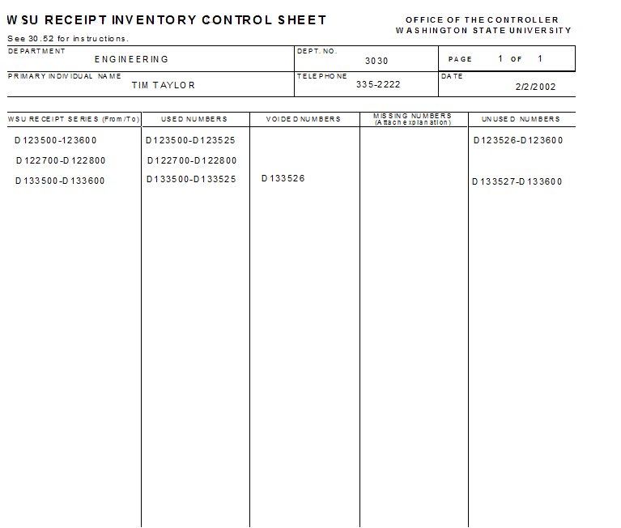
Departmental Information

Slide 101
Receipt and Logsheet Series Issued

Slide 102
Used Numbers
Voided Numbers
Missing Numbers
Unused Numbers

Slide 103
CASH REGISTER SALES
If your department uses a cash register that sequentially numbers receipts, then you need not use the D-receipts and log sheets.
A copy of the ring-out at the end of the day is attached to the cash deposit report, to be discussed next, as the back-up for the individual sales.
BPPM 30.59

Slide 104
CASH REGISTER REQUIREMENTS
Departments must:
  Maintain complete records of cash register activity
  Close out cash register at the end of each day
  Complete a balance reconciliation for each register
BPPM 30.59

Slide 105
CASH REGISTER REQUIREMENTS
  One cash drawer or one cash register per cashier
  Ability to record cashier identification name or number on each transaction
  A cash register tape and journal tape which record all transactions
  A key which enables readings or totals throughout the business day
  A grand total of cumulative sales which cannot be reset to zero or continuous trans counter

Slide 106
CASH REGISTER REQUIREMENTS
  A void transaction key on the register or department procedures in place to track voided transaction numbers
  The ability to show money totals by type (cash, check, bankcard, Cougar Card, etc.)
Note: A daily reconciliation sheet may be found
in the PDF version of 30.59.5 as needed.

Slide 107
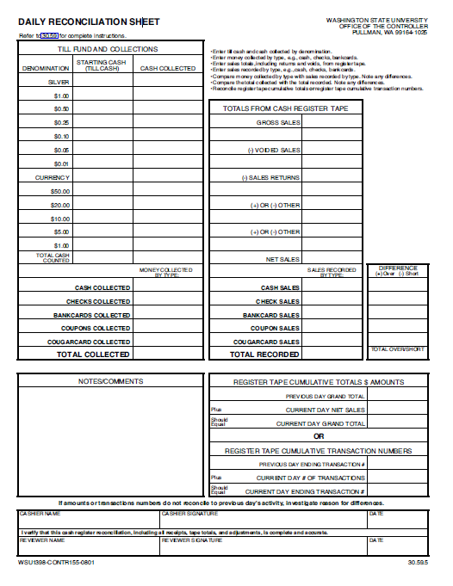

Slide 108
BANKCARD SALES
  Many departments are set up to receive payments by bankcard.
  Most of the departments are on electronic data capture and many are setting up web sites.

Slide 109
BANKCARD SALES
- Transaction Types -
If the net of the bankcard sales is a negative, the department must use a transaction type of 02.
If the net is positive, the department uses atransaction type of 01.
Include the date of the transactions.
A separate cash deposit report must be prepared for each day’s settlements.

Slide 110
BANKCARD SALES
- Electronic Bankcards -
Most departments use the electronic card swipe.
When the bankcard machine is batched out at night, the money is electronically fed to the bank.
The department need only prepare a cash deposit report for the net amount of the credit card batchout.

Slide 111
BANKCARD SALES
- Electronic Bankcards -
A copy of the ring-out needs to be attached to the cash deposit report. Do not include a copy of the individual sales.
Only the ring-out with the totals is needed. This is run by the Controller’s Office as a “no money” transaction, since the money is already in the bank.

Slide 112
REVENUE SOURCES
There are many revenue sources to identify the purpose of the revenue. From the “AIS: BALANCES” main page, using “PF6” allows you to choose a complete list of sources.
The following slide shows the most common sources used for most service centers on campus.

Slide 113
REVENUE CODES
BALANCES - MAIN MENU PF6
SOURCE 420 | -- OUTSIDE COLLEGE AREA
SOURCE 428 | -- WITHIN COLLEGE AREA
SOURCE 451 | -- OFF CAMPUS

Slide 114
TRANSACTION TYPES
The transaction type indicates in accounting how to post the revenue.
TT 01 and 02 For revenue using sources and subsources
TT 05 and 06 For recoveries of expenditures, which use objects and subobjects

Slide 115
TRANSACTION TYPES
TT – 01 | -- POST POSITIVE REVENUE
TT – 02 | -- POST NEGATIVE REVENUE
TT – 05 | -- POST POSITIVE RECOVERY
TT – 06 | -- POST NEGATIVE RECOVERY

Slide 116
CASH OVERAGE
If there is more cash in the till drawer than receipts issued, there is an overage.
To post an overage, post gross receipts, the total of d-receipts and logsheets and use transaction type 01.
Then, post the overage using a transaction type “01” for positive revenue, but use source 490-10.

Slide 117
CASH OVERAGE
In the following example, we had receipts and log sheets totaling $300
Our till at the end of the day was $310
  We code the receipts as regular revenue to source 420 and then code the overage using source 490.
  The total posted equals the total amount of money we have in the till.

Slide 118
CASH OVERAGE
- Gross Receipts -
Post the amount of receipts issued, which will total D-Receipts and logsheets. In this example, this is $300
Use the normal source/subsource to post the revenue
Use transaction type 01 for positive revenue

Slide 119
Post Gross Receipts to Budget Coding

Slide 120
CASH OVERAGE
- Overage Account -
Post the overage to the account the gross receipts occurred.
Many departments have an account designated for overs and shorts. This account may also be used.

Slide 121
Post Overage to Budget Coding

Slide 122
CASH OVERAGE
- Overage Source -
Use source 490 with subsource 10 to post an overage.

Slide 123
Overage Source
Overage Sub Source

Slide 124
CASH OVERAGE
- Overage Transaction Type -
Post an overage with transaction type “01”, since this is positive revenue.

Slide 125
Positive Tran Type

Slide 126
CASH OVERAGE
- Total Amount -
The total amount of cash deposited will be more than the amount of D-Receipts and logsheets by the amount of the overage.

Slide 127
Total

Slide 128
Completed Cash Deposit Report for Overage

Slide 129
CASH SHORTAGE
Post gross receipts
Post shortage as 490-11
Use TT-02

Slide 130
CASH SHORTRAGE
In the following example, we had gross receipts of $300. Our till at the end of the day was only $290.00. We will post gross receipts of $300 to our regular revenue, source 420, and $10 as a shortage using source 490-11, with a transaction type of 02 for negative revenue. The total will now equal our till amount.

Slide 131
CASH SHORTRAGE
- Gross Receipts -
Post the gross receipts to the appropriate revenue accounts. The gross receipts is the total of the D-Receipts and logsheets being deposited.

Slide 132
Post Gross Total to Budget Coding

Slide 133
CASH SHORTRAGE
- Shortage Account -
Post the shortage amount to the appropriate budget and project. Many departments use a specific account to post overs and shorts.

Slide 134
Shortage Coding to Budget Coding

Slide 135
CASH SHORTRAGE
- Shortage Source -
  Post the shortage to source 490 and subsource 11.
  The source 490 is used for both overs and shorts, but the subsource is different to indicate if it is over or short.

Slide 136
Shortage Source
Shortage Sub Source

Slide 137
CASH SHORTRAGE
- Shortage Transaction Type -
Use transaction type “02” for a shortage, since this is negative revenue.

Slide 138
Negative Tran Type

Slide 139
CASH SHORTRAGE
- Total Deposited -
The total amount deposited will be lower than the gross receipts, or D-Receipts and logsheets by the amount of the shortage.

Slide 140
Total

Slide 141
Completed Cash Deposit Report for Shortage

Slide 142
CASH OVERAGES & SHORTRAGES
- Conclusion -
For both overages and shortages:
  Post the gross amount of receipts issued
  Adjust as a positive or a negative for the overage and shortage
  The total posted to all accounts will equal the amount of cash in the till.

Slide 143
RECOVERY OF EXPENDITURE
Occasionally a department will receive a rebate check or a check that is handled as a recovery of expenditure.
    The receipting process is the same as for revenue.
    The difference is in completing the cash deposit report.

Slide 144
RECOVERY OF EXPENDITURE
Prepare cash deposit report
Include vendor number
Include reference number
Use TT-05

Slide 145
RECOVERY OF EXPENDITURE
- Object / Subobject -
Instead of using a source/subsource as with revenue, use an object/subobject to indicate expenditure.
This will be the same as the original expenditure you are recovering against.

Slide 146
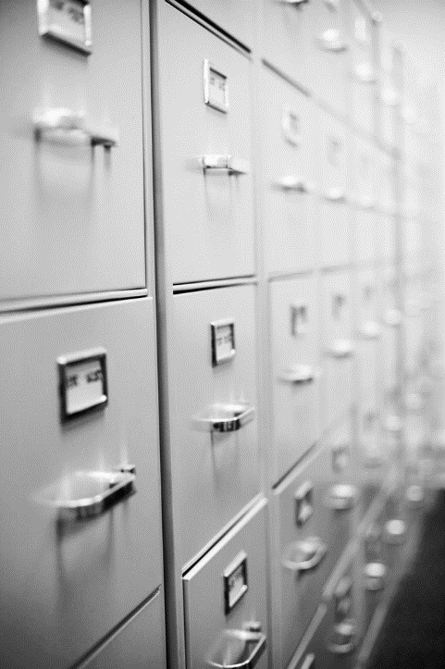
RECOVERY OF EXPENDITURE
$500 filing cabinet purchase
Vendor offers to reimburse portion of cost
BALANCES provides:
- object and sub object
- vendor number and reference number
TT-05

Slide 147
Sub Object
Object

Slide 148
RECOVERY OF EXPENDITURE
- Transaction Type -
Use a transaction type of 05 for a positive recovery. As was mentioned earlier, 01 and 02 are used for revenue, 05 and 06 are used for recoveries of expenditures.
In the following slide, the 01 should be
an 05.

Slide 149
Transaction Type

Slide 150
RECOVERY OF EXPENDITURE
- Reference/Document Number -
This number is the same as the original expenditure we are recovering against.
It could be a payment request number, a travel number, a contract number, or some other reference number assigned at the time of original expense.

Slide 151
Reference Number

Slide 152
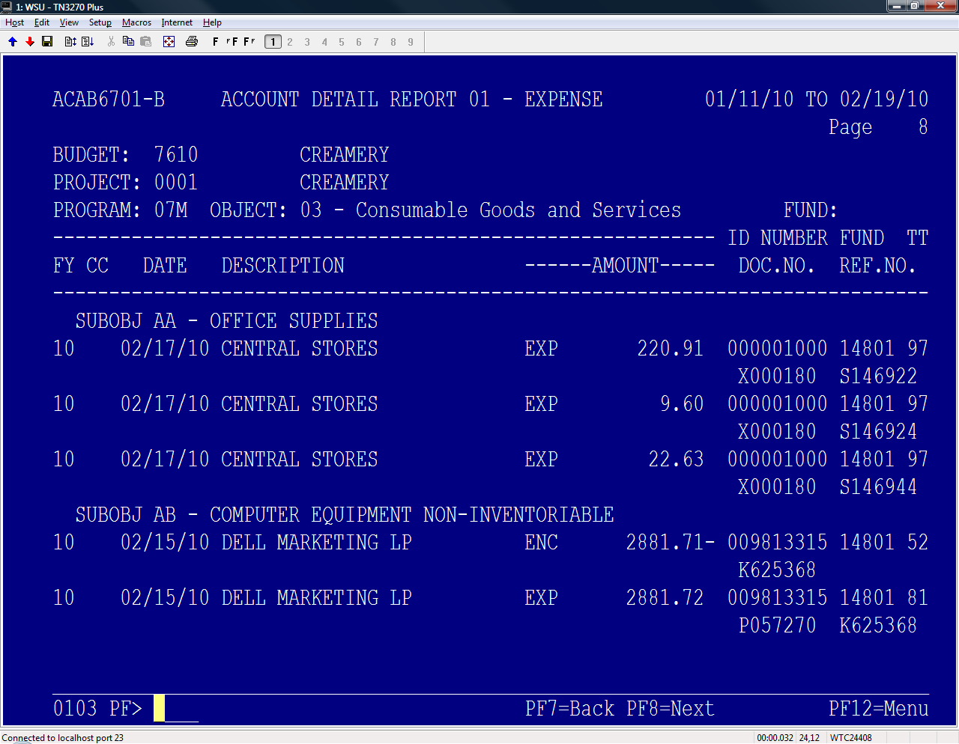
Reference number or document number

Slide 153
RECOVERY OF EXPENDITURE
- Vendor Number -
This is the vendor number assigned by Accounts Payable. This number could also be a student id number.
Each vendor or student or staff member has a unique number assigned to them which can be found on BALANCES when locating the original expense.

Slide 154
Vendor Number

Slide 155
Vendor number

Slide 156
Completed Cash Deposit Report

Slide 157
CASH ON ACCOUNT
Many departments bill through the receivables office. Those payments are made to the cashier’s office.
Occasionally, someone will pay in the department. This money needs to be deposited to the Controller’s Office as a Cash on Account, to clear the Accounts Receivable.

Slide 158
CASH ON ACCOUNT
The difference is that the money is not directly deposited into a budget and project.
The money goes thru the receivables posting and is eventually posted to the budget and project that the receivable was charged against.
This clears the customers account.

Slide 159
CASH ON ACCOUNT
ACBR502M BILLING RECEIVABLES SYSTEM 02/25/10
ACBR5020 Customer Ledger Page 1 of 1 15:12:46
------------------------------------------------------------------------------
99999999 COUGAR,BUTCH T * Present Bal: 71.00
Posted Subcode Description Charge Credit Outstanding
------ ----- ------------------------------ ---------- ---------- -----------
063009 41612 VET /INV 2222222 9.00
070209 41613 VET INV 3333333 20.00
070709 41614 VET INV 4444444 44.00

Slide 160
CASH ON ACCOUNT
D-Receipt
Cash deposit report
No departmental coding

Slide 161
CASH ON ACCOUNT
In addition to indicating the mode of payment as cash, check, or bankcard, note on the D-Receipt that this is a Cash on Account payment.

Slide 162
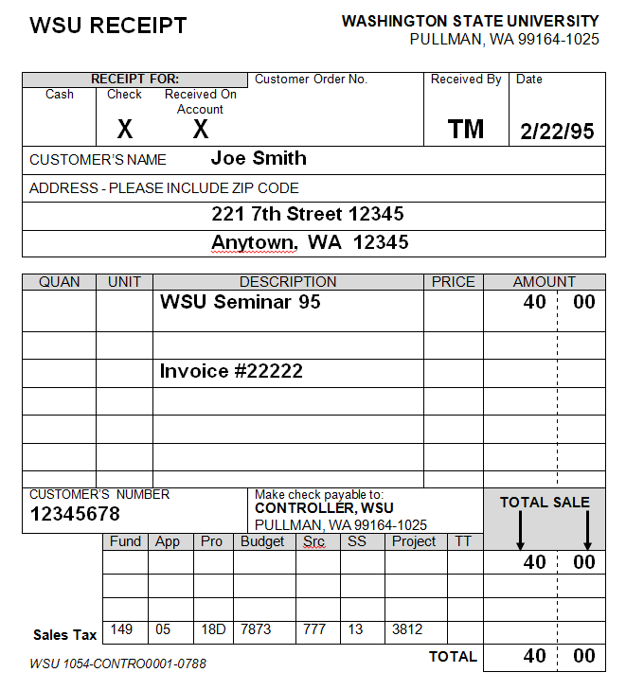
Indicate Cash on Account

Slide 163
CASH ON ACCOUNT
- Vendor Number -
If the person or company’s Vendor or ID Number is known, indicate that in this space.
It hastens the posting process, as the number does not have to be researched by the Cashier’s Office.

Slide 164
Customer Number if known

Slide 165
Completed D-Receipt
for Cash on Account

Slide 166
CASH ON ACCOUNT
- Budget Coding -
As mentioned earlier, there is no budget coding for this type of payment. This is posted to the customer’s receivable account.

Slide 167
CASH ON ACCOUNT
- Cash Deposit Report -
The cash deposit is prepared in total with the following differences:
  There is no budgetary coding
  At the bottom of the cash deposit report, there is a line indicating that this is a cash on account payment. Indicate the amount paid on this line

Slide 168
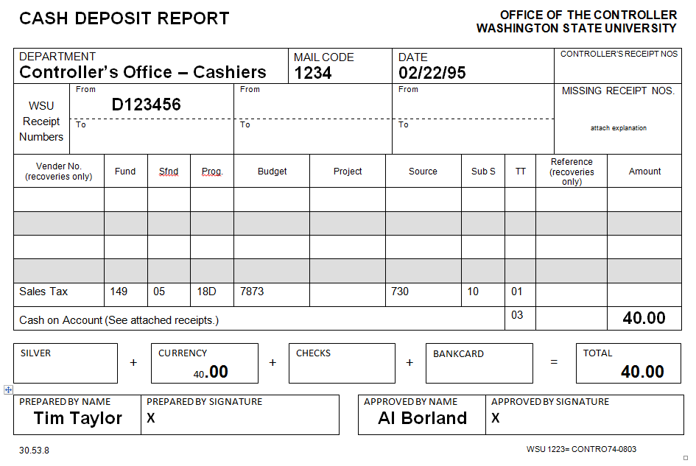
No Budgetary Coding
Amount Paid

Slide 169
FOREIGN ITEMS
Foreign checks may not clear through the United States banking system without being sent for collection.
If the front of a foreign check indicates an American bank is associated with the foreign bank, the check will probably be ok to deposit.

Slide 170
FOREIGN ITEMS
If there is no American bank on the check, it will have to be sent for collection.
There will be collection costs associated with collecting the money, usually starting at about $30 dollars.
Send these checks to the cashier’s office to be sent for collection.

Slide 171
FOREIGN COLLECTION ITEMS
Cashier’s log check and send to bank
Cashier’s notify department upon credit
Department furnishes coding
WSU is not responsible for collection fees

Slide 172
RETURNED CHECK
Occasionally, a check is returned by the bank NSF, closed account, or some other reason.
Some departments collect their own checks.
Other departments have set up a sub code in the Receivables Office to collect their bad checks. Departments may charge a $30 charge for NSF’s

Slide 173
RETURNED CHECK
Returned checks are initially handled in the controller’s office.
A receipt coding form is sent to the department indicating the account charged for the returned item.
If the department collects their checks, the check will be attached to this receipt coding form.

Slide 174
RETURNED CHECK
If Receivables collects the check, the department will receive a receipt coding form, and the check is sent to Receivables.
Each month, the department will receive a report indicating any outstanding items, along with who paid and how much toward their returned item

Slide 175
RETURNED ITEM
- BPPM 30.58 -
Negative receipt by Controller’s Office
Charge on source 420-91
Receipt copy to department
Check to:
    Department, or
    University Receivables

Slide 177
REFUNDS OF REVENUE
Occasionally, a department will need to issue a refund of revenue received by a person or a company.
To do this, complete an invoice voucher and forward to the revenue section of the Controller’s Office (zip 1025).
The following slides show how to complete this form.

Slide 178
REFUNDS OF REVENUE
- BPPM 30.55 -
        Complete Invoice Voucher
        Include Customer Number if known
        Description of refund
        Authorized signature
        Send to Revenue Desk (zip 1025)
Send second copy for companies

Slide 179
REFUNDS OF REVENUE
- Department / Customer -
Complete the department name and address on the top left of the invoice voucher.
Below the department name, complete the name and address of the person or company receiving the refund. This will be the address the check is mailed to.

Slide 180
Department Processing Refund
Name and Address of Refundee

Slide 181
REFUNDS OF REVENUE
- Date – Description - Amount -
Give the date of the original receipt of funds.
Include a brief description for the purpose of the refund, and indicate the refund amount.

Slide 182
Amount
Original Date of Receipt
Description of Refund

Slide 183
REFUNDS OF REVENUE
- D-Receipt or Receipt -
If known, indicate in the description field:
    Original receipt number,
    D-Receipt number, or
    Reference number

Slide 184
Original Receipt Number if Known

Slide 185
REFUNDS OF REVENUE
- Authorized Signature -
The Invoice Voucher must be signed by a person authorized on the budget and project against which the refund is being charged.

Slide 186
Authorized Signature

Slide 187
REFUNDS OF REVENUE
- Budget Coding -
Indicate the budget coding for this refund. Should be the same as where the revenue was originally receipted.

Slide 188
Original Deposit Coding

Slide 189
REFUNDS OF REVENUE
- Customer Number -
Indicate the Customer Number or ID Number if known.
This speeds the process for issuing the refund, as research does not have to be done to find the person’s vendor number.

Slide 190
Customer Number if Known

Slide 191
Completed
Invoice
Voucher

Slide 192
BANKCARD REFUND
A bankcard refund is processed by using a bankcard invoice voucher. Two signatures are required for this type of refund.
Refer to BPPM 30.55 for bankcard refunds.

Slide 194
Requires two Signatures

Slide 195
BANKCARD REFUND
Complete a credit card refund voucher for each credit card refund.
The department submits the refund to the credit card company via electronic processing or using the manual slips, depending on how the department is set up with merchant services

Slide 196
BANKCARD REFUND
The credit card refund voucher is retained by the department for 6 years.
If the original payment was made over the world wide web or the touchtone credit card system, the invoice voucher is sent to the revenue section of the controller’s office for processing.

Slide 197
PETTY CASH ACCOUNT
Petty cash accounts are issued through the controller’s office and are used for small emergency purchases.
They are not to be used as a till cash fund and checks should never be cashed through a petty cash account.
Most petty cash accounts are $50 to $100

Slide 198
PETTY CASH ACCOUNT
These accounts are issued to a fund custodian and that person is solely responsible for the money.
If a person needs money to purchase an item, a note is left in the account indicating how much was given by the custodian and to whom.
That person brings back a receipt after purchase.

Slide 199
PETTY CASH ACCOUNT
At any point in time:
receipts in the till for purchases
notes indicating money out to individuals
money left in the till
+
=
amount of the petty cash fund

Slide 200
PETTY CASH ACCOUNT
- BPPM 30.50 -
Small or emergency purchases
Reconcile at all times
Reimburse at least monthly
      invoice voucher
      authorized signature
      List and attach receipts

Slide 201
PETTY CASH ACCOUNT
- Reimbursements -
To reimburse a petty cash account, complete an invoice voucher attaching the receipts and submit to the controller’s office.
The following slides show how to complete this form for a petty cash reimbursement.

Slide 202
PETTY CASH ACCOUNT
- Invoice Voucher -
The invoice voucher is completed in the normal fashion for an invoice voucher.
For petty cash, list the dates of purchase, the items purchased, any receipt numbers for the attached receipts, and the amounts of each receipt.

Slide 203
Department
Custodian
Reason
Receipts
Original Dates and Amounts

Slide 204
PETTY CASH ACCOUNT
- Invoice Voucher -
An expense will occur on the account listed for budget coding.
A check will be produced to the fund custodian to cash and replenish the petty cash account.

Slide 205
Expense Coding

Slide 206
Completed Invoice Voucher for
Petty Cash Reimbursement

Slide 207
INTERNAL CONTROL
WSU has instituted an internal control policy consistent with that of the State of Washington.
Each year, deans and vice presidents complete a questionnaire for their areas attesting that they are complying with state and university internal control procedures.
The following areas are included in this survey.

Slide 208
INTERNAL CONTROL
Cash receipts
Petty cash
Disbursements
Purchases
Supplies, inventories, fixed assets
Payroll

Slide 209
SEGREGATION OF DUTIES
Individuals who collect monies and/or write receipts may not prepare and/or make deposits.

Slide 210
SEGREGATION OF DUTIES
Different individuals are to perform the following functions:
  Collecting monies and preparing receipts
  Depositing receipts
  Accounting for receipts - this would be the primary person assigned by the Dean or VP

Slide 211
EXCEPTIONS
Exceptions to this policy are to be made in writing to the Controller’s Office with a copy to the Internal Audit Division of WSU.

Slide 212
STATE OF WASHINGTON
INTERNAL CONTROL POLICY
- Revenue -
The following questions are taken from the section pertaining to revenue of the Internal Control Policy of the State of Washington.

Slide 213
INTERNAL CONTROL QUESTIONS
Are responsibilities for cash receipt functions segregated from those for cash disbursement?
Are responsibilities for collecting, depositing and accounting for receipts performed by different individuals?
Are cash receipts recorded properly and timely and deposited intact daily?
Is a balance and summary of all cash receipts prepared daily?

Slide 214
INTERNAL CONTROL QUESTIONS
Are all shortages and overages investigated and, to the extent possible, corrected?
Are collections made over the counter documented by the issuance of sequentially pre-numbered receipts?
Are two people present during opening of the mail?
Are procedures adequate for follow-up on checks stamped “not sufficient funds?

Slide 215
INTERNAL CONTROL QUESTIONS
Is this follow-up by someone other than the person processing and recording cash receipts?
Are physical security safeguards maintained where cash is stored and processed?
Are cashiers prohibited from cashing personal checks or notes of personal indebtedness?
Are cash signing machines, signature plates and blank check stock protected from unauthorized use?

Slide 216
CONCLUSION
This concludes the presentation.
Please contact either of the following offices with questions you may have:
Cashier's Office - (509) 335-2017
Revenue Desk - (509) 335-2024

