Slide 1
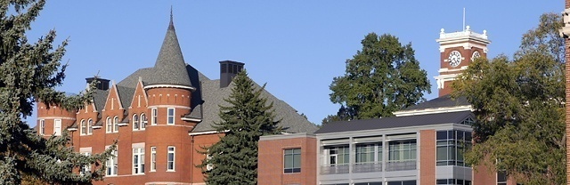

Awareness, Confidence, and Policies
WSU Computer and Network Security Awareness Training
Revised January 2015

Slide 2

Information
Reduced Risk
  (At work and at home)
Reduced Anxiety
Hopefully More Sleep

Slide 3
Agenda
Awareness
  Who are we up against and why?
  What are we up against?
Confidence
  How can I help myself and WSU?
  Examples
Policy
  What is expected of me?

Slide 4
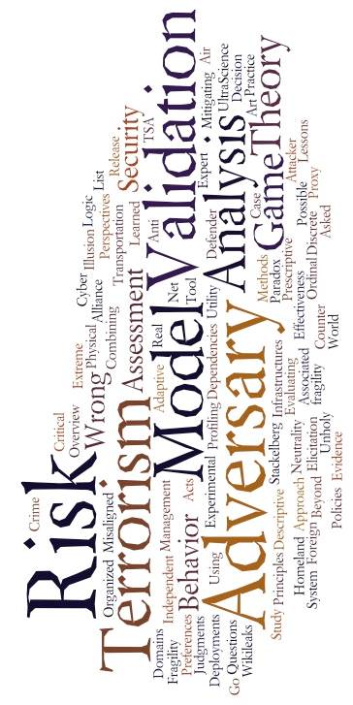
Awareness
Who are we up against and why?
Recent Headlines
Humans as Adversaries
Our Digital Assets

Slide 5
High Value Targets
September 2013 to April 2014
Notes:
Examples of breaches
Sept. 28, 2013: Virginia Tech reveals 144,963 online applications to the university may have been accessed. No Social Security numbers or financial data were exposed but nearly 17,000 driver's license numbers were.
Nov. 27, 2013: Names, Social Security numbers, bank account information and dates of birth for 2.5 million people associated with the Maricopa County Community College district in Phoenix, Ariz., may have been exposed.
Dec. 13, 2013: Names, Social Security numbers and tax identification numbers of 6,500 individuals associated with the University of North Carolina, Chapel Hill were mistakenly posted online.
Feb. 19, 2014: The University of Maryland, College Park says the Social Security numbers and birth dates for 309,079 students, alumni, faculty and staff were exposed in a breach. It later revises the number downward to 287,580 when some incomplete or inaccurate data is discovered in the database.
Feb. 26, 2014: Indiana University announces personal data including Social Security numbers, of 146,000 students and alumni breached.
March 6, 2014: North Dakota University System notifies students, staff and faculty that 290,780 personal records, including Social Security numbers, were exposed in a breach.
March 6, 2014: The Johns Hopkins University says the names and contact information of 1,307 students and faculty were exposed when a hacker attempted to extort the university for further access to its servers. It later lowered the number to 848.

Slide 6

WSU’s Environment
9.4 Trillion Security-Relevant Events per Day
In the Last 6 Months at WSU:
  Server Compromises
  PCI-Related Compromises (Credit/Debit Card)
  Hundreds of Workstation Compromises
  Dozens of Compromised Email Accounts
  Dozens of Compromised VPN Accounts
Notes:
4 server compromises

Slide 7
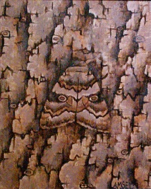
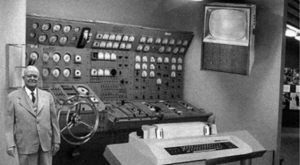

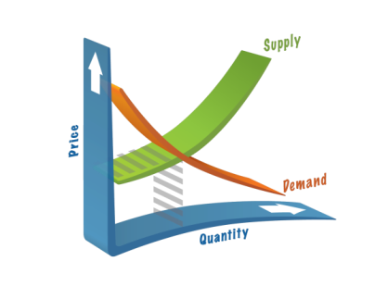
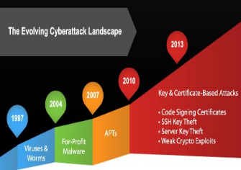

Humans as Adversaries
Adaptation
Obsolescence
Economics
Specialization
Speed
Escalation

Slide 8

Our Digital Assets
Intellectual Property
Financial Information
Reputation
Personnel Files
Network Resources

Slide 9

Awareness
Who are we up against and why?
WSU’s Digital Adversaries

Slide 10
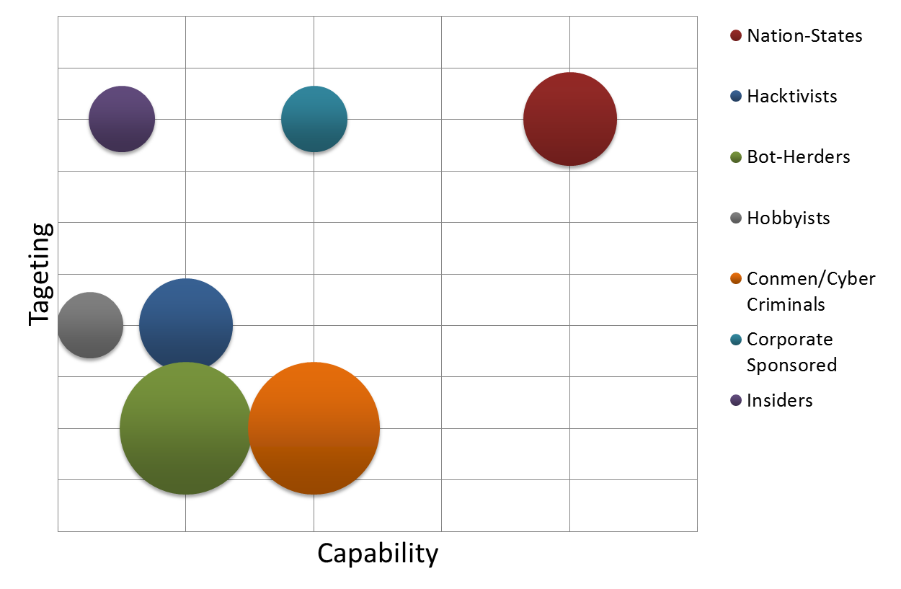
WSU’s Digital Adversaries
Broad Targeting Narrow
Bubble Size Represents Frequency of Contact
Low Capability High

Slide 11

Confidence
How can I help myself and WSU?
Trust, but Verify
Reducing Anxiety: Keeping Yourself Safe
Reducing Risk: Keeping WSU Safe
What About the Cloud?

Slide 12


Trust, but Verify
IT’S ALL ABOUT TRUST
Identity and Authenticity
  More than just usernames and passwords
Indicators
  Can be positive or negative
Nothing is black & white

Slide 13
Reducing Anxiety: Keeping Yourself Safe
Software Security Updates
Operating System
Security Software
Web Browser
Installed Software
Patch Early, Patch Often
Set to Auto
What are Zero Days?
Do not buy software in response to unexpected pop-up messages or emails. Especially messages that claim to have scanned your PC.

Slide 14
Reducing Anxiety: Keeping Yourself Safe
Passwords
At least 10 Characters
Mix Cased Letters, Numbers, Special Characters
Change at least every 6 months
Do Not Use Same Pass for Many Accounts
Be Unpredictable
Example Password:
1Dnlg34h1Dnlt514!!
It would take 1 desktop PC 71 Quadrillion years to crack this password.
Do Not Share via Phone, Text or Email
Store In Secure Location
Notes:
Information Entropy -The entropy of the first character is four bits;
The entropy of the next seven characters are two bits per character;
The ninth through the twentieth character has 1.5 bits of entropy per character;
Characters 21 and above have one bit of entropy per character.
A "bonus" of six bits is added if both upper case letters and non-alphabetic characters are used.
A "bonus" of six bits is added for passwords of length 1 through 19 characters following an extensive dictionary check to ensure the password is not contained within a large dictionary. Passwords of 20 characters or more do not receive this bonus because it is assumed they are pass-phrases consisting of multiple dictionary words.

Slide 15
Reducing Anxiety: Keeping Yourself Safe
Treat Personal Information Like Cash
Social Security Number
Credit Card Number
Bank & Utility Account Numbers
Every time you are asked for this type of information ask:
Can I Trust The Request?

Slide 16
Reducing Anxiety: Keeping Yourself Safe
Once posted, Always posted
Be honest if you’re uncomfortable
Your online reputation can be a good thing
Social Media
Know and manage your friends
Keep personal info personal
Privacy and security settings exist for a reason

Slide 17
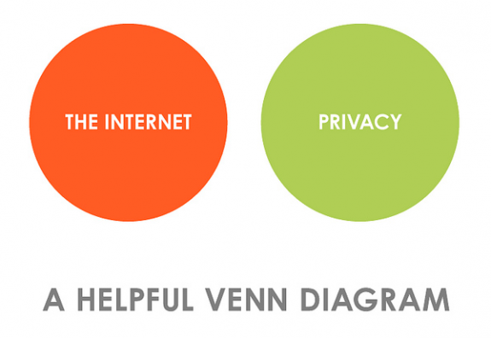
  The Internet Is Not a Private Place

Slide 18
Reducing Anxiety: Keeping Yourself Safe
Email
Practice Email Etiquette
Spam Reduction:
Use A Filter
Email Security Settings
Limit Exposure
Use multiple addresses
Check Privacy Policies
Use Caution
When installing software look for pre-checked boxes that automatically sign up for email updates from partners
Check to see if they sell your email address
Try not to display in public
Notes:
Use multiple addresses (1 personal, 1 shopping)
Try not to display in public (blogs, chat rooms, social networks, online memberships. Social networking site)

Slide 19
Reducing Anxiety: Keeping Yourself Safe
Phishing:
Legit companies do not ask for personal info via email or text
Messages may appear to be from organizations you do business with
May include threatening statements to close account if you fail to respond
Do not click on links or phone numbers provided in message – May redirect to spoof sites
If concerned look up organization independently and contact them directly

Slide 20
Locks Mean Protection
Screen Locks
HTTPS
Encryption
Remote Access

Slide 21





Mobile Computing - Basics
Updates
HTTPS
Screen Locks - Passwords
Limit Exposure
Use Caution

Slide 22
Mobile Computing
Think Before You App
Data
Wi-Fi – Bluetooth
Review Data Privacy Policy
Backup Regularly
Get Wi-Fi Savvy
What Data Can the App Access
Delete Data Before Recycling
Free Wi-Fi Internet Traffic Can Be Intercepted
Download from Trusted Sources
Be Aware of Excess Data use Charges
Turn Off Automatic Wi-Fi Discovery
Threat of Exposure When “Jailbreaking” & “Rooting” Device
Turn Off Bluetooth When Not In Use

Slide 23
Reducing Risk: Keeping WSU Safe
See previous slides
Risk-Based Approach
  Nothing is black & white
Notes:
Treat WSU IS resources and data as you would treat your own resources and data.

Slide 24

What About the Cloud?
Is my data more secure or less secure in the cloud?
?
Additional Considerations
Most Cloud Providers Use Non-Negotiable Terms of Service
  What are terms of use?
  Who owns the rights to user content?
  Does the service sell or share user information with 3rd parties?
WSU Non-Public and WSU Confidential Data Is Not To Be Stored In An Unauthorized Cloud!!

Slide 25

Confidence
Examples

Slide 26
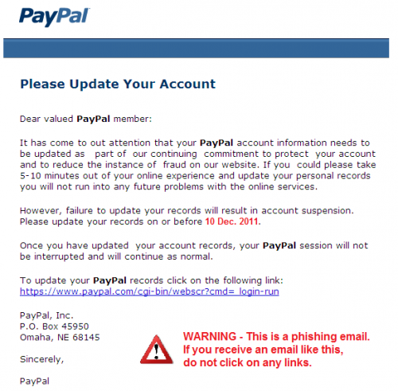
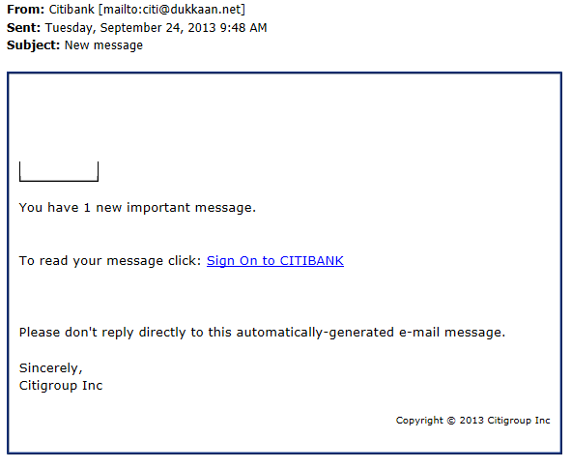
Phishing

Slide 27
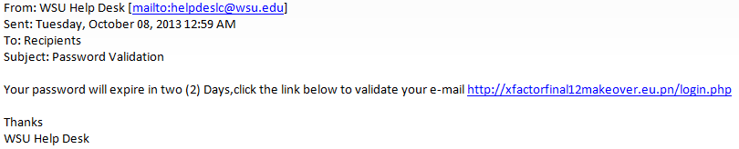
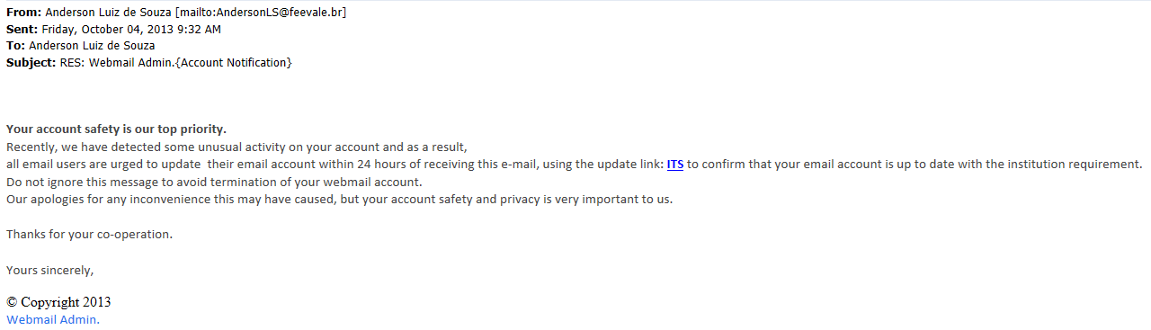
Spear-Phishing

Slide 28
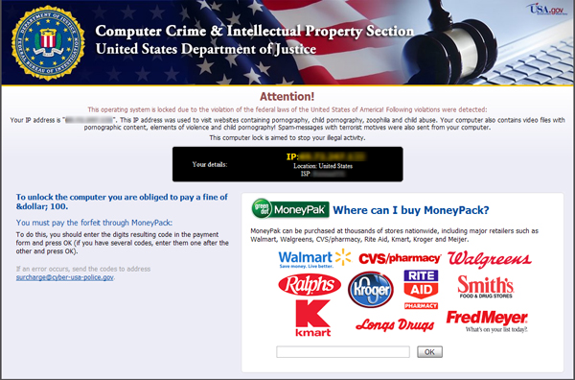
Ransomware
Preventive Measures
Perform regular backups of critical information. This data should be kept on a separate device, and backups stored offline.
Maintain up-to-date anti-virus software.
Keep your operating system and software up-to-date with the latest patches.
Do not follow unsolicited web links in email.
Use caution when opening email attachments.
Follow safe practices when browsing the web

Slide 29

Policy
What is expected of me?
WSU Policies
State & Federal Requirements

Slide 30
WSU Policies
A balancing act
Requires universal Participation
As a user of Washington State University Information Technology Resources, it is your responsibility to help in the protection and proper use of our information and technology assets.

Slide 31
WSU Policies
Electronic Communication Policy– EP4
University Data Policies – EP8
Wireless LAN Policy – EP13
University Antivirus Policy – EP14
University Network Policies – EP16
Computer and Network User Identification and
Password Policy– EP18
University Domain Name Policy – EP21
Public Data:
  Of interest to the general public and for which there is no University business need or legal reason to limit access
Non-Public Data:
  Not appropriate or available for general public use
Confidential Data:
  Restricted for legal or other University business reasons

Slide 32
WSU Policies
Electronic Communication Policy
WSU Executive Policy #4
Recommended Reading
Understand What You Can Do
Know What Is Prohibited

Slide 33
WSU Policies
University Data Polices
WSU Executive Policy #8
Administration
Access
Usage
Maintenance
Security
Identifies Data Steward
Outlines Data Steward Responsibilities
Defines Classification Definitions and Accessibility
Public
Non Public
Confidential
Data must be used as intended
Not for inappropriate purposes
Must not be used to promote or condone
unlawful activities
Willful misuse can result in access termination and possible civil/criminal charges
Defines who is responsible for maintaining data integrity
Outlines data storage and transmission requirements for each data classification
Defines preservation and backup requirements
Data destruction requirements

Slide 34
WSU Policies
Wireless LAN Policy
WSU Executive Policy #13
Central IT/IS responsible for deployment/ management of access points
Central IT/IS will specify equipment to prevent compatibility issues
Authentication service for authorization required
Access will be through VPN gateway

Slide 35
WSU Policies
University Anti-Virus Policy
WSU Executive Policy #14
Anti-Virus software is required.
Keep Anti-virus definitions up-to-date
    System and application patches included
Scan ALL incoming files
Contact your Systems Administrator,
or the IT Helpdesk (335-4357)

Slide 36
WSU Policies
University Network Policy
WSU Executive Policy #16
Additional Best Practices
Disable unnecessary services/daemons such as mail relay (SMTP), SNMP, telnet, ftp, etc.
Disable or otherwise protect vulnerable TCP/IP ports.
Take appropriate steps to physically secure servers from theft or damage.
Regularly review activity logs for evidence of break-ins and take the appropriate corrective actions.
Maintain regular system backups to facilitate disaster recovery.
Remove or disable unused accounts.
Keep informed of current industry security standards and apply them as appropriate.

Slide 37
WSU Policies
Computer and Network User Identification and Password Policy
WSU Executive Policy #18
User IDs shall be assigned to individual
users
Passwords are considered confidential and
shall not be shared or transferred to others
Passwords should not be written down
where anyone else can find them

Slide 38
WSU Policies
University Domain Name Policy
WSU Executive Policy #21
Defines .edu and .org DNS policy
What Qualifies
Who is Responsible
How to Acquire

Slide 39
State & Federal Requirements
Common/Major
FERPA – Family Educational Rights and Privacy Act (1974)
DMCA – The Digital Millennium Copyright Act (1998)
WA OCIO Policy 141 - Securing Information Technology Assets
Less Common
GLBA – Gramm-Leach-Bliley Act (1999)
HIPAA – Health Insurance Portability and Accountability Act (2000)
SOx – Sarbanes-Oxley (2002)
USA Patriot Act – (2001-present)
Homeland Security – (2002)

Slide 40
Summary
We have some pretty diverse adversaries
  Some have rather scary capabilities
WE ARE A TARGET
Principles that help keep you secure = Principles that help keep WSU secure
WSU computer and network security policies are available online
YOU can make a BIG difference

Slide 41
Questions?

Slide 42

Reducing Anxiety: Keeping Yourself Safe
P2P Software
No Centralized Server
Mirror Site Downloads
Unintentional File Sharing
Some P2P Software May Be Bundled
All files originate from other users
Can be impersonated
Configuration problems
Adware/
Spyware
Viruses
Trojans
      A popular P2P software package was installing a Trojan for 3 weeks before it was discovered.
      “Over a 12-hour period, regular searches were performed on KaZaA for Microsoft Outlook Express e-mail files, assuming that users would not intend to share private e-mails. Of 443 searches, 61 percent returned one or more hits for the e-mail files. In addition, other tests showed up word processing documents, Web browser caches and cookies, and financial software files.” - SANS
There are safer ways to share information.
Notes:
No centralized server – All files originate from other users.
Mirror Site Downloads
Can be impersonated
Some P2P Software May Be Bundled
Adware
Spyware
Trojans
A popular P2P software package was installing a Trojan for 3 weeks before it was discovered
Accidental Sharing of Private Files
Over a 12-hour period, regular searches were performed on KaZaA for Microsoft Outlook Express e-mail files, assuming that users would not intend to share private e-mails. Of 443 searches, 61 percent returned one or more hits for the e-mail files. In addition, other tests showed up word processing documents, Web browser caches and cookies, and financial software files.
There are safer ways to share information.

Slide 43
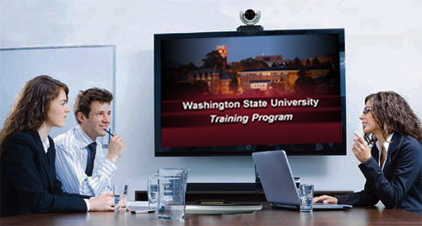
This has been a WSU Training Videoconference
If you wish to have your attendance documented in your training history,
please notify Human Resource Services
within 24 hours of today's date:
hrstraining@wsu.edu

