Slide 1
2015 SUMMER SESSION APPOINTMENTS
Revised March 2014

Slide 2
Purpose of Training
NEW! Summer Session Salary Calculation Formula
Salary Policies for Summer Session
Review Summer Session Appointment Policies
Review TEMPS Appointments
Review Summer Session PERMS
Appointments w/ new salary formula incorporated

Slide 3
Summer Session Documents
www.summeradmin.wsu.edu
2015 Planning Guide
Call for PERMS Appointments

Slide 4
Policy Highlights
Appointments ALWAYS begin on Monday and end on Friday.
Appointment dates and course dates must be the same.
Holidays that fall on Monday
(Appointments begin on Monday and end on Friday)
Memorial Day Holiday (May 25, Monday)
Fourth of July Holiday (July 3, Friday)
Appointment begins on Monday and ends on Friday
Courses that do not meet five days a week, i.e.,TuTh, MTuWTh, MW
(Appointments begin on Monday and end on Friday)

Slide 5
Policy Highlights
Visiting Faculty
Temporary faculty from another institution of higher education. Use Job Class Code 0206.
Negotiated Salary
Use only for true negotiated salaries, i.e, overlapping appointments, and some instructors.

Slide 6
Policy Highlights
End of Spring Term Overlapping Appointments
Typical overlap between spring and summer appointments are just fine
Early 6-week overlaps with 9.5-month, 10-month, 11-month, or 12-month appointments, extra steps need to be taken.
PERMS will let you enter appointments for this overlap,
but
They will not be approved.

Slide 7
Policy Highlights
All TEA and Faculty Time Card Appointments
Summer Session Approves
Need to include the same information as a PERMS appointment.

Slide 8
Policy Highlights
All TEA and Faculty Time Card Appointments
Letter of justification approved by Fran McSweeney, Vice Provost for Faculty Affairs, filed in Summer Session Office.
Salaries need to follow formula and policies.

Slide 9
Policy Highlights
Time Card Appointments
Required Information in TEMPS
Course Prefix, Number, Section
Example Chem 101.1
Course Dates
Example: 6/8-7/31
Total amount you plan to this the person for this appointment.
I need this information and it needs to match what the person will actually be paid.

Slide 10
Policy Highlights
Part-Time Temporary Faculty
Instructors are part-time temporary faculty, Job Class Code 0215.
Graduate students who graduate in May are part-time temporary faculty, Job Class Code 0215.
Salaries can be based on their current salary, or they can be negotiated at a reasonable rate.
See page 20, 11.Q. of "Call for PERMS" for more information on part-time temporary faculty.

Slide 11
SUMMER SESSON SALARY CALCULATION WORKSHEET
NAME:_________________________________________ APPOINTMENT DATES:_____________________________
 | X 22% |  | X |  | =
Academic Salary |  |  |  | # Credits of course ÷ 6 |  | Total SS Salary
 |  |  |  |  | =
Total SS Salary |  | Total % Effort for Period |  | Appt % |  | Full-Time Mo Salary
 | X |  | X |  | =
Full-Time Mo Salary |  | Appt % |  | % Effort for Period |  | $ for Pay Period |  | Pay Date
 | “ “ | “
 |  |  | X | % Effort for Period | = | $ for Pay Period |  | Pay Date
 | “ “ | “
 |  |  | X | % Effort for Period | = | $ for Pay Period |  | Pay Date
 | “ “ | “
 |  |  | X | % Effort for Period | = | $ for Pay Period |  | Pay Date
 | “ “ | “
 |  |  | X | % Effort for Period | = | $ for Pay Period |  | Pay Date
 | “ “ | “
 |  |  | X | % Effort for Period | = | $ for Pay Period |  | Pay Date
 | “ “ | “
 |  |  | X | % Effort for Period | = | $ for Pay Period |  | Pay Date
 |  |  |  |  |  | Total SS Salary

Slide 12
New Summer Session Formula
First Line
Academic Salary X 22% X (course credit /6) = Summer Session Salary
Academic Salary: FT (monthly) Rate X 9
Appt %: Will still need to be used on the PERMS calculator.
Example: 3 credits taught in 6 weeks, Appt % = 66.7

Slide 13
Summer Session Formula Second Line
SS Salary / Total % Effort for Pay Period / Appt % = Full-Time Monthly Salary
SS Salary: Previous calculation
Total % Effort Link:
www.summeradmin.wsu.edu
PERMS left hand side of page, last link:
"SumrSes Effort Chart"
Appt %:
www.summeradmin.wsu.edu
Page 8 of "Call for PERMS"
Example: 3 credits taught in 6 weeks = Appt % of 66.7

Slide 14
NEGOTIATED SALARY
Salaries cannot be negotiated at a rate higher than the formula calculates for
Fulltime faculty.
Graduate students.
Negotiate salaries down for low enrollment courses.
May negotiate salaries for temporary part time employees like instructors.

Slide 15
YELLOW TRIANGLE FLAG
Review required.
Examples: Mass salary increase or "B" line
Summer "B" line runs early May.
Summer "B" line will trigger Yellow Triangle.

Slide 16
PERMS Benefit Line
Summer Session and summer appointments hanging out in PERMS, will generate an email stating that a “review” of the appointment is required.
Go to PERMS action (add/change/route).
Click ‘Change’ button.
Review for possible changes, if none,
Click CONTINUE. Review icon will disappear, the appointment will be “Ready for HEPPS” or whatever status the action is currently set to.
DO NOT REROUTE the PERMS appointment unless you made a change to it.

Slide 17
PERMS Action Codes
New Appointment 25: Use this code for adding Summer Session appointments.
DO NOT use “Renewal” or “Reappointment.”

Slide 18
PERMS Action Codes (cont)
Using an improper code will incorrectly route the PERMS appointment and HRS will have to manually change the action code in PERMS.
If you are unsure of which action code to use, please call HRS at 335-4521.

Slide 19
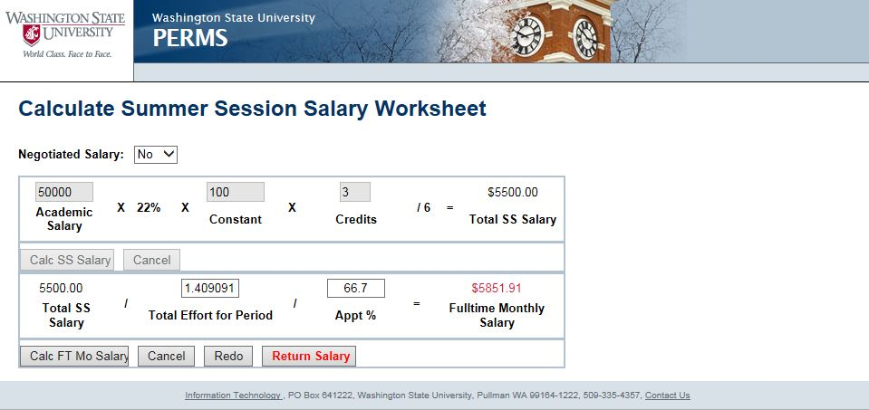
Summer Calculator
Can’t change this field
Still need to use appt% chart for calculating full-time monthly

Slide 20
Conditions
The information you enter in the Conditions box is not saved in PERMS OR HEPPS. Summer Session receives this information in a download.

Slide 21
Teaching Assistant and Research Assistant Appointments

Slide 22
Research Assistants – Title Code 9971 Staff Assistantants – Title Code 9972
Enroll in 3 credits
Student is responsible for additional credits
FTE > 50% or 20 hours/wk. +
Appointment must be at least 4 weeks long
POSN funding: Grant, ICR, 17A, Etc. account
Override Account must be identified "QTR Ovr Acct" field in PERMS
Ex. (145-02-12G-2940-0076) 1420212G29400076

Slide 23
Summer Assistantship Waiver Details
SSW post to student accounts during the same summer block as the student enrolls in credit- may differ from appointment dates
QTR’s will begin to post to students accounts last week in May
QTR will hit your accounts starting 6/25 payroll
SSW value $1,447.00
QTR value $1,447.00

Slide 24
Summer Graduate Student Titles
Title | Title Code
Graduate Teaching Assistantship | 9970
Graduate Research Assistantship | 9971
Graduate Staff Assistant | 9972
Graduate Project Assistant | 9904

Slide 25
Last, But Very Important
Cancel appointment if the course is cancelled.
Cancel appointment if instructor, faculty, or TA unable to teach.

Slide 26
This has been a WSU Training Videoconference
If you wish to have your attendance documented in your training history, please notify Human Resource Services within 24 hours of today's date: hrstraining@wsu.edu

