Slide 1
Online Position Description and recruitment System (OPDRS)
Presented by HRS

Slide 2
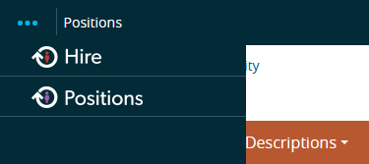
What is OPDRS?
WSU Online Position Description and Recruitment System
Allows for tracking of recruitment and personnel actions
www.wsujobs.com/hr
Two Modules
Position Management (Orange screen used for position description actions)
Applicant Tracking (Blue screen used for recruitment)
Move Between modules using the indicator in the top left hand corner:

Slide 3
Thinking critically
To better understand the two sides of OPDRS, consider the following phrase:
“We want to hire someone for this job”
The position side is where you create and modify the position description for your new job or an existing job you want to update or change before recruiting for it.
This is also where to modify position descriptions for current staff members.
The recruitment/hire side is where you create a posting which links to your summary of duties from the position description and tells your applicants what the job you are recruiting for is about.
It is also where applicants apply for the job and your search committee views those applicants, makes their recommendation for hire of the top applicant and then the hiring proposal seats that top applicant onto the position description when they accept the position.

Slide 4
What type of staff actions do I need OPDRS for?
Position Management
New Position Descriptions
Salary Increases
Stipends/ADRs
Reclassifications – vacant and occupied
Updates – vacant and occupied
Applicant Tracking
Recruitments/Postings
Applicant management

Slide 5
What type of faculty actions do I need OPDRS for?
Position Management
New Position Numbers: Contact your HR Service team and provide them with the Title and Position Number of the new Faculty position. HRS will input the details into OPDRS and notify you once the position is ready to submit for job posting.
Existing Position Numbers: If the position number exists in OPDRS, you may submit the job posting. If you want to change the official position title prior to posting, contact your HR Service Team.
Actions no longer submitted for faculty in ODPRS: Salary increases, ADRS/Stipends, position configuration changes, and/or title changes.
Applicant Tracking
Recruitments
Applicant management

Slide 6
How do I create a new staff position description?
The Create New Position Description action is used to create new position descriptions that are not currently within OPDRS.
Verify you are in the Position Management module as a Hiring Manager, Personnel Admin, or Appointing Authority.
Hover over Position Descriptions and click on Staff. Staff is used for Classified Staff and Administrative Professional positions.
Click the Create New Position Description button at the top right corner.

Slide 7
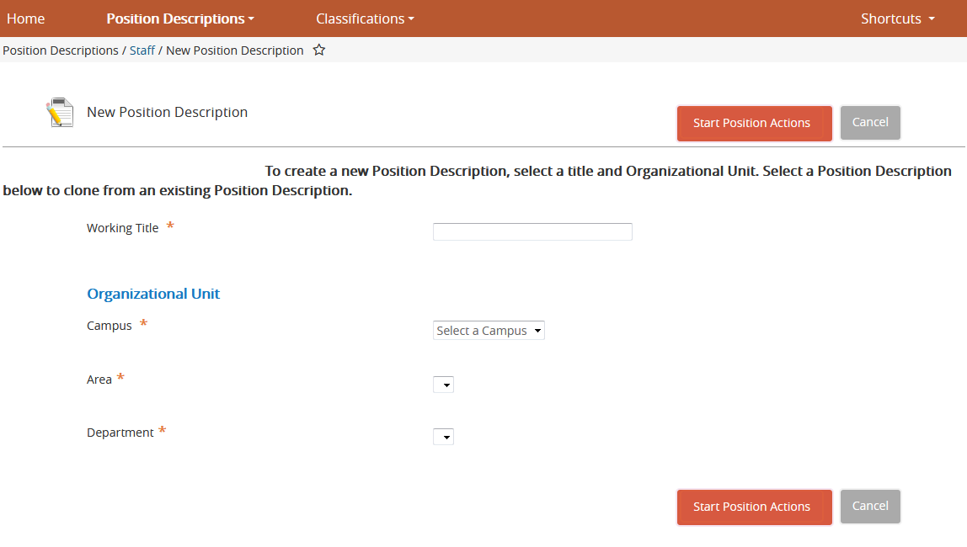
How do I create a new staff position description?
Enter Working Title.
The Area and Department sections will default unless you have responsibility for more than one. If you have responsibility for more than one Area and/or Department, you will then select the Area and Department the position will report under from the drop down list.
Select “Start Position Actions”

Slide 8
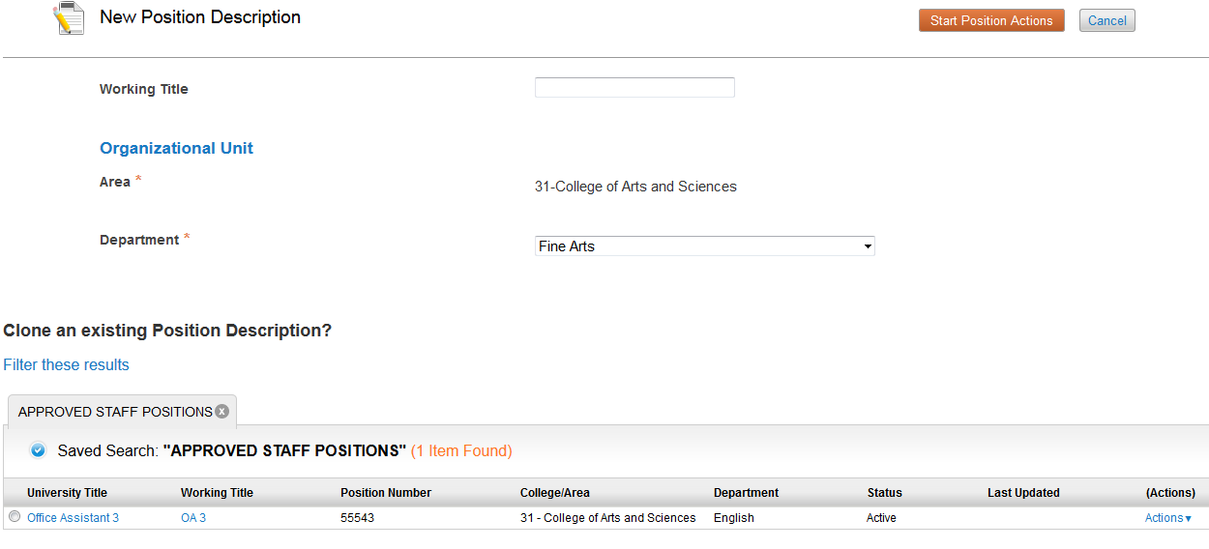
How do I create a new staff position description?
If you have an existing position description within your department(s) you wish to copy or ‘clone’, choose that position description from the list at the bottom of the page. This will pull in the pertinent information from the ‘cloned’ position description into this action and allow for edits.

Slide 9
How do I create a new staff position description?
Title– Is the official University title. Scroll through the titles at the bottom or search for the title by selecting the “Filter these results” button.
Continue through the tabs, completing all required information. Please note that if you ‘cloned’ from an existing position description, many of the fields will be prepopulated and ready for you to edit if applicable. Also note that by clicking the Next button, your changes will automatically save.

Slide 10
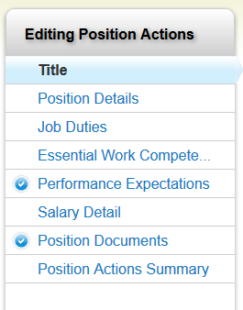
The following is a list of the sections within new Staff positions that will need to be completed.
Select the official university title

Slide 11
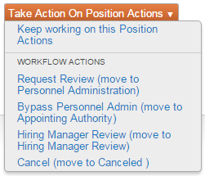
How do I create a new staff position description?
After completing all sections, review changes on the Position Actions Summary tab. Check all information entered for accuracy and make additional edits if necessary. Completed sections are noted with a green checkmark , while incomplete sections are noted with an orange exclamation mark .
Once all sections are completed, move the action through the workflow by hovering over the Take Action on Position Actions button on the top right hand corner of the page and select the workflow option you wish to take. The actions you can take are determined by your user type.

Slide 12
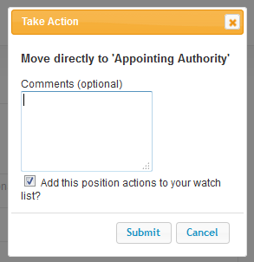
How do I create a new staff position description?
A pop-up ‘Take Action’ window will open in which you can make comments, if needed, which would be sent to the next approver.
Please note, comments will be tied to the historical record of the action.
Check the box to include the action on your watch list, if needed, and click Submit. An email will be sent to the next approver, notifying them of the pending action.
You will receive a blue bar on the top of your page that
will state the action was successfully transitioned.
Notes:
Most of this slide deals with an action that is not pictured. I think it would helpful to users to what this slide is describing. DONE

Slide 13
How do I modify an existing staff position description?
The Modify Position action is used to reclassify positions, request salary increases or stipends, and to update position descriptions.
Verify you are in the Position Management module as either Hiring Manager, Personnel Admin, or Appointing Authority.
Hover over Position Descriptions and click on Staff. Staff is used for Classified Staff and Administrative Professional positions.
Near the bottom of the page is a listing of all approved positions in the department(s) you have access to. Select an approved position by clicking on the university or working title.
Select the Modify Position button in the upper right corner.
You will receive a message on your screen stating the position will be locked once you start the action until the action has been completed. Once finished reading the message, select Start.
Notes:
Near the bottom of the page is a listing of all approved positions in the department(s) you have access to. Select an approved position.
Recommend changing to:
Near the bottom of the page is a listing of all approved positions in the department(s) you have access to. Select an approved position by clicking on the university or working title. DONE

Slide 14
How do I modify an existing staff position description?
The first tab, titled Action Justification, allows you to select the action you are requesting, along with providing any necessary justifications. Note: only one modification action should be selected. Modification actions are as follows:
Reclassification – Occupied: used for reclassifications, including salary reviews due to the reclassification, in which an incumbent will be affected.
Reclassification – Vacant: used for reclassifications, including salary reviews due to the reclassification, in which there is no incumbent.
FLSA Review: used when classification is not changing, but FLSA is being reviewed.
AP Salary Review: used when the incumbent has requested a review of their salary per BPPM 60.12.
Update Position – Occupied: used when there is no change to title or salary and in which an incumbent will be affected. This includes changes in FTE, Term, and duties.
Update Position – Vacant: used when there is no change to title or salary and in which there is no incumbent. This includes changes in FTE, Term, or duties.
Salary Increase – 10% or Below: used when there is no change to title, however a salary increase of 10% or less for administrative professional, or requesting a step increase for classified staff, is being requested.
Salary Increase – Above 10%: used when there is no change to title, however a salary increase of above 10% is being requested.
Additional approval outside of HRS is required per BPPM 60.12.
Stipend: used when the department is requesting a stipend for duties performed by an AP employee above and beyond their normal load per BPPM 60.12.

Slide 15
How do I modify an existing staff position description?
Continue through the tabs, making changes and saving.
After completing all sections, review changes on the Position Actions Summary tab. Check all information entered for accuracy and make additional edits if necessary. Completed sections are noted with a green checkmark , while incomplete sections are noted with an orange exclamation mark .
Once all sections are completed, move the action through the workflow by hovering over the Take Action on Position Actions button on the top right hand corner of the page and select the workflow option you wish to take. The actions you can take are determined by your user type.
A pop-up ‘Take Action’ window will open in which you can make comments, if needed, which would be sent to the next approver. Please note, comments will be tied to the historical record of the action. Check the box to include the action on your watch list, if needed, and click Submit. An email will be sent to the next approver, notifying them of the pending action as necessary.

Slide 16
How do I modify an existing faculty position description?
The following Faculty actions are not submitted in OPDRS: salary increases, ADRs/Stipends, position configuration changes, and/or title changes.
Title: to change a title to a position prior to posting, contact your HR Service Team. HRS will make the change for you and notify you once the position is ready to submit for job posting.
Please note, a PA/PRR must be submitted to Position Control to update DEPPS.
An Open Rank title may also be used when the final title may be dependent upon a new hire’s experience. The titles under consideration will then be noted under Working Title. Contact your HR Service Team if you would like to use this title or discuss options.

Slide 17
How will I know if my position has been approved?
Your HR Service team will notify you when your position has been approved by HRS.
To check the status of your action you can return to the “Home Screen” and view your “Watch List” or hover over “Staff” and select “position Actions”

Slide 18
Now that my position has been approved by HRS, what are my next steps in OPDRS?
Now the recruitment/posting can be submitted in OPDRS!
Verify you are in the Hire module as a Hiring Manager, Personnel Admin, or Appointing Authority.
Select postings and click on Staff or Faculty. Staff is used for Classified Staff and Administrative Professional.
Click the Create New Posting button at the top right corner.

Slide 19
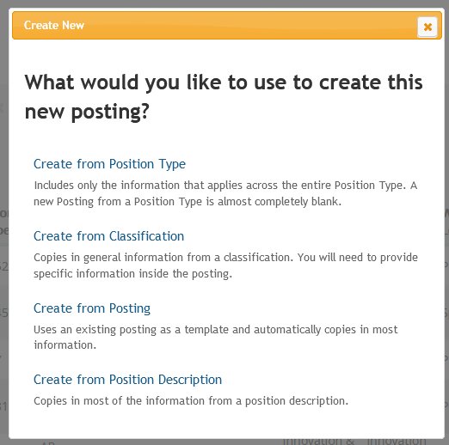
Creating Postings Continued
A pop-up box will open. Choose the “Create from Position Description” option.
Although Faculty do not have traditional position descriptions as Staff do, for purposes of OPDRS, postings begin with a position description.

Slide 20
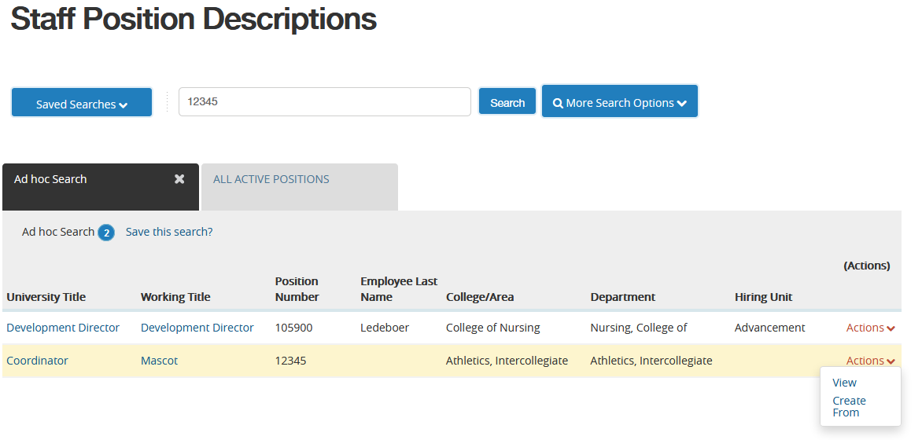
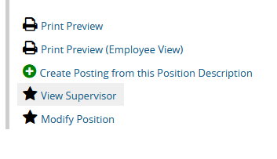
Creating Postings Continued
Find the position you would like to post. Hover over Actions to see your options:
Select Create From to create the posting from the selected position description; or
Select View to see the current position description prior to beginning the action. If the selected position description is correct, click on Create Posting from this Position Description on the upper right corner.
NOTE: Always review the position description prior to starting the posting. If changes are needed, they will need to be done prior to starting the posting.
If you cannot find the position you would like to post, contact your HR Service Team.
Notes:
Need to demonstrate these steps. DONE?

Slide 21
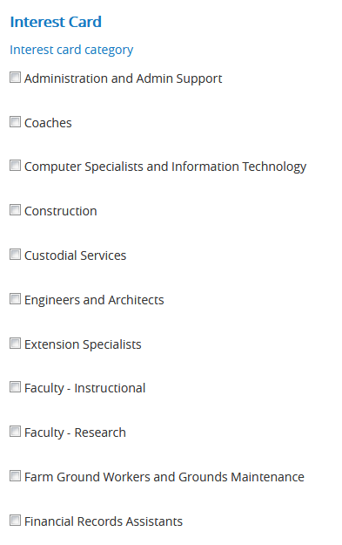
Creating Postings Continued
This will take you directly into the “settings” tab of the posting. Most information will auto-populate from the position description.
You will need to select the appropriate “Interest Card” category. These categories allow for applicants to search by job type, rather than just by specific titles. They allow for greater searchability and functionality within WSUjobs.

Slide 22
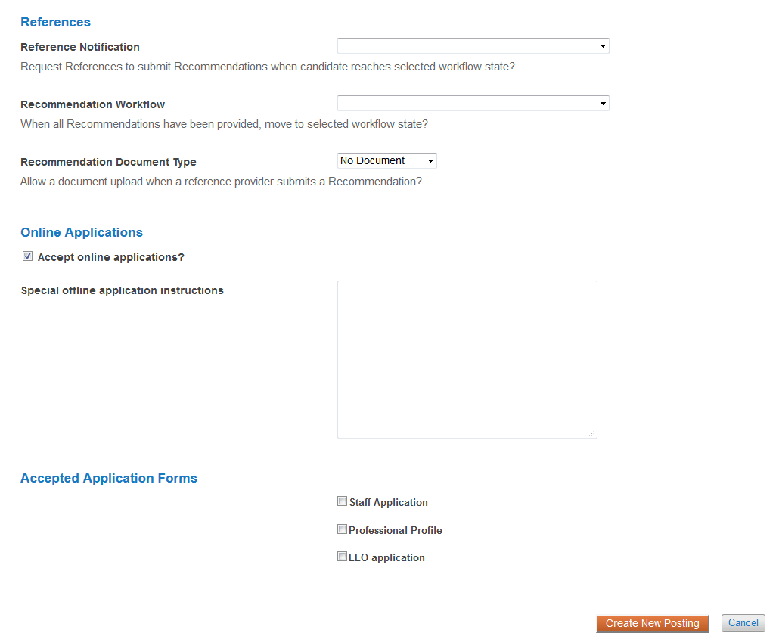
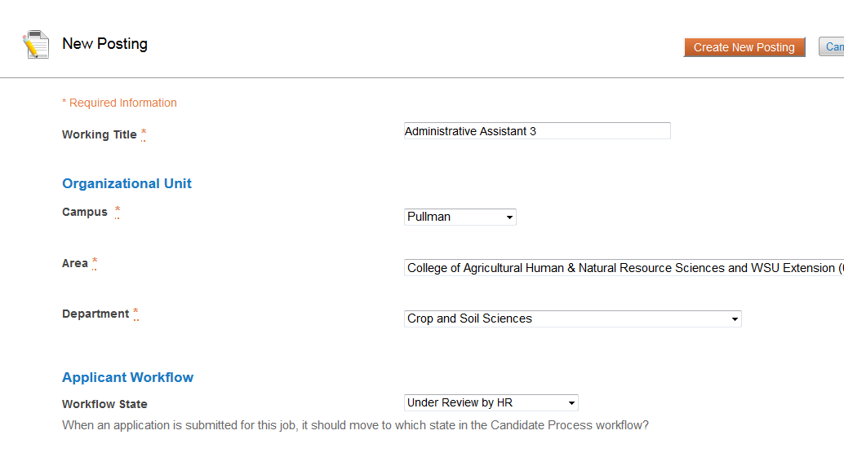
Creating Postings Continued
“References” in this section means letters of recommendation.
Only used for faculty
Select the application type
Select Create New Posting
More information , work history/education/references etc
Contact information only.

Slide 23
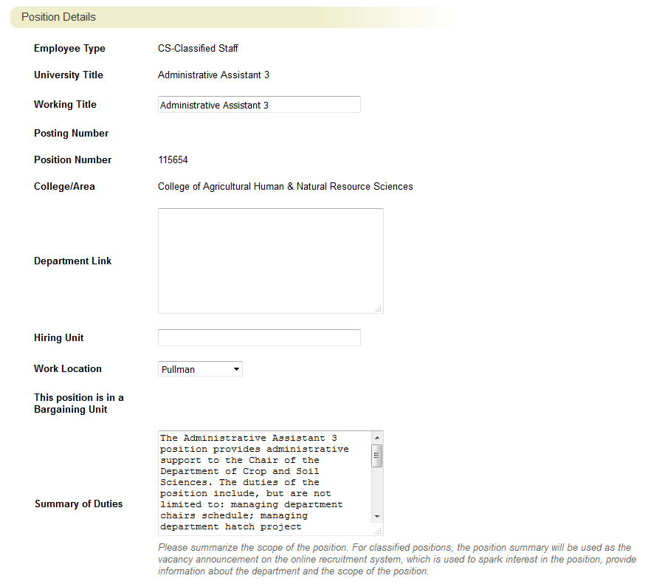
Creating Postings Continued
Pulled from PD
Title info is pulled from the PD
Website link for candidates to review.
Pulled from PD Note: if minor changes are made to Summary of Duties HRS can update on the PD side as well.

Slide 24
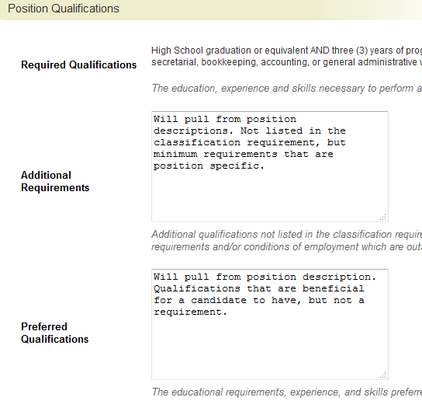
Creating Postings Continued

Slide 25
Creating Postings Continued

Slide 26
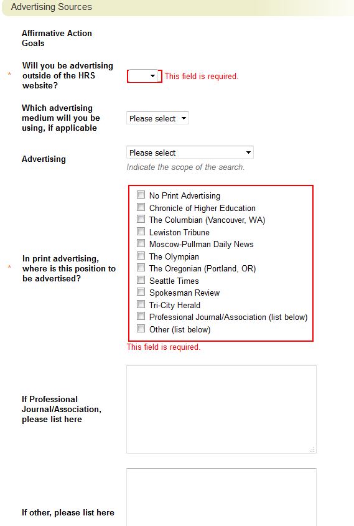
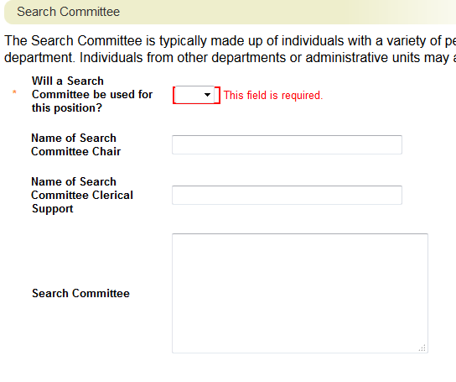
If specific individuals have not been named, please still feel free to send to HRS. Once names have been identified send an email to your HRCA and they can enter this information at a later time.

Slide 27
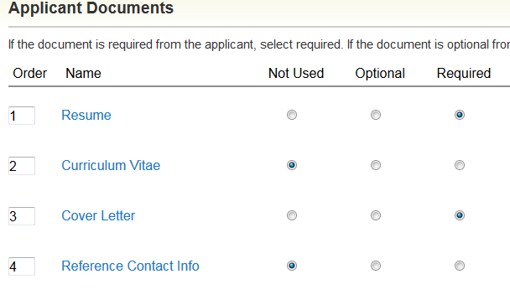

Slide 28
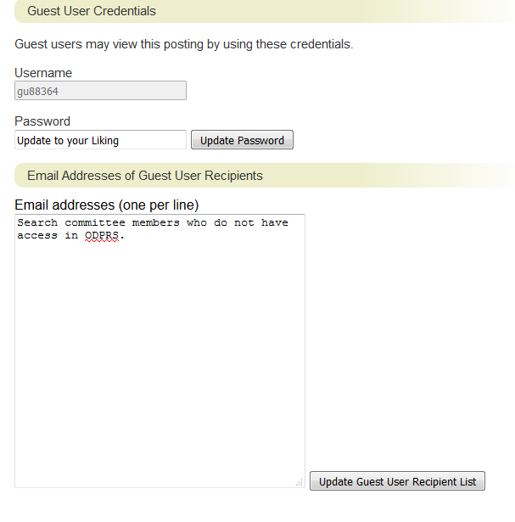
Notes:
Slide title is missing. MOVED PHOTOS TO ACCOMMODATE

Slide 29
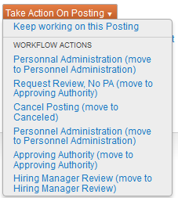
Creating Postings Continued
After completing all sections, review edits on the Summary tab. Check all information entered for accuracy and make additional edits if necessary.
Completed sections are noted with a green checkmark , and incomplete sections are noted with an orange exclamation mark
Once all sections are completed, move the action through the workflow by hovering over the Take Action on Posting button on the top right hand corner of the page and select the workflow option you wish to take. The actions you can take are determined by your user type.
Notes:
This is a lot of text for one slide. Consider breaking up or reducing text. DONE

Slide 30
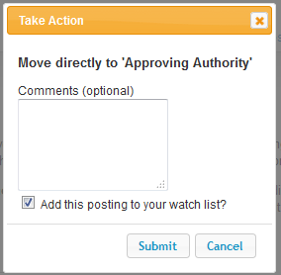
Creating Postings Continued
A pop-up ‘Take Action’ window will open in which you can make comments, if needed, which would be sent to the next approver. Please note, comments will be tied to the historical record of the action. Check the box to include the action on your watch list, if needed, and click Submit. An email will be sent to the next approver, notifying them of the pending action.
You will receive a green bar on the top of your page that will state the action was successfully transitioned.

Slide 31
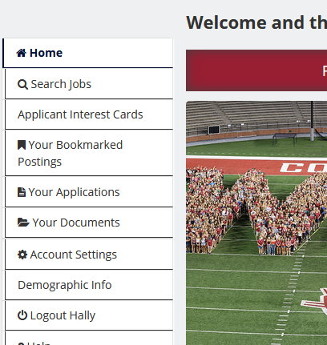
Now that I’ve created my posting what happens?
It moves through the appropriate channels and will then be posted on the www.wsujobs.com website!
Is there a direct link to my posting?
Yes! Visit www.wsujobs.com, click on “Search Jobs” on the left hand side of the screen and locate your posting. Open the posting and the URL at the top of the screen within the posting is a direct URL to the posting.

Slide 32
What is different about the faculty Posting Process?
International Programs – Hiring managers can work directly with International Programs (IP) to send the recruitment/ad copies for tenure track positions.
Faculty position descriptions are much less descriptive than staff, as such most information will need to be entered in the posting manually as opposed from being pulled over from a position description. Most information can be pulled directly from the Notice of Vacancy (NOV) for the position.
Letters of recommendation can be accepted through the system.
NOTE: Letters of recommendation do not take the place of the “reference contact information” document.

Slide 33
What if I want Reference letters through the system on my faculty posting?
The first screen after creating a posting from a position description includes this section:
This allows for you to request letters later on in the recruitment when a candidate moves past a certain point (such as long list, campus interview, etc.)

Slide 34
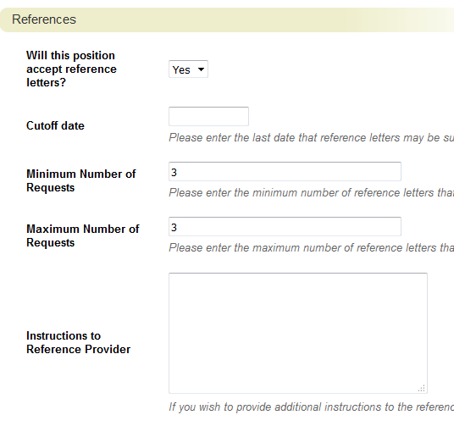
What if I want Reference letters through the system on my faculty posting?
Additionally, after initiating the posting the last section is “References.” Be sure to provide information.

Slide 35
Now that my recruitment has been posted, what are the next steps?
HRS will release applicants to the hiring manager in OPDRS on the designated screening date or the day after the position has closed. (Faculty applicants are automatically “under review by the department/committee”)
HRS sends an email with information regarding the search as well as the guest user credentials that can be forwarded along to the search committee
Note: Prior to releasing, HRS reviews materials for protected information as well as to ensure all applications forwarded are complete.

Slide 36
Applicants have been released to me. Now how do I find them?
Find the posting in one of the following places in the Hire module:
Watch List on the Home tab, or
Select “Staff” or “Faculty” under the Postings tab
To view inactive applicants, change your search parameters:
Click on “More Search Options” next to your search bar to select Active and/or Inactive applicants.
Holding down the Ctrl button on your keyboard will allow you to select more than one option, or deselect an option.

Slide 37
How do I review application materials?
Application materials can be viewed individually or in bulk.
To view application materials individually, select an applicant name from the list. This will open the application for the selected applicant.
Scroll to the bottom of the application to view other submitted documents, such as resume/cover letter.
A combined document that includes all application materials submitted can also be generated at the bottom of each application.
To view application materials in bulk, select the box next to the applicants you want to review and then hover over the Action button on the right.
Download Applications as PDF: Select this to choose which applicant document(s) you would like to include in the download.
Create Document PDF per Applicant: select this to open a pdf of all documents submitted by each applicant.

Slide 38
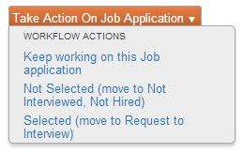
Changing Applicant Statuses
To change applicant status individually, select an applicant name from the list. This will open the application for the selected applicant.
On the right side of the application, hover over the orange Take Action on Job Application button.
The workflow actions available will change each time an applicant is moved through the workflow.

Slide 39
Changing Applicant Statuses
To change applicant status in bulk, select the box next to the applicants you want to move and then select the Action button on the right.

Slide 40
Changing applicant statuses
Select “Move in Workflow”.
If the “Move in Workflow” action is missing:
Change the search parameters to include only applicants under the Hiring Manager Workflow state owner. Click on “More Search Options” next to your search bar to select specific Workflow State(s).
Holding down the Ctrl button on your keyboard will allow you to select more than one option, or deselect an option.
To finalize the posting, each applicant not hired will need to have a Not Hired Reason.
Note: As a best practice, the search committee should identify the candidates they do not wish to move forward with at the same time applicants are being requested to interview.
Notes:
A lot of information on one slide. Removed information regarding “Owned” workflow states, and we can just mention that when giving presentation. (i.e. if one applicant ‘owned’ by HR, then department can’t move applicant – will need to change settings).

Slide 41
What do the different applicant statuses mean?
Staff Workflow Statuses | Definition
Under Review by Dept. | Owned by Hiring manager. Used for reviewing applications to determine if an interview will be requested.
Not Interviewed, Not Hired | Owned by HRS. Department does not want to interview.
Request to Interview | Owned by HR. HRS will review the request.
Approved for Interview | Owned by Hiring Manager. Dept. may schedule interviews
Interviewed, Not Selected | Owned by HR. After interview process. Dept. has determined to not proceed with hiring.
Alternate Finalist | Owned by HR. Dept. has determined they do not wish to move forward with this applicant.
Recommend for Hire | Owned by HR. Dept. has determined top candidate (s). HRS will move forward with Hiring Proposal & BGC, if required
Hired | Owned by HR. Once Hiring Proposal is complete applicant's status will update to “Hired” and the position will be “filled” if all other candidates have been moved out of the active pool.

Slide 42
What do the different applicant statuses mean?
Faculty Applicant Workflow States | Definition
Under Review by Department/Committee | Owned by Hiring Manager. Reviewing materials to determine if candidate will be moved to long list.
Not Interviewed, Not Hired | Owned by HR. Dept. does not wish to interview applicant.
Long List | Owned by Hiring Manager. Reviewing candidate to determine if a preliminary interview will be conducted.
Preliminary Interview | Owned by Hiring Manager. Reviewing to determine if Campus interview will be conducted
Campus Interview | Owned by Hiring Manager. Search committee determining top candidate(s).
Interviewed, Not Selected | Owned by Human Resources. After interview dept. has determined they do not wish to move forward with candidate
Recommend for Hire | Dept. has determined top candidate(s). HRS will move forward with Hiring Proposal & BGC, if required
Selected as Finalist | Owned by HR. Used if more than one vacancy is being filled from the posting.
Hired | Owned by HR. Once Hiring Proposal is complete applicant's status will update to “Hired” and the position will be “filled” if all other candidates have been moved out of the active pool.

Slide 43
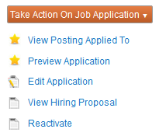
Staff Hiring Proposals
Hiring proposals are initiated by HRS and completed by hiring managers to “seat” an individual on their new position.
HRS selects the applicant that has been “Recommended for Hire” and begins the hiring proposal.
If there is a background to check to process, HRS will begin the process and move the hiring proposal to “Background Check.”
Once a satisfactory background check is complete, or if the recruitment did not require a background check, HRS will move the hiring proposal to “Approved to Make Offer.”
Find the hiring proposal in one of the following places in the Applicant Tracking module:
Inbox on the Home tab,
Select Staff under the Postings tab
Once a posting is chosen, select the “Hiring Proposal” tab to view active and inactive hiring proposals.
OR Select Staff under the Hiring Proposals tab
Notes:
I don’t know that the image matches what is being described well. DONE – not quite sure if this is what else you wanted?

Slide 44
Reference Checks
Typically departments choose to perform reference checks prior to, or simultaneously with the background check
Best practice calls for checking three references via phone with two members of the search committee.
If phone is not possible the search committee can use different mediums, however, we recommend utilizing the same medium for each candidate
Please note, background checks/letters of recommendation do not take the place of reference checks. All provide valuable insight into the candidate’s experience.

Slide 45
Offer Letters
Please feel free to send drafts of offer letters to your HR Consultant and Assistant if you would like us to review.
All templates are available on the HRS website at this link: http://hrs.wsu.edu/Letters
Note: Offer letters must be signed by an appointing authority; a list is available at this link: https://hrs.wsu.edu/utils/File.aspx?fileid=252

Slide 46
Staff Hiring proposals continued
Select Edit to edit the details (requested salary/start date). When done, select the appropriate action:
Offer Accepted: use if the salary is at the minimum step for Classified Staff (usually step A), or at or below the approved salary amount for Administrative Professional (AP). This moves the action directly to HRS, skipping the Appointing Authority.
Change Offer: use if the requested salary is above the minimum step for Classified Staff, or above the approved amount for AP. The justification section will need to be completed. This moves the action to the Appointing Authority (AA). Once the AA has approved/adjusted the request, it is moved to HRS for review and approval.
HRS will work with Appointing Authorities and other offices as necessary for any
concerns with monthly salary amount requests. Offers are not to be extended without
approval from HRS.
Notes:
A lot of text. DONE

Slide 47
Faculty Hiring Proposals
HRS selects the applicant that has been “Recommended for Hire” and begins the hiring proposal.
If there is a background to check to process, HRS will begin the process and move the hiring proposal to “Background Check.”
Once a satisfactory background check is complete, or if the recruitment did not require a background check, HRS will move the hiring proposal to the Hiring Manager.
Find the hiring proposal in one of the following places in the Applicant Tracking module: Inbox on the Home tab,
Select Faculty under the Postings tab
Once a posting is chosen, select the “Hiring Proposal” tab to view active and inactive hiring proposals. OR Select Faculty under the Hiring Proposals tab

Slide 48
Faculty Hiring Proposals
To view inactive hiring proposals, change your search parameters:
Click on “More Search Options” next to your search bar to select specific Workflow State(s).
Holding down the Ctrl button on your keyboard will allow you to select more than one option, or deselect an option.
Select Edit to begin editing the Hiring Proposal details, including requested salary and start date. When finished, move the action back to Human Resources.
NOTE: If Open Rank was used as the title for the recruitment, change the Working Title on the hiring proposal to define the official title the candidate is being hired at.
If there are concerns or questions on the salary amount, HRS will move the applicant to the Appointing Authority for additional review.
Once details are finalized (BGC results, questions, etc.) HRS will approve the hiring proposal.

Slide 49
I’ve selected my candidate. What about the other applicants?
Best practice calls for a phone call notification from the search chair for those that were interviewed, but not selected. You may also provide email notification via OPDRS.
Sample notifications are available on the Recruitment ToolKit: http://hrs.wsu.edu/Recruitment%20toolkit
For those that were not interviewed best practice calls for a written notification from the search committee via mail, email, etc.

Slide 50
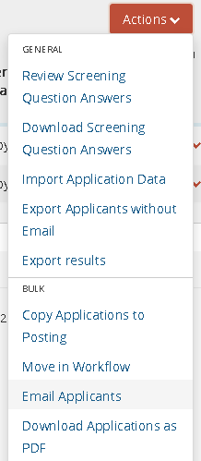
I’ve selected my candidate. What about the other applicants?
To use the built-in notification system in OPDRS, select the all the applicants from the appropriate status (e.g. those who were not interview, not hired).
Use the bulk move option and select ‘email applicants’
Then select the appropriate template for notification from the list of templates.
Note, only the last 4 templates should be used by departments.

Slide 51
I’ve selected my candidate. What about the other applicants?
Select “preview” then proof read to ensure the correct template has been selected. Note you will only see an example for the first applicant to be emailed. All selected applicants will be emailed.
If the template is correct, select “send emails”

Slide 52
Hiring and onboarding
Pre-Employment Inquiry Guidelines
http://public.wsu.edu/~forms/PDF/BPPM/60-08.pdf
Onboarding Resources
http://hrs.wsu.edu/onboarding
Resources for New Employees
https://hrs.wsu.edu/New+Employees

Slide 53
What if I don’t remember all of this information?
Please visit the OPDRS training website:
http://hrs.wsu.edu/opdrs
For all recruitment information check out the Recruitment ToolKit:
http://hrs.wsu.edu/Recruitment%20toolkit
To provide the best possible candidate experience:
http://hrs.wsu.edu/candidate+Experience
For tips on advertising & outreach:
http://hrs.wsu.edu/outreach+tools

