Slide 1
Washington State University Strategic Plan 2014-19 Update
It’s Time to Refresh the Plan!
On web site at
www.strategicplan.wsu.edu

Slide 2
Why having no strategic plan presents a problem
http://upload.wikimedia.org/wikipedia/commons/a/a7/Longleat-maze.jpg

Slide 3
WSU is mission driven and publicly accountable
To our university and local communities
To the state of Washington
To the U.S. Department of Education
Northwest Council on Colleges and Universities
To discipline-specific oversight bodies

Slide 4
Developing and using a strategic plan creates and fulfills opportunities
Provides direction and focus
Enables accountability
Facilitates celebration of accomplishments

Slide 5
Vision = How we contribute
Washington State University will be one of the nation’s leading land-grant universities, preeminent in research and discovery, teaching, and engagement.

Slide 6
Mission = Why we exist (Directs how we achieve our vision)
Washington State University is a public research university committed to its land grant heritage and tradition of service to society. Our mission is threefold:
To advance knowledge…
To extend knowledge through innovative educational programs in which students and emerging scholars are mentored to realize their highest potential and assume roles of leadership, responsibility, and service to society.
To apply knowledge through local and global engagement that will improve quality of life and enhance the economy of the state, nation, and world.

Slide 7
Drive to 25 shared vision
Washington State University will be recognized as one of the nation’s top 25 public research universities, preeminent in research and discovery, teaching, and engagement by 2030.
The Drive to 25 builds on the cornerstones of our institutional Strategic Plan and its two pivotal goals:
WSU will offer a transformative educational experience to undergraduate and graduate students
WSU will accelerate the development of a preeminent research portfolio

Slide 8
Parts of the strategic plan
Themes = Summarize intentions
Goals = Directions to pursue
Initiatives = Examples of relevant strategies
Metrics = Measures that demonstrate progress
Peers = Relevant institutions for comparison

Slide 9
Strategic plan peer institutions
Colorado State University-Fort Collins
Iowa State University
Louisiana State University and A&M
Mississippi State University
North Carolina State University Raleigh
Oregon State University
Purdue University-Main
University of Georgia
University of Maryland-College Park
University of Missouri-Columbia
University of Nebraska-Lincoln
University of Tennessee-Knoxville
Virginia Tech
Public Land Grant institutions, “Very High Research” Institutions, Veterinary school, within 50% above or below WSU’s enrollment size, within 100% +/- WSU’s research and development expenditures

Slide 10
Other types of peer institutions
Legislative Peers – Public, Land Grant, with Veterinary School
e.g., UC Davis, Colorado State*, Purdue*, U Georgia*, U Tennessee*
Global Challenge State Peers – Public Research Institutions in the “top-8 performing states”
e.g., Colorado State*, UC Davis, Rutgers, V. Tech*
AAU Public Institutions –Invited Membership
e.g., Iowa State U*, U Illinois, Purdue*, Texas A&M, U Oregon
Top-25 Public American Research Institutions – Metrics tracked by the Center for Measuring University Performance
UC Davis, Purdue*, Rutgers, NC State U*, U Maryland*,Virginia Tech*, U Tennessee*, U Oregon *SP Peer

Slide 11
Emphasis of the current plan
Theme 1: Exceptional Research, Innovation, and Creativity
Theme 2: Transformative Student Experience
Theme 3: Outreach and Engagement
Theme 4: Institutional Effectiveness: Diversity, Integrity, and Openness

Slide 12
How we developed the active plan
Iterative committees
Feedback loops
Web site updates for transparency
Approval by Board of Regents
Development of implementation plan

Slide 13
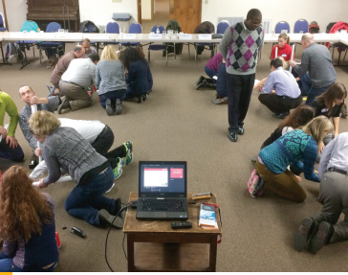
Situation Analysis

Slide 14
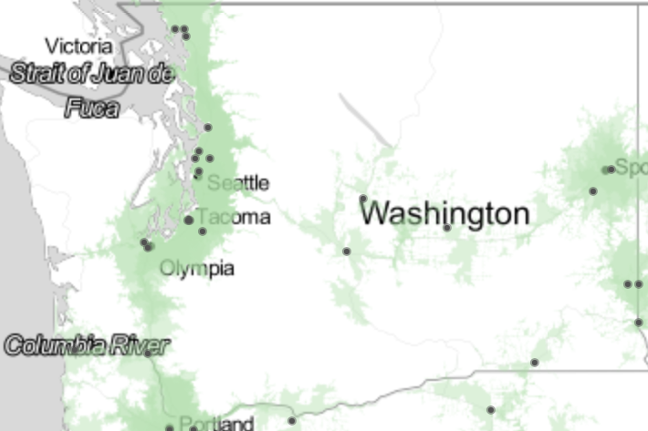
“SWOT” or “SWOC” Strengths, Weaknesses, Opportunities, Threats (Challenges)
e.g. “education deserts”

Slide 15
Situation Analysis: What was new for 2014-19 plan
Dramatic changes in public funding (52% reduction in state allocations)
Increased accountability to the state and its citizens
Dramatic and fundamental changes within higher education nationwide
Changing demographics of Washington state
* http://budget.wsu.edu/state-budget/final-biennial-budget.html

Slide 16
How we responded
“Refresh” – mission, vision, values largely unchanged.
Emphasizes unique mission as a land-grant research university.
More attention to infrastructure needs and resource alignment.
Infuses commitment to diversity and inclusiveness throughout plan.
Emphasis on implementation and measurement of progress (mapping of metrics).

Slide 17
Mapping of Themes, Goals Sub-goals, Initiatives & Metrics
Themes:
1.____
2.____
3.____
4.____
Goals:
1.____
2.____
3.____
Sub-goals:
1.____
2.____
3.____
4.____
Initiatives:
1.____
2.____
3.____
4.____
Metrics:
1.____
2.____
3.____
4.____

Slide 18
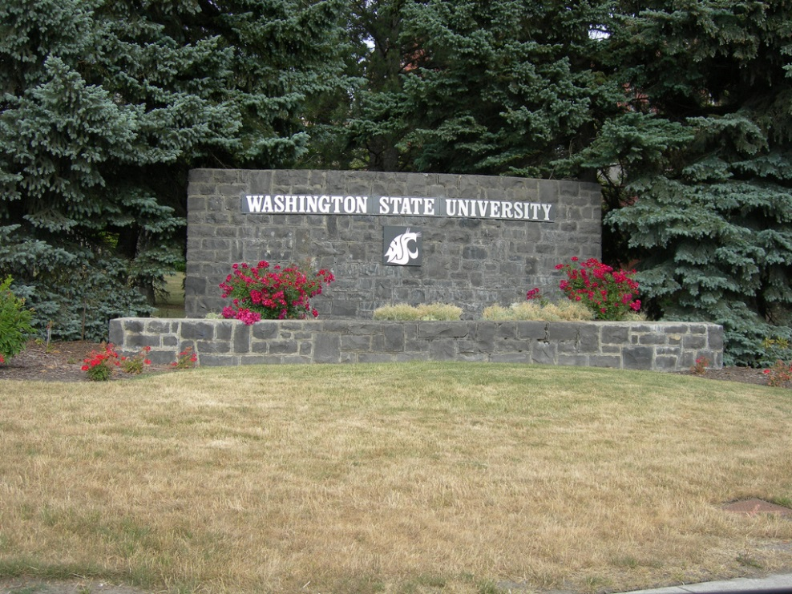
Themes = Summarize intentions
Theme 1: Exceptional Research, Innovation, and Creativity
Theme 2: Transformative Student Experience
Theme 3: Outreach and Engagement
Theme 4: Institutional Effectiveness: Diversity, Integrity, and Openness
https://www.flickr.com/photos/auvet/3750918356/

Slide 19
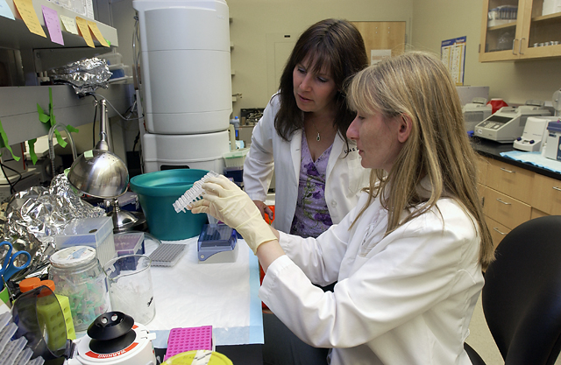
Goals = Directions to pursue Theme 1: Exceptional Research, Innovation, and Creativity
Goal 1: Increase productivity in research, innovation, and creativity to address the grand challenges and opportunities of the future.
Goal 2: Further develop WSU’s unique strengths and opportunities for research, innovation, and creativity based on its locations and land-grant mandate to be responsive to the needs of Washington state.
Goal 3: Advance WSU’s reach both nationally and internationally in existing and emerging areas of achievement.

Slide 20
Subgoals for Theme 1: Research, Innovation, Creativity
Grow and diversify extramural research funding.
Attract, retain, and develop high-quality research faculty members system-wide.
Develop and sustain the physical and technological infrastructure, resources, and expertise to support increased research and scholarly productivity system-wide, with particular emphasis on core laboratories and academic computing.
Build upon WSU’s current and emerging areas of research excellence and international reputation.
Increase engagement and productivity of graduate students, postdoctoral associates, and undergraduates in mentored research, innovative projects, and creative endeavors.

Slide 21
Theme 2 goals: Transformative Student Experience
Goal 1: Provide an excellent teaching and learning opportunity to a larger and more diverse student population.
Goal 2: Provide a university experience centered on student engagement, development, and success, which prepares graduates to lead and excel in a diverse United States and global society.
Goal 3: Improve curricular and student support infrastructure to enhance access, educational quality, and student success in a growing institution.

Slide 22
Subgoals for Theme 2: Transformative Student Experience
2.a. Enhance student engagement and achievement in academics and co-curricular activities.
2.b. Increase the size, diversity, and academic preparedness of the undergraduate and graduate student populations in Pullman and at the urban campuses.
2.c. Produce graduates who are highly sought by post-baccalaureate and post-graduate employers and graduate/professional programs.
2.d. Align student recruitment, admissions, and retention system-wide to enhance access, inclusiveness, and student success.

Slide 23
Theme 3 Goals: Outreach and Engagement
Goal 1: Increase access to and breadth of WSU’s research, scholarship, creative, academic, and extension programs throughout Washington and the world.
Goal 2: Expand and enhance WSU’s engagement with institutions, communities, governments, and the private sector.
Goal 3: Increase WSU faculty, staff, and students’ contributions to economic vitality, educational outcomes, and quality of life at the local, state, and international levels

Slide 24
Subgoals for Theme 3: Outreach and Engagement
3.a. Increase the impact of WSU research, scholarship, creative, and outreach activities on quality of life and economic development within the state and region.
3.b. Increase access to the WSU system for place-bound, non-traditional, first-generation, and other underserved and underrepresented students.
3.c. Contribute to economic security, stability, social justice, and public policy through research, education, the arts, extension, and citizen-based and public policy engagement.
3.d. Increase WSU’s global presence and impact worldwide.
3.e. Improve WSU’s reputation with external constituencies.

Slide 25
Theme 4 goals: Institutional Effectiveness: Diversity, Integrity, and Openness
Goal 1: Create and sustain a university community that is diverse, inclusive, and equitable.
Goal 2: Cultivate a system-wide culture of organizational integrity, effectiveness, and openness that facilitates pursuit of the institution’s academic aspirations.
Goal 3: Steward and diversify resources invested by students, the public, and private stakeholders in a responsible way to ensure economic viability of the institution.

Slide 26
Subgoals for Theme 4: Institutional Effectiveness
4.a. Recruit, retain, and advance a diverse intellectual mix of faculty, staff, and students, including women and those from underrepresented groups.
4.b. Maintain respectful, inclusive, and equitable behavior in all university environments.
4.c. Increase employee productivity and satisfaction.
4.d. Strengthen administrative accountability, innovation, creativity, openness, transparency, and collaboration to advance the University’s mission.
4.e. Utilize institutional strategic plans, valid and reliable data, and evaluation indicators to align investments of resources with institutional priorities.
4.f. Expand, diversify, and effectively steward funding to advance the University’s mission.

Slide 27
Review: Mapping of themes, goals sub-goals, initiatives & metrics
Themes:
1.____
2.____
3.____
4.____
Goals:
1.____
2.____
3.____
Sub-goals:
1.____
2.____
3.____
4.____
Initiatives:
1.____
2.____
3.____
4.____
Metrics:
1.____
2.____
3.____
4.____

Slide 28
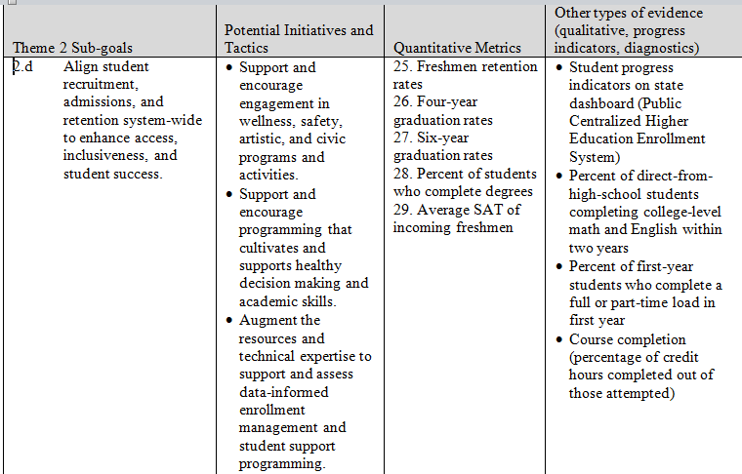
Mapping example

Slide 29
Implementation plan
Established a strategic planning implementation committee (Institutional Effectiveness Council)
Defined quantitative benchmarks for each of the metrics
Called for a process to identify current and emerging areas of research excellence (the "120 Day Plan")
Annual report of progress issued by Provost’s Office (startegicplan.wsu.edu)

Slide 30
The Institutional Effectiveness Council: “A coordinated, sustainable system to pursue university institutional effectiveness”
To coordinate strategic planning implementation, required accountability reporting, and decision support;
To reduce redundancy and increase efficiency, transparency, and accountability among strategic planning, institutional management, university accreditation, and other state and federal reporting requirements; and
To optimize usefulness of data and reports system wide at all levels.

Slide 31
IEC Steering Committee purpose
Oversees implementation and fulfillment of strategic plan.
Directs and resources the Council and the Accreditation, Assessment and Academic Program Review Committee.
Reviews and approves recommendations from the Council for strategic planning implementation and institution-level accountability metrics
Ensures alignment of data collection and reporting for institutional effectiveness, NWCCU accreditation standards, other external report mandates, and other internal needs for data and evaluation.

Slide 32
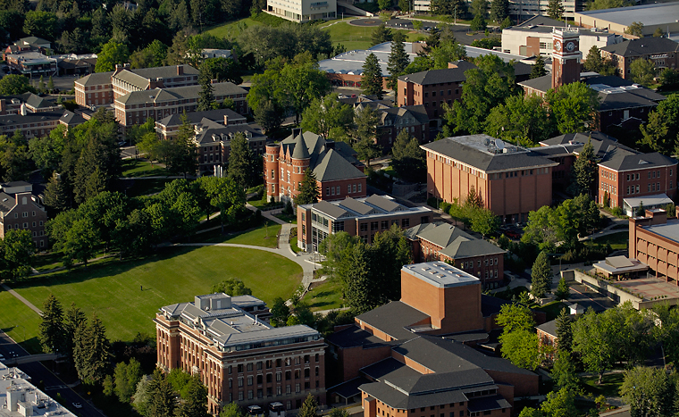
IEC Subcommittees (1 per theme)
Broad range of representatives from
Academic affairs
Student affairs
Business services and operations
Faculty
Staff
Students
All campuses and areas
Membership and contributions based on how programs and services connect to each theme.

Slide 33
What IEC subcommittees do
Facilitate unit- and program-level fulfillment of strategic plan goals.
Monitor and report to steering committee on infrastructure and training needs from units and programs.
Contribute to a university-wide progress report for each theme.
Promote awareness and communication about these topics among WSU units and employees.
Help to explain alignment of strategic plan and DT25
Progress reports at strategicplan.wsu.edu

Slide 34
How the current plan relates to the Drive to 25
Commitment to full Strategic Plan
Extra emphasis on subset of goals and metrics
sharpens our focus
provides context to better understand inter-relationships implied by the plan
Institutions for comparison are complementary
Key metrics already exist in our plan

Slide 35
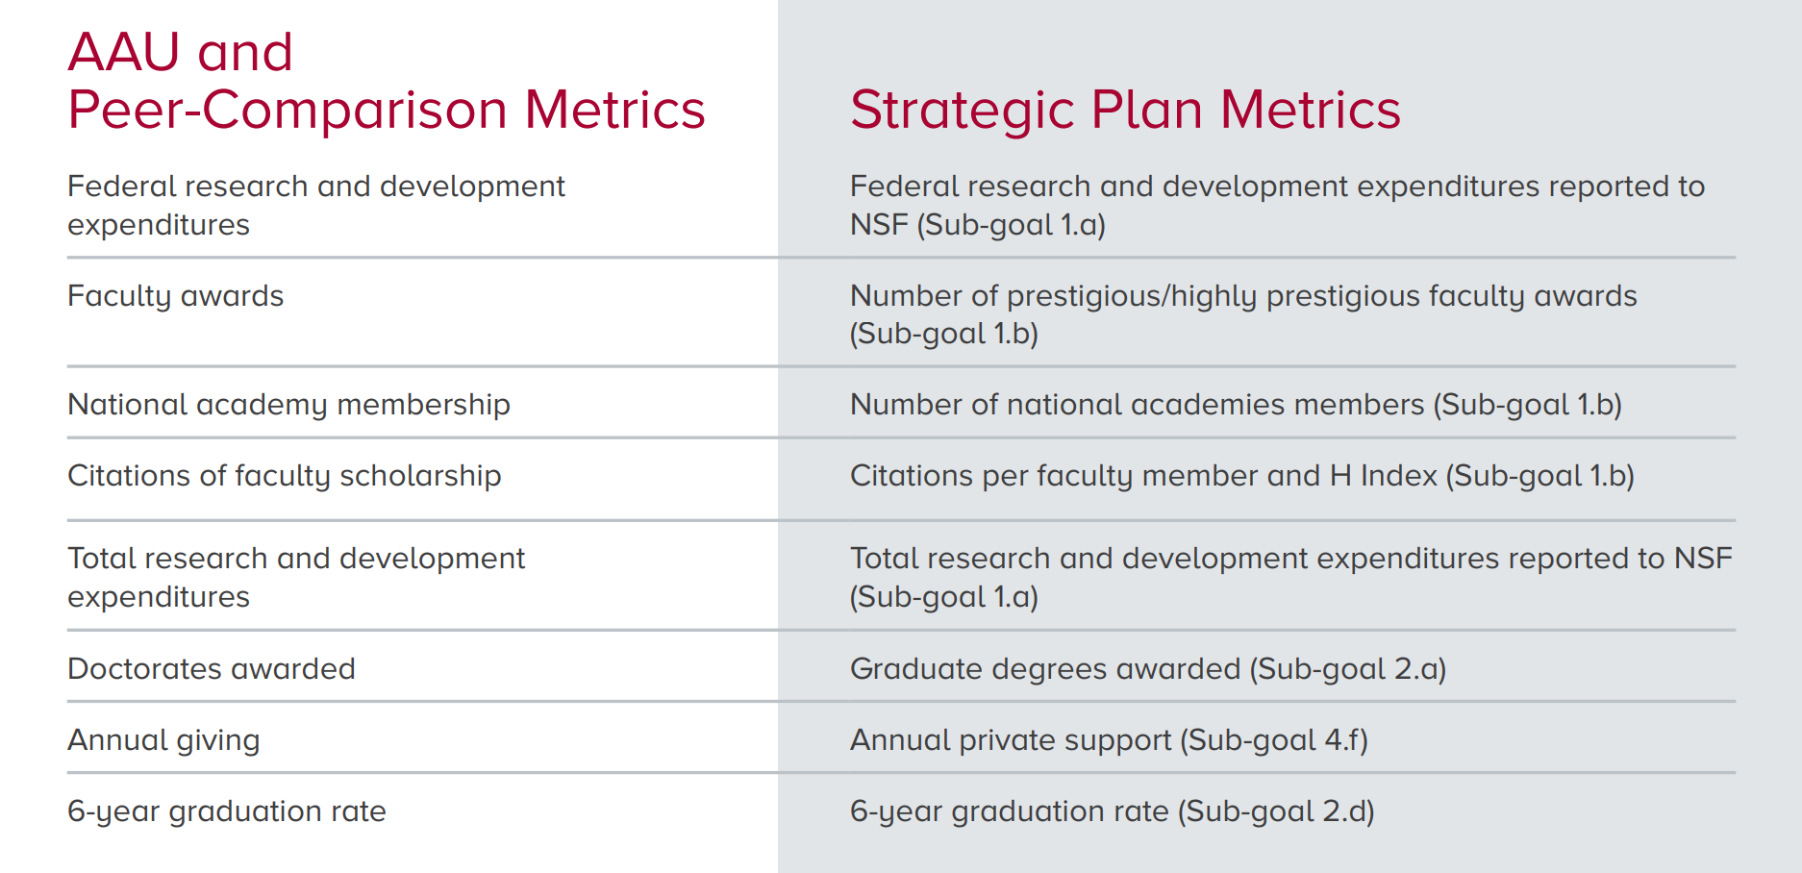
How the current plan relates to the Drive to 25

Slide 36
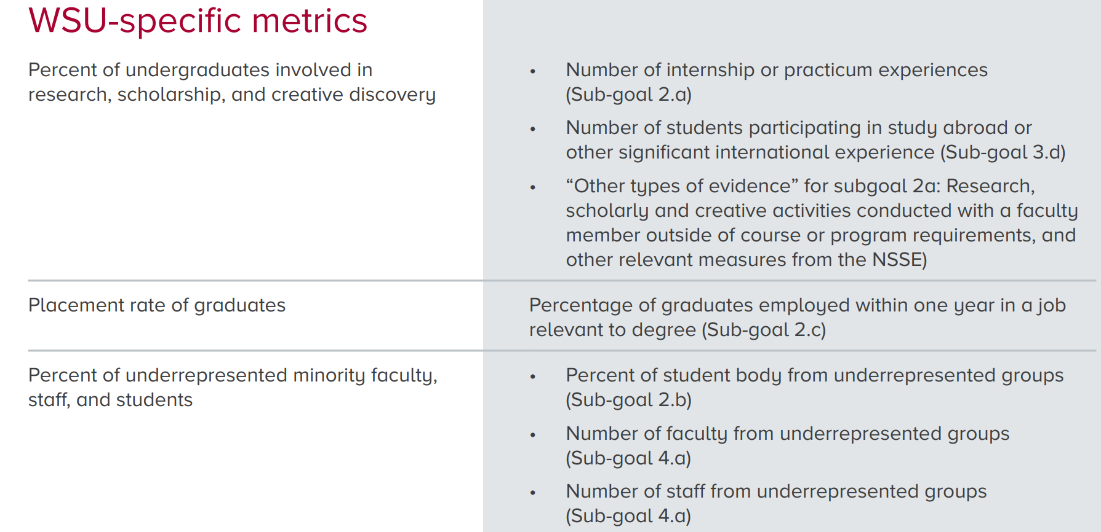
How the current plan relates to the Drive to 25

Slide 37
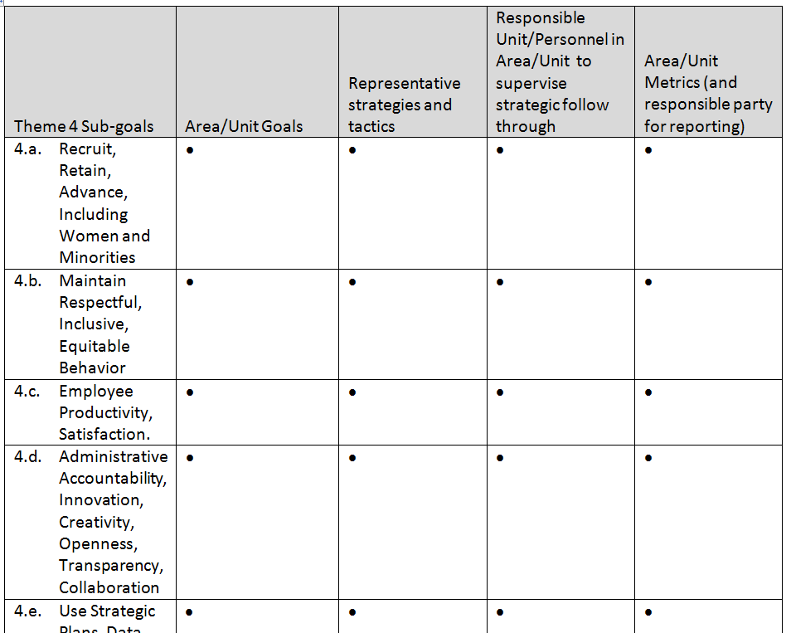
Mapping on to the plan

Slide 38
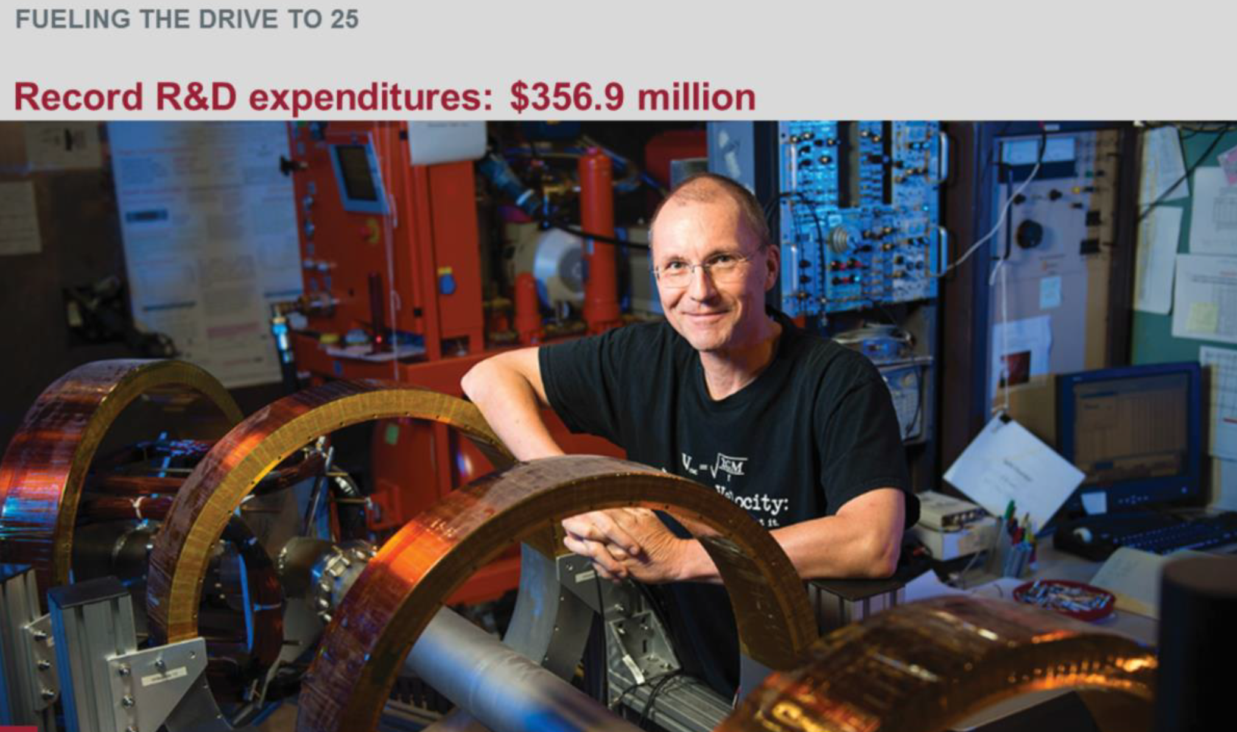
Progress report for 2017
https://s3.wp.wsu.edu/uploads/sites/153/2018/09/159988_strategic_plan_progress_report_contents_no_crops-1.pdf

Slide 39
Progress report for 2017 Theme1

Slide 40
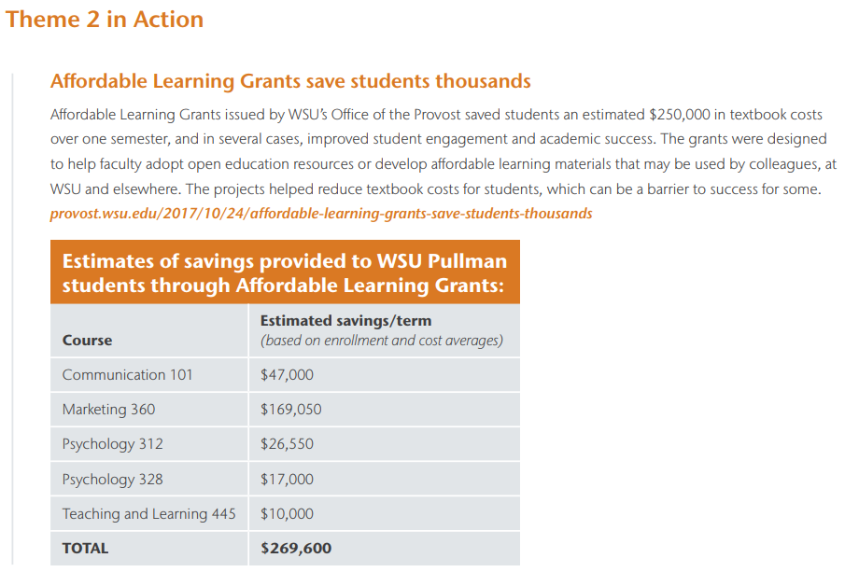
Progress report for 2017 Theme 2

Slide 41
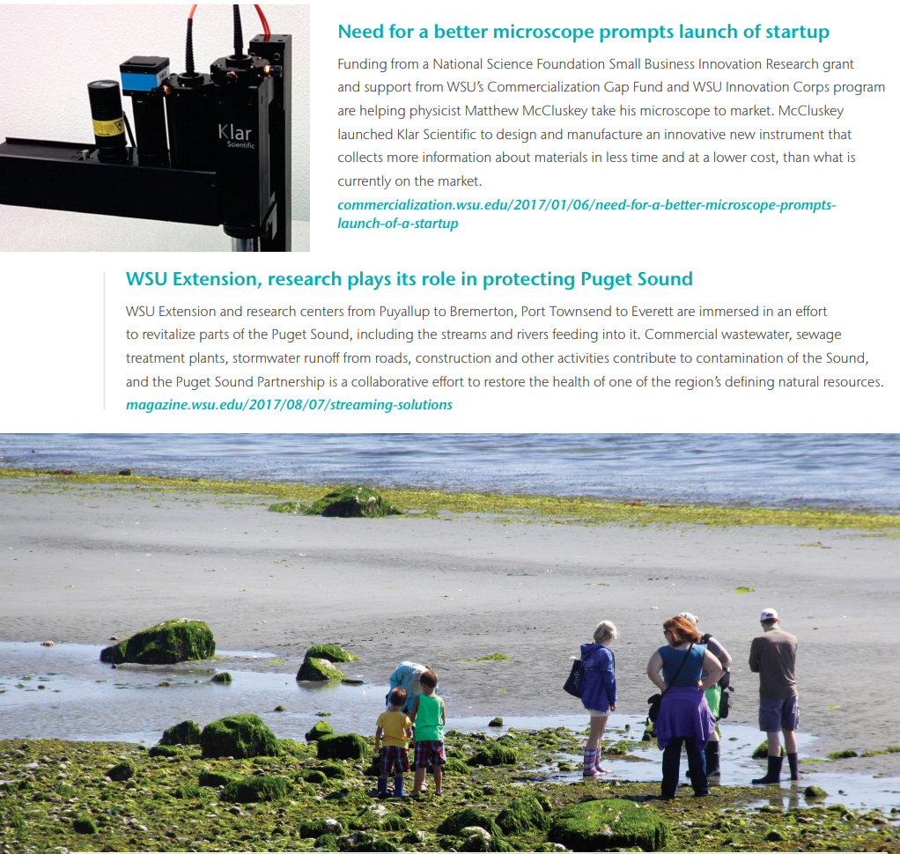
Progress report for 2017 Theme 3

Slide 42
Progress report for 2017 Theme 4

Slide 43
Situation Analysis: What is new now (and what is not) and how should we respond?
WSU is a diverse institution across campuses and other locations, colleges, areas
We now have an institution-wide strategic plan, the Drive to 25, and campus-, college-, area-specific plans
Available sources of funding, energy, time, etc. inform ud about the levers we can harness to move us toward our aspirational goals
Updating is an opportunity to focus more on outcomes and tie resources to priorities more tightly
Other?

Slide 44
Thank you!
The successful pursuit of Washington State University’s mission requires the efforts of our entire community.
strategicplan.wsu.edu
wsu.edu/drive-to-25
accreditation.wsu.edu

Slide 45
This has been a
WSU Training Videoconference
If you attended this live training session and wish to have your attendance documented in your training history, please notify Human Resource Services within 24 hours of today's date: hrstraining@wsu.edu

