Slide 1
The Supervisor as Safety Manager
Environmental Health & Safety, Public Safety, and the
Office of Emergency Management
Revised November 2018

Slide 2
Mission
Washington State University is a public research university committed to its land-grant heritage and tradition of service to society. Our mission is threefold:
To advance knowledge through creative research, innovation, and creativity across a wide range of academic disciplines.
To extend knowledge through innovative educational programs in which students and emerging scholars are mentored to realize their highest potential and assume roles of leadership, responsibility, and service to society.
To apply knowledge through local and global engagement that will improve quality of life and enhance the economy of the state, nation, and world.

Slide 3
Why Safety is Important?
Shared Values: We, WSU commit to:
A safe and secure campus environment
A workplace where employees can be productive
Preventing work-related injuries and illnesses
And there are rules too…

Slide 4
WAC 296-800-110
Employer responsibilities: Safe Workplace Summary.
Your responsibility:
To provide a safe and healthy workplace free from recognized hazards.
WAC 296

Slide 5
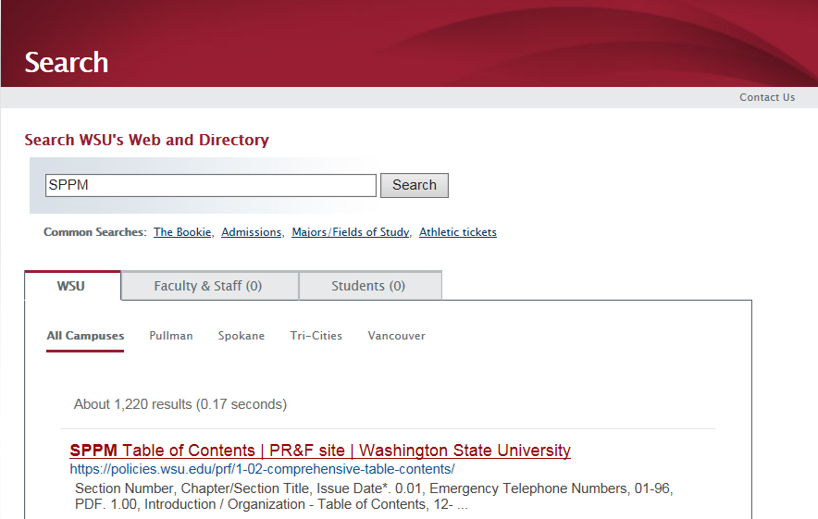

Slide 6
WSU Safety & Health Units
Public Safety
Police Services
Fire Safety Services
Office of Emergency Management
EH&S
Occupational Health and Safety
Environmental Services
Risk Management
Office of Research Assurances
Radiation Safety
Biosafety
Research Animal Safety
Human Resource Services
Worker’s Compensation
Return-to-Work

Slide 7
WSU Police Department
The Mission of the Washington State University Police Department, in partnership with the campus community, is to cultivate an atmosphere which supports the educational process and promotes academic and personal achievement, and community prosperity.
WSU POLICE DEPARTMENT PATROLS CAMPUS 24 HOURS A DAY
FOR NON EMERGENCY ASSISTANCE OR RESPONSE CALL 509-335-8548
FOR EMERGENCY RESPONSE CALL 911
FRONT OFFICE BUSINESS HOURS: MONDAY THROUGH FRIDAY 8AM-5PM
WSUPD FAX: 509-335-4239

Slide 8
WSU Fire Safety Officer
Fire and EMS services provided by Pullman FD
Fire Safety & Compliance Officer & Fire Inspector on campus
Conduct plans review, fire code enforcement, fire inspections, and fire safety training. The public areas (hallways, corridors, meeting rooms, etc.) of residence halls are inspected once each semester. Academic buildings are inspected periodically based on hazard classification and time availability.

Slide 9
WSU Alerts: Air Quality
https://airquality.wsu.edu/

Slide 10
Office of Emergency Management
ALERT – ASSESS – ACT
WSU OEM administers a comprehensive emergency management program focused on the Pullman campus, but also engaging regional campuses, research stations and sites throughout the state.
Our goal is to help protect lives and safety of students, faculty staff, visitors & animals; safeguard critical infrastructure, facilities, environment, essential records & research.
We do this through support of all phases of Emergency Management:
Planning
Preparedness
Mitigation
Response
Recovery
Contact: 311 Hulbert Hall, 509-335-7471, emergencymanagement@wsu.edu
http://www.oem.wsu.edu

Slide 11
Alert, Assess, Act
Over-arching Protocol for Emergencies/Disasters
Alert: Individuals have responsibility to remain alert to their surroundings and situation. WSU will provide Alert information as soon as possible to raise awareness of situations.
Assess: Once alerted to an emergency or disaster situation/event, each individual must assess his/her situation to determine the most appropriate course of action.
Act: Each individual must then take that action –based on his/her assessment – which will best assure safety.

Slide 12
Alert, Assess, Act
Washington State University follows an overall approach of “Alert, Assess, Act,” under which each individual must maintain a level of awareness about his/her personal situation.
When made ALERT to an emergency situation (through direct observation or emergency notification),
Each individual must ASSESS his/her particular situation, and
ACT in the most appropriate way to assure his or her own safety. If possible, Cougs should also act to assure the safety of others.
WSU encourages all students, faculty and staff to be aware of developing incidents, quickly make a personal assessment of the situation, and to act to ensure their own personal safety.

Slide 13
Alert, Assess, Act
Alert:
The WSU Office of Emergency Management will notify the campus community of emergencies through a number of outlets. The WSU Alert Notification System contacts anyone who signs up through myWSU to receive alerts via cellphone calls/texts, landline phones, WSU and personal email. This is an opt-in service that you must sign up for. The WSU Alert website (alert.wsu.edu) provides safety and awareness information, as well as details on alerts that are issued. This is where you can reach official information sources on emergencies. The Cougar Outdoor Warning System (COWS) is a set of outdoor sirens that will sound in events posing an immediate threat to the safety of those outdoors. The appropriate action after hearing these sirens is to go indoors and see alert.wsu.edu for more information. WSU has recently added a new component to emergency notifications, including desktop alerts. These alerts will only pop up on computers that are connected to the WSU server.
Even with all of these outlets to disseminate information to the campus population, WSU cannot do it alone. If you see something, say something. Alert others quickly and call 911 if you see something suspicious.

Slide 14
Alert, Assess, Act
Assess:
Once made aware of an emergency situation, each individual must personally assess his/her own situation. The way an individual measures an incident will determine how he/she will act.

Slide 15
Alert, Assess, Act
Act:
The way one acts to ensure their own safety may vary from person to person depending on location, severity of the incident, etc. An action that one individual may take might not be the right one for another. WSU encourages each individual to evaluate their personal situation and to take appropriate action to safeguard themselves. If possible, help others to safety.

Slide 16
WSU Public Safety Initiatives
Planning:
Unit Level:
Emergency Response Plans
Emergency Action Plans
Continuity of Operations Plans
University:
Comprehensive Emergency Management Plan
Continuity of Operations Plan
Hazard Mitigation Plan
Preparedness:
Training, Exercises, Materials, EOC
Mitigation:
Construction, Operation
Response:
Scaled Support Structure (EOC, Teams)
Notification
Coordination with State/Partners
Recovery:
Interface with FEMA/EMD
Coordinate Long-term

Slide 17
Example Types of Event
Severe Weather
Weather Triage Team
Policy Decision
Notification
Hazardous Materials, Fire, Active Shooter
Response
Core Emergency Operations Team
Policy (Decision)
Notification

Slide 18
Active Shooter Response
Alert, Assess, Act applies to these situations
Actions include: Run, Hide, Fight
Run, Hide, Fight is national standard
Training available and expanding

Slide 19
Active Shooter Response
Alert, Assess, Act applies to these situations
Actions include: Run, Hide, Fight
Run, Hide, Fight is national standard
Training available and expanding

Slide 20
Clery Act
Overview
Timely warnings
Emergency notifications
Non-compliance $35,000 each

Slide 21
The Supervisor as Safety Manager
The supervisor represents WSU as the “employer.”

Slide 22
Shawn’s Notes ^{$0.02}
Safety 101
Report hazards to:
Supervisor,
Hazard Notification form SPPM 2.52,
MyFacilities
Safety Committee

Slide 23
Shawn’s Notes ^{$0.02}
Safety 101
Training:
All employees are to receive the following training within the employing department:
Back injury prevention (Ergonomics)
Prevention of slips and falls
Fire extinguisher operation
Hazard Communication
Office safety
Asbestos Awareness
Use and care of personal protective equipment (if applicable)

Slide 24
Training:
The following duties, if assigned require additional training:
Chemical Handling | Trench/Excavation Work | Dangerous Waste Handling
Respirator Use (non-voluntary) | Work with Hazardous Energy/LOTO | Spill Response
Confined Space Entry | Hot Work (Weld/Cut) | Signaling/Flagging
Work above 10 feet aka fall protection | Work with Blood Borne Pathogens/OPIM | Laboratory Work
Ladder Use | Electrical Work | Work around Lasers
Work from Scaffolds | Asbestos Work | Work around Radio Transmitters
Operate Lifts | Lead Based Paint | Pesticide Handling
Operate Powered Tools | Compressed Gas

Slide 25
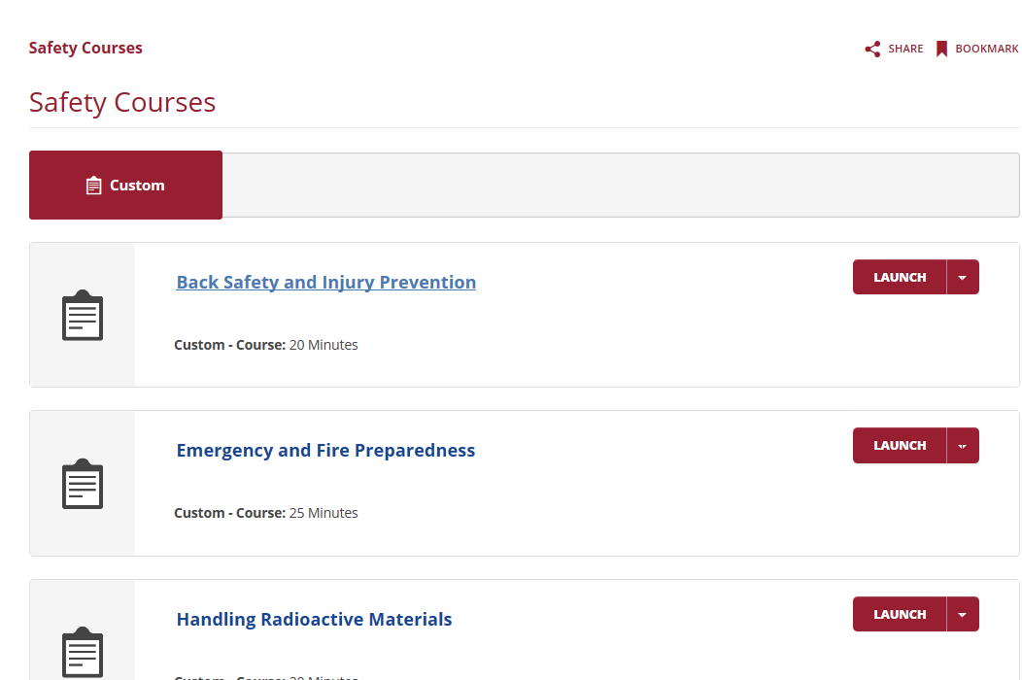
Enroll

Slide 26
2017 vs 2016 vs 2015 Incidents

Slide 27
2017 Incidents

Slide 28
WSU Safety & Health Units
Environmental Health, Safety and Risk Management Services (EHS&RMS):
Environmental Services (Chemical Spills and Waste)
Public Health/Air & Water Quality
Risk Management & Insurance
Occupational Health & Safety
Hazard Evaluations
IAQ
Program/Facilities Reviews
Training
Policy Development
Program Administration

Slide 29
Environmental Services Public Service Announcement
EH&S Environmental Services would like to remind you to stop and think before throwing away chemicals or dumping chemicals down the drain.
Why?
Because Washington rules for characterizing Dangerous Waste are more stringent than the national standards.

Slide 30
WSU Safety & Health Units
EH&S' Interface with Public Safety
Spill Response and Cleanup
IAQ = Indoor Air Quality
OAQ = ??? Air Quality
MCS = Minor Capital Safety
TLA = Three Letter Acronym

Slide 31
WSU Safety & Health Related Committees
Presidential Committees with safety and health related oversight:
Employee Health & Safety Committee(s) (EHS)
Institutional Animal Care and Use Committee (ORA)
Radiation Safety Committee (ORA)
Institutional Biosafety Committee (ORA)
Reactor Safeguards Committee (ORA)
Human Subjects Institutional Review Board (ORA)
Laboratory Chemical and Physical Hazards Safety Committee (EHS)
Student Safety and Security (Public Safety)
Infectious Disease and Public Health (HWS & EHS)
Emergency Management (Public Safety)

Slide 32
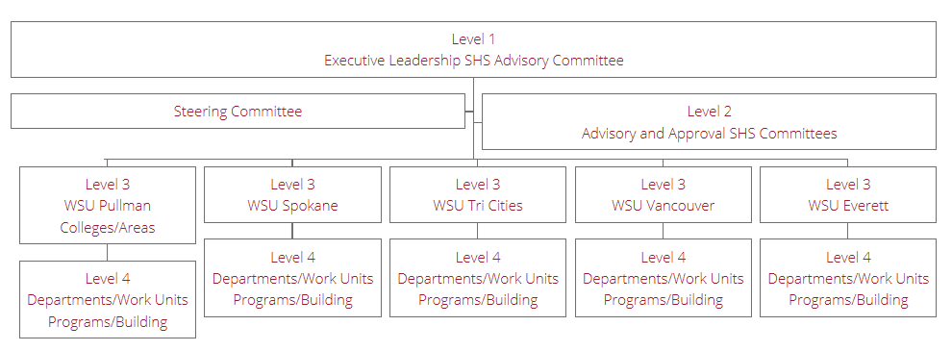

Slide 33
WSU’s Safety & Health Program
The big picture:
WSU’s Safety Policies and Procedures (SPPM)
Departmental level Safety and Health Programs (Departmental Safety Committees, APP, CHP)
EH&S's Occupational Health and Safety Administered Programs
RSO/ORA Administered Programs for radiation, biohazard and animal safety
These programs support WSU's commitment to provide a safe and healthy work environment. They are intended to reduce the potential for work related injuries and exposures to workplace hazards.

Slide 34
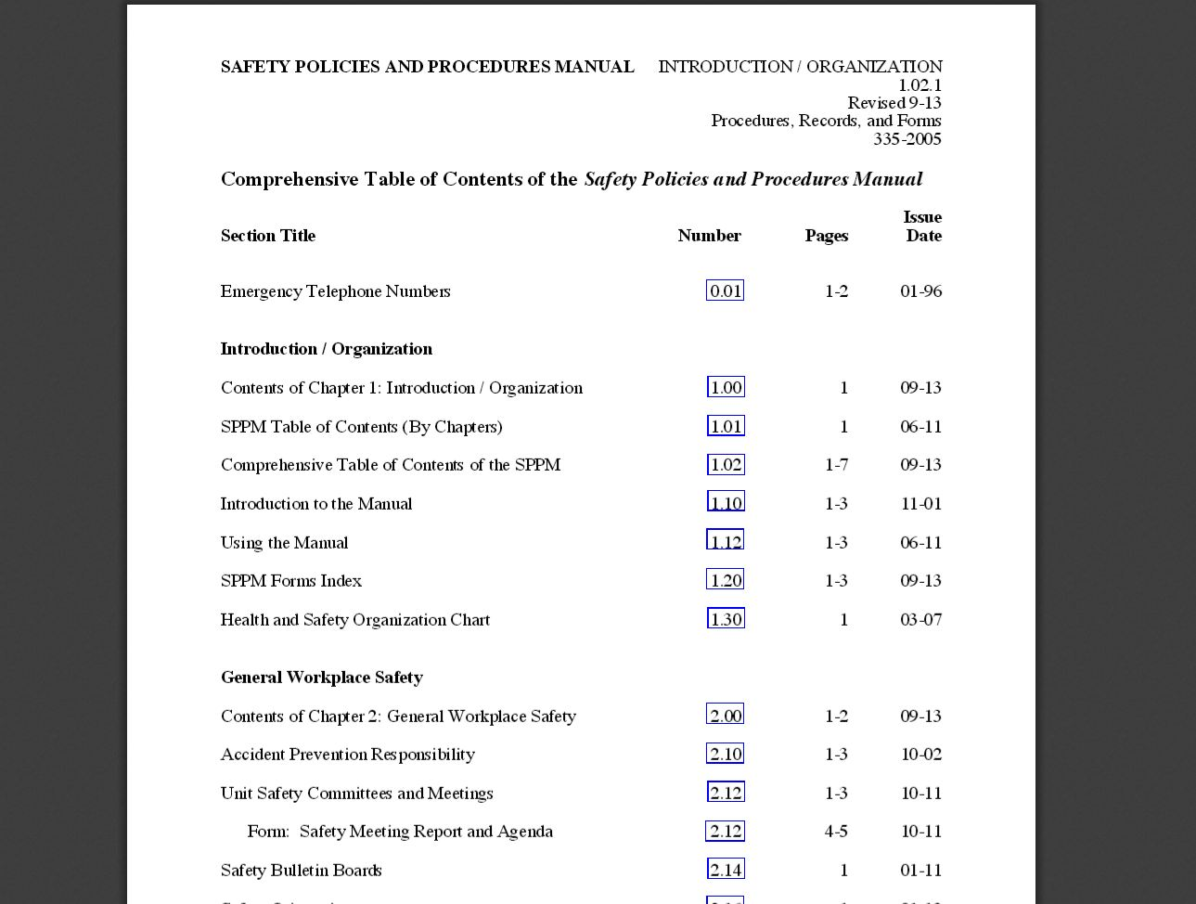

Slide 35
Departmental Level Programs
Accident Prevention Program (APP)
Department/Unit Safety Committees
Safety Bulletin Board
Accident Reporting
Hazard Notification Process
Safety and Health Inspections
Accident Investigation
Emergency Action Plan
Safety and Health Training
Resource: APP template can be found at www.ehs.wsu.edu
SPPM 2.10

Slide 36
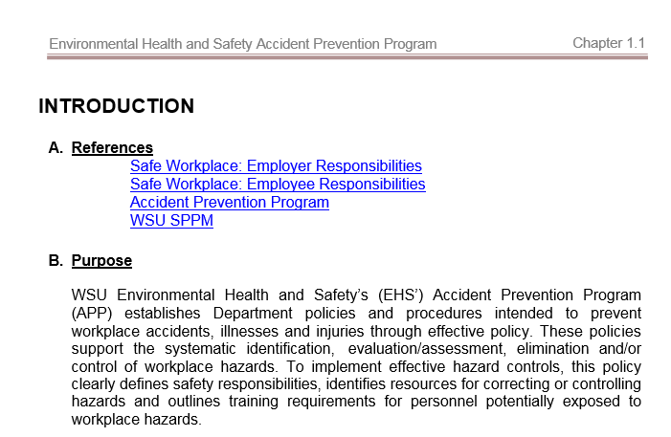

Slide 37
Accident Prevention Program
Department/Unit Safety Committees
Employee involvement is integral to WSU’s accident prevention efforts. Each employee must be represented by a safety committee per WAC 296-800-130.
The unit safety committee serves to:
Assist supervisors in promoting safety
Evaluate employee safety concerns and reported hazards
Evaluate Incident Reports and Supervisor Accident Investigation Reports, and recommend prevention measures
Assist supervisors in coordinating and conducting annual safety inspections WAC 296-800-13020
SPPM 2.12

Slide 38
Accident Prevention Program
Department/Unit Safety Committees
Based upon Employee Appointing Authorities, WSU is supported by 279 Departments under 31 Areas (where an Area = a College e.g. CAHNRS or Major Office e.g. Office of the Provost and Executive Vice President)
Resource: EH&S can assist in establishing and training a committee

Slide 39
Accident Prevention Program
Accident Reporting
Major accidents must be reported to EH&S immediately:
e.g. death, inpatient hospitalization (not just ER visit), loss of limb, loss of an eye.
Supervisors are to report any injury and occupational illness within 24 hours of occurrence using the on-line “Incident Report” form (www.ehs.wsu.edu).
SIGNIFICANT NEAR MISSES MUST ALSO BE REPORTED
Students/Visitors: Risk Management
Residence Hall Occupants: Residence Life
Employees/Student Employees/Volunteers: EH&S
SPPM 2.24

Slide 40
Accident Prevention Program
Hazard Notification Process
Employees observing a safety concern are to contact their unit administrator, their supervisor and/or EH&S per WAC 296-800-120.
All safety hazards are to be reported to the unit administrator, the safety committee, and EH&S using the “Hazard Notification” form (SPPM 2.52.2).
The department responsible to address the safety concern completes the “Corrective Action” section of the form.
All serious hazards should be reported immediately to EH&S (5-3041).
SPPM 2.52

Slide 41
Accident Prevention Program
Emergency & Continuity Planning
First-Aid/CPR
One trained responder is to be available to provide first-aid per WAC 296-800-15005
Fire Planning
Fire extinguisher training – only use if you are trained
Evacuation
Evacuation
Evacuate upon activation of emergency alarm
Posted maps indicating exits, first-aid kits, emergency eyewashes and showers, and the outside gathering location
WSU Ready On-line Planning Tool
Required of all WSU units (usually departments)

Slide 42
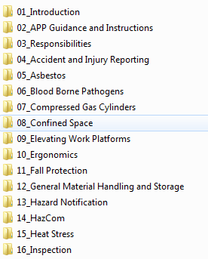
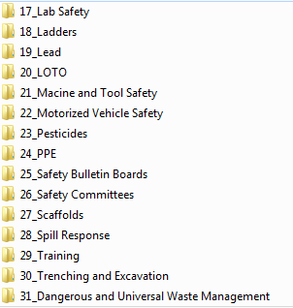
Departmental Safety & Health Programs

Slide 43
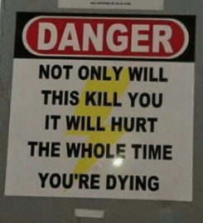
Establishing a Safe Workplace
A safety minded supervisor instills in their employees the desire and ability to work safely by:
Clearly communicating expectations
Leading by example
Encouraging and welcoming suggestions
Ensuring work is safely done
Acknowledging safety efforts, and
Document non-conformance
"Safety Culture” = Peer to peer accountability
What you permit, you promote!

Slide 45
This has been a WSU Training Videoconference
If you attended this live training session and wish to have your attendance documented in your training history, please notify Human Resource Services within 24 hours of today's date: hrstraining@wsu.edu

