Slide 1

Understanding the University Budget
Kelley Westhoff
Executive Director for Budget, Planning, & Analysis
November 13, 2018

Slide 2
Agenda
The Washington State Budget & Higher Education Sector
Budget Models
The WSU Budget
The WSU Budget Office
WSU Budget Policies
Financial Recovery

Slide 3
Washington State Budget & Higher Education Sector

Slide 4
State Budget Cycle
Washington enacts budgets on a two-year cycle
  Biennial budgets are adopted in odd-numbered years
By law, the Governor must propose a biennial budget before Legislature convenes in January
  2012 law requires a balanced operating fund budget
Biennial budget can be modified in any legislative
session
  Supplemental Budgets

Slide 5

Dec
Governor Proposed Budget
January
Legislature Convenes
Fall
(Capital) Scoring Process
OFM Reviews Agency Requests
April
September
Legislative Regular Session Ends
Agencies Submit
Budget Requests
State Budget
Cycle
May/June
June
Governor Signs Budget
OFM Issues Budget
Instructions
Supplemental Budget Requests
Summer
July 1
Agencies Submit Allotments
Budget Takes Effect

Slide 6
The Higher Education Sector
Comprised of:
  2 Research Universities
  4 Regional Universities
  State Board of Community and Technical Colleges (34 total colleges)
  Washington Student Achievement Council – (financial aid / student success advocacy)
Discretionary funding – from the state level
  K-12, human services, pension obligations and debt service comprise between 2/3 – 3/4 of the state budget
  Higher education is a sector that is considered for funding after these ‘mandatory’ obligations are met.

Slide 7
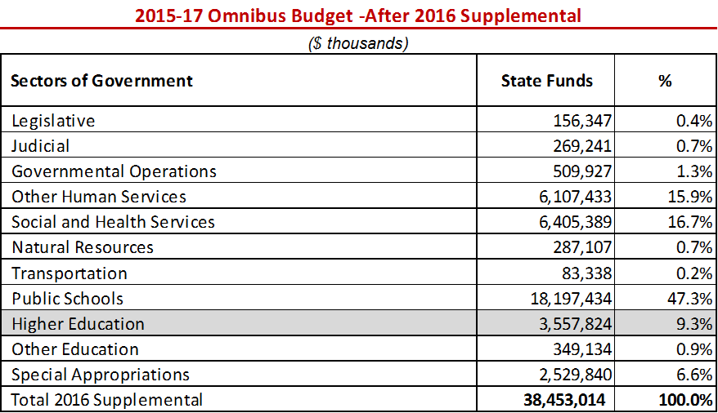
The Higher Ed Sector – Operating Budget

Slide 8
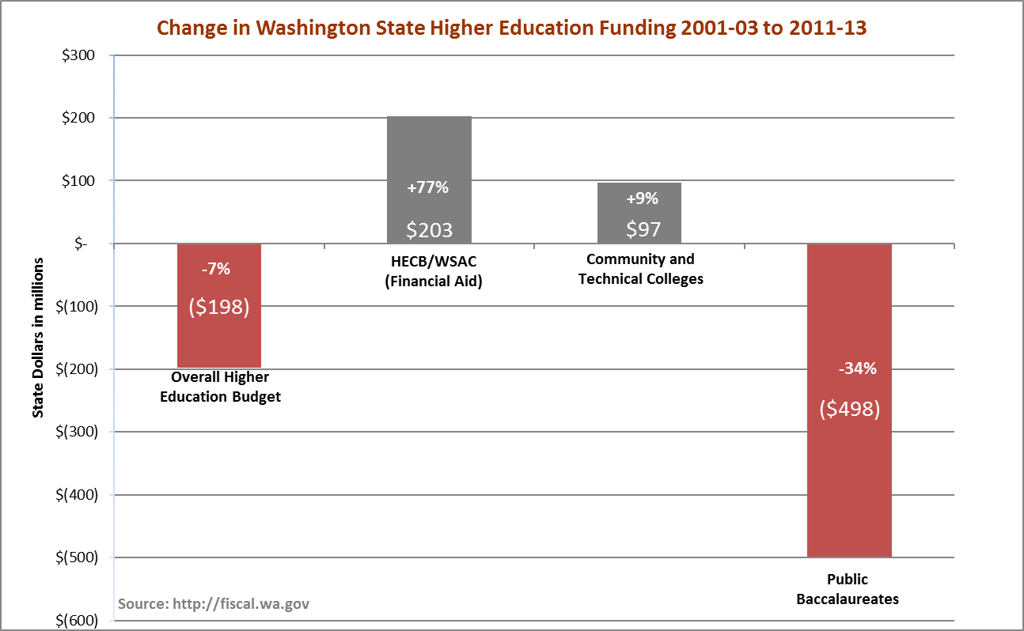
Higher Education Sector General Fund Appropriations
Overall state spending increased $7.1B between 2001-2003 and 2011-13. Overall spending on higher education decreased $198M in the same timeframe, and Washington public baccalaureate institutions saw a disproportionate $498M decrease in state funding.

Slide 9
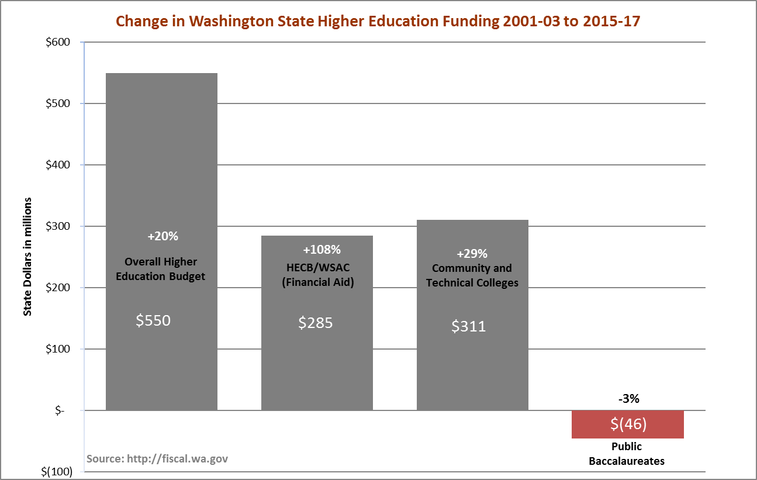
Overall state spending has increased $13.4B since 2001-2003. Overall spending on higher education has increased $550M in the same timeframe, and Washington public baccalaureate institutions have seen a $46M decrease in state funding.

Slide 10
Budget Models

Slide 11

Two classic models in higher education:
Incremental Budget v.
Responsibility Centered Budget
EASY

Slide 12
Incremental Budget employs an allocation process where units’ legacy funding levels increase incrementally based on overall changes in institutional resources.
$
$
$
$
$
$
$
$
$
$
$

Slide 13


Example of Incremental Budgeting: PBL – Planning Budget Level
Units have base levels of funding, which is backed by a pool of tuition plus state appropriations. When new state funding is provided, such as for mass salary increases, each unit receives a proportional increase in PBL.

Slide 14


Responsibility Centered (RCM) Budget allocates resources such as tuition to the units that generate them, which is intended to incentivize revenue growth and cost control.

Slide 15
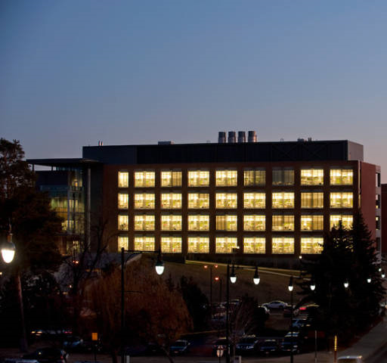
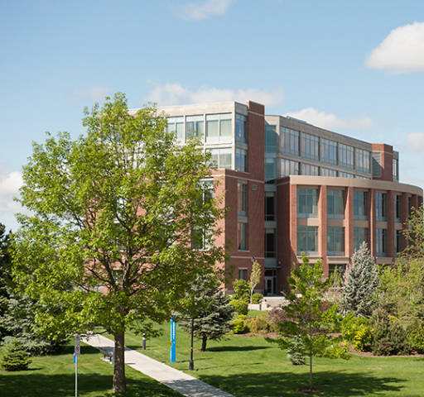
WSU’s Enrollment Based Budget (EBB) Model for undergraduate enrollment on the Pullman and Spokane campuses is an example of an RCM element of the budget. Under this model new undergraduate tuition is allocated to the colleges that generate it through new enrollment.

Slide 16

Another key element of an RCM budget is that revenue generating units are responsible, typically through a tax, for paying the costs of institutional overhead and funding a subvention fund that is used to subsidize units that may not generate enough revenue to operate at a profit, but are vital to the mission of the institution.
TAXES

Slide 17
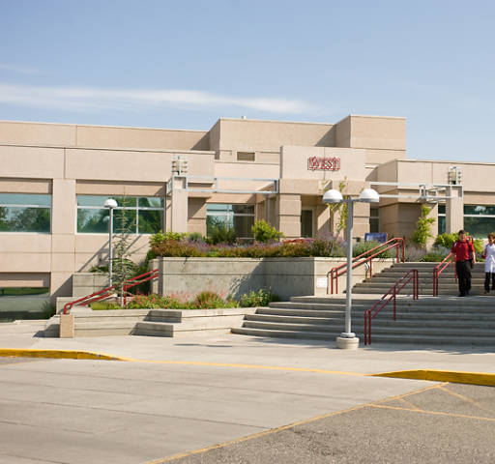

WSU uses this type of overhead assessment with our campuses in Vancouver and Tri-Cities. Both those campuses receive the tuition they generate less an 11% assessment for institutional support.

Slide 18
The WSU Budget

Slide 19
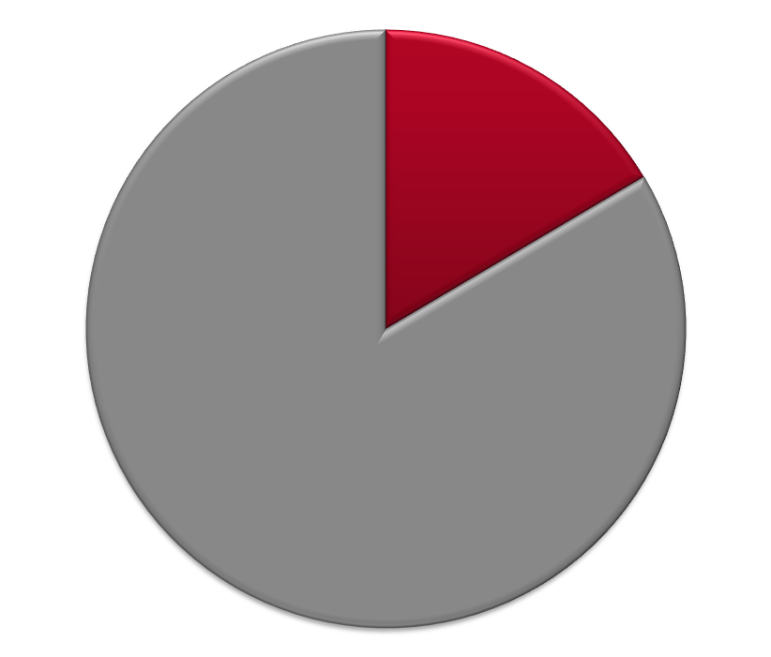
University Operating & Capital Budgets
2015-17 Biennium - $2.297 Billion Total
Capital
13%
$296.7M
$2.0B
Operating
87%

Slide 20
2015-17 Capital Budget
Total Authority: $311.7 M Projected Expenditures: $296.7 M
(includes Re-appropriation Balances)
Parking
1%
WSU Building/Land Grant Endowment
16%
Local/Private
53%
State General Obligation Bonds
26%
S&A Fees & Athletics
less than1% each
Housing & Dining
4%
Notes:
State General Bonds: Vancouver Applied Tech and Riverpoint Bio Medial Facility (breaks ground today), Minor Capital Renovations.
Building/Land Grant: MCR, pre-design for an Ag Animal Health Facility and design for a Clean Tech laboratory.
Housing/Dining: Major renovations (North Side, Duncan Dunn)
Athletics: Martins Stadium Remodel

Slide 21
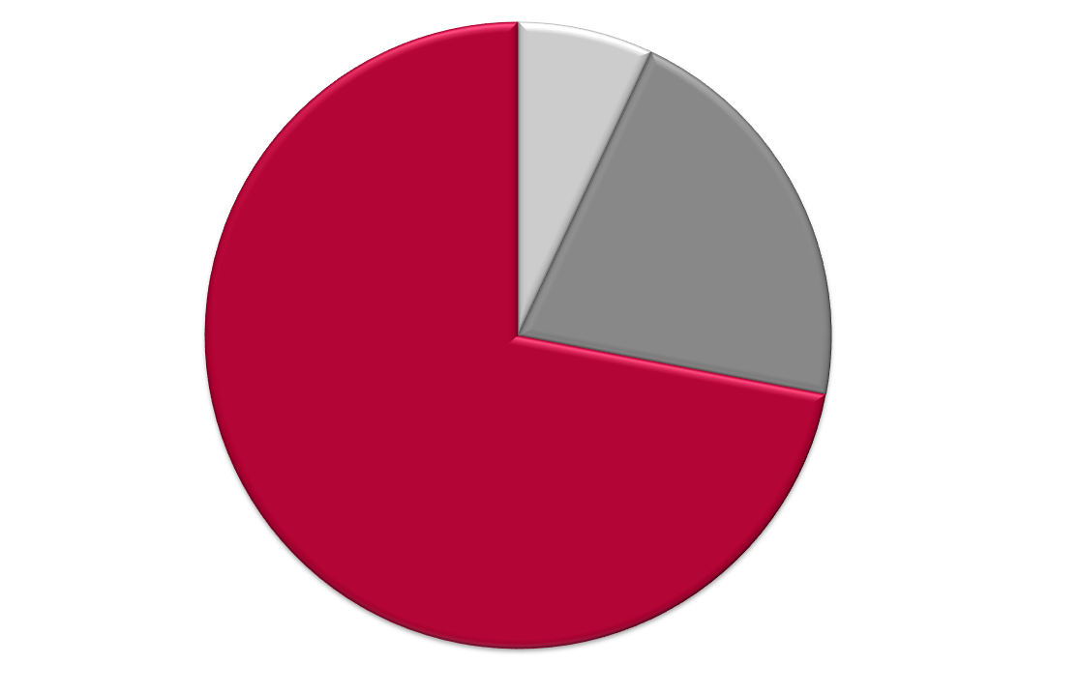
Use of 2015-17 Capital Budget – By Expense Type
State Appropriation, Land Grant Income, and Student Building Fees
Preventative Maintenance
(Operating) – 7%
Minor Capital
Projects – 20%
Major Capital Projects – 73%

Slide 22
2015-2017 Operating Budget
Fund Sources – Estimated Total: $2.0 Billion
Other
1%
Net Investment Income - 6%
Gifts/Endowment – 4%
*Net Operating Tuition & Fees
24%
Federal Appropriations
1%
*State Appropriations
16%
Net Restricted Student Fees
4%
Auxiliary Enterprises
14%
Federal Grants & Contracts
16%
Ed Dept Sales & Services
2%
Local Grants & Contracts
3%
State Grants & Contracts
9%
* Available for allocation
Notes:
Provide examples of different activities associated with each part of the chart.

Slide 23
Sources of Funds for Core University Functions
State Appropriations
Net Operating Tuition
Facilities & Administrative (F&A) Fees on Grants and Contracts
All are used to fund the permanent operating budget of the University

Slide 24
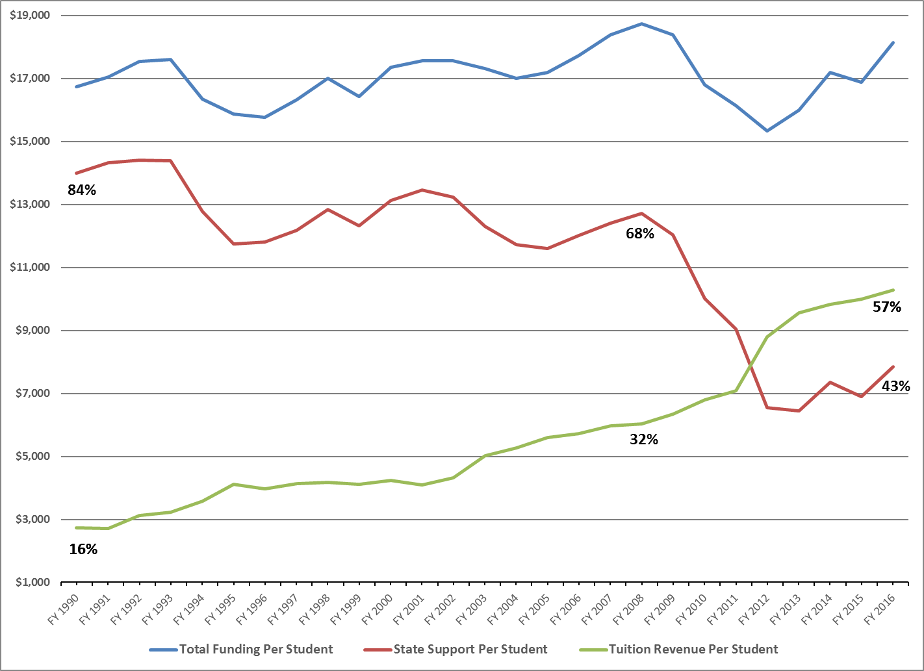
State and Tuition Funding per FTE
(in 2017 Dollars)
Adjusted for inflation, the total cost of educating a student at WSU has remained steady during 20 years of declining state investments.
Student tuition now covers 57% of the cost of education.

Slide 25
Tuition Policy: Components of Tuition

Slide 26
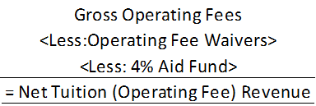
Tuition Policy: Net Operating Fees

Slide 27
Net Operating Fees by Category
Pie chart of percentages

Slide 28
Undergraduate Net Operating Fees

Slide 29
Tuition Policy-Post Recession
2013-15 Biennium
No increase in resident UG tuition per legislative mandate, WSU held all rates flat.
2015-17 Biennium
Resident undergraduate tuition (operating fee portion) reduced by 5% for academic year 2015-16 and by an additional 10% in academic year 2016-17, per legislative mandate. Backfill state funding was provided.
Although authorized to increase tuition by any amount for all other student categories, WSU opted for no tuition increase in academic year 2015-16, or 2016-17.
2017-19 Biennium
Current law allows inflationary increases in resident UG tuition for FY18 and FY19.

Slide 30
WSU Budget Principles
Distribution of F&A Revenue
For more information: BPPM 40.25

Slide 31
Use of 2015-17 Biennial Budget – By Function
State Appropriation and Operating Tuition
Plant Operations & Maintenance
9%
Institutional Support
10%
Instruction
50%
Student Services
5%
Library
2%
Primary Support
9%
Public Service
6%
Research
9%

Slide 32
Use of 2015-17 Operating Budget
– By Expense Type
State Appropriation and Operating Tuition
Operations
15%
Benefits
18%
Salaries and Wages
67%

Slide 33
The WSU Budget Office

Slide 34
What Does the Budget Office Do?
State Budget - Requests, Allocations, and Reporting
Allotments
Compensation Impact Model
Internal Budget Processes (review, hearings, summit)
Revenue Tracking (F&A, 17A, AFI)
Tuition Modeling (census day)
Central Benefit Pool Tracking / Analysis
Expenditure Monitoring
Area Carryforward Projections
Benefit Model
Accrual Analysis
Tuition Schedules
MSI, if applicable
Ad hoc Decision Support
University Workgroups & Committees
System Maintenance (HEPPS;MSI;DEPPS;AIS;BPS)

Slide 35
WSU Budget Policies

Slide 36
Allocation of Resources
General funding is tracked by campus
Budget allocations are provided by the Budget Office to areas/campuses
Areas/campuses determine distribution of funding to their departments

Slide 37
Pooled Benefits
WSU utilizes a central benefit pool to allocate resources to cover benefit related costs for particular fund types (001-XX, 143-XX, 148-02, 148-05, 148-06)
Automatic budget allocations are made to area departmental operating accounts where actual benefit expenses are incurred each payroll expense cycle

Slide 38
Accruals (Salary Savings)
Central pool provides for turnover costs (sick and annual leave payouts), and PIDs
Areas retain savings from vacant faculty and graduate student positions on WSU program 05 (libraries) and 06 (instruction)
Areas retain savings from the transfer of expenditures to grants (programs 11A-14Y) regardless of employee type
Central captures savings from vacant classified, administrative professional, and non-instructional faculty positions for the first four months. Subsequent accruals are returned to areas upon request
* WSU Vancouver, WSU Tri-Cities, Extension, and Ag Research manage their own accruals.

Slide 39
Carryforward
Most funds carry forward at the area level. Dean, vice president or chancellor decides if they carry forward at the department level.
Operating budgets
F&A accounts
Donated funds
Some funds do not carry forward
Equipment replacement allocations
Special allocations for specific purposes, such as proviso funds

Slide 40
Financial Recovery

Slide 41
Budget was one of the first topics President-elect Schulz addressed his in message to campus in May 2016 …
“We have been spending more money annually than has been brought in, which is not sustainable”
“We are spending down reserves”

Slide 42
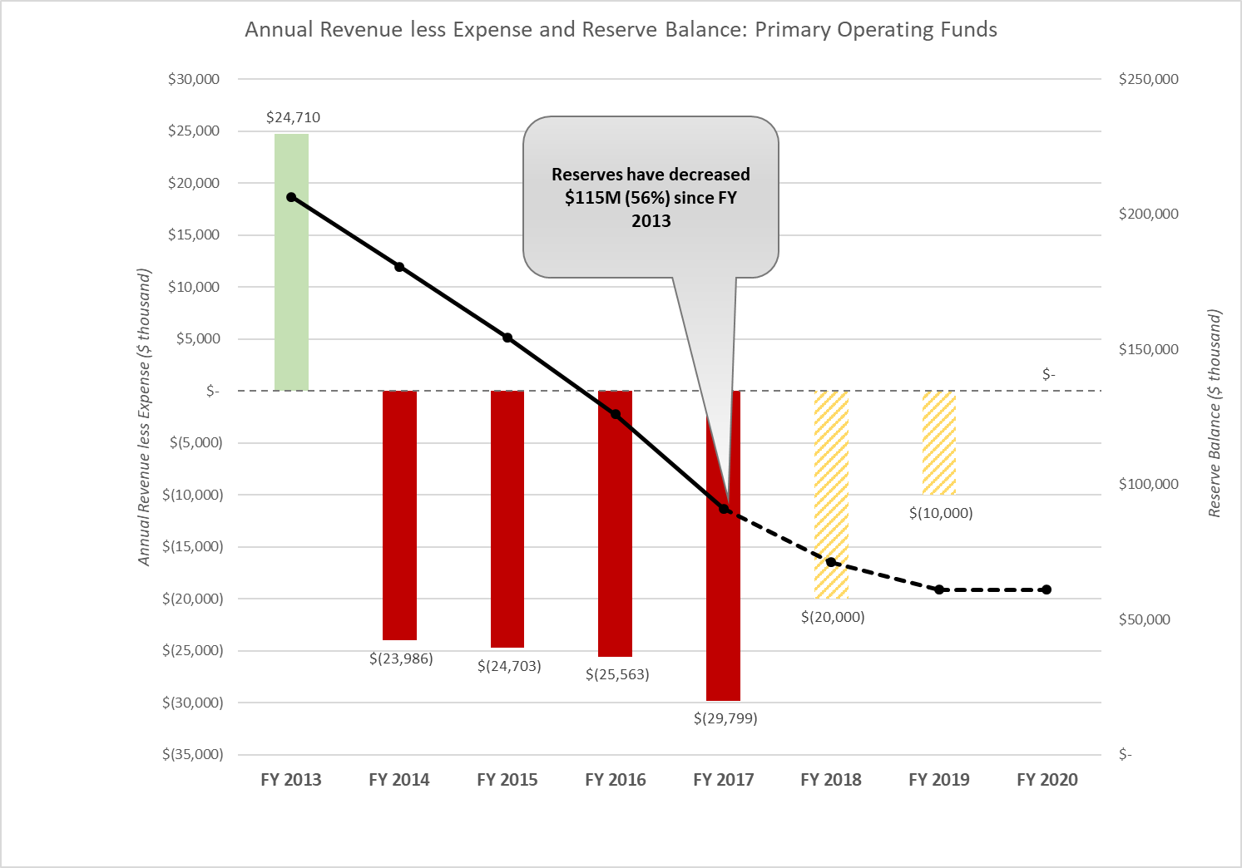

Slide 43
Fiscal Year 2018
First year of a three year recovery plan
We have overspent the University budget for the previous 4 years by about $25-$30 million each year. This overspending has decreased the University’s reserves to slightly less than $100 million.
$25 - $30 million is 2.5%-3.0% of the annual $1billion operating budget

Slide 44
Recovery Plan Specifics
Three-year recovery plan calls for $10 million improvement over three consecutive years
Areas have specific improvement targets to be met through expenditure reductions or revenue enhancement or both
Areas retain savings (not a budget cut)
Monthly reporting, using a common template

Slide 45
Other Budget / Fiscal Initiatives
Regular updates to campus community
President’s Perspectives columns
Fiscal Health Web Page
University Fiscal Health Advisory Committee

Slide 46
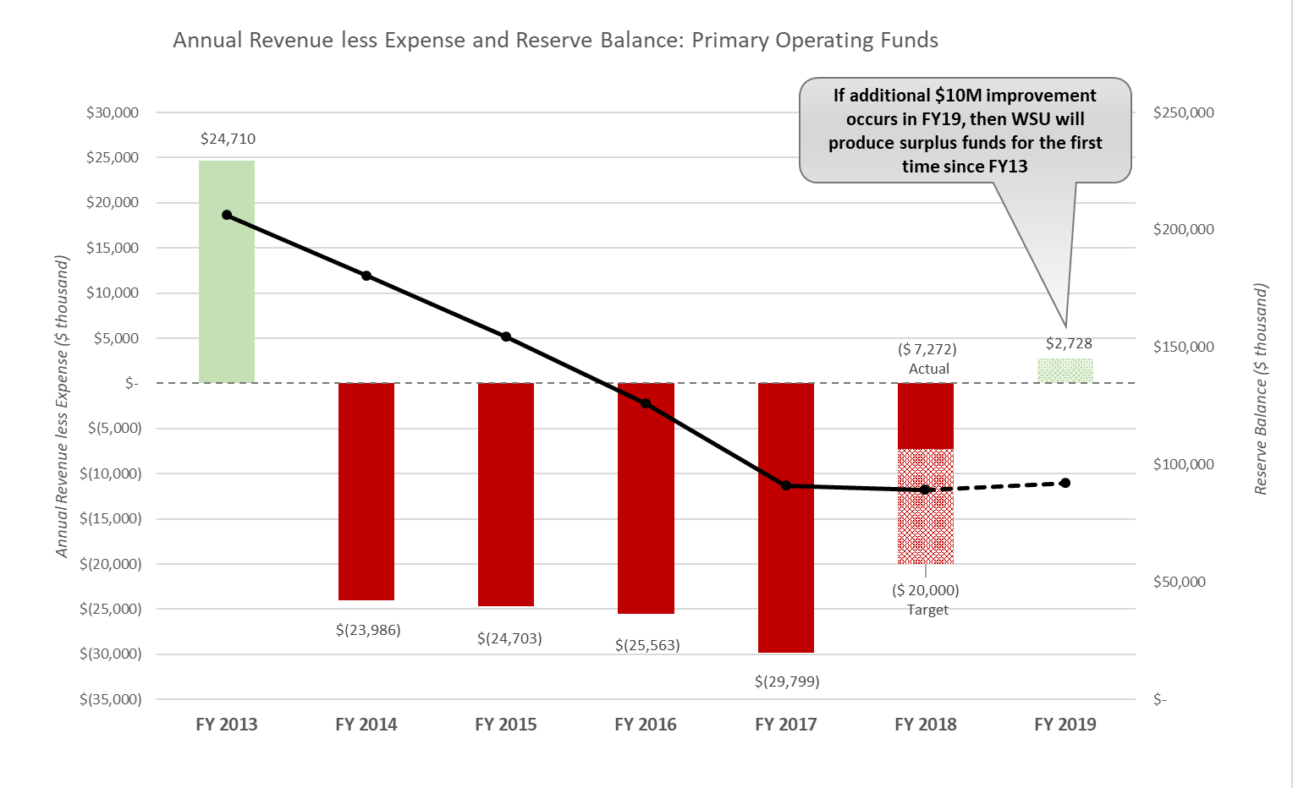
FY18 Results

Slide 47

QUESTIONS ?

