Slide 1
Proposal Submission, Review, and Acceptance
January 2019
Matt Michener – matthew.michener@wsu.edu
Office of Research Support and Operations (ORSO)
Savannah Tiedeman – savannah.tiedeman@wsu.edu
Integrative Physiology and Neuroscience (IPN)
Maureen Bonnefin, CRA – maureenb@wsu.edu
Office of Research Advancement and Partnerships (ORAP)

Slide 2
PI Generates Idea
Proposal Development
PI finds Collaborators*
PI/ Dept. RA Begins Creating Proposal*
PI creates a one page proposal pitch*
PI Seeks Funding for Idea*
Proposal uploaded to eREX & submitted for electronic approval
(minimum of 2 days prior to
due date.)
Proposal Prepared* w/ help from Dept. RA, advisors and team
Proposal Reviewed & budget approved
by Dept. RA
Proposal Denied: improve idea/look for other funding*
ORSO reviews proposal and submits it to agency
eREX Approved & Routed to ORSO
AWARDED!
Now the fun begins.
*ORAP available for assistance, https://orap.wsu.edu/ .

Slide 3
Fundamentals of the Proposal Process
Starts with an Idea - Faculty member defines a problem and identifies a solution.
Funding source or opportunity is identified.
In the event a Pre-Proposal is required, it may be directly submitted to the agency, unless it requires something more than a brief letter of interest from the PI. To determine if an eREX is needed please refer to Guideline 30 https://orso.wsu.edu/documents/2018/02/guideline-30.pdf/.
With the help of the department, the proposal package is developed based on instructions provided from the funding agency.*
Proposal and attachments are uploaded to the eREX and routed through ORSO to obtain required approvals.
ORSO reviews the proposal package and submits to Sponsor.
If proposal is funded, ORSO begins award negotiation and acceptance.
* ORAP can help with this stage of the proposal. Proposals >$1M, junior faculty proposals, and proposals aligned with WSU strategic initiatives are given priority.
Notes:
If other areas are volunteering effort as cost share, or have faculty as Co-I’s, include their RAs/dean/chair on the eREX and get the approvals – now auto

Slide 4
Tips for Successful Proposals
Read the RFP!!! (Request for Proposal)
Also referred to as the Call, Solicitation, Funding Opportunity Announcement, Program Announcement, or Broad Agency Announcement.
One of the most crucial and most often missed steps.
General application information is also found on the agency’s website.
Why is the RFP important?
The RFP includes the programs/projects/research areas that the agency would like to fund as well as the type of organizations they generally fund (Universities, foundations, corporations, etc).
The RFP outlines the application’s requirements (i.e. maximum funded amount, overhead and cost share limitations, mandatory attachments).
Includes instructions regarding how to submit and when to submit.
Limited amounts of proposals allowed by submitting institutions.
Notes:
https://orso.wsu.edu/frequently-required-information/
Make sure all contributors are using the same font, size and formatting for consistency and coherence.

Slide 5
Tips for Successful Proposals
Resources to prepare a certified budget.
ORSO Guideline #2 (Budgeting Assistance Information for Preparing Sponsored Program Proposals).
ORSO training to obtain budget certification.
Take the “Budgeting for Sponsored Projects,” “Effort Certification,” “F&A” and “Cost Sharing” classes during the Research Administration Series (RAS).
All proposal budgets must be approved before they are routed with the
eREX by a:
Budget certified department administrator
OR
ORSO – two weeks prior to deadline for approval.
Guidelines and templates at https://orso.wsu.edu/
Notes:
If you don’t have a budget certified RA and need a budget approved, send a rough budget, budget justification and RFP to your ORSO coordinator.

Slide 6
Tips for Successful Proposals
Gather supporting documents ahead of time.
Items to Gather Early in the Process: Biographical Sketches/CVs, Current & Pending Support, Conflict of Interest, Disclosure of Lobbying Activities, Environmental Questionnaires, Personnel/Grad Student salary verification, Sub-awardee Documents.
Other Common Supplemental Docs: Facilities, Equipment and Other Resources, Data Management Plan, Human Subjects Protection, Management Plan, Bibliography, Project Summary/ Specific Aims*
Letters: Letters of Support/Commitment, Letters of Cost Share Commitment, Third Party Cost Share Commitment (both University & Industry require authorized signatory – start early)
Other: F&A and Benefit Rate Agreements, etc.
* ORAP has templates and can help the PI draft these documents.
Notes:
Cost Share Letters from Universities – should include period of performance, amount of cost share, amount of federal request dollars, if applicable, detailed explanation of how cost share is being met (RAs should also keep track of faculty commitments to avoid over commitment (recommend no more than 70% of research appt.))
Third Party Letters – Should include the same information as University CS letters, but need more follow through from lead to monitor progress of commitment and requires letter from source that CS has been met – sent to SPS with Manual CS Memo.
WSU/ Internal Letters - Only Dan can sign off on the cost share letters for cost share committed by the university regardless of the source (i.e. department, college, school). It is important to make sure that the PI has discussed cost share with their Dean, Director, or Chair, as appropriate, PRIOR to sending in the eREX. Dan will need some sort of indication (email, letter) from the departmental side that they approve the cost share. It is not good to get to the eREX approval stage and find out that your PI has not had the cost share discussions necessary.

Slide 7
Tips for Successful Proposals
Be mindful of the submission deadline.
Faculty should let you know ASAP when they know they will submit a proposal. They should have all supporting documents and a draft budget completed and to you 2 weeks prior to submission.
Start filling out eREX and agency application form (Workspace, Fastlane, ASSIST, etc.) as soon as you find out about the proposal.
PI should have technical info written in time to allow others to contribute and review, recommend having a full draft ready 1 month before due date.
WSU policy is that each eREX be submitted and approved two working days prior to the sponsor’s deadline. The proposal must be in final form at the time the eREX is submitted & ORSO must be granted access to it (if required by the submission method). Exception for Narrative Hold.
Last minute submissions are often not reviewed which increases the chance of a failed submission to Sponsor.
Notes:
If the due date falls on the weekend, submit the week prior. Narrative Hold to be explained more in depth later.

Slide 8
The eREX Form (Electronic “Request for Approval of Application for Extramural Support” Form)

Slide 9
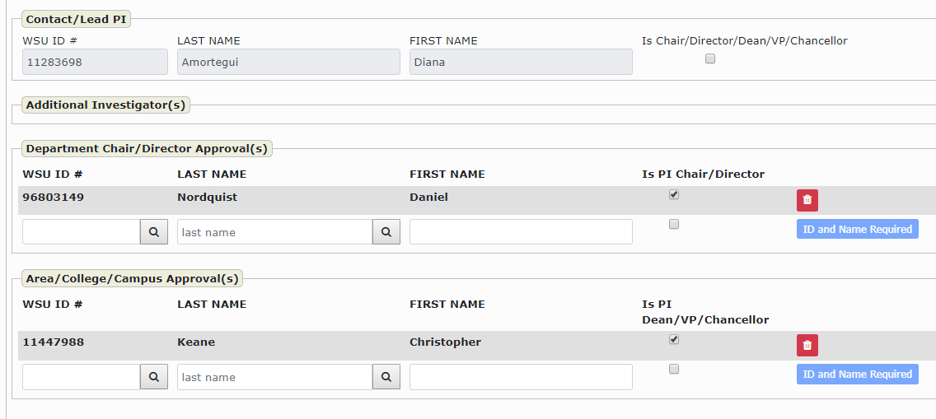
Video available at: https://youtu.be/tmiEp4qmw2A.
Notes:
Cat’s video, “How to Create a new eREX” (10:25 length)
Deadline tab has been changes to include Narrative Hold option & proposal ID number when appropriate
Checklist – questions have been condensed – hover to get full info for highlighted – question 11 should almost always be Yes
Contacts/Approvals tab needs to have PI affiliates designated
Reminders:
PI, Co-I’s, Dean, Chair and Dept. contacts must to be listed – affiliates need to be designated
An email from the PI providing delegate permission for someone else to approve for them on this exact proposal is required and needs to be attached to the eREX as documentation. The PI is required to make certain certifications on the eREX and these certifications cannot be auto-approved.
Mobile app approvals available

Slide 10
Checks before submitting the eREX
Do the total dollar amounts and period of performance dates match on the eREX, proposal, budget justification, and sponsor & WSU budget?
Ensure PI credit goes to PIs academic tenure department and the sum of all Co-PI credit is equal to 100%.
Include specific submission instructions as detailed on the Deadline tab. Be sure to communicate instructions clearly in the “Special Comments” box, e.g. list of docs to be sent, docs to be signed by the ORSO AVP/Director. If submitting by email, include email address(es) in designated spot. Include Proposal ID Number as applicable.
Notes:
Joint Appointments - Some PIs have joint appointments with more than one college/department, in this case, be sure that the credit in the eREX is set to the correct department for the proposed project and that the total amount of credit between the PI and all Co-I’s is equal to 100.

Slide 11
Checks before submitting the eREX
If hard copy(ies) are required by the agency: mail, or hand deliver, copies along with a Request for Shipment Form for your FEDEX package to ORSO.
Is the F&A correct? Attach supporting docs if requesting a non standard rate.
Foreign collaboration? Did you attach the Export Control Decision Tree?
Supporting documentation is attached (Subcontract budgets/LOS/SOW, F&A Agreement, Cost Share Statement, etc.)
Is the attached budget approved by a certified RA; including cost sharing (is it attached to the eREX?)
Is the FINAL version of the proposal attached to the eREX? Exception Narrative Hold allows the use of Draft documents when eREX is submitted and approved prior to the 2-day window.
Do all validations pass?

Slide 12
RUSH Proposal Policy
The deadline for completion of a submitted and fully approved eREX to the Office of Research Support and Operations (ORSO) will be two working days prior to the sponsor’s deadline. (see BPPM 40.02)
• Faculty need to work with the grant administrator for their unit to determine further timelines for processing proposal submissions before routing to ORSO.
• A waiver process will be initiated when proposals via the eREX are not submitted and approved to ORSO by the two working days requirement – if approvals are not completed outside the 2 day window, they will automatically begin again for all designated affiliates.
• Waivers will be granted for a variety of reasons, provided they are justified. Waivers for any other reason will require a Principal Investigator (PI) waiver justification that includes a reasonable rationale and subsequent written endorsements from the appropriate chair or director; area dean, chancellor or vice-president; and the ORSO associate vice president.
•It is the responsibility of the department/college to monitor all waiver eREX’s approvals and work with the ORSO AVP as needed for exceptions when approvals will not be completed before the sponsor deadline.
Notes:
This is where the PI’s designated affiliates are very important and in the waiver timeframe, only delegates of equal or higher authority can approve at the different levels.

Slide 13
Narrative Hold Policy
The Narrative Hold Program will only be applicable for eREX Forms that are completed and approved two days prior to the sponsor deadline. Any RUSH submission (eREX Forms submitted within 2 days of the deadline) will be not be able to use this Narrative Hold In Summary:
• Only the research/technical narrative and directly related documents as noted above can be in DRAFT FORMAT – all other components of the proposal (including budget) must be in final form when the eREX Form is submitted.
• The final research/technical narrative must be provided no later than five business hours before the deadline OR by Noon on the day the proposal is due – whichever is earliest.
• The PI is required to notify ORSO via email (orso@wsu.edu) providing in that email a copy of the final narrative documents to let us know that the research narrative information is complete and the proposal is ready for submission.
• If the eREX is not fully approved 2 business days before the deadline it will no longer be eligible to use the Narrative Hold Program – the eREX will be returned and will need to be resubmitted once the proposal is in its final form and ready for submission.
Notes:
Narrative Hold is allowed only for proposals being submitted through ASSIST, Workspace, NSF FastLane or NASA NSPIRES- only those proposals that require submission by the institutional AOR via online federal portals. The eREX must be submitted and approved 2 days prior to the deadline, otherwise the Narrative Hold will not be granted. The Narrative Hold allows draft copies of the projects scientific Narrative and all associated scientific documents (e.g. References Cited, Project Abstract) to be provided on the eREX. It is requested that any draft files attached to the eREX have “DRAFT” in the file name, so that those are not reviewed until the RA has notified the ORSO Coordinator that they are final. Final documents must be uploaded and ready for submission a minimum of 5 hours prior to the submission deadline.

Slide 14
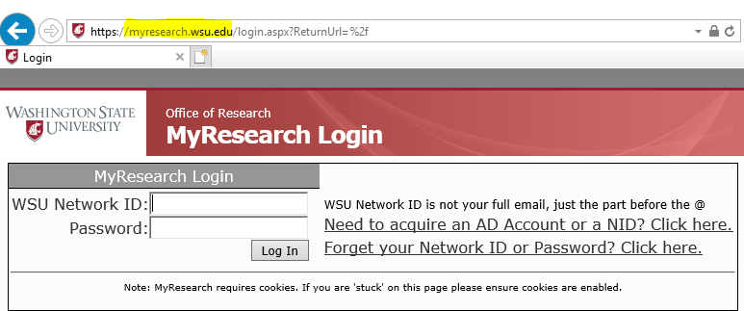
ORSO and MyResearch
Upon eREX approval, proposal is logged into MyResearch, given an ORSO Number, and assigned to a Coordinator.
Coordinator will thoroughly review and submit the proposal with the Authorized Institutional Signature once the requirements of WSU and the agency have been fully met when fully approved prior to the 2-day window.
PI’s, Research Administrators, and other departmental figures have access depending on their role at WSU.
MyResearch provides the
WSU Research Community
with tools for:
Tracking sponsored
activity; Dissemination
and Communication
& Reporting

Slide 15
If Denied… RESUBMIT!!!
ORSO will process the proposal as denied and will await a revised resubmission.
Have the PI carefully read and understand the Reviewer Comments. These are important for resubmission as they will need to be addressed in the revised narrative. ORAP is available to help interpret the comments, and edit and update the narrative.
Prepare your proposal for resubmission. This will require you to review the new RFP to ensure no changes have been made and update any applicable supplemental documents.
ORAP can help with the resubmission process or they can help find other funding possibilities for the project.
Notes:
If resubmitting, you need to reference the previous ORSO number and reference it as a resubmission on the eREX and to the sponsor (if the same). Fed ID can be obtained by calling ORSO

Slide 16
AWARD Processing
ORSO receives award
Subawards? Work with ORSO
Are Research Compliance Protocols Needed? Work with ORA
ORSO reviews award for acceptance, negotiates changes as needed
ORSO routes to Dept/RA & PI for review (if needed)
Dept/ RA returns award to ORSO with approval &/or changes to be made
ORSO sends executed copy of award to SPS
ORSO has Dan Nordquist sign award & returns it to the agency for execution (if needed)
If changes need to be made to the project after award, work with ORSO
SPS sets up WSU account, manages invoices & financial reports

Slide 17
When Awarded…
If you received the award directly, make sure ORSO has a copy.
Check the MyResearch database for updates.
Be prepared for Contract Negotiation. Your ORSO Coordinator will work with the agency on the negotiation.
You may be asked to include MTA’s, NDA’s and other No-Money Agreements in addition to your contract.
Subcontracts? Fill out initiation form: https://orso.wsu.edu/forms-templates/ (and change requests)
For more information on contracts and subcontracts take the RAS classes “Ins and Outs of Contracts” and “Subcontracts.”
Notes:
Can’t begin work until award is executed.
It takes more than a day to review and turn around a contract. We need time to review all the T&Cs and clauses and negotiate out those that are unfavorable. Worst case, this process can take weeks to months to complete.

Slide 18
ORSO Processing of Award
Receive award/contract and log in MyResearch.
Send to appropriate college for review (via DN Memo or otherwise), when required/requested.
Coordinator will review the contract and prepare for signature/negotiation.
University Authorized Official Representative signs document, NOTE: This is not the PI, although they may be asked to sign in addition to the AOR.
Does the document need to be returned to the agency for execution?
Send back to Agency for full execution, otherwise, process to Sponsored Program Services.

Slide 19
Account Setup & Post Award
ORSO will distribute fully executed contract/award to SPS and to the Agency, as necessary.
SPS will review the award and set-up the project account. If the budget has been split to account for multiple departments or PIs multiple accounts will be created.
For post award changes work with ORSO – Amendments, No Cost Extensions, PI Change, etc.
Reports, reports, reports – ours and yours
Agency Reports
WSU Award and Proposal Reports
Financial Reports (SPS)
For more post award best practices attend the rest of the Research Administration Series.
Notes:
If the proposal is well written, all of these items are easier to execute.

Slide 20
Working with Faculty
Get to know your faculty and their field of research. Set up one-on-one meetings to go over goals and suggest RFPs.
Express your willingness to provide excellent service but remind them that in order to do this they must give you time to do your job effectively. This will result in a better product and higher chance of success!
Set up a means of providing regular communication with all your faculty. Develop a culture in which you are the first one they contact with grant questions.
Stress that you are in a position to protect the PI and University from audit risk – get your faculty to buy into this philosophy.
Now is the time to set boundaries and expectations. Use your newness as a tool to implement new procedures.
You are the expert in your field. Make sure you project this – if you don’t know the answer – use your resources.

Slide 21
ORAP
Office of Research Advancement &
Partnerships
Pre-Proposal Development
Locates Funding Sources
http://pivot.cos.com
Conducts Proposal Writing Classes
Provides training to faculty on all proposal components.
Coordinates the Office of Research grant competitions & Limited Submissions
Proposal Development
Provides proposal writing assistance
Large Proposal Development & Management
Strategic Partnership Development
Budget assistance in partnership with the department
https://orap.wsu.edu/
ORSO
Office of Research Support & Operations
Proposal & Award Processing
Reviews/submits proposals
Drafts/negotiates contracts
Coordinate w/SPS for change requests & allocations
Certifies/assures adherence to policies and regulations
Monitors/reports certain activity
Advises faculty, staff & graduate students on any of these items
Confidentiality/Material Transfers
Obtains non-disclosure agreements
Handles material transfer agreements
No money, licensing, equipment agreements
https://orso.wsu.edu/
ORA
Office of Research Assurance
Law & Regulation Compliance/Policy
Human Subjects (IRB)
Hazardous waste & shipment, radiation
Use of animals for research (IACUC)
Export controls
Biosafety (IBC)
Conflict of Interest
Pesticide Policies
Reviews possible research misconduct
Post Award Approval Review
Assists with compliance
http://www.research-compliance.wsu.edu/
Notes:
All

Slide 22
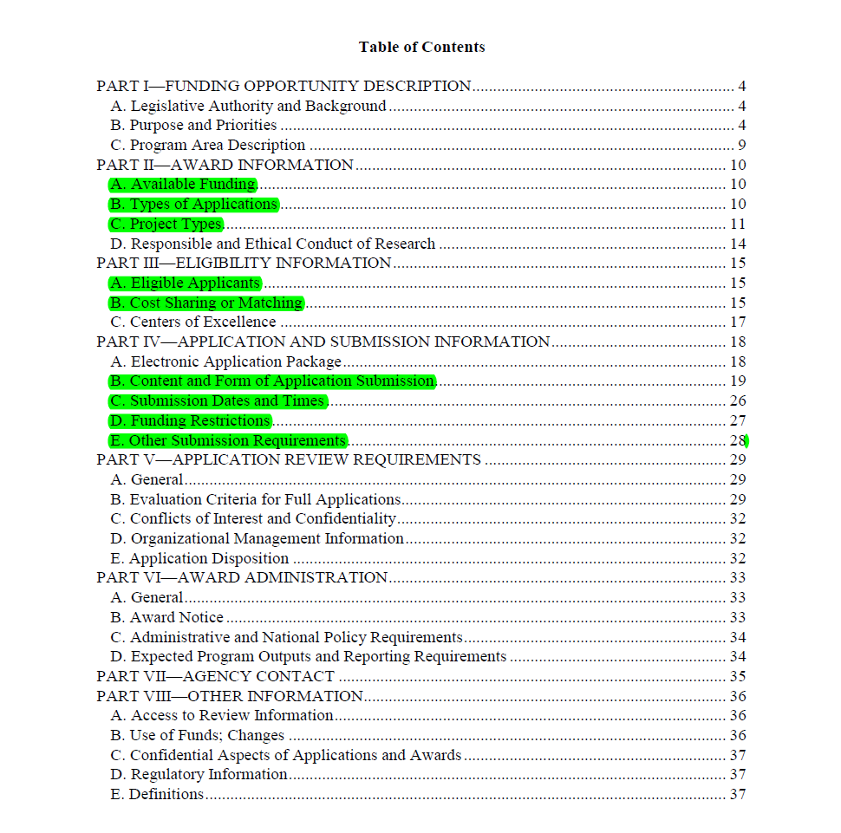
RFP Example: USDA SCRI Group Activity
Notes:
Max, 15 minute exercise. Split into groups of 3-5. Compete as groups.

Slide 23
This has been a WSU Training Videoconference
If you wish to have your attendance documented in your training history, please notify Human Resource Services within 24 hours of today's date: hrstraining@wsu.edu

