Slide 1
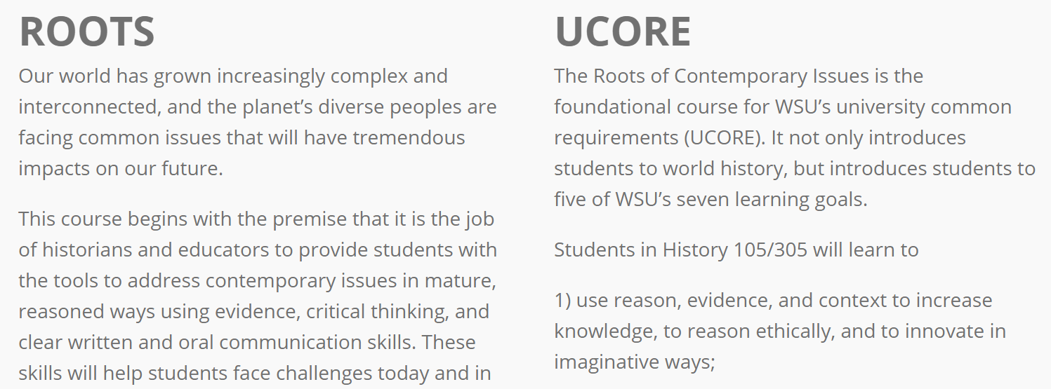
Foundational UCORE Course

Slide 2
Challenges in the promotion of effective learning for ROOTS classes (67 sections for Fall 2018 across all campuses, with 3,530 students)
Students:
Required GenEd classes often automatically unpopular
History is often especially unpopular among high school students
Faculty:
Balance between promoting fairness and consistency across all sections and respecting faculty autonomy
Difficult to recruit excellent non-tenure track faculty to Pullman, and difficult to find excellent non-tenure track faculty already in Pullman
Administration:
Need for assessment data for accreditation
Concerns about retention rates

Slide 3
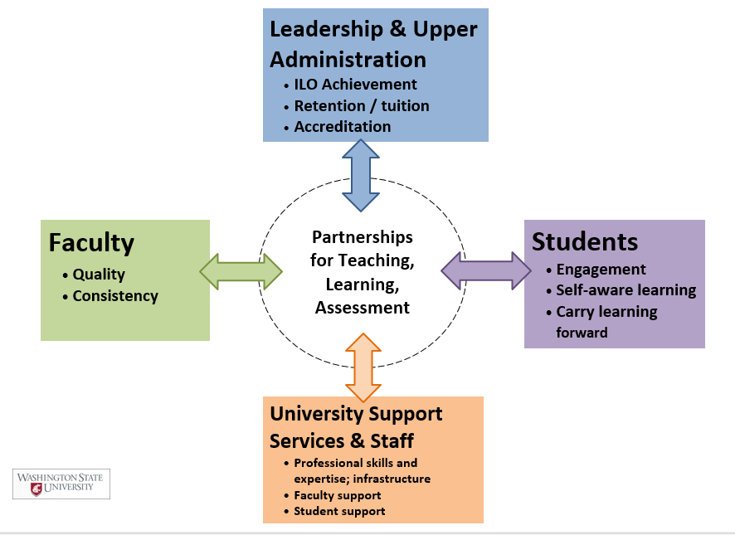
Stakeholders in Learning

Slide 4
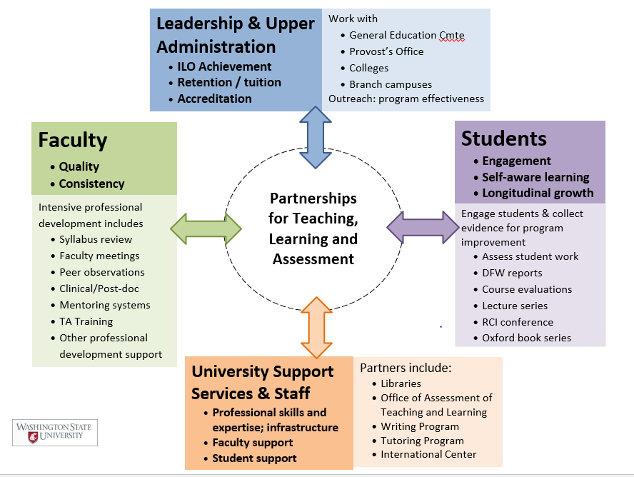
The Roots of Contemporary Issues

Slide 5
1. Designing Curriculum
Be intentional and explicit about covering topics people want to know understand or wish they better understood
Narrow the topics enough to allow students to understand (and discuss) their complexity
Build real challenges into all lessons, but make sure they are scaffolded and students understand them as achievable

Slide 6
5 UCORE Learning Outcomes
Designed to build foundational skills that will aid students from all disciplinary backgrounds
Develop Critical and Creative Thinking
Increase Information Literacy
Develop Communication Skills
Foster Diversity
Enhance Depth, Breadth, and Integration of Learning

Slide 7
Roots of Contemporary Issues
Five Case Studies
Scaffolded Research
Global Climate Change
Pandemics
Origins of Racial Inequality
The History Islam and the West
Refugee Crises in World History
Identify an issue or debate in the world of interest to you
Learn its history by finding and reading book and articles
Find and interpret primary source evidence for yourself
Prepare an annotated bibliography
Write a complete outline

Slide 8
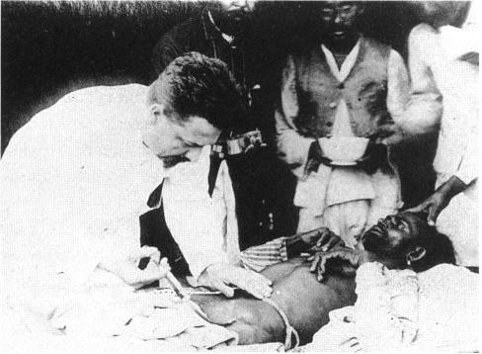
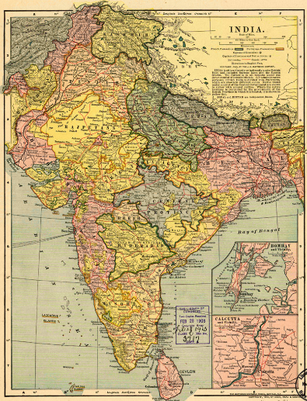
Outbreak of Bubonic Plague in British India, 1897-98
Pune
European doctor treating plague victim in Karachi, 1898

Slide 9
Primary Source Interpretation: Newspaper Reports, February-September 1897
What can these sources tell us about how different people responded to the outbreak of bubonic plague?
Educated newspaper reporters
British colonial officials
Illiterate Hindus and Muslims in Pune
Be prepared to provide a specific example, including either a paraphrases or a quote.

Slide 10
Conclusions?
Nineteenth-century imperialism as a political system became a means of moving disease globally
Nineteenth-century technological changes – driven by global capitalism – created new vectors for spread of disease
Political actions (riots and an assassination) forced a response that resulted in change. The outcome was not inevitable.
Language of “scientific” solutions without understanding cultures worsened the outcome. An effective response required doctors and scientists cooperating with people who could teach them about India’s diverse cultures and religions.
That’s why future scientists, medical professionals, engineers and others benefit from taking History 105

Slide 12
2. Supporting Faculty
Provide substantive (and measurable) incentives for faculty development (including assessment)
Incorporate meaningful peer review of teaching into annual review
Run professional searches for teaching faculty

Slide 13
Assign Someone to Support Faculty
Experienced mentoring promotes quality teaching
Monitoring assessment results, course evaluations, complaints and annual reviews helps identify and solve problems

Slide 14
Personnel
RCI Director
Assistant Director
Curriculum Coordinator
Steering Committee (including an ASWSU rep and a librarian)
Faculty (monthly meetings)
Teaching Assistants (and TA training)

Slide 15
Reducing Grading Overload and Student Anxiety
Conducted study of TA workloads. Reconsidered grading expectations about citation standards, improved TA training and shared rubrics
Improving the ability of students to write theses
Shared assessment data at monthly faculty meetings and develop a cooperated response. Shared positive results
Helping non-native speakers in large classes
Worked with International Center to train tutors with Mandarin, Arabic and Spanish fluency

Slide 16
Ensuring students feel treated fairly across sections
Discussed grade distributions, rubrics, and workload across sections to balance grade distributions without imposing quotas
Helping students who fail more than once
Require all students taking the class a third time to also enroll in a one-credit student success seminar
Identifying ways to help students who fail
Conducted internal study of DFW students in gradebooks, and then conducted focus groups

Slide 17
What are the strengths and challenges of promoting quality instruction in your unit?

Slide 18
WSU Academic Outreach and Innovation
Dr. Rebecca Van de Vord, Assistant Vice President
Director, Learning Innovations

Slide 19
AOI
Academic Outreach & Innovation
Learn365
Summer Session
Intersession
Winter Session
Professional Education
Conference Management
Continuing Education Courses & Certificates (Online and Face to Face)
Academic Technology
Learning Innovations
Instructional Design Media Development & Delivery
GUC & The Spark
Videoconference Courses and Events
Global Campus
Online Degrees
Global Connections

Slide 20
WHO
AOI Learning Innovations
Our mission–academic technology -> foster innovation -> increase access to education and student success
Support all faculty, all campuses
All things related to academic technology
Classroom, Online, videoconference, lecture capture, student engagement, collaboration, etc.
Notes:
Faculty support initiative

Slide 21
What
Panopto – Lecture Capture
Blackboard Learn - LMS
Blackboard Collaborate Ultra - WebConferencing
VideoConferencing (AMS)
General University Classrooms
Global Campus (including instructional design, media creation, student support for online courses)
Teaching innovation w/ AcademicTechnology
Bryan 404 Active Learning Classrooms
The Spark (faculty innovation lab/technology test kitchen)
Recording Studios/Lightboard
Open Educational Resources, adoption/customization/creation
Technology Test Kitchen

Slide 22
HOW
Face to Face and virtual training sessions
Tailor, individualize
Faculty-led Workshops
Spring Teaching Innovation Day
Teaching Listserv – weekly tips, workshop announcements, etc.
AOI Innovation Teaching Series Certificates
Collaborations (LIFT, VMTA, PTA)
https://li.wsu.edu/trainings-workshops-tutorials/workshop-schedule/

Slide 23
How Can We Help?
Documentation
Certificates
Other?
Communication
WSU Announcements
ListServe
Other ?
Attendance
Topics
Model (shorter, longer)
??

Slide 24
Contact us
Spring training schedule handout
Innovation Day (February 19)
OER Workshops (March 5 & 6)
Greg Walton (April 5) – Social Belonging Interventions
Aoi.li@wsu.edu
https://li.wsu.edu
Rebecca Van de Vord, bvandevord@wsu.edu

Slide 25
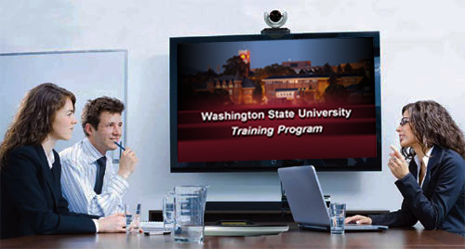
If you wish to have your attendance documented in your training history, please notify Human Resource Services within three days of today's date: hrstraining@wsu.edu
This has been a WSU Training Videoconference

