Slide 1
Administrative
Policies and Procedures
Deb Bartlett
dbartl@wsu.edu
Joy Faerber
faerber@wsu.edu
Office of Procedures, Records, and Forms
Revised October 2019

Slide 2
Training Objectives: Manuals
History of operations manuals at WSU.
Why we have operations manuals.
How to use online manuals.
How the manuals are updated.

Slide 3
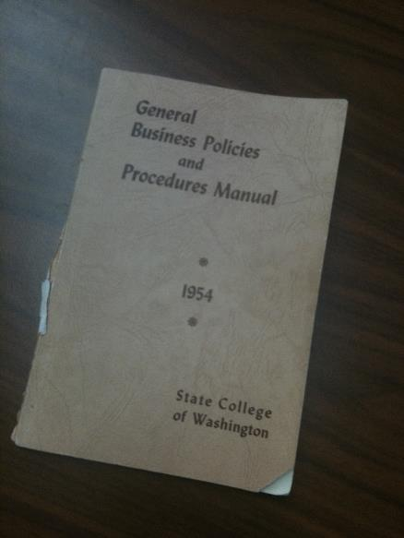
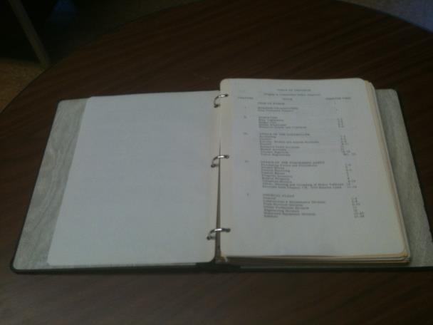
History Lesson
1954 BPPM 1960s Manual

Slide 4
History Lesson
1972 State Audit Report
Hard Copy BPPM, SPPM
1997 Online Manuals
2000 Executive Policy Manual
2016 Board of Regents Policy Manual
2018 WordPress CMS website

Slide 5
Why have manuals?
Serves as a quasi-supervisor. Always in.
No trips or leave. Fewer phone calls.
Fewer errors.
Primary communications device. Provides knowledge of laws, regulations, and institutional practices.

Slide 6
Why have manuals?
Institutional memory.
Levels playing field.
Standardizes practices. Promotes efficiency.
Consolidates location.

Slide 7
Where to Find Manuals
Uniform Resource Locator (URL):
https://policies.wsu.edu/prf/index/manuals/
WSU Home Page
A-Z Index

Slide 8
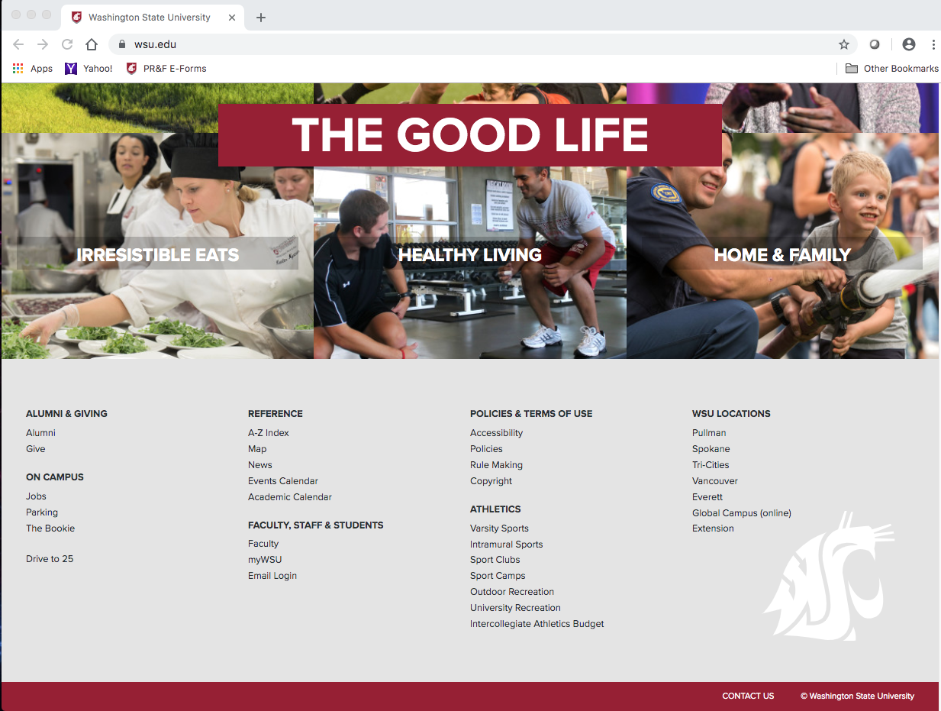

Slide 9
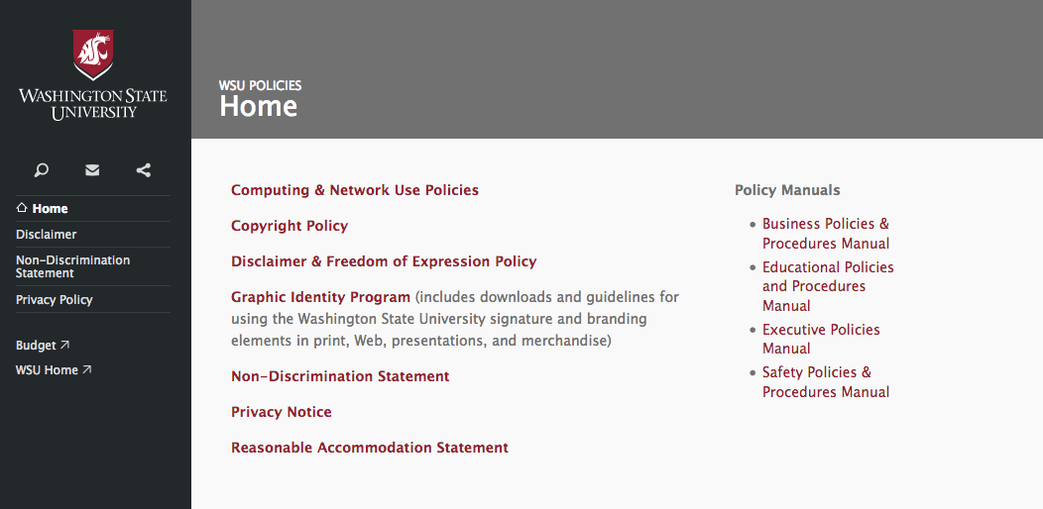

Slide 10
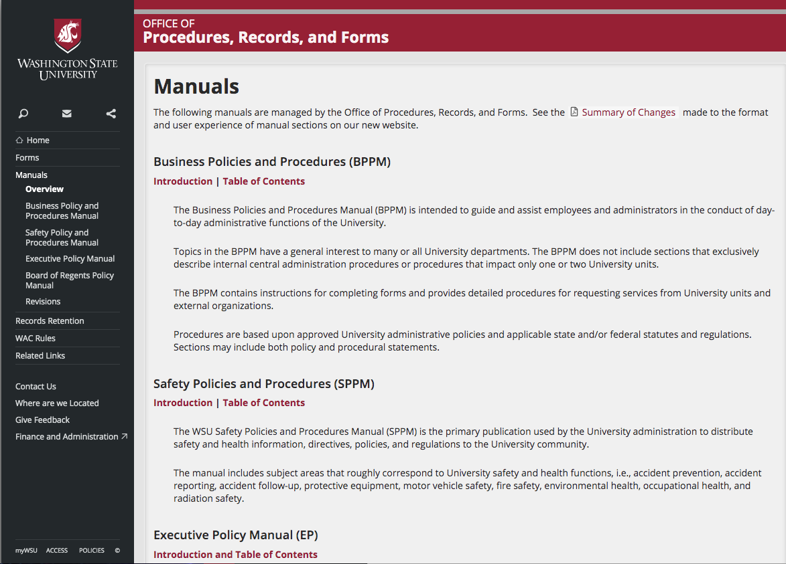

Slide 11
How to Find Information
Search engine
Contents pages
Forms Index
Cross references

Slide 12
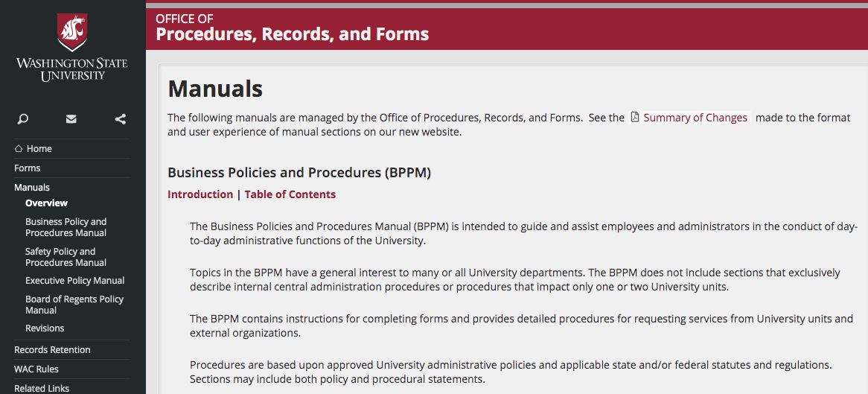

Slide 13
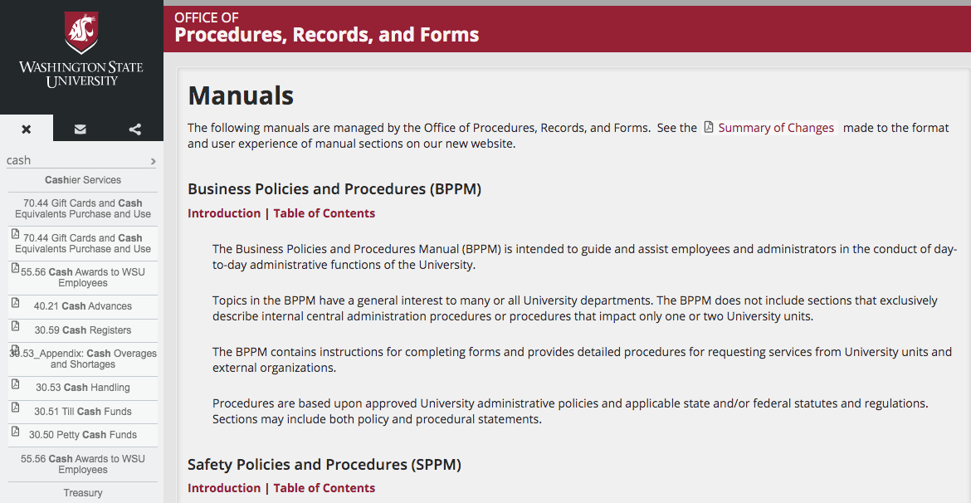

Slide 14
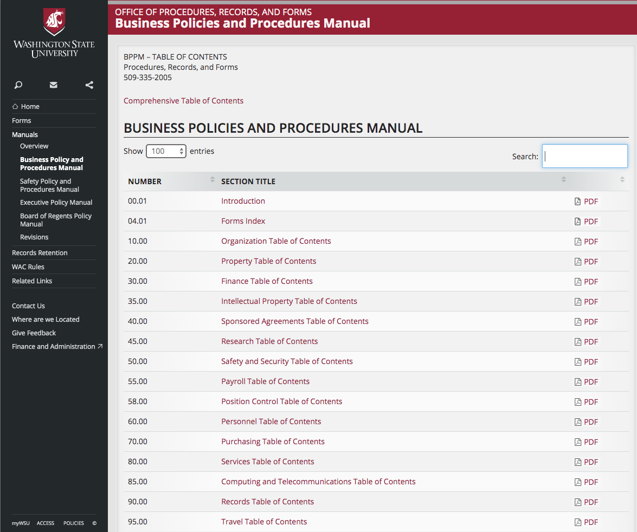

Slide 15
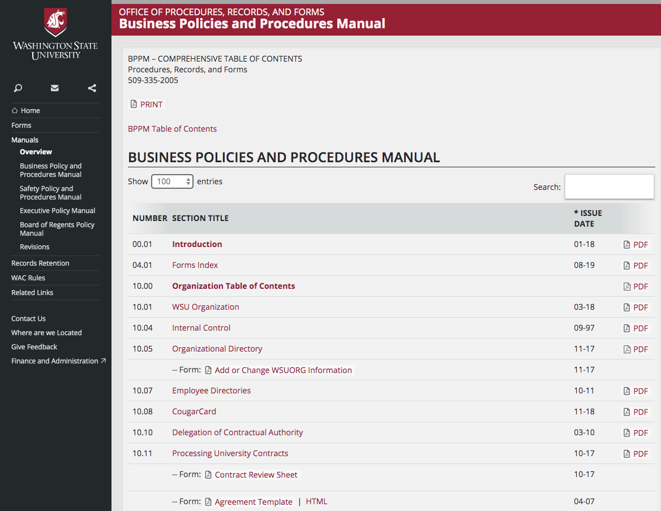

Slide 16
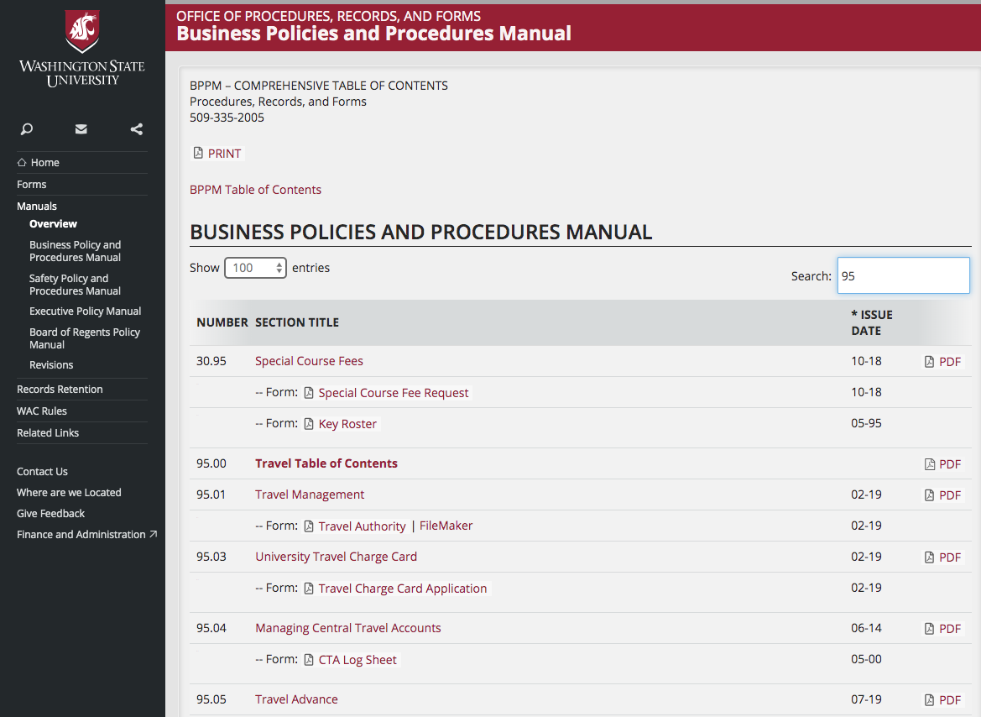

Slide 17
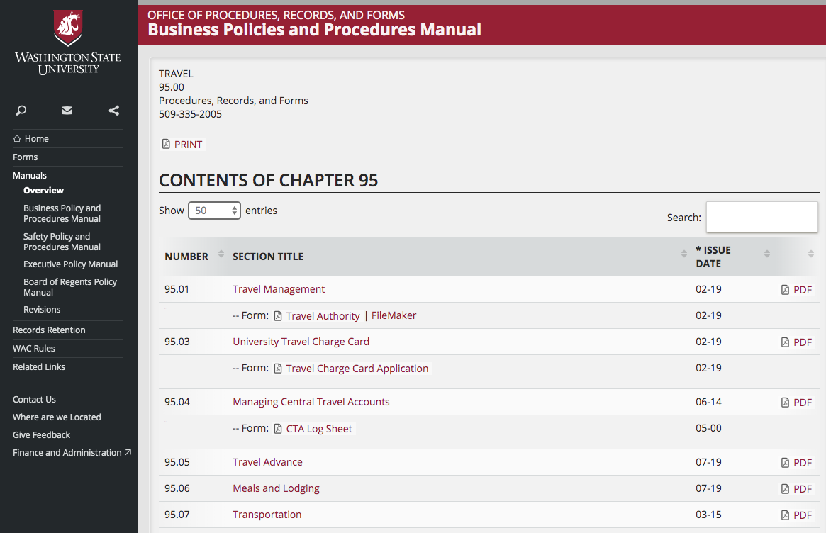

Slide 18
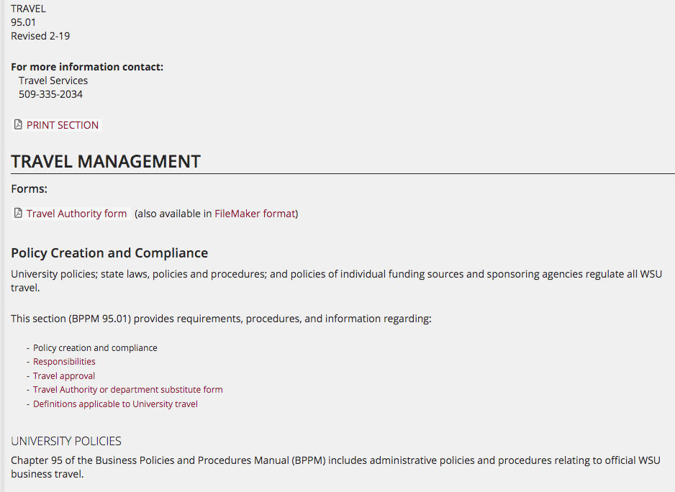

Slide 19
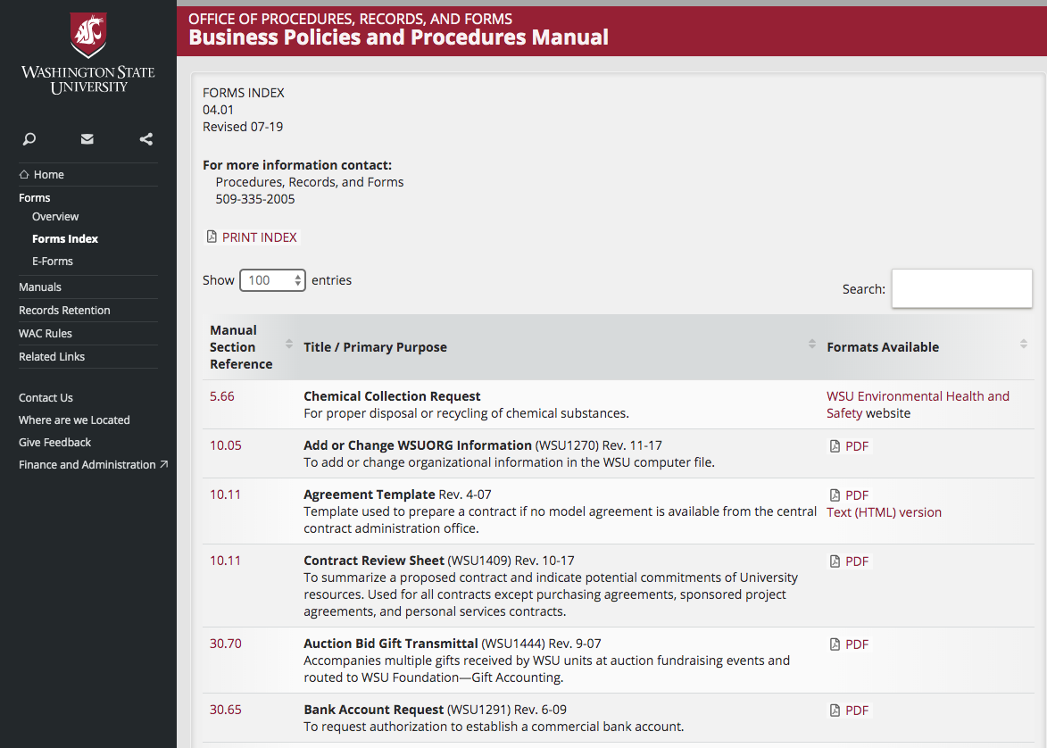

Slide 20
Announcing Revisions
Procedures, Records, and Forms sends out an e-mail message on WSU Insider Announcements.
To subscribe refer to: https://insider.wsu.edu/
    NOTE: Be sure to select the Daily Announcements link at the end of each day’s WSU Insider news e-mail message to view all of the day’s announcements.
Revision announcements are linked to the Manuals web page.

Slide 21
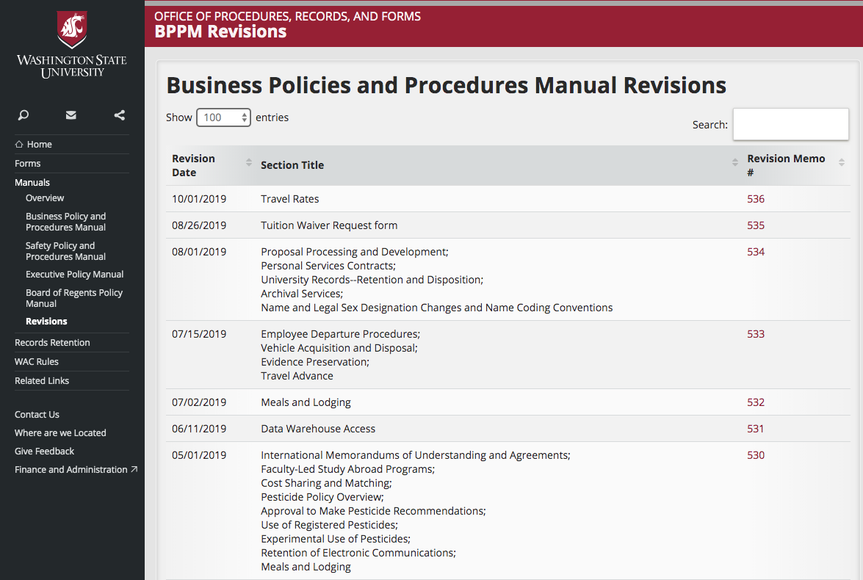

Slide 22
Revising Manuals: Sources
Auditors
Statutes/regulations
Administrators
Users

Slide 23
Revising Manuals: Process
Input
Prepare draft
Review and approval

Slide 24
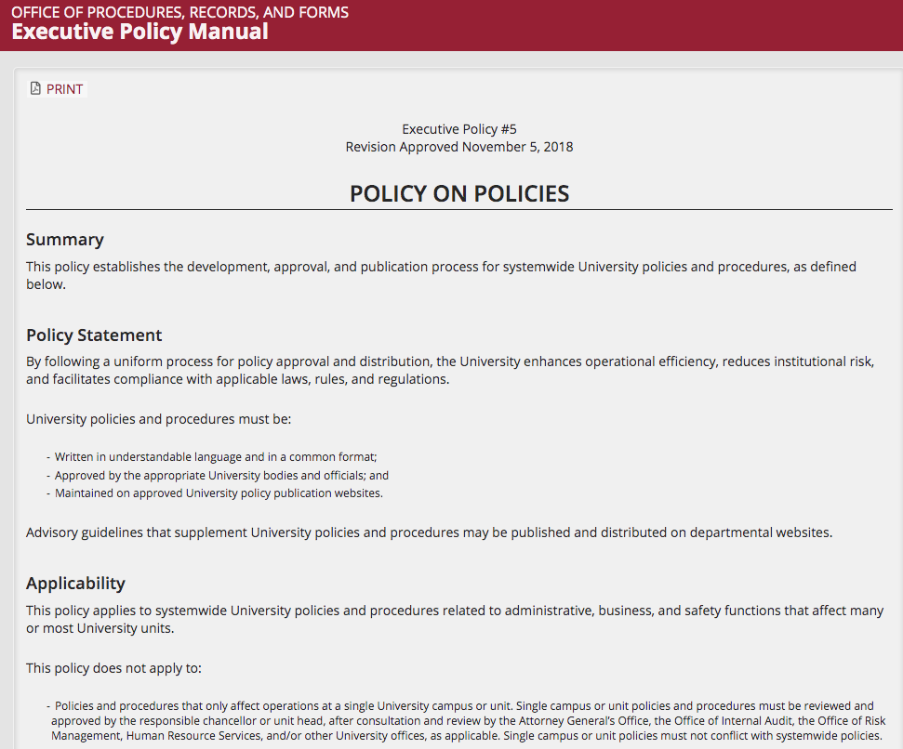

Slide 25
Distribution
Convert to HTML and PDF
Upload to UNIX
Notify University
Save old section in archive media

Slide 26
You should now know:
How to locate manuals online.
How to find information in manuals.
How manuals are updated and how to find out when manuals are updated.

Slide 27
Records Retention
Deb Bartlett
dbartl@wsu.edu
Joy Faerber
faerber@wsu.edu
Office of Procedures, Records, and Forms
509-335-2005

Slide 28
Training Objectives: Records
State definition of records.
How to find out how long to keep records.
Which records are confidential.
How to dispose of records.

Slide 29
Records Retention:
What are we talking about?
Management of records for
the period of time between
record creation and record disposition.
What we do with it and
how long we keep it.

Slide 30
Why do we keep records at WSU?
We need to document our business.
We need to meet requirements of laws/regulations.
We need to be able to recreate the history of WSU.

Slide 31
State of Washington Records
Any paper, photograph, film, sound recording, map drawing, machine-readable material or other document, regardless of physical form, made or received by the state in connection with the transaction of public business.
(From RCW 40.14.010)

Slide 32
Legal Requirement:
RCW 40.14
(Preservation and Destruction of Public Records)
University records are public records. Public records may not be destroyed, microfilmed, or transferred to archives without authorization.

Slide 33
Records Officer
Coordinates University's records retention program.
Prepares retention schedules.
Liaison with State Records Committee.

Slide 34
Responsibility for Records
Primary responsibility resides with each individual University office.
The unit director/manager/chair designates a departmental records coordinator.

Slide 35
Records Coordinator
Liaison with Records Officer
Notifies Records Officer changes in office records.
Files and refers to records retention schedules.
Applies retention standards to records.
Ensures that department personnel apply retention standards to records held in their files and computers.

Slide 36
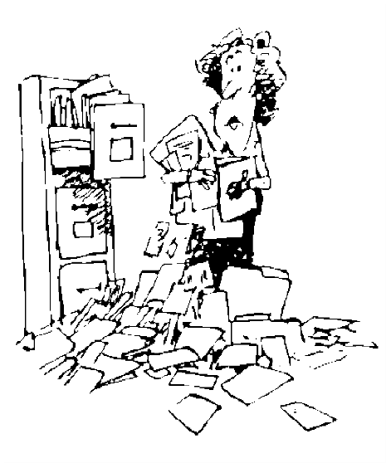
Why not just keep everything?
Must look through it.
Must track it.
Takes up expensive space.
Causes additional processing in litigation, audit, or public records requests.

Slide 37
Some records are
essential records.
Records you would need to restart
your operation after a catastrophe.
See 90.15.
Back up and store offsite.

Slide 38
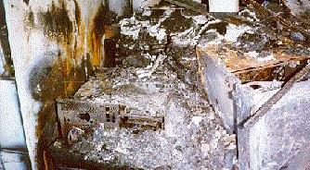
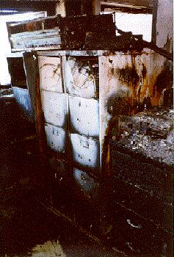
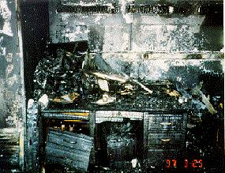
1997 Kincaid Fire - UW

Slide 39
All-University Records Retention Schedule
BPPM 90.01

Slide 40
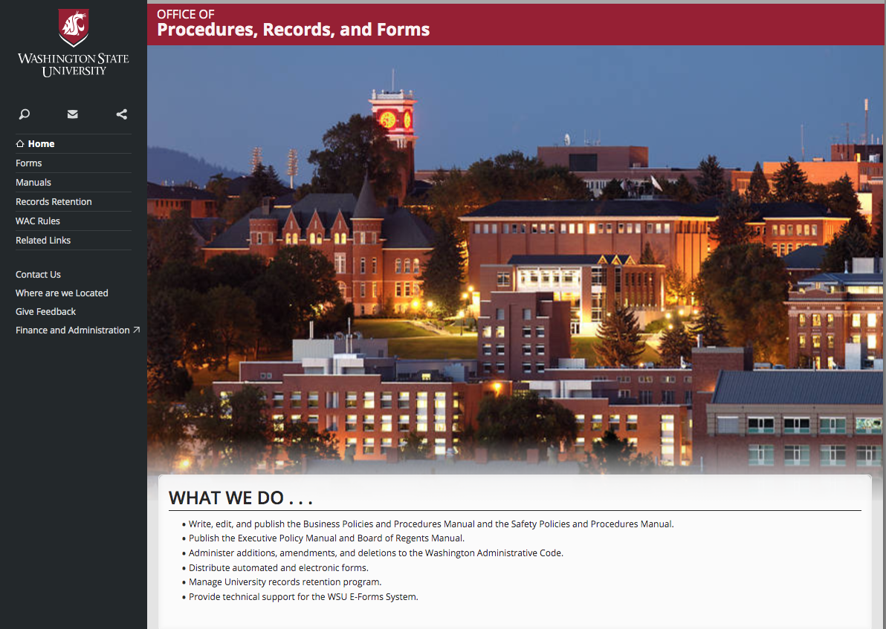

Slide 41
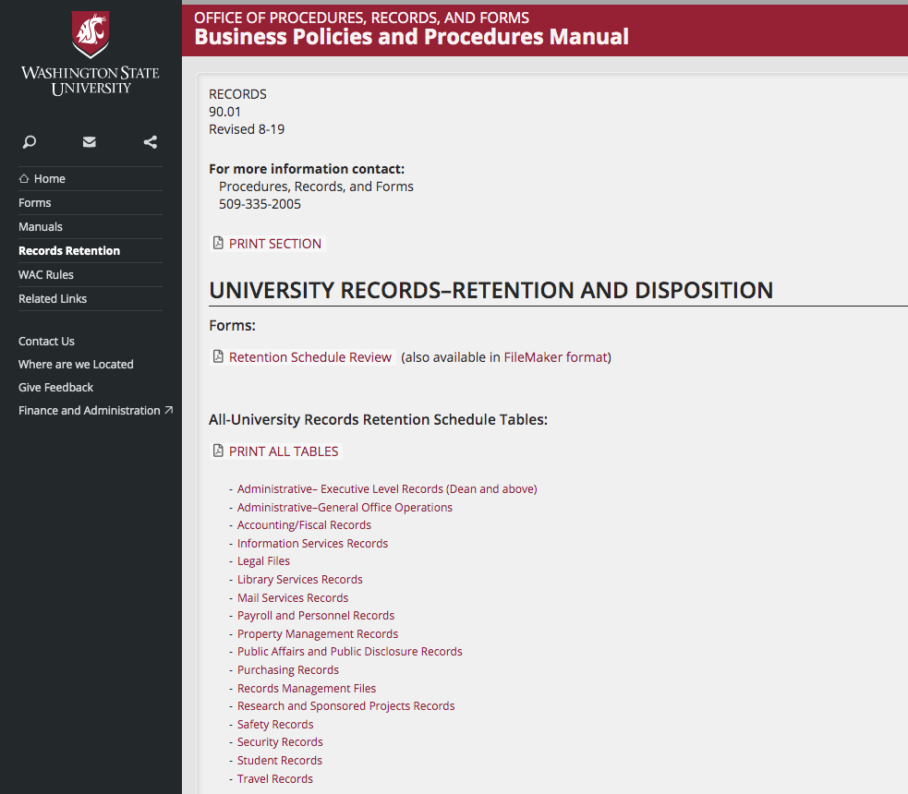

Slide 42
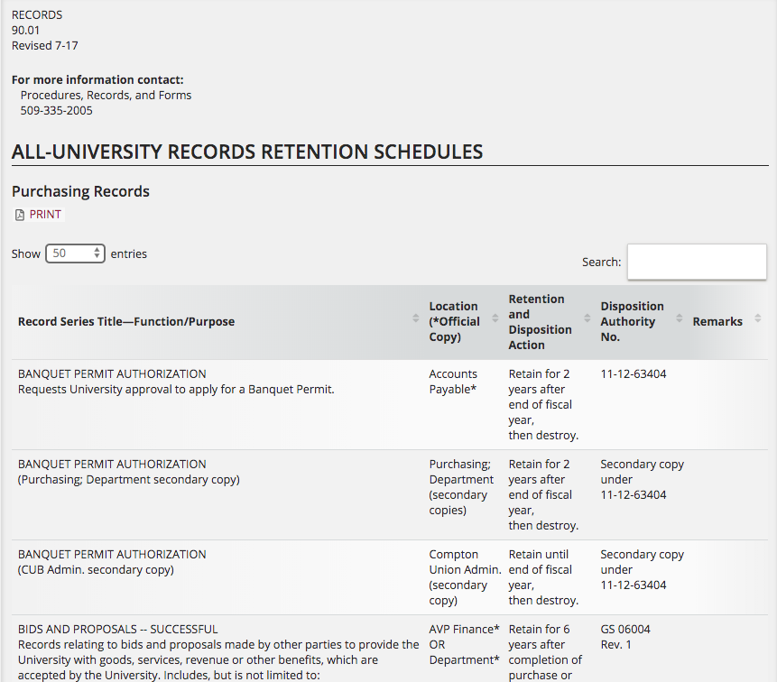

Slide 43
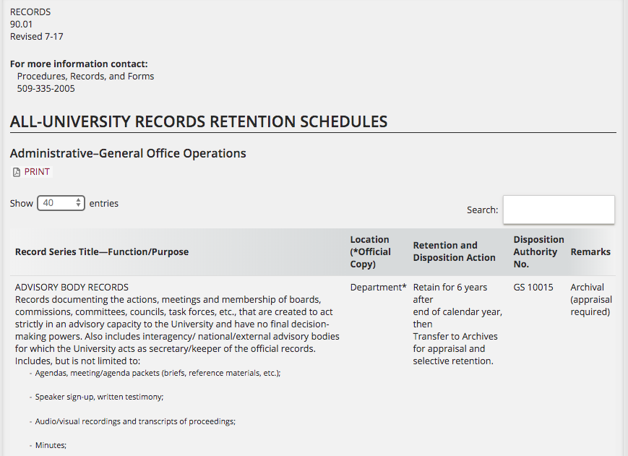

Slide 45
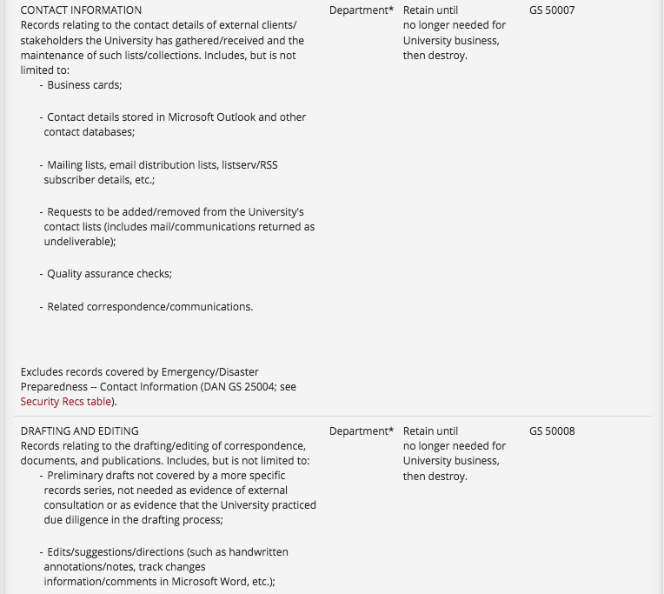

Slide 46
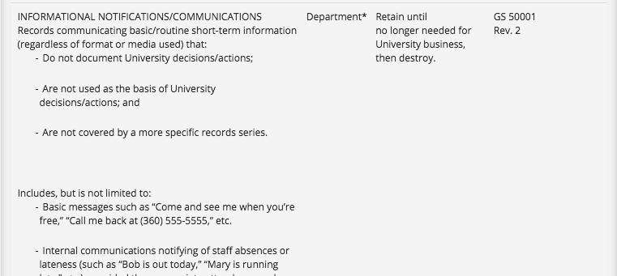
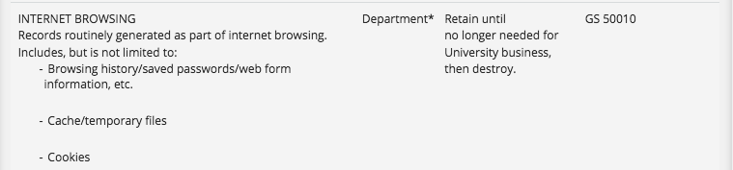

Slide 47
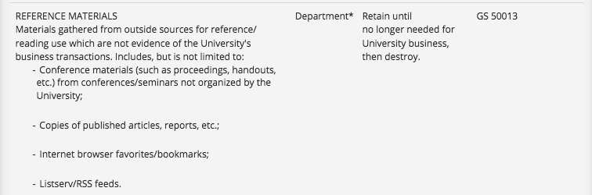
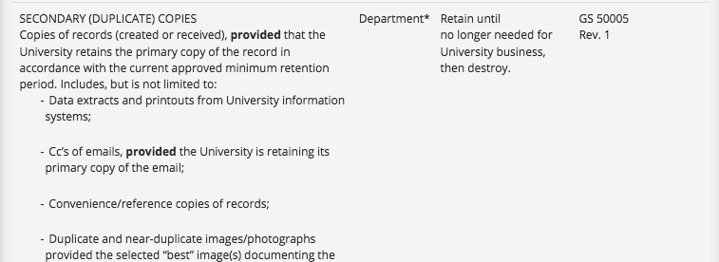

Slide 48
State Requirement
WAC 434-662-040, effective January 1, 2009
Electronic records must be retained in electronic format and remain usable, searchable, retrievable and authentic for the length of the designated retention period.
Printing and retaining a hard copy is not a substitute for the electronic version.

Slide 49
State Imaging Standards
Must be observed when agency wants to use the image as the record copy and dispose of paper original.
Not required when agency uses the image as a working copy and retains the paper original for the approved retention period.
To obtain a copy of or a link to the standards, contact Office of Procedures, Records, and Forms. See also BPPM 90.21.

Slide 50

E-Mail, Text, Voicemail, and Social Media
Most e-mail, text, voicemail, and social media messages are transitory communications.
Some e-mail, text, voicemail, and social media messages are public records requiring retention. Evidence of official policies, actions, decisions, or transactions.
See BPPM 90.03.

Slide 51
Saving Text, Voicemail, and
Social Media Messages
To save text or social media messages, manually:
    Send the messages to a University email account. Save as email.
    Save the messages to a University-controlled server or content management system.
To save voicemail messages:
  Contact applicable telephone provider.
  Use Single Inbox Messaging to save message as .WAV file attachment to University email account.

Slide 52
Manage Your E-mail
Don't let thousands of e-mail messages clutter your e-mail account.
Delete immediately if you don't need it.
Have a timetable for reviewing e-mail.
Store e-mails with longer-term retentions in special folders in Outlook or elsewhere (e.g., your computer, a shared drive).

Slide 53
Important to Remember:
E-mail, text, social media, and voicemail messages created to conduct University business
are public records
EVEN IF the messages are
sent from or received on personal devices,
e.g., cell phones, tablets, laptops.

Slide 55
Determining Retention
Legal requirements.
Fiscal and audit requirements
Functional needs of office
Historical and archival requirements.

Slide 56
To schedule a record:
Check the All-University Schedule in BPPM 90.01.
Check any unique departmental schedule.
Complete a Retention Schedule Review form (see 90.01.8). Route to PR&F.
Procedures, Records, and Forms prepares a draft.
Approvals by department, records officer, State Records Committee.

Slide 57
Retention Schedule Superseded
Litigation holds
Public records requests
Audits

Slide 58
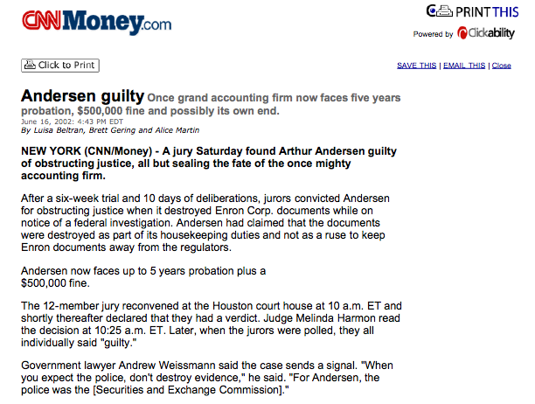

Slide 59
Storage of Inactive Records
WSU Pullman: Facilities Services--Capital at 509-335-5571
Other locations: Campus facilities management
Store records at State Records Center in Olympia
Store inactive electronic records offline,
e.g., tape, external hard drive, dedicated storage server
NOTE: State records must be kept in a state facility!

Slide 60
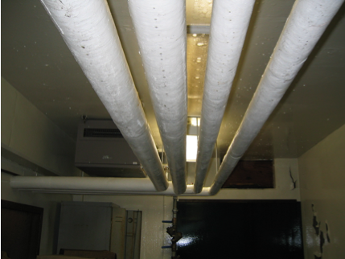
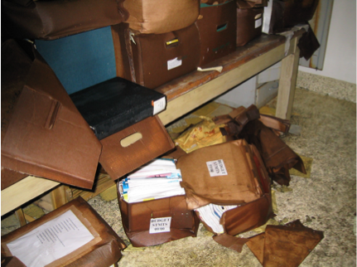
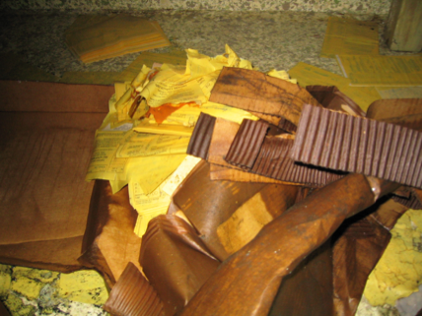

Slide 61
Records Disposal
Send to Manuscripts, Archives, and Special Collections (MASC).
    See BPPM 90.02 for more information regarding archival records.
Recycle.
Make illegible if confidential.

Slide 62
Which records are confidential?
All records which are exempt from public disclosure in accordance with state law. (RCW 42.56)
Refer to BPPM 90.05, 90.06, 90.07.

Slide 63
Partial list of confidential records
Personal information
Lists for commercial purposes
Application information
Tests
Library records

Slide 64
Disposal of Confidential Records
Records must be reduced to an illegible condition.
(WAC 434-640-020)

Slide 65
Shredding
University Recycling at WSU Pullman
Commercial shredder (Iron Mountain)
Departmental shredder

Slide 66
Destruction of
Electronic Records
Hard Drives
CDs and DVDs
Tapes
    See “Specific Item or Transaction Requirements” in BPPM 20.76 for more information regarding destruction of digital media.

Slide 67
You should now know:
State definition of records
How to read a records retention schedule
How to schedule a record
What to do with old records
How to determine if a record is confidential
How to dispose of records

Slide 68
Questions???
Contact PR&F
Telephone 509-335-2005
E-mail dbartl@wsu.edu
E-mail faerber@wsu.edu
E-mail prf.forms@wsu.edu

Slide 69

If you attended this live session and wish to have your attendance documented in your learning history,
please notify Human Resource Services
within 24 hours of today's date:
hrstraining@wsu.edu

