Slide 1

Understanding the University Budget
Kelley Westhoff
Executive Director for Budget, Planning, & Analysis
October 24, 2019

Slide 2
Agenda
The Washington State Budget & Higher Education Sector
Budget Models
The WSU Budget
The WSU Budget Office
WSU Budget Policies
Financial Recovery

Slide 3
Washington State Budget & Higher Education Sector

Slide 4
Washington State Budget & Higher Education Sector
Washington enacts budgets on a two-year cycle
  - Biennial budgets are adopted in odd-numbered years
By law, the Governor must propose a biennial budget before Legislature convenes in January
  - 2012 law requires a balanced operating budget
Biennial budget can be modified in any legislative
session
  - Supplemental Budgets

Slide 5

Washington State Budget & Higher Education Sector
Dec
Governor Proposed Budget
January
Legislature Convenes
Fall
(Capital) Scoring Process
OFM Reviews Agency Requests
March / April
September
Legislative Regular Session Ends
Agencies Submit
Budget Requests
State Budget
Cycle
May/June
Governor Signs Budget
June
OFM Issues Budget
Instructions
Supplemental Budget Requests
July 1
Budget Takes Effect
Summer
Agencies Submit Allotments

Slide 6
The Higher Education Sector
Washington State Budget & Higher Education Sector
Comprised of:
  2 Research Universities
  4 Regional Universities
  State Board of Community and Technical Colleges (34 total colleges)
  Washington Student Achievement Council – (financial aid / student success advocacy)
Discretionary funding – from the state level
  K-12, human services, pension obligations and debt service comprise between 2/3 – 3/4 of the state budget
  Higher education is a sector that is considered for funding after these ‘mandatory’ obligations are met.

Slide 7
The Higher Ed Sector – Operating Budget
Washington State Budget & Higher Education Sector

Slide 8
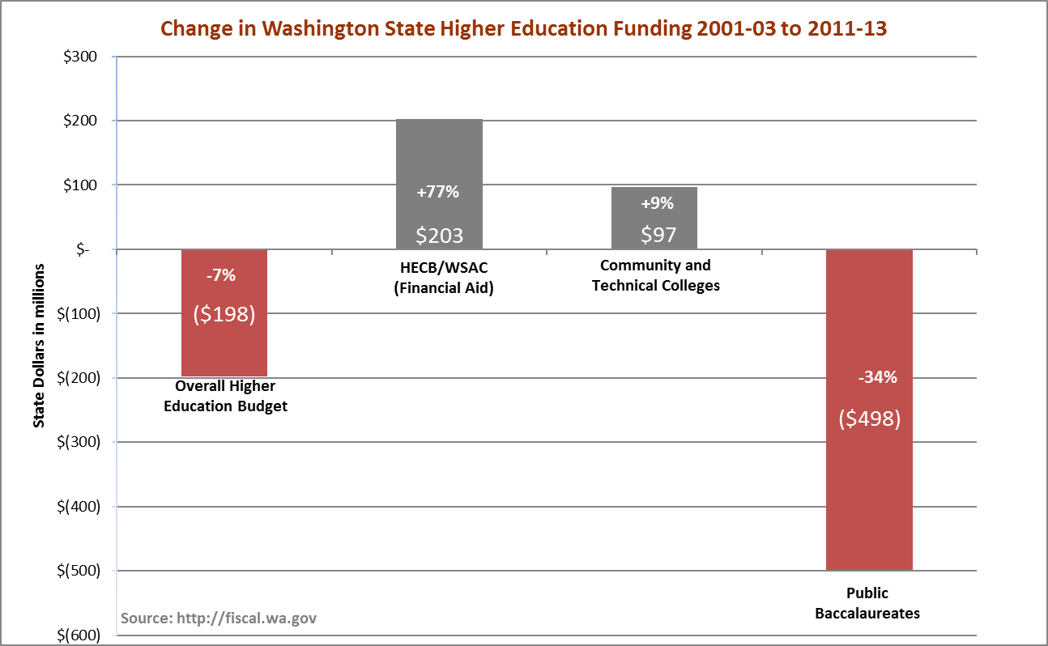
Washington State Budget & Higher Education Sector
Higher Education Sector General Fund Appropriations
Overall state spending increased $7.1B between 2001-2003 and 2011-13. Overall spending on higher education decreased $198M in the same timeframe, and Washington public baccalaureate institutions saw a disproportionate $498M decrease in state funding.

Slide 9
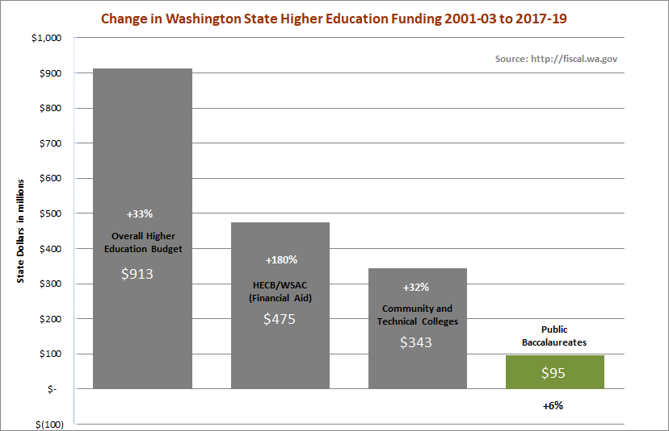
Washington State Budget & Higher Education Sector
Overall state spending has increased $19.3B since 2001-2003. Overall spending on higher education has increased $913M in the same timeframe, while Washington public baccalaureate institutions have seen a $95M increase in state funding.

Slide 10
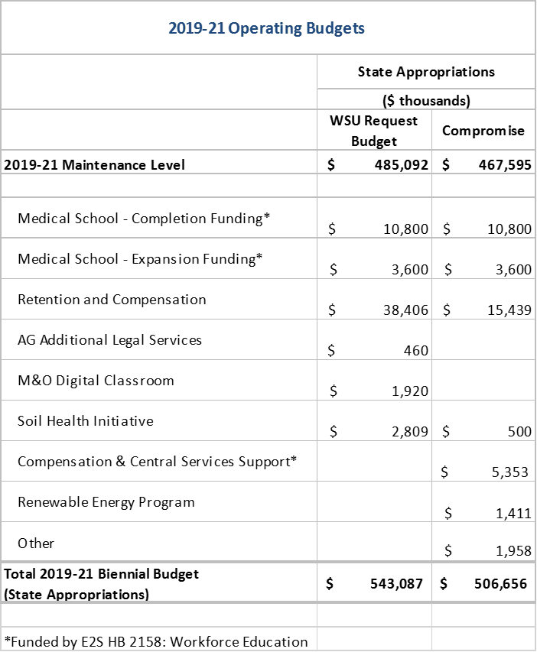
2019-21 Biennial Operating Budget

Slide 11
State Budget Breakdown
Fully Funded Requests
$10.8M for ESF College of Medicine Completion funding
$3.6M for ESF College of Medicine Expansion funding

Slide 12
State Budget Breakdown
Partially Funded Requests
$1.4M M&O for buildings to be completed this biennium
$500K for soil health initiative
$15.4M of our $38.4M request for compensation

Slide 13
State Budget Breakdown
Unfunded
M&O digital classroom

Slide 14
State Budget Breakdown
Other Funding / Mandates
Miscellaneous bills
Clean Energy
Veteran’s mental health counselor
Suicide/crisis counseling hotlines
$5.4M compensation and central service support (foundational support)

Slide 15
Tuition & Foundational Support
Budget assumes $20.2 million of new costs for compensation and central services will be covered by new tuition.
Budget writers recognized that the assumed costs covered from tuition ($20.2 million) are greater than the new tuition WSU could generate, so ‘Compensation and central service’ support (foundational support) of $5.3 million was provided as state appropriation to reduce the costs assumed to be covered from new tuition.
Net amount WSU is expected to generate from new tuition $14.8 million

Slide 16
Budget Models
Budget Models

Slide 17

Budget Models
Two classic models in higher education:
Incremental Budget v.
Responsibility Centered Budget
EASY

Slide 18
Budget Models
Incremental Budget employs an allocation process where units’ legacy funding levels increase (or decrease) incrementally based on overall changes in institutional resources.
$
$
$
$
$
$
$
$
$
$
$

Slide 19


Example of Incremental Budgeting: PBL – Planning Budget Level
Units have base levels of funding, which is backed by a pool of tuition plus state appropriations. When new state funding is provided, such as for mass salary increases, each unit receives a proportional increase in PBL.
Budget Models

Slide 20


Responsibility Centered (RCM) Budget allocates resources such as tuition to the units that generate them, which is intended to incentivize revenue growth and cost control.

Slide 21
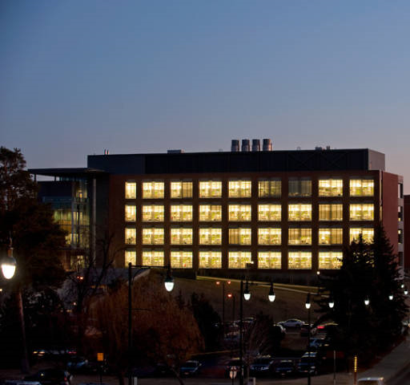
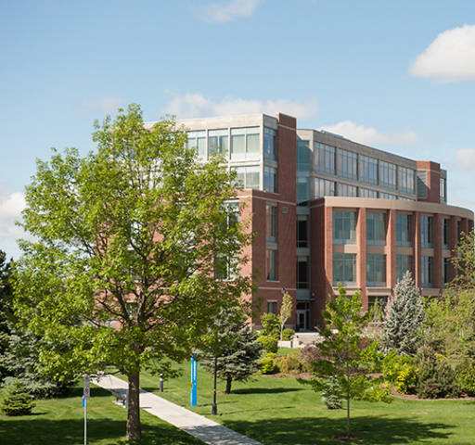
WSU’s Enrollment Based Budget (EBB) Model for undergraduate enrollment on the Pullman and Spokane campuses is an example of an RCM element of the budget. Under this model new undergraduate tuition is allocated to the colleges that generate it through new enrollment.
Budget Models

Slide 22

Another key element of an RCM budget is that revenue generating units are responsible, typically through a tax, for paying the costs of institutional overhead and funding a subvention fund that is used to subsidize units that may not generate enough revenue to operate at a profit, but are vital to the mission of the institution.
Budget Models
TAXES

Slide 23
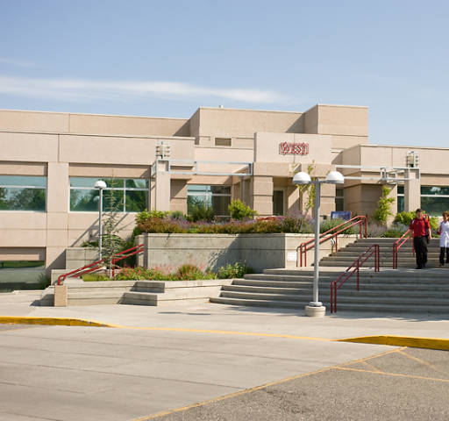

WSU uses this type of overhead assessment with our campuses in Vancouver and Tri-Cities. Both those campuses receive the tuition they generate less an 11% assessment for institutional support.
Budget Models

Slide 24
The WSU Budget
The WSU Budget

Slide 25
University Operating & Capital Budgets
2015-17 Biennium - $2.297 Billion Total
The WSU Budget
Capital
13%
Capital
13%
$296.7M
$2.0B
Operating
87%

Slide 26
2015-17 Capital Budget
Total Authority: $311.7 M Projected Expenditures: $296.7 M
(includes Re-appropriation Balances)
The WSU Budget
Parking
1%
WSU Building/Land Grant Endowment
16%
Local/Private
53%
State General Obligation Bonds
26%
S&A Fees & Athletics
less than1% each
Housing & Dining
4%

Slide 27
Use of 2015-17 Capital Budget – By Expense Type
State Appropriation, Land Grant Income, and Student Building Fees
The WSU Budget
Preventative Maintenance
(Operating) – 7%
Major Capital Projects – 73%
Minor Capital
Projects – 20%

Slide 28
2015-2017 Operating Budget
Fund Sources – Estimated Total: $2.0 Billion
Other
1%
Net Investment Income - 6%
Gifts/Endowment – 4%
*Net Operating Tuition & Fees
24%
Federal Appropriations
1%
*State Appropriations
16%
Net Restricted Student Fees
4%
Auxiliary Enterprises
14%
Federal Grants & Contracts
16%
Ed Dept Sales & Services
2%
Local Grants & Contracts
3%
State Grants & Contracts
9%
* Available for allocation

Slide 29
The WSU Budget
Sources of Funds for Core University Functions
State Appropriations
Net Operating Tuition
Facilities & Administrative (F&A) Fees on Grants and Contracts
All are used to fund the permanent operating budget of the University

Slide 30
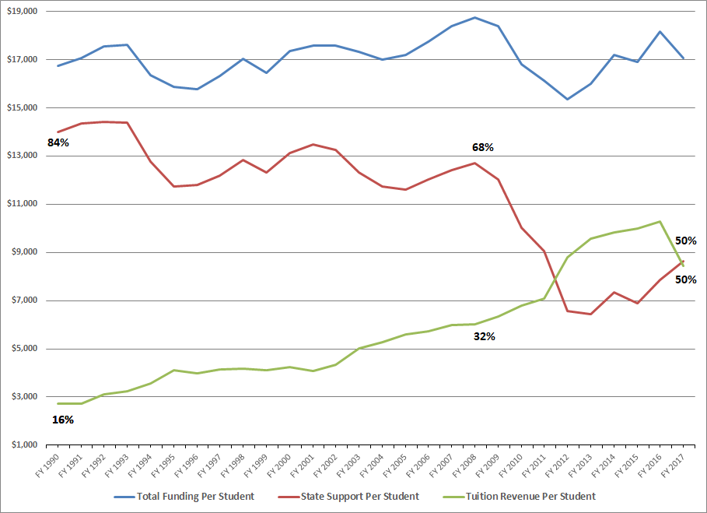
State and Tuition Funding per FTE
(in 2017 Dollars)
The WSU Budget : Tuition
Adjusted for inflation, the total cost of educating a student at WSU has remained steady during 20 years of declining state investments.
Student tuition now covers 50% of the cost of education.

Slide 31
The WSU Budget : Tuition
Net Operating Fees
Gross Operating Fees
Less: Operating Fee Waivers
Less: 4% Aid Fund
Net Tuition (Operating Fee) Revenue

Slide 32
Components of Tuition
The WSU Budget : Tuition

Slide 33
Net Operating Fees by Category
The WSU Budget
Pie chart of percentages

Slide 34
Undergraduate Net Operating Fees
The WSU Budget

Slide 35
Tuition Policy-Post Recession
The WSU Budget : Tuition
Tuition setting authority RCW 28B.15.067
2013-15 Biennium
No increase in resident UG tuition per legislative mandate, WSU held all rates flat.
2015-17 Biennium
Resident undergraduate tuition (operating fee portion) reduced by 5% for academic year 2015-16 and by an additional 10% in academic year 2016-17, per legislative mandate. Backfill state funding was provided.
Although authorized to increase tuition by any amount for all other student categories, WSU opted for no tuition increase in academic year 2015-16, or 2016-17.
2017-19 & 2019-21 Biennium
Beginning with the 2017-18 academic year, full-time tuition operating fees for resident undergraduates may increase by no more than the average annual percentage growth rate in the median hourly wage for Washington for the previous fourteen years as the wage is determined by the federal bureau of labor statistics.
Governing boards may set rates for all other categories of students

Slide 36
Tuition Rate Change History
Until this year there had been no increases to Non-resident Undergraduate or Graduate rates since AY 2012-13
Resident Undergraduate rate increases have been modest (inflationary) or decreased since AY 2013-14

Slide 37
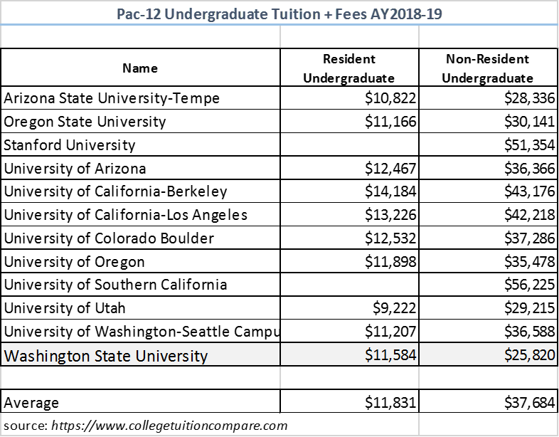
Pac-12 Peers: Undergraduate Tuition and Fees
WSU undergraduate tuition + fees are lower than the Pac-12 average for both residents and non-residents.
WSU resident undergraduate tuition & fees are fifth lowest in the Pac-12
WSU non-resident undergraduate tuition & fees are the lowest in the Pac-12

Slide 38
WSU Budget Principles
Distribution of F&A Revenue
The WSU Budget : F&A
4% Office of
Research
23% to F&A Revenue
Generating Units
7% Libraries
38% Campus
Support
28% University
Support
For more information: BPPM 40.25

Slide 39
Use of 2015-17 Biennial Budget – By Function
State Appropriation and Operating Tuition
The WSU Budget
Plant Operations & Maintenance
9%
Institutional Support
10%
Instruction
50%
Student Services
5%
Library
2%
Primary Support
9%
Public Service
6%
Research
9%

Slide 40
Use of 2015-17 Operating Budget
– By Expense Type
State Appropriation and Operating Tuition
The WSU Budget
Operations
15%
Benefits
18%
Salaries and Wages
67%

Slide 41
The WSU Budget Office
The WSU Budget Office

Slide 42
The WSU Budget Office
What Does the Budget Office Do?
State Budget - Requests, Allocations, and Reporting
Allotments
Compensation Impact Model
Internal Budget Processes (review, hearings, summit)
Revenue Tracking (F&A, 17A, AFI)
Tuition Modeling (census day)
Central Benefit Pool Tracking / Analysis
Expenditure Monitoring
Area Carryforward Projections
Benefit Model
Accrual Analysis
Tuition Schedules
MSI, if applicable
Ad hoc Decision Support
University Workgroups & Committees
System Maintenance (HEPPS;MSI;DEPPS;AIS;BPS)

Slide 43
WSU Budget Policies
WSU Budget Policies

Slide 44
Allocation of Resources
WSU Budget Policies
General funding is tracked by campus
Budget allocations are provided by the Budget Office to areas/campuses
Areas/campuses determine distribution of funding to their departments

Slide 45
Pooled Benefits
WSU Budget Policies
WSU utilizes a central benefit pool to allocate resources to cover benefit related costs for particular fund types (001-XX, 143-XX, 148-02, 148-05, 148-06)
Automatic budget allocations are made to area departmental operating accounts where actual benefit expenses are incurred each payroll expense cycle

Slide 46
Accruals (Salary Savings)
WSU Budget Policies
Central pool provides for turnover costs (sick and annual leave payouts), and PIDs
Areas retain savings from vacant faculty and graduate student positions on WSU program 05 (libraries) and 06 (instruction)
Areas retain savings from the transfer of expenditures to grants (programs 11A-14Y) regardless of employee type
Central captures savings from vacant classified, administrative professional, and non-instructional faculty positions for the first four months. Subsequent accruals are returned to areas upon request
* WSU Vancouver, WSU Tri-Cities, Extension, and Ag Research manage their own accruals.

Slide 47
WSU Budget Policies
Carryforward
Most funds carry forward at the area level. Dean, vice president or chancellor decides if they carry forward at the department level.
Operating budgets
F&A accounts
Donated funds
Some funds do not carry forward
Equipment replacement allocations
Special allocations for specific purposes, such as proviso funds

Slide 48
Financial Recovery
Financial Recovery

Slide 49
Financial Recovery
Budget was one of the first topics President-elect Schulz addressed his in message to campus in May 2016 …
“We have been spending more money annually than has been brought in, which is not sustainable”
“We are spending down reserves”

Slide 50
Recovery Plan Specifics
Financial Recovery
Three-year recovery plan calls for $10 million improvement over three consecutive years
Areas have specific improvement targets to be met through expenditure reductions or revenue enhancement or both
Areas retain savings (not a budget cut)
Monthly reporting, using a common template

Slide 51
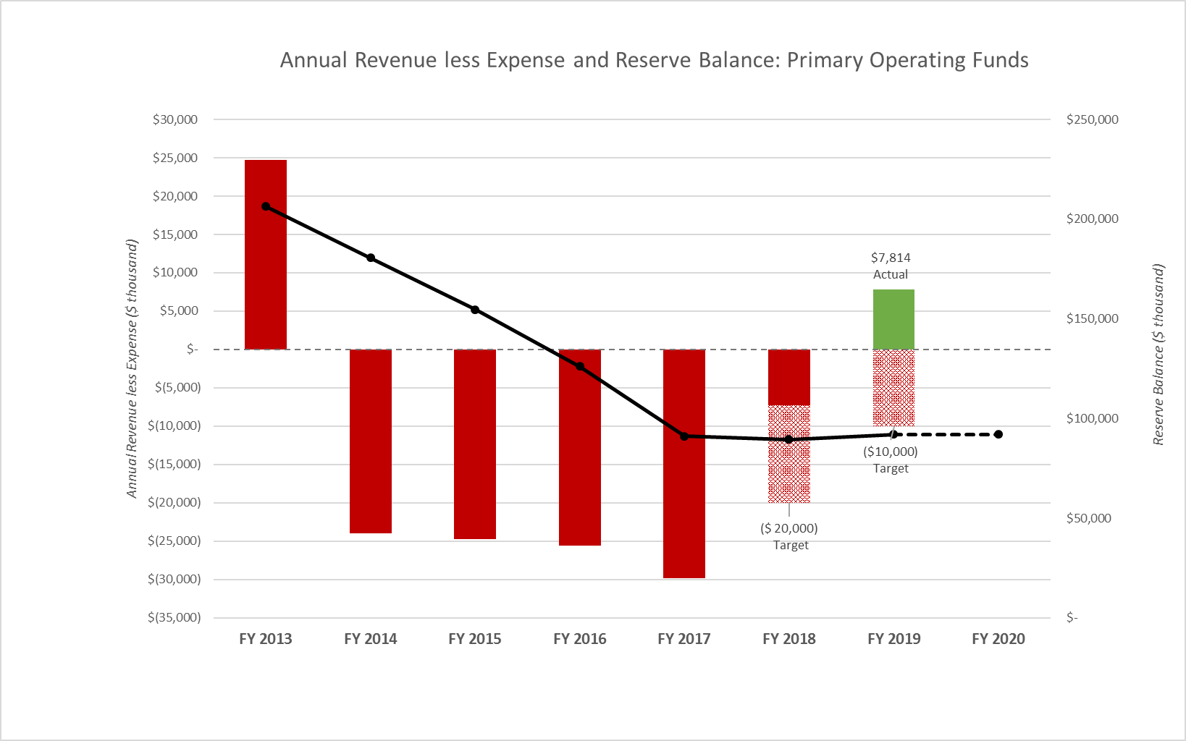
While we have exceeded our target for each of the last two years, the overall reserve balance (Areas + Central) is flat.
Overall Recovery

Slide 52
Other Budget / Fiscal Initiatives
Financial Recovery
Regular updates to campus community
President’s News & Notes columns
Fiscal Health Web Page
University Fiscal Health Advisory Committee

Slide 53

QUESTIONS

