Slide 1
Welcome! We will get started in a few minutes!

Slide 2
Community & Equity Certificate for WSU Faculty and Staff
LGBTQ+ Ally Training
Matthew Jeffries, Ph.D. (he/him)
Marco Cerqueira (he/him)

Slide 3
Getting Started: The Zoom Platform

Slide 4
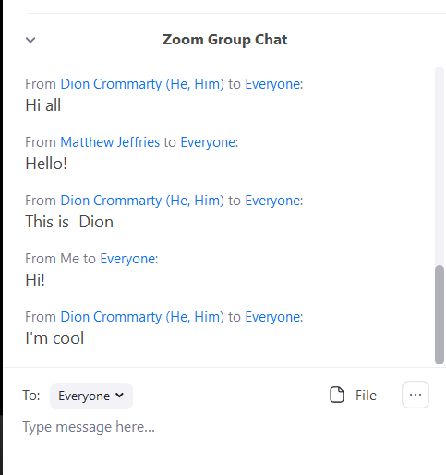
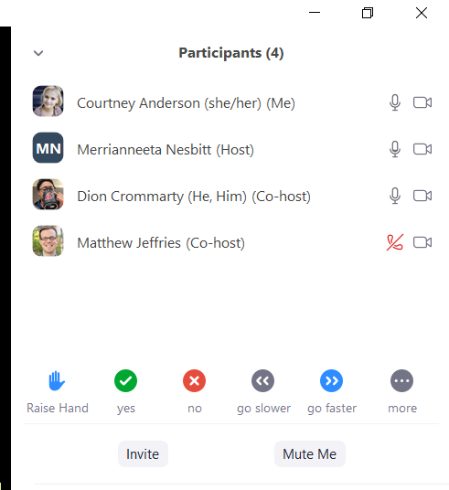
Getting Started

Slide 5
A Few Thoughts on Virtual Etiquette
Turn cameras on
Use earphones when possible, close door, etc.
Indicate the need to step away

Slide 6
WSU Land Acknowledgement
WSU Pullman is located on the ancestral homelands of the Palus people and on the ceded lands of the Nimíipuu (Nez Perce) Tribe.

Slide 7
Acknowledgement of America’s First Peoples
Washington State University acknowledges that its locations statewide are on the homelands of Native peoples, who have lived in this region from time immemorial. Currently, there are 43 tribes, 36 of which are federally recognized, that share traditional homelands and waterways in what is now Washington state. Some of these are confederacies that represent multiple tribes and bands.

Slide 8
Acknowledgement of America’s First Peoples, cont.
The University expresses its deepest respect for and gratitude to these original caretakers of the region. As an academic community, we acknowledge our responsibility to establish and maintain relationships with these tribes and Native peoples, in support of tribal sovereignty and the inclusion of their voices in teaching, research, and programming.
Washington State University established the Office of Tribal Relations and Native American Programs to guide us in our relationship with tribes and service to Native American students and communities.​
We also pledge that these relationships will consist of mutual trust, respect, and reciprocity.​

Slide 9
Workshop Overview
Introductions
Cultivating Community by Building Commitments
What is an ally?
Unpacking the LGBTQ+ Umbrella
Definitions & Concepts
Coming Out
Overview of Pronouns
Campus Policies & Pronouns
Case Studies

Slide 10
Introductions
When we call your name, we invite you to type the following into the Chat Box...
Pronouns you use, example:
(he/him/his)
(she/her/hers)
(they/them/theirs)
other
Department

Slide 11
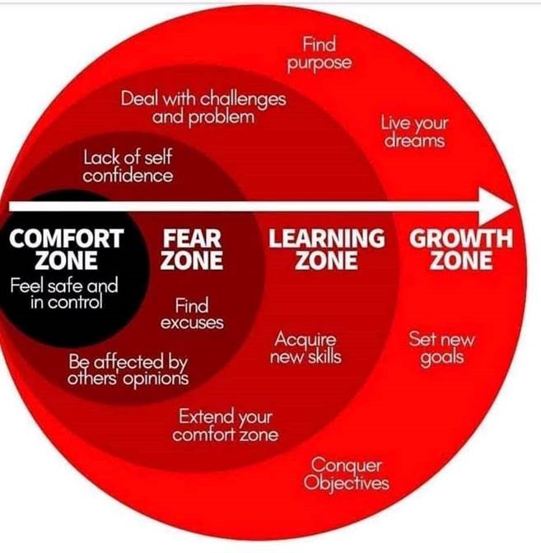
Moving Toward Brave Spaces

Slide 12
Cultivating a Safe, yet Brave Learning Environment
What is one (1) hope
you have for this workshop?
Take a moment to reflect and share your thoughts in the Chat box.

Slide 13
Cultivating a Safe, yet Brave Learning Environment, cont.
What is one (1) fear, apprehension, or barrier
that may keep you from achieving your hope and prevent you from fully engaging and getting a bit uncomfortable or vulnerable?
Take a moment to reflect and share your thoughts in the Chat box.

Slide 14
Community Commitments
What do you need from this space, the facilitators, and the other participants in order to put aside a fear, apprehension, or barrier and challenge yourself to get a bit uncomfortable so you can really learn/grow today?
Feel free to add 1 Community Commitment into the Chat box
Please write down the Community Commitments to use as we work together

Slide 15
Strategies for “Speaking Up”
Acknowledge; Correct; Move Forward
I’m really nervous/scared/uncomfortable saying this and/but…​
From my experience/perspective as [identity]…​
I’m afraid I may offend someone, and please let me know if I do, but…​
I’m not sure if this will make any sense, and/but…​
I just felt something shift in the space. I’m wondering if anyone else did too.​
It seems as though some people may have had a reaction to that. Can you help me understand why?​
Can you help me understand whether what I’m thinking right now is problematic?​
I’m having a “yeah but.” Can you help me work through it?​​
Adopted from Özlem Sensoy, Robin DiAngelo​, & Equity Series Collective

Slide 16
I consider myself an ally to LGBTQ+ people.
Agree
Disagree

Slide 17
Why Does the LGBTQ+ Community Need Allies?
Allies can help cultivate change
Raise awareness to LGBTQ+ issues
Allies can influence those around them

Slide 18
What roles do allies serve?
“Allies are some of the most effective and powerful voices of the LGBT movement. [They] help people in the coming-out process…help others understand the importance of equality, fairness, acceptance and mutual respect” - GLAAD
Educate others whose knowledge of the LGBTQ+ community might not be as up-to-date or accurate
Support members of the LGBTQ+ community
Addressing acts of discrimination

Slide 19
Steps to Being an Ally
Understanding why the LGBTQ+ community needs allies
Supporting & listening to those around you
Continuously educating yourself on current LGBTQ+ events and up-to-date language
Advocating for the LGBTQ+ community that is the most educational for your given environment
Adapted from GLSEN

Slide 20
Ally Pro Tip #1
“People in dominant groups must respectfully listen to how oppressed people define their own needs, work with them to support getting those needs met, and operate in solidarity with their organizations, efforts, and social movements” (Bell, 21; Kivel, 2006)

Slide 21
I feel confident in my language about LGBTQ+ individuals.
Agree
Disagree

Slide 22
Who Belongs to the LGBTQ+ Community
Simply put, anyone that does not identify as heterosexual and cisgender belongs in the LGBTQ+ or Queer community
List of LGBTQ+ Identities
Gay
Lesbian
Transgender
Bisexual
Intersex
Pansexual
Asexual
Queer
Non-binary

Slide 23
Sexual Orientation
A person’s physical, aesthetic, and/or other form of attraction to others.

Slide 24
Explanation of Terms: Sexual Orientations
Gay: When someone is attracted to one’s own gender.
Lesbian: A woman who is attracted to other women.
Bisexual: Attraction to both one’s own gender and other genders
Pansexual: When a person is attracted to someone regardless of their gender
Queer: Applicable for both gender identity and sexual/romantic orientation as well. It is a term that can be used by anyone who does not identify as heterosexual or cisgender.
Asexual: Someone who does not experience sexual attraction. Exists on a spectrum.

Slide 25
Romantic Orientation
A person’s romantic, emotional, and/or other form of attraction to others.

Slide 26
Romantic vs. Sexual Orientations
The Difference
Romantic orientation: describes who someone is romantically attracted to.
Sexual orientation: describes who someone is sexually attracted to
They are separate identities
ex.) Tyree identifies as biromantic and asexual.
ex.) Andrea identifies as aromantic and straight.

Slide 27
Ace Identities
Asexual: Someone who does not experience sexual attraction toward anyone.
Aromantic: Someone who does not experience romantic feelings.
Demisexual/Demiromantic: Someone who only experiences sexual or romantic attraction to those they are deeply emotionally connected to.
Grey-sexual/Grey-romantic: When one is between sexual and asexual or romantic and aromantic.

Slide 28
Sex
A biological term dividing a species into male, female, or intersex. Criteria include chromosomes, hormone levels, secondary sex characteristics, and internal and external genitalia.

Slide 29
Gender
A social construct encompassing customs and norms related to masculinity, femininity, both, and/or neither of these.

Slide 30
Gender Identity
One’s internal sense of being a man, woman, neither of these, both, or other gender(s).

Slide 31
Gender Expression
External manifestation of one’s gender identity, usually expressed through clothing, haircut, voice, or body characteristics.

Slide 32
Gender Identities
Cisgender: Someone whose assigned sex at birth aligns with their gender identity.
Transgender: A person whose sex assigned at birth does not align with their gender identity.
Genderfluid: A person whose gender identity shifts from masculine to feminine and exists on a spectrum.
Non-Binary: A person’s whose gender identity falls outside of the “male”/”female” binary. Exists on a continuum of gender expressions and identities.
Two-Spirit pride flag
Transgender pride flag
Genderfluid pride flag
Non-Binary pride flag

Slide 33
Two-Spirit Explained by Geo Soctomah Neptune

Slide 34
Let’s Talk About Outdated Terminology
Don't Say...
Instead Say….
Homosexual
A gay lifestyle
Hermaphrodite
Transgendered/transvestite
Sex change or The Surgery
Gay or lesbian
Intersex
Transgender or “a transgender person”
Medically transitioning or gender affirmation surgery

Slide 35
Short Break #1 (5 minutes)

Slide 36
I see/read LGBTQ+ stories in the news.
Often
Never

Slide 37
Ally Pro-Tip #2: Following LGBTQ+ Media
Them
Color Bloq
The Advocate

Slide 38
Let’s Talk Coming Out

Slide 39
Coming Out: The Basics
What does it mean to “come out”?
How many times does one have to come out?
Is it the same for everyone?

Slide 40
D'Augelli's Model of Lesbian, Gay & Bisexual Identity Development
Stage 1: Exiting heterosexual/cisgender identity
Stage 2: Developing a personal queer identity status
Stage 3: Developing a queer social identity
Stage 4: Becoming a queer "offspring“
Stage 5: Developing a queer intimacy status
Stage 6: Entering a queer community

Slide 41
Barriers to Coming Out
Are all coming out experiences the same?
What are some things to people consider prior to coming out?
Am I ready to come out?
Cultural background
Is it safe to come out?
Will my family/friends still love me?
Can I keep my religious beliefs and still be true to myself?

Slide 42
How to Be an Ally in the Coming Out Process
Be attune to the other person’s needs
Understand that coming out is a lifelong process
Do not judge someone for the way they come out
Be supportive
Take them seriously
Know that identity can change over time
Someone may initially come out as a queer man, but then later come out as a queer transwoman.

Slide 43
Pronouns

Slide 44
I often hear people introduce themselves with their pronouns.
Agree
Disagree

Slide 45
Pronouns
Names & pronouns are used in reference to others
He went grocery shopping at his favorite grocery store.
Pronouns affirm someone’s gender-identity
Pronouns that are used today
She/her/hers
He/him/his
They/them/theirs
Zie/zir/zir

Slide 46
How to use Pronouns

Slide 47
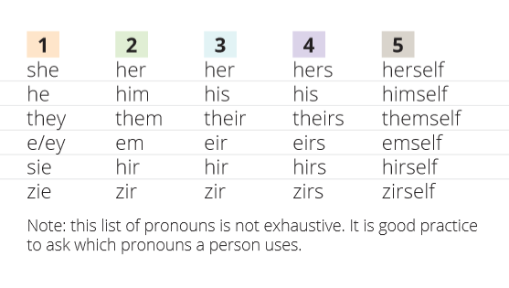
Pronouns

Slide 48
Pronouns: How to Ask
Worried about misgendering someone? Ask their pronouns!
“Hi my name is Melissa, I use she/her/hers pronouns. What’s your name and what pronouns do you use?
It’s always better to ask than to assume someone’s pronouns

Slide 49
Laws & Policies

Slide 50
LGBTQ+ Laws & Policies in the U.S.
In 28 states, a company can legally fire you for being part of the LGBTQ+ community
It can be hard for transgender people to get jobs
Conversion therapy is still legal within 32 states
Washington banned conversion therapy in 2018

Slide 51
Gender inclusive bathrooms should be in all buildings.
Agree
Disagree

Slide 52
Laws & Policies: WSU Specific
Bathroom policy
Housing policy
Student rights
Using chosen name/pronouns in our system
Changing one’s email address
Cougar Cards
Legal sex change/legal name change
Student Financial Services (Financial Aid)

Slide 53
Resources at WSU & on the Palouse
Human Resource Services
Office of Compliance & Civil Rights (CCR)
Gender Identity/Expression & Sexual Orientation Resource Center (GIESORC)
Student Organizations: GPAWs, GSA, QIA
President's Commission on Gender Identity/Expression and Sexual Orientation (GIESO)
LGBTQ+ Faculty/Staff Association
Inland Oasis
PFLAG Moscow
Free Mom Hugs- Pullman; Free Mom Hugs- Moscow
Ombuds Office

Slide 54
Short Break #2 (5 minutes)

Slide 55
Case Studies/What Would You Do’s
Move into break out groups
Read the prompts on the following slides to yourself
Discuss your thoughts on how you'd handle this situation
We’ll reconvene to discuss these case studies as a group

Slide 56
What Would You Do #1
You have noticed a fellow staff member making comments that are subtly homophobic and transphobic, which are making you and others uncomfortable. You’re unsure if this person realizes what they are saying is problematic or not.
What is your first reaction?
What would you do in this situation?
How might what you do be different if they were a close friend or family member?
What kind of follow-up is needed for this situation?
Adapted from The Safe Zone Project.

Slide 57
What Would You Do #2
A student that you’ve been working with for a few months visits you during your office hours. You know him rather well as he often visits you to talk. He tells you that he’s been stressed out due personal reasons and comes out to you as bisexual. He is already out to his family but he is worried that his friends and teammates will not accept him.
What is your immediate reaction?
What do you tell the student after he comes out to you?
What words of encouragement/advice would you give to them?
What resources would you give to them?
What kind of follow-up is needed for this situation?

Slide 58
Questions? Comments?

Slide 59
Facilitator Contact Information
Matthew Jeffries
Email: matthew.jeffries@wsu.edu
Phone: 509-335-8841
Marco Cerqueira
Email: marco.cerqueira@wsu.edu
Phone: 509-335-6388

Slide 60
Next Steps
Community & Equity Certificate
for WSU Faculty and Staff:
Community & Equity Workshops 101, 102, 103
Allyship Electives
Skill Development Electives
Community Building Electives
hrstraining@wsu.edu

Slide 61
Thank you for your time and energy today!
This has been a WSU Training and Videoconference offered in partnership between our office and:
WSU Student Affairs
&
Human Resource Services
HRS will be notified of your attendance to receive credit for participation in this
Community & Equity Certificate workshop

